Slide 1
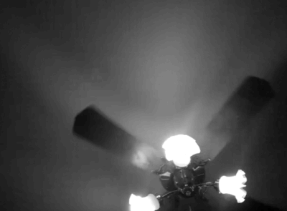
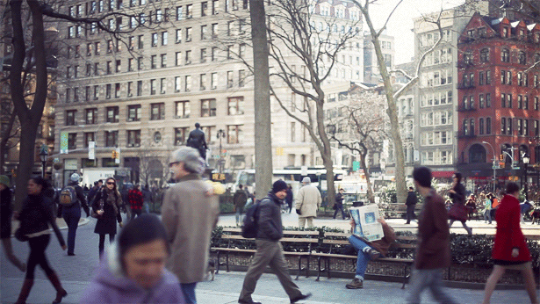
CAG Cinemagraph: Automated Generation
Motivation
What are cinemagraphs?
Cinemgraphs are short, repeating animated images of a mainly static scene with slight motions, usually in GIF format.
Why cinemagraphs?
Currently, artists must carefully setup and edit the video to create a cinemagraph. This process is both tedious and time-consuming. Our method streamlines the pipeline to reduce the amount of work the user have to perform to create a cinemagraph.
www.tumblr.com/tagged/cinemagraph
Walter Li & Bo Xian See
1

Slide 2
Pipeline of automated cinemagraph generation
User inputs stable region
is stationary?
Blend Frames
Apply Video Texturing
User inputs video
System outputs animated GIF
Stabilize Video
User inputs region of interest
Track Motion
Blend Frames
is moving?
Algorithm determines region of interest
Stabilize
Track motion
Blend & Loop
Walter Li & Bo Xian See
2

