Slide 1
Lecture: Object detection
Juan Carlos Niebles and Ranjay Krishna
Stanford Vision and Learning Lab

Slide 2
What we will learn today
Object detection
Task and evaluation
A simple detector
Deformable parts model

Slide 3
What we will learn today
Object detection
Task and evaluation
A simple detector
Deformable parts model

Slide 4
Object Detection
Credit: Flickr user neilalderney123
What do you see in the image?

Slide 5
Object Detection
Problem: Detecting and localizing generic objects from various categories, such as cars, people, etc.
Challenges:
Illumination,
viewpoint,
deformations,
Intra-class variability

Slide 6
Object Detection Benchmarks
PASCAL VOC Challenge
20 categories
Annual classification, detection, segmentation, … challenges
Notes:
Key to progress!
Good design of data
Large scale
Large variations

Slide 7
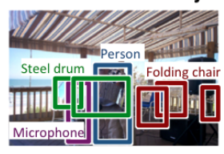
Object Detection Benchmarks
PASCAL VOC Challenge
ImageNet Large Scale Visual Recognition Challenge (ILSVR)
200 Categories for detection
Notes:
Key to progress!
Good design of data
Large scale
Large variations

Slide 8
Object Detection Benchmarks
PASCAL VOC Challenge
ImageNet Large Scale Visual Recognition Challenge (ILSVR)
Common Objects in Context (COCO)
80 Object categories
Notes:
Key to progress!
Good design of data
Large scale
Large variations

Slide 9
How do we evaluate object detection?
predictions
ground truth

Slide 10
How do we evaluate object detection?
predictions
ground truth
True positive:
- The overlap of the prediction with the ground truth is MORE than 0.5

Slide 11
How do we evaluate object detection?
predictions
ground truth
True positive:
False positive:
- The overlap of the prediction with the ground truth is LESS than 0.5

Slide 12
How do we evaluate object detection?
predictions
ground truth
True positive:
False positive:
False negative:
- The objects that our model doesn’t find

Slide 13
How do we evaluate object detection?
predictions
ground truth
True positive:
False positive:
False negative:
- The objects that our model doesn’t find
What is a True Negative?

Slide 14
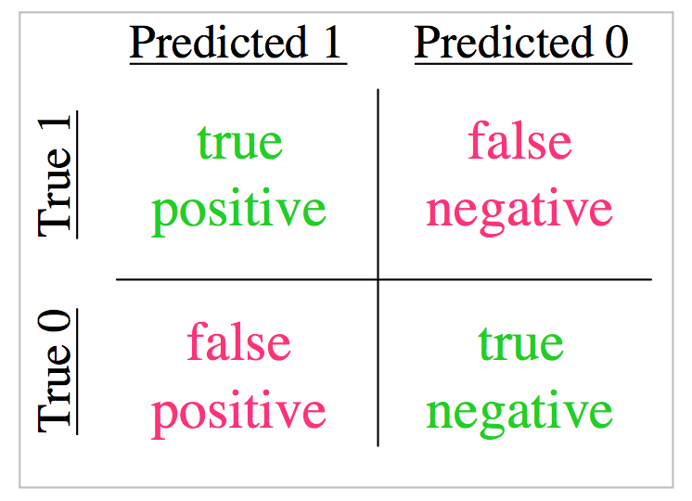

Slide 15
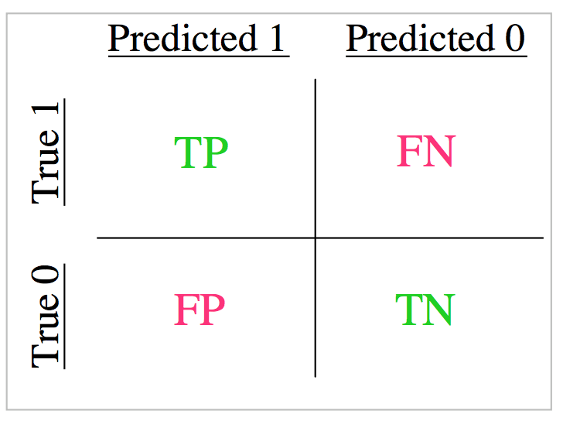

Slide 16
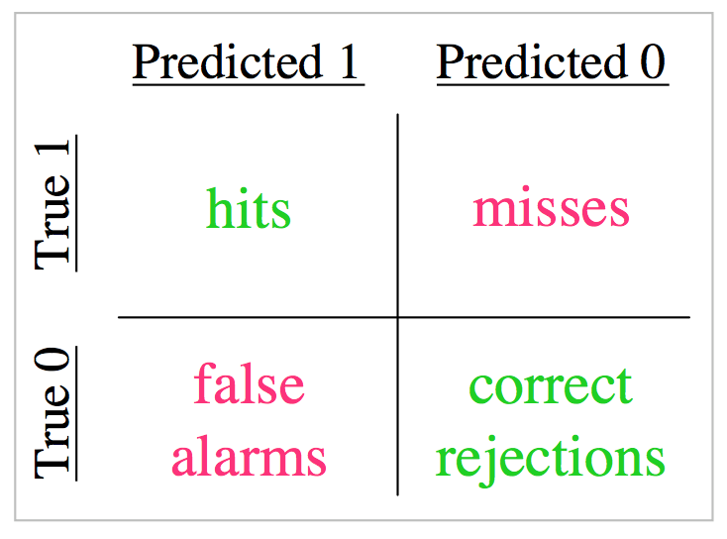

Slide 17
$$precision= \frac{TP}{TP+FP}$$
$$recall= \frac{TP}{TP+FN}$$

Slide 18
How do we evaluate object detection?
predictions
ground truth
True positive: 1
False positive: 2
False negative: 1
So what is the
- precision?
- recall?

Slide 19
Precision versus recall
Precision:
how many of the object detections are correct?
Recall:
how many of the ground truth objects can the model detect?

Slide 20
In reality, our model makes a lot of predictions with varying scores between 0 and 1
predictions
ground truth
Here are all the boxes that are predicted with score > 0.
This means that our
Recall is perfect!
But our precision is BAD!

Slide 21
How do we evaluate object detection?
predictions
ground truth
Here are all the boxes that are predicted with score > 0.5
We are setting a threshold of 0.5

Slide 22
Precision – recall curve (PR curve)

Slide 23
Which model is the best?

Slide 24
Which model is the best?
Notes:
Area under curve,
Operating point

Slide 30
What we will learn today
Object detection
Task and evaluation
A simple detector
Deformable parts model

Slide 31
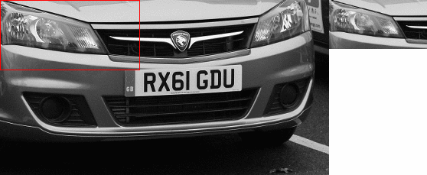
Dalal-Triggs method
sliding window

Slide 32
Recap – HOG features
Find a HOG template and use as filter

Slide 33
Sliding window + hog features
Slide through the image and check if there is an object at every location
No person here

Slide 34
Sliding window + hog features
Slide through the image and check if there is an object at every location
YES!! Person match found

Slide 35
Sliding window + hog features
But what if we were looking for buses?
No bus found

Slide 36
Sliding window + hog features
But what if we were looking for buses?
No bus found

Slide 37
Sliding window + hog features
We will never find the object if we don’t choose our window size wisely!
No bus found

Slide 38
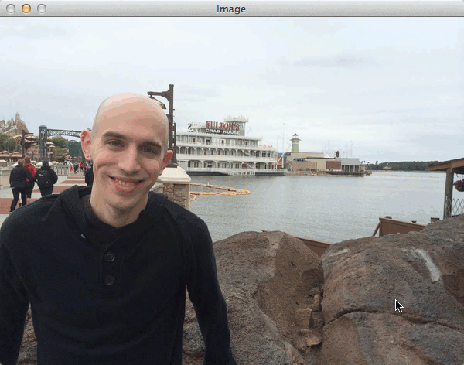
Sliding window + hog features
We need to do multi scale sliding window

Slide 39
Create a feature pyramid

Slide 40
What we will learn today
Object detection
Task and evaluation
A simple detector
Deformable parts model

Slide 41
Recap – bag of visual words
We can present images as a set of words
Where each word represents a part of the image.
Can we do the same for objects within those images?

Slide 42
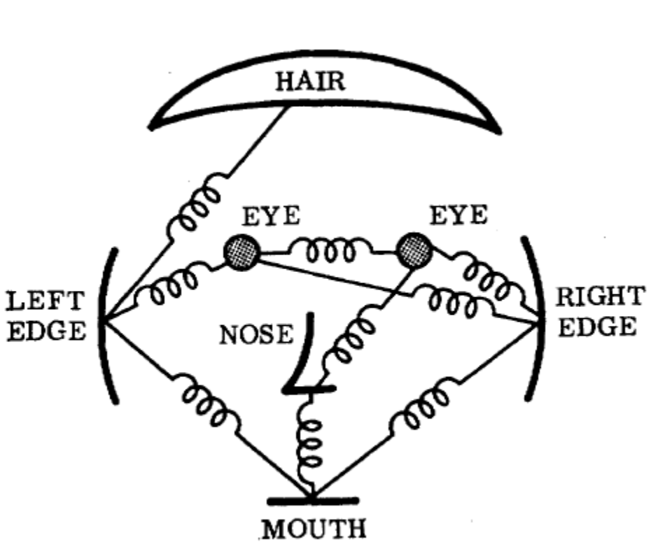
Deformable parts model
Represents an object as a collection of parts arranged in a deformable configuration
Each part represents local appearances
Spring-like connections between certain pairs of parts
Fischler and Elschlager, Pictoral Structures,
1973

Slide 43
Deformable parts model
The parts of an object form pairwise relationships.
We can model this using a “star model”
where every part is defined relative to a root.

Slide 44
Detecting a person with their parts
For example, a person can be modelled as having a head, left arm, right arm, etc.
All parts can be modelled relative to the global person detector, which acts as the root.

Slide 45
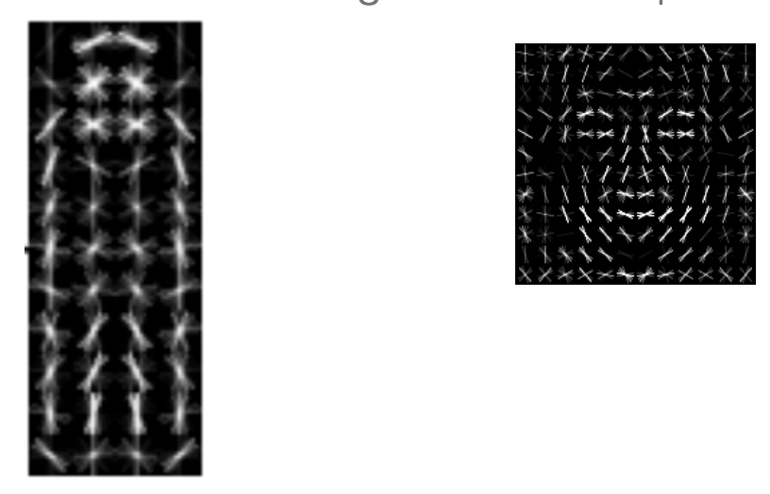
Deformable parts model
Each model will have a global filter. And a set of part filters. Here is an example of a global person filter with it’s ‘head’ part filter:
Part filter
Global/root filter

Slide 46
Two-component bicycle model
Allowable part locations
Root filter
Part filters
“side view” bike model component
“frontal view” bike model component

Slide 47
Deformable parts model
Mixture of deformable part models
Each component has global component + deformable parts
Part filters have finer details

Slide 48
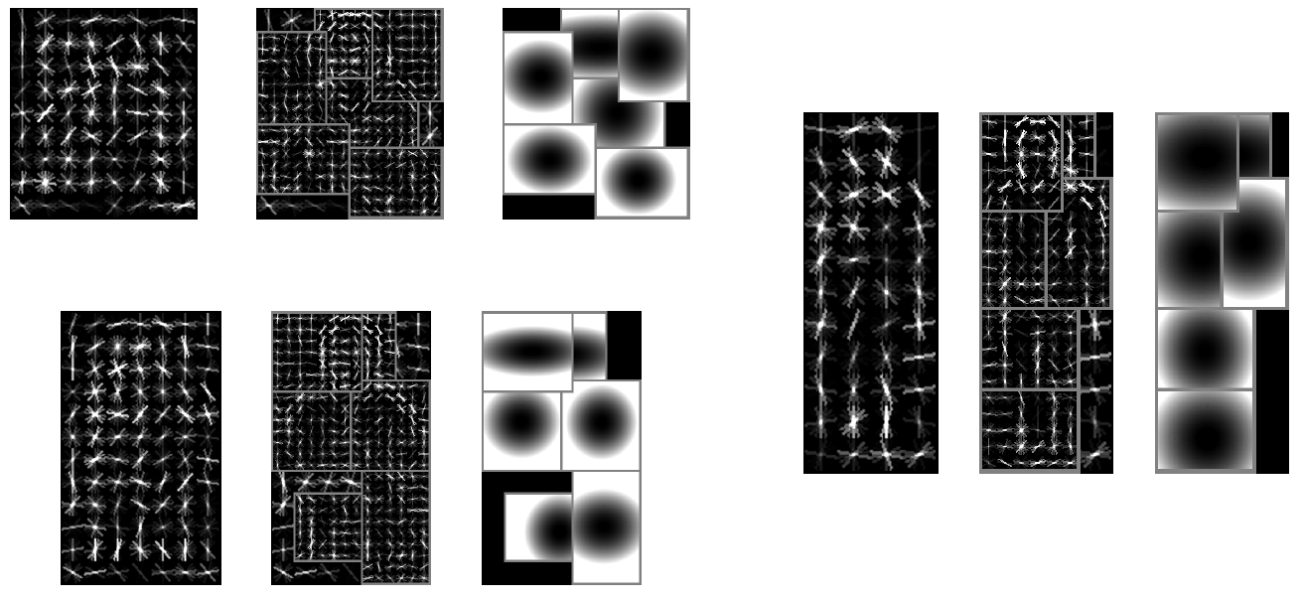
Six-component person model

Slide 49
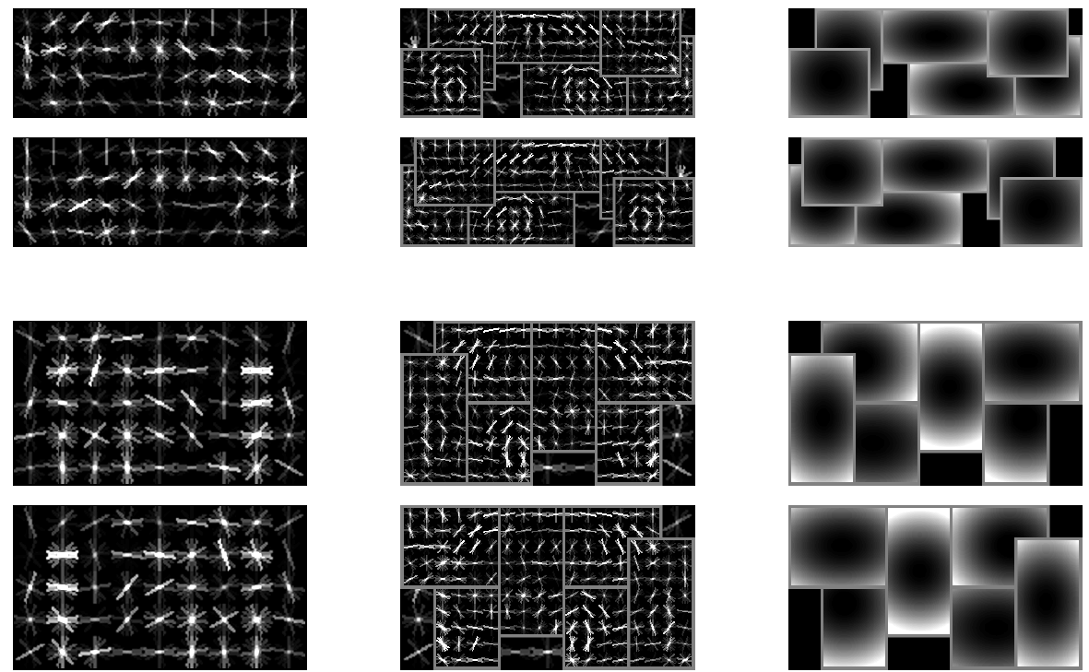
Six-component car model
side view
frontal view
root filters (coarse)
part filters (fine)
deformation models

Slide 50
Remember from Dalal and Triggs

Slide 51
Deformable parts model

Slide 52
Deformable parts calculates a score for each part along with a global score

Slide 53
Calculating the score for a detection
The score for a detection is defined as the sum of scores for the global and part detectors minus the sum of deformation costs for each part.
This means that if a detection’s
parts are really far away from
where they should be, it’s
probably a false positive.

Slide 54
Calculating the score for a detection
The score for a detection is defined as the sum of scores for the global and part detectors minus the sum of deformation costs for each part.

Slide 55
Calculating the score for a detection
The score for a detection is defined as the sum of scores for the global and part detectors minus the sum of deformation costs for each part.
$$detection score=\sum_{i=0}^{n}{Fi φ\left(pi, H\right)}−\sum_{i=1}^{n}{d_{i}\left({∆x}_{i},{∆y}_{i},{∆x}_{i}^{2},{∆y}_{i}^{2}\right) }$$

Slide 56
Calculating the score for a detection
$$detection score=\sum_{i=0}^{n}{Fi φ\left(pi, H\right)}−\sum_{i=1}^{n}{d_{i}\left({∆x}_{i},{∆y}_{i},{∆x}_{i}^{2},{∆y}_{i}^{2}\right)}$$
Scores for each part filter + global filter (similar to Dalal and Triggs).

Slide 57
Calculating the score for a detection
$$detection score=\sum_{i=0}^{n}{Fi φ\left(pi, H\right)}−\sum_{i=1}^{n}{d_{i}\left({∆x}_{i},{∆y}_{i},{∆x}_{i}^{2},{∆y}_{i}^{2}\right)}$$
The deformation costs for each part.
$∆xi$ measures the distance in the x-direction from where part i should be.
$∆yi$ measures the same in the y-axis direction.
$di$ is the weight associated for part i that penalizes the part for being away.

Slide 58
Calculating the score for a detection
$$detection score=\sum_{i=0}^{n}{Fi φ\left(pi, H\right)}−\sum_{i=1}^{n}{d_{i}\left({∆x}_{i},{∆y}_{i},{∆x}_{i}^{2},{∆y}_{i}^{2}\right)}$$
If $di$ = (0, 0, 1, 0). What does this mean?

Slide 59
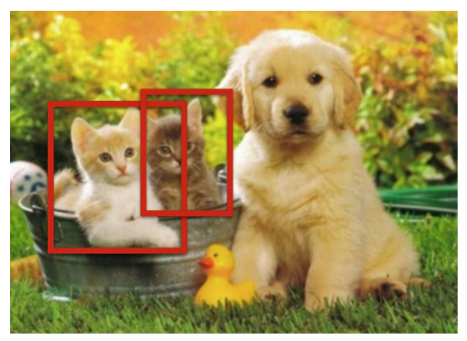
Detection pipeline
So, to make a detection, we use the sliding window technique and with the global and part filters.
To score a detection, we accumulate the global and part scores and penalize the deformation of the parts.

Slide 60
Overall detection pipeline Let’s break this down

Slide 61
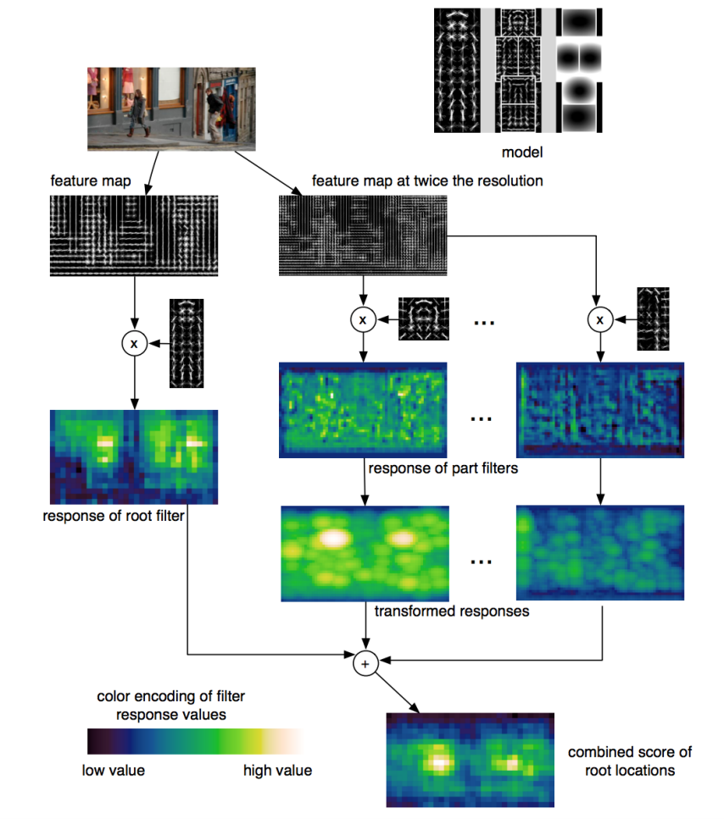
Detection pipeline
Make sure you have filters for the global and the parts: $Fi$
Compute HOG feature maps from the input image

Slide 62
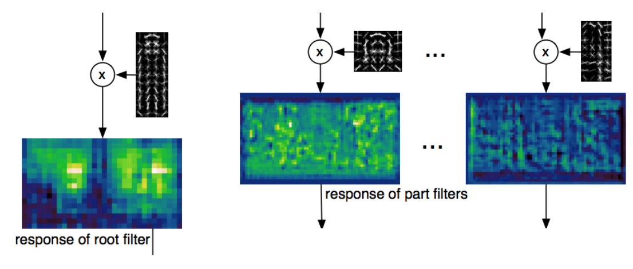
Detection pipeline
Apply the filters:
$Fi φ\left(pi, H\right)$ , i = 1, …, n

Slide 63
Accounting for Spatial cost with a Transformation
Given the location for the detected head, we can guess where the body should be.
The body should be in the direction calculated from the root person filter: $v_{i}$
But we allow for some deformation or spatial shift on the location of the head with respect to the body:${ d}_{i}$
We should ‘spread’ the head detection when calculating potential locations of the root!
$$v_{i}$$

Slide 64
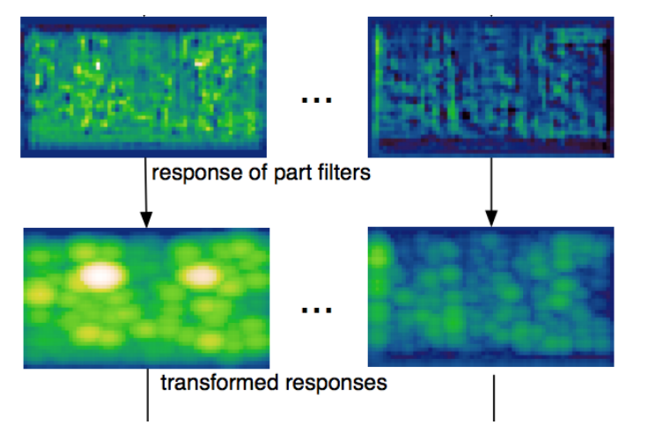
Detection pipeline
Now apply the spatial costs for each part:
$$detection score=Fi φ\left(pi, H\right)−d_{i}\left({∆x}_{i},{∆y}_{i},{∆x}_{i}^{2},{∆y}_{i}^{2}\right)$$

Slide 65
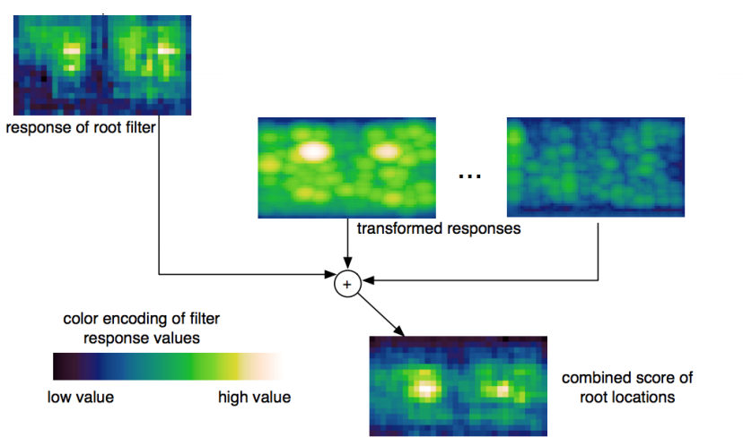
Detection pipeline
Now add the global filter:
$$detection score=F_{0}+\sum_{i=1}^{n}{Fi φ\left(pi, H\right)}−\sum_{i=1}^{n}{d_{i}\left({∆x}_{i},{∆y}_{i},{∆x}_{i}^{2},{∆y}_{i}^{2}\right) }$$

Slide 66
DPM - bicycle

Slide 67
DPM - person

Slide 68
DPM - bottle

Slide 69
Results – car detection

Slide 70
Results – Person detection

Slide 71
Results – horse detection

Slide 72
DPM - discussion
Approach
Manually selected set of parts - Specific detector trained for each part
Spatial model trained on part activations
Evaluate joint likelihood of part activations
Advantages
Parts have intuitive meaning.
Standard detection approaches can be used for each part.
Works well for specific categories.
Disadvantages
Parts need to be selected manually
Semantically motivated parts sometimes don’t have a simple appearance distribution
No guarantee that some important part hasn’t been missed
When switching to another category, the model has to be rebuilt from scratch.

Slide 73
Extensions - From star shaped model to constellation model

Slide 74
What we have learned today
Object detection
Task and evaluation
A simple detector
Deformable parts model

