Slide 1
Lecture: k-means & mean-shift clustering
Juan Carlos Niebles and Ranjay Krishna
Stanford Vision and Learning Lab

Slide 2
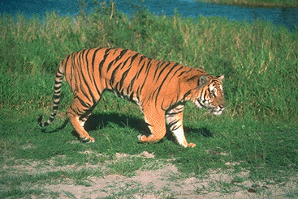
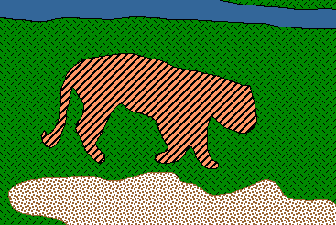
Recap: Image Segmentation
Goal: identify groups of pixels that go together

Slide 3
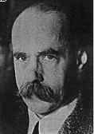
Recap: Gestalt Theory
Gestalt: whole or group
  Whole is greater than sum of its parts
  Relationships among parts can yield new properties/features
Psychologists identified series of factors that predispose set of elements to be grouped (by human visual system)
        “I stand at the window and see a house, trees, sky.
        Theoretically I might say there were 327 brightnesses
        and nuances of colour. Do I have "327"? No. I have sky, house, and trees.”
        Max Wertheimer
        (1880-1943)
Untersuchungen zur Lehre von der Gestalt,
Psychologische Forschung, Vol. 4, pp. 301-350, 1923
http://psy.ed.asu.edu/~classics/Wertheimer/Forms/forms.htm

Slide 4
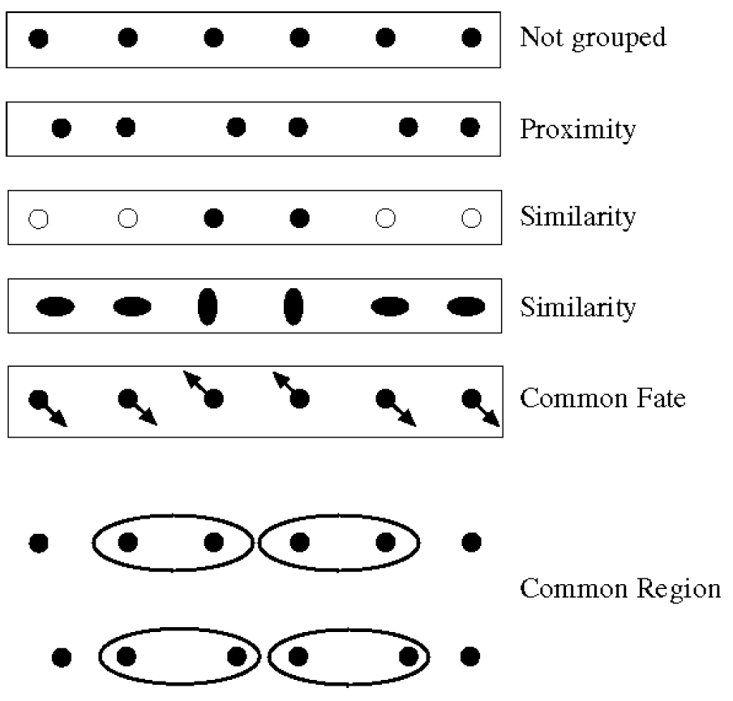
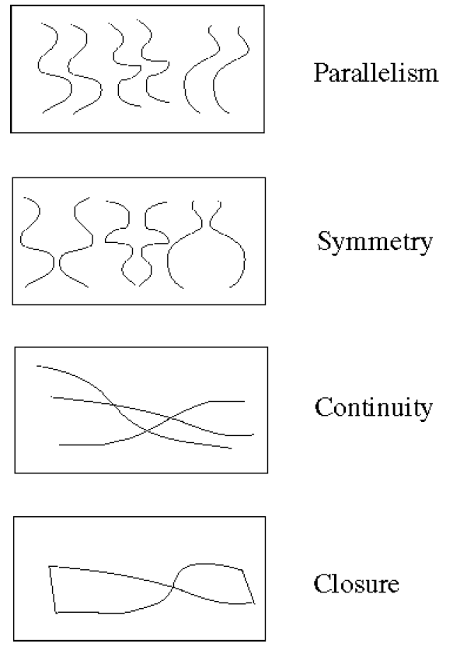
Recap: Gestalt Factors
These factors make intuitive sense, but are very difficult to translate into algorithms.

Slide 5
What will we learn today?
K-means clustering
Mean-shift clustering
Reading: [FP] Chapters: 14.2, 14.4
D. Comaniciu and P. Meer, Mean Shift: A Robust Approach toward Feature Space Analysis, PAMI 2002.

Slide 6
What will we learn today?
K-means clustering
Mean-shift clustering
Reading: [FP] Chapters: 14.2, 14.4
D. Comaniciu and P. Meer, Mean Shift: A Robust Approach toward Feature Space Analysis, PAMI 2002.

Slide 7
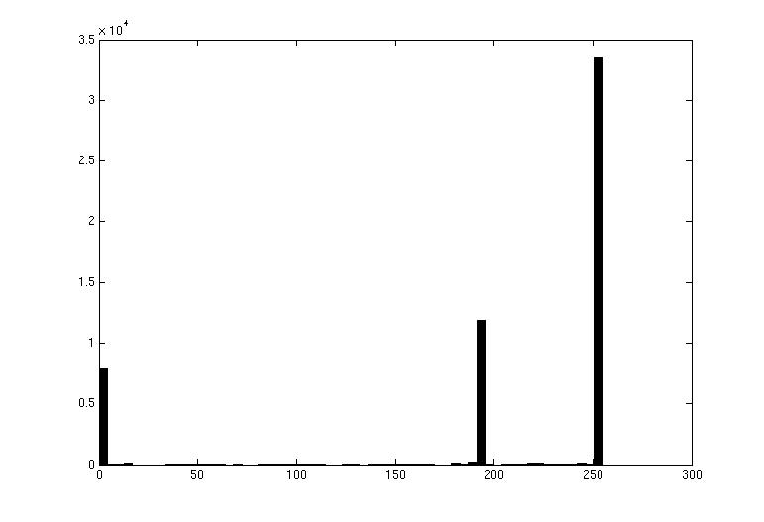
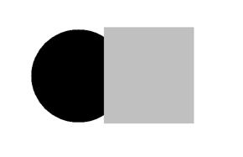
Image Segmentation: Toy Example
white pixels
3
These intensities define the three groups.
We could label every pixel in the image according to which of these primary intensities it is.
  i.e., segment the image based on the intensity feature.
What if the image isn’t quite so simple?
black pixels
gray pixels
1
2
input image
intensity
Slide credit: Kristen Grauman

Slide 8
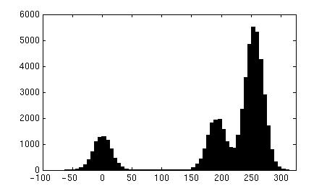

Pixel count
Input image
Intensity
Pixel count
Input image
Intensity
Slide credit: Kristen Grauman

Slide 9
Now how to determine the three main intensities that define our groups?
We need to cluster.
Pixel count
Input image
Intensity
Slide credit: Kristen Grauman

Slide 10
Goal: choose three “centers” as the representative intensities, and label every pixel according to which of these centers it is nearest to.
Best cluster centers are those that minimize Sum of Square Distance (SSD) between all points and their nearest cluster center c_{i}:
0
190
255
Intensity
3
1
2
Slide credit: Kristen Grauman

Slide 11
Clustering for Summarization
Goal: cluster to minimize variance in data given clusters
  Preserve information
Cluster center
Data
Whether is assigned to
Slide: Derek Hoiem

Slide 12
Clustering
With this objective, it is a “chicken and egg” problem:
  If we knew the cluster centers, we could allocate points to groups by assigning each to its closest center.
  If we knew the group memberships, we could get the centers by computing the mean per group.
Slide credit: Kristen Grauman

Slide 13
K-means clustering
Initialize ( ): cluster centers
Compute : assign each point to the closest center
  denotes the set of assignment for each to cluster at iteration t
Computer : update cluster centers as the mean of the points
Update , Repeat Step 2-3 till stopped
Slide: Derek Hoiem

Slide 14
K-means clustering
Initialize ( ): cluster centers
Compute : assign each point to the closest center
Computer : update cluster centers as the mean of the points
Update , Repeat Step 2-3 till stopped
Commonly used: random initialization
Or greedily choose K to minimize residual
Typical distance measure:
  Euclidean
  Cosine
  Others
doesn’t change anymore.
Slide: Derek Hoiem

Slide 15
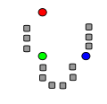
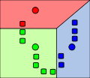
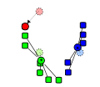
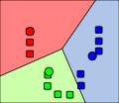
K-means clustering
1. Initialize Cluster Centers
2. Assign Points to Clusters
3. Re-compute Means
Repeat (2) and (3)
Java demo:
http://home.dei.polimi.it/matteucc/Clustering/tutorial_html/AppletKM.html
Illustration Source: wikipedia

Slide 16
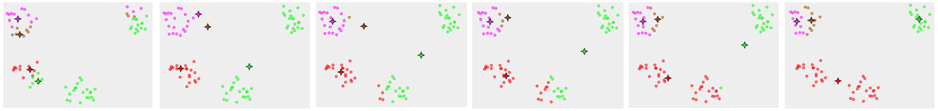
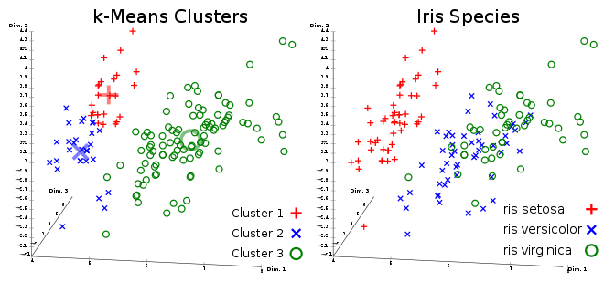
K-means clustering
Converges to a local minimum solution
  Initialize multiple runs
Better fit for spherical data
Need to pick K (# of clusters)

Slide 17
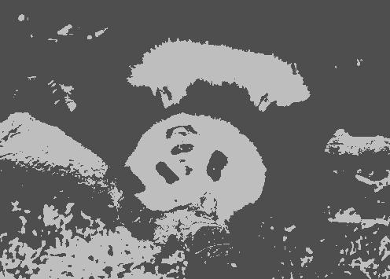
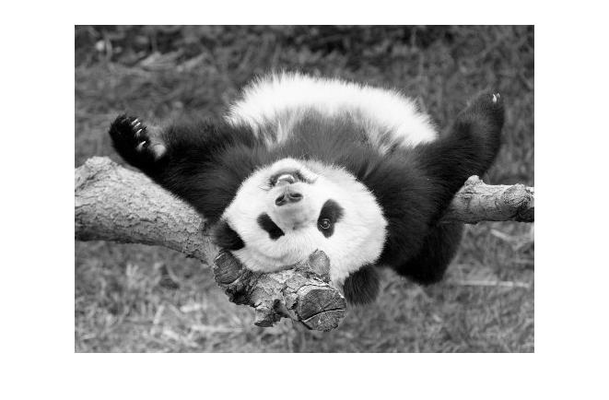
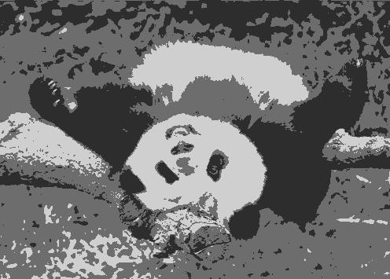
Segmentation as Clustering
2 clusters
Original image
3 clusters

Slide 18
K-Means++
Can we prevent arbitrarily bad local minima?
Randomly choose first center.
Pick new center with prob. proportional to
  (Contribution of x to total error)
Repeat until K centers.
Expected error * optimal
Slide credit: Steve Seitz
Arthur & Vassilvitskii 2007

Slide 19
Feature Space
Depending on what we choose as the feature space, we can group pixels in different ways.
Grouping pixels based on
intensity similarity
Feature space: intensity value (1D)
Slide credit: Kristen Grauman

Slide 20
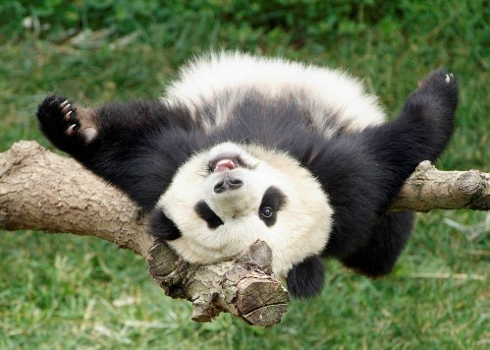
Feature Space
Depending on what we choose as the feature space, we can group pixels in different ways.
Grouping pixels based
on color similarity
Feature space: color value (3D)
R=255
G=200
B=250
B
G
R=245
G=220
B=248
R
R=15
G=189
B=2
R=3
G=12
B=2
Slide credit: Kristen Grauman

Slide 21
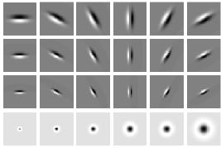
Feature Space
Depending on what we choose as the feature space, we can group pixels in different ways.
Grouping pixels based
on texture similarity
Feature space: filter bank responses (e.g., 24D)
F₁
F₂
Filter bank of 24 filters
…
F₂₄
Slide credit: Kristen Grauman

Slide 22
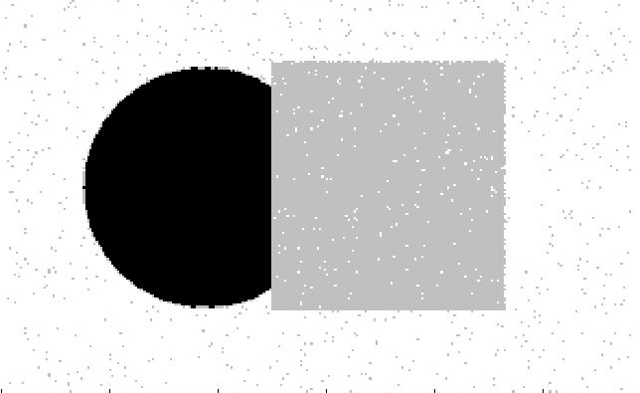
Smoothing Out Cluster Assignments
Assigning a cluster label per pixel may yield outliers:
How can we ensure they
are spatially smooth?
Original
Labeled by cluster center’s intensity
?
3
1
2
Slide credit: Kristen Grauman

Slide 23
Segmentation as Clustering
Depending on what we choose as the feature space, we can group pixels in different ways.
Grouping pixels based on
intensity+position similarity
⇒ Way to encode both similarity and proximity.
Intensity
Y
X
Slide credit: Kristen Grauman
Notes:
Both regions are black, but if we also include position (x,y), then we could group the two into distinct segments; way to encode both similarity & proximity.

Slide 24
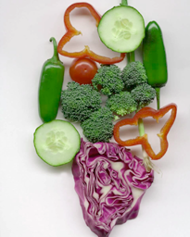
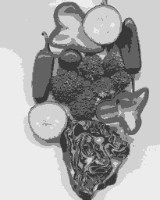
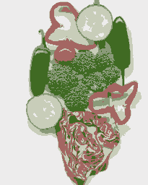
K-Means Clustering Results
K-means clustering based on intensity or color is essentially vector quantization of the image attributes
  Clusters don’t have to be spatially coherent
Image
Intensity-based clusters
Color-based clusters
Image source: Forsyth & Ponce

Slide 25
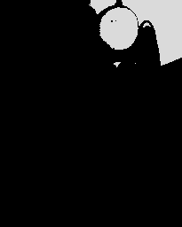
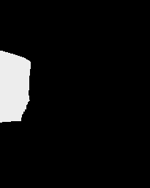
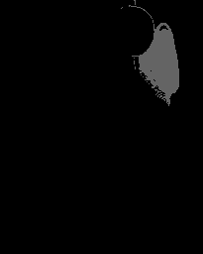
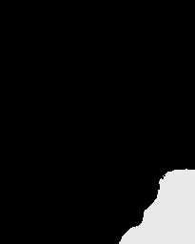
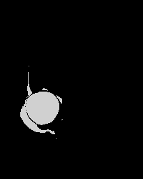
K-Means Clustering Results
K-means clustering based on intensity or color is essentially vector quantization of the image attributes
  Clusters don’t have to be spatially coherent
Clustering based on (r,g,b,x,y) values enforces more spatial coherence
Image source: Forsyth & Ponce

Slide 26
How to evaluate clusters?
Generative
  How well are points reconstructed from the clusters?
Discriminative
  How well do the clusters correspond to labels?
    Can we correctly classify which pixels belong to the panda?
  Note: unsupervised clustering does not aim to be discriminative as we don’t have the labels.
Slide: Derek Hoiem

Slide 27
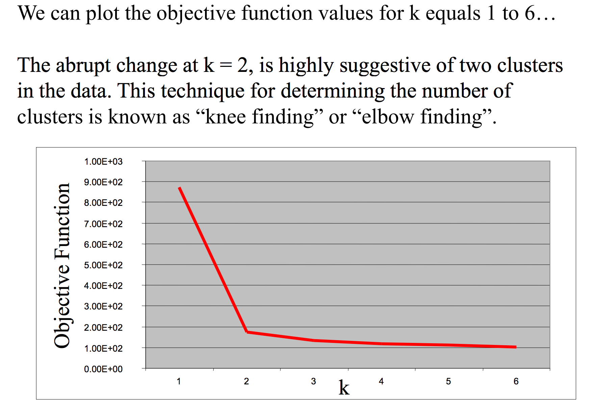
How to choose the number of clusters?
Try different numbers of clusters in a validation set and look at performance.
Slide: Derek Hoiem

Slide 28
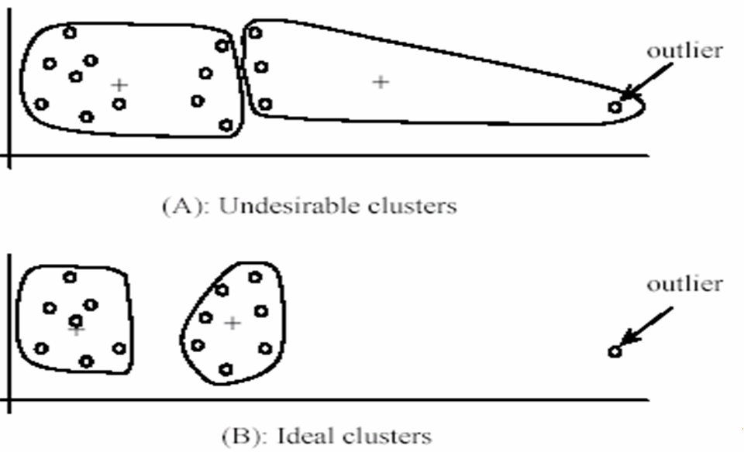
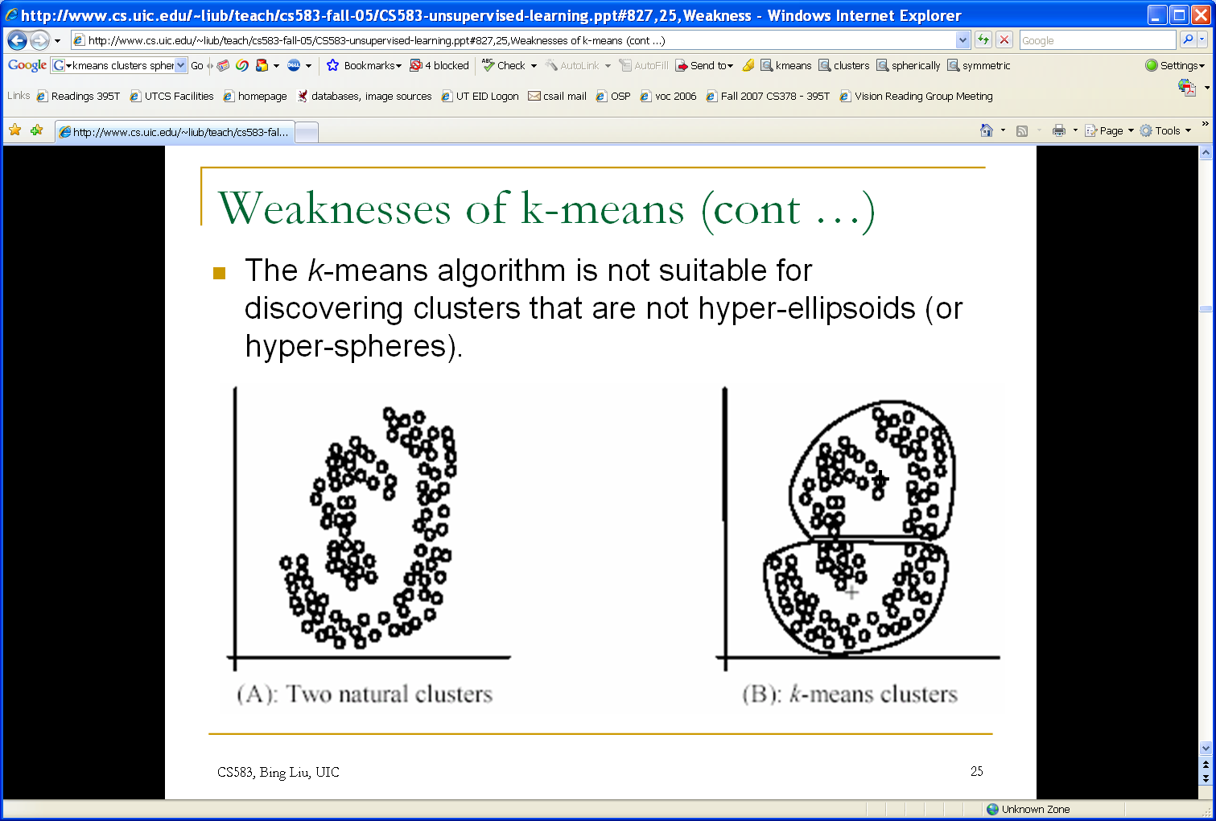
K-Means pros and cons
Pros
  Finds cluster centers that minimize conditional variance (good representation of data)
  Simple and fast, Easy to implement
Cons
  Need to choose K
  Sensitive to outliers
  Prone to local minima
  All clusters have the same parameters (e.g., distance measure is non-adaptive)
  *Can be slow: each iteration is O(KNd) for N d-dimensional points
Usage
  Unsupervised clustering
  Rarely used for pixel segmentation

Slide 29
What will we learn today?
K-means clustering
Mean-shift clustering
Reading: [FP] Chapters: 14.2, 14.4
D. Comaniciu and P. Meer, Mean Shift: A Robust Approach toward Feature Space Analysis, PAMI 2002.

Slide 30
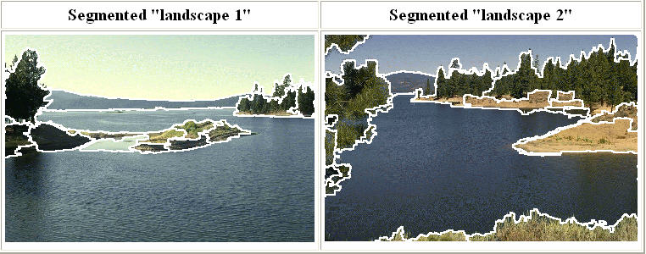
Mean-Shift Segmentation
An advanced and versatile technique for clustering-based segmentation
Slide credit: Svetlana Lazebnik
http://www.caip.rutgers.edu/~comanici/MSPAMI/msPamiResults.html
D. Comaniciu and P. Meer, Mean Shift: A Robust Approach toward Feature Space Analysis, PAMI 2002.

Slide 31
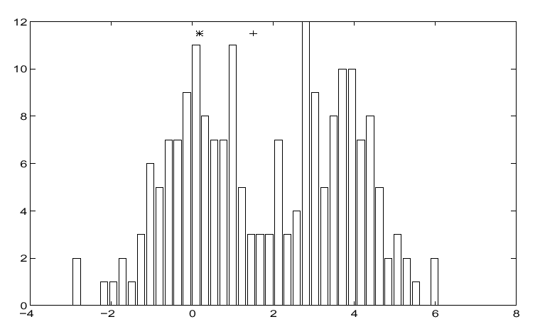
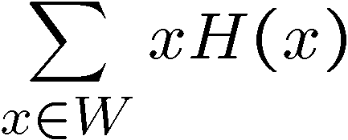
Mean-Shift Algorithm
Iterative Mode Search
  Initialize random seed, and window W
  Calculate center of gravity (the “mean”) of W:
  Shift the search window to the mean
  Repeat Step 2 until convergence
Slide credit: Steve Seitz

Slide 32
Mean-Shift
Region of
interest
Center of
mass
Mean Shift
vector
Slide by Y. Ukrainitz & B. Sarel

Slide 33
Mean-Shift
Region of
interest
Center of
mass
Mean Shift
vector
Slide by Y. Ukrainitz & B. Sarel

Slide 34
Mean-Shift
Region of
interest
Center of
mass
Mean Shift
vector
Slide by Y. Ukrainitz & B. Sarel

Slide 35
Mean-Shift
Region of
interest
Center of
mass
Mean Shift
vector
Slide by Y. Ukrainitz & B. Sarel

Slide 36
Mean-Shift
Region of
interest
Center of
mass
Mean Shift
vector
Slide by Y. Ukrainitz & B. Sarel

Slide 37
Mean-Shift
Region of
interest
Center of
mass
Mean Shift
vector
Slide by Y. Ukrainitz & B. Sarel

Slide 38
Mean-Shift
Region of
interest
Center of
mass
Slide by Y. Ukrainitz & B. Sarel

Slide 39
Real Modality Analysis
Slide by Y. Ukrainitz & B. Sarel
Tessellate the space with windows
Run the procedure in parallel

Slide 40
Real Modality Analysis
Slide by Y. Ukrainitz & B. Sarel
The blue data points were traversed by the windows towards the mode.

Slide 41
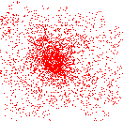
Mean-Shift Clustering
Cluster: all data points in the attraction basin of a mode
Attraction basin: the region for which all trajectories lead to the same mode
Slide by Y. Ukrainitz & B. Sarel

Slide 42
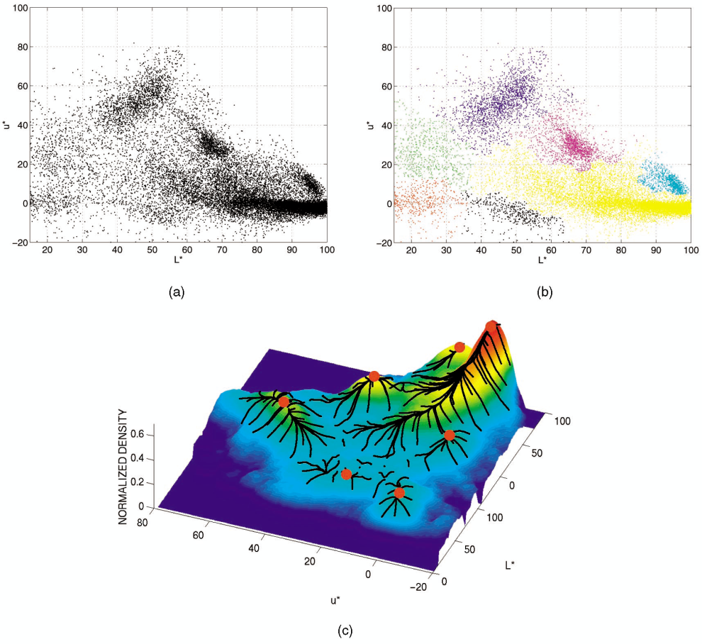
Mean-Shift Clustering/Segmentation
Find features (color, gradients, texture, etc)
Initialize windows at individual pixel locations
Perform mean shift for each window until convergence
Merge windows that end up near the same “peak” or mode
Slide credit: Svetlana Lazebnik

Slide 43
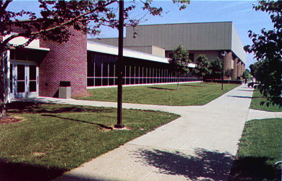
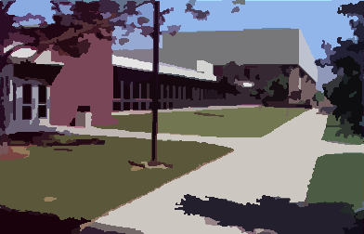
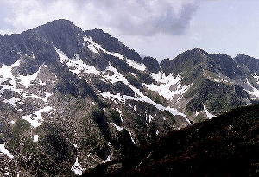
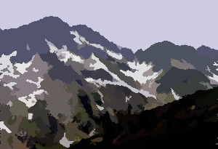
Mean-Shift Segmentation Results
Slide credit: Svetlana Lazebnik
http://www.caip.rutgers.edu/~comanici/MSPAMI/msPamiResults.html

Slide 44
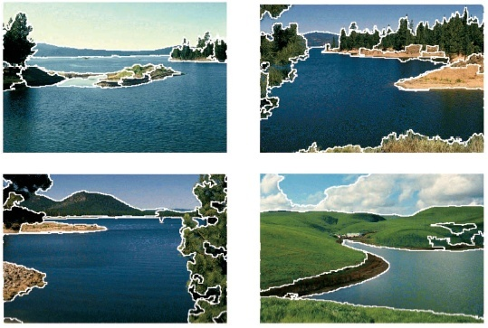
More Results
Slide credit: Svetlana Lazebnik

Slide 45
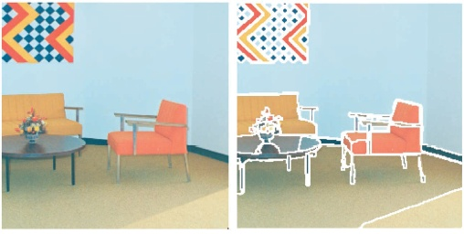
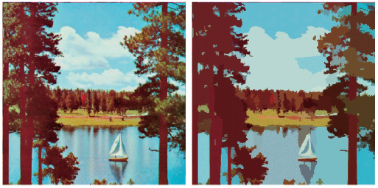
More Results

Slide 46
Problem: Computational Complexity
Slide credit: Bastian Leibe
Need to shift many windows…
Many computations will be redundant.

Slide 47
Speedups: Basin of Attraction
r
Slide credit: Bastian Leibe
Assign all points within radius r of end point to the mode.

Slide 48
Speedups
Slide credit: Bastian Leibe
Assign all points within radius r/c of the search path to the mode -> reduce the number of data points to search.

Slide 49
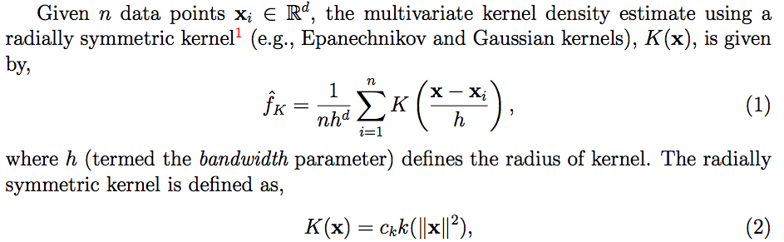
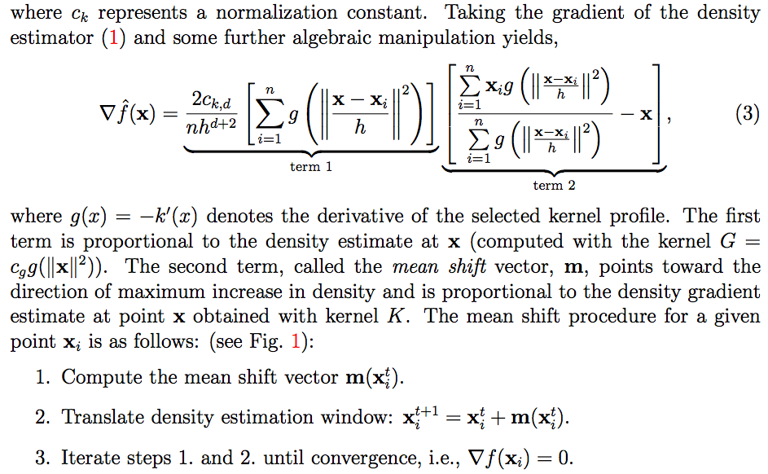
Technical Details
Comaniciu & Meer, 2002

Slide 50
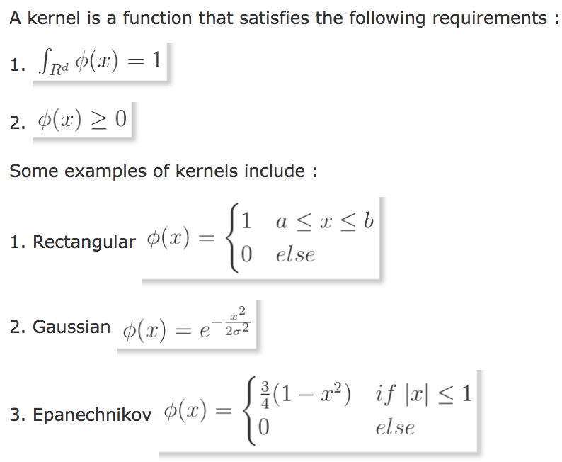
Other Kernels
source

Slide 51
Technical Details
Taking the derivative of:
Term1: this is proportional to the density estimate at x (similar to equation 1 from two slides ago).
Term2: this is the mean-shift vector that points towards the direction of maximum density.
Comaniciu & Meer, 2002

Slide 52
Technical Details
Finally, the mean shift procedure from a given point x_{t} is:
Computer the mean shift vector m:
Translate the density window:
Iterate steps 1 and 2 until convergence.
Comaniciu & Meer, 2002

Slide 53
Summary Mean-Shift
Pros
  General, application-independent tool
  Model-free, does not assume any prior shape (spherical, elliptical, etc.) on data clusters
  Just a single parameter (window size h)
    h has a physical meaning (unlike k-means)
  Finds variable number of modes
  Robust to outliers
Cons
  Output depends on window size
  Window size (bandwidth) selection is not trivial
  Computationally (relatively) expensive (~2s/image)
  Does not scale well with dimension of feature space
Slide credit: Svetlana Lazebnik

Slide 54
What will we have learned today
K-means clustering
Mean-shift clustering
Reading: [FP] Chapters: 14.2, 14.4
D. Comaniciu and P. Meer, Mean Shift: A Robust Approach toward Feature Space Analysis, PAMI 2002.

