Slide 1
Lecture: Semantic Segmentation
Juan Carlos Niebles and Ranjay Krishna
Stanford Vision and Learning Lab

Slide 2
What we will learn today
Introduction to segmentation and clustering
Gestalt theory for perceptual grouping
Agglomerative clustering
Oversegmentation
Reading: [FP] Chapters: 14.2, 14.4

Slide 3
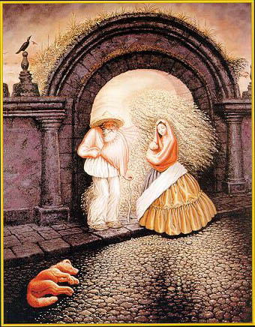

Slide 4
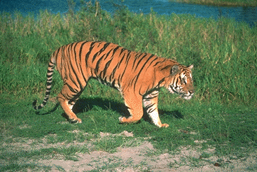
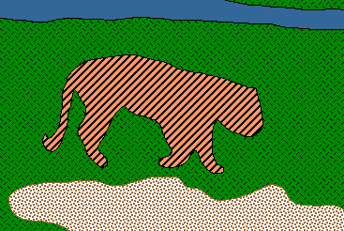
Image Segmentation
Goal: identify groups of pixels that go together
Slide credit: Steve Seitz, Kristen Grauman

Slide 5
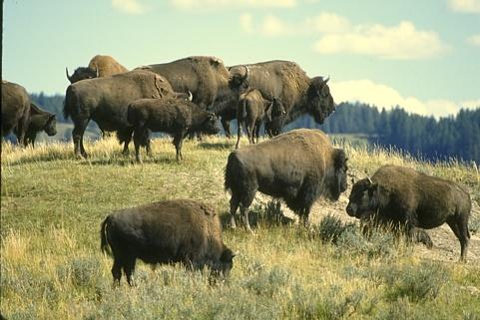
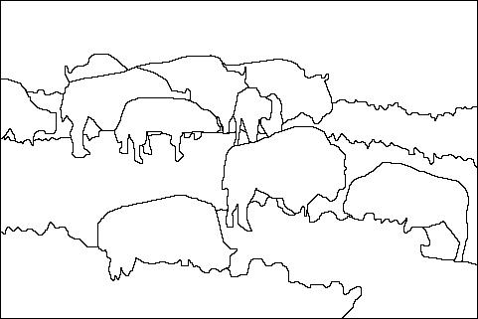
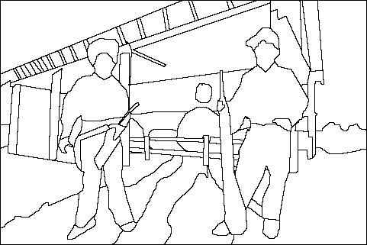
The Goals of Segmentation
Separate image into coherent “objects”
Image
Human segmentation
Slide credit: Svetlana Lazebnik

Slide 6
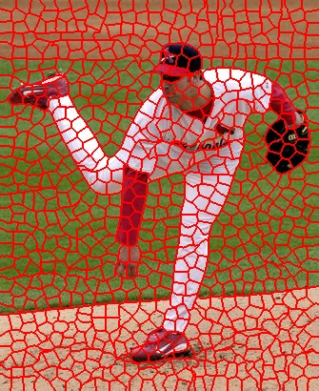
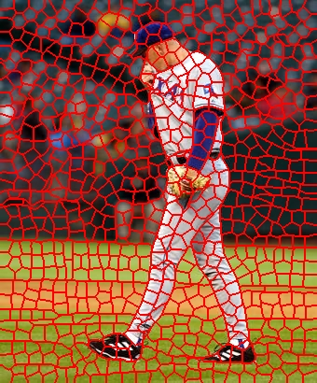
The Goals of Segmentation
Separate image into coherent “objects”
Group together similar-looking pixels for efficiency of further processing
“superpixels”
Slide credit: Svetlana Lazebnik
X. Ren and J. Malik. Learning a classification model for segmentation. ICCV 2003.

Slide 7
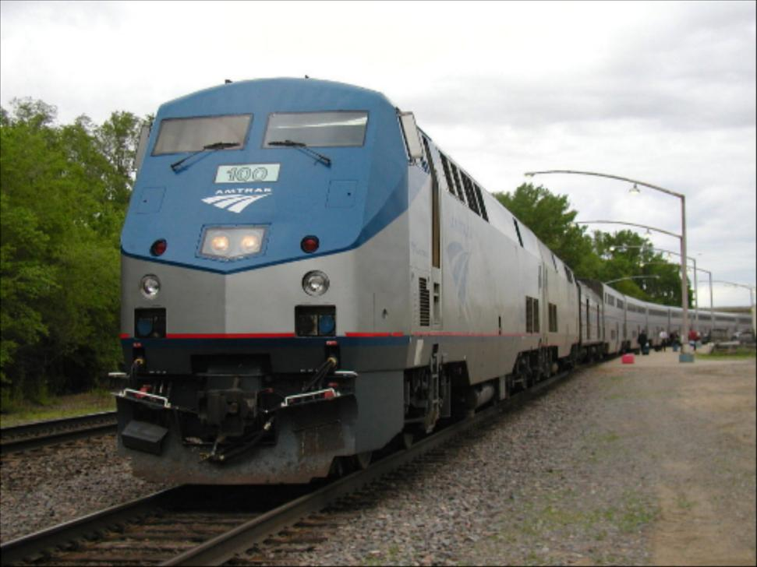
Segmentation for feature support
50x50 Patch
50x50 Patch
Slide: Derek Hoiem

Slide 8
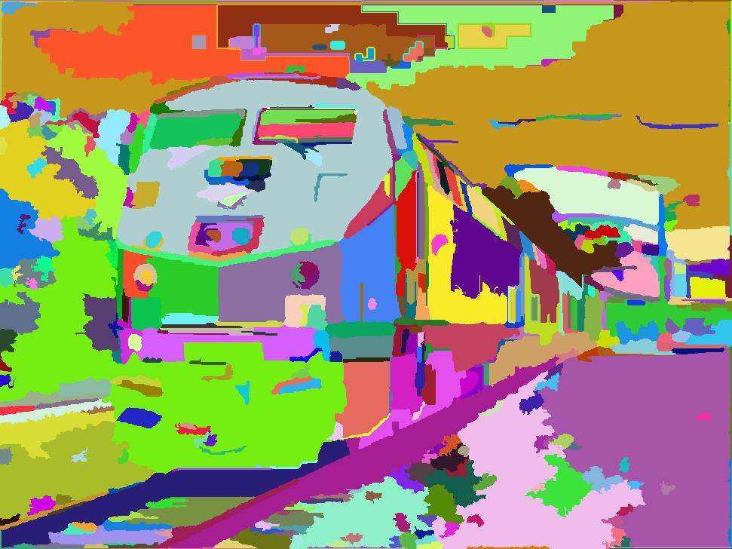
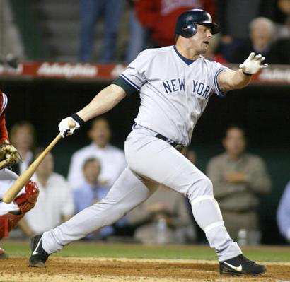
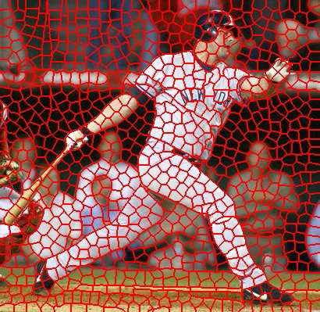
Segmentation for efficiency
[Felzenszwalb and Huttenlocher 2004]
[Hoiem et al. 2005, Mori 2005]
[Shi and Malik 2001]
Slide: Derek Hoiem

Slide 9
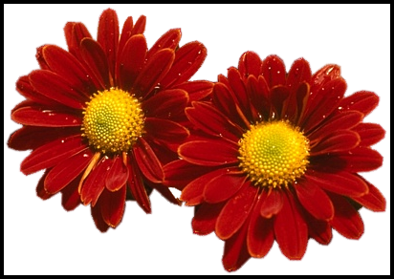
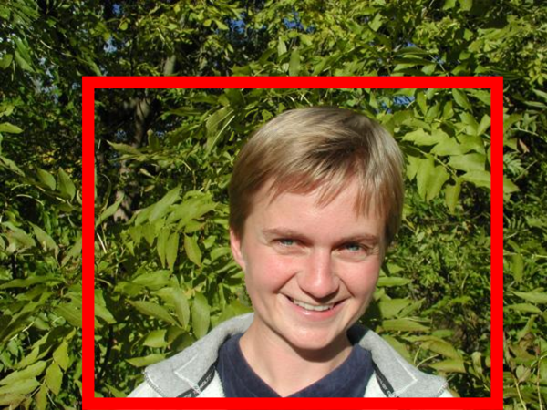
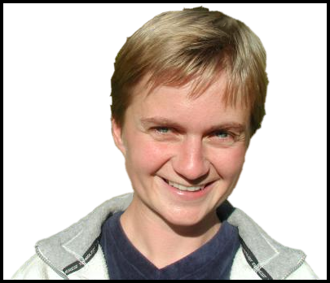
Segmentation as a result
Rother et al. 2004

Slide 10
Types of segmentations
Oversegmentation
Undersegmentation
Multiple Segmentations

Slide 11
One way to think about “segmentation” is Clustering
Clustering: group together similar data points and represent them with a single token
Key Challenges:
1) What makes two points/images/patches similar?
2) How do we compute an overall grouping from pairwise similarities?
Slide: Derek Hoiem

Slide 12
Why do we cluster?
Summarizing data
Look at large amounts of data
Patch-based compression or denoising
Represent a large continuous vector with the cluster number
Counting
Histograms of texture, color, SIFT vectors
Segmentation
Separate the image into different regions
Prediction
Images in the same cluster may have the same labels
Slide: Derek Hoiem

Slide 13
How do we cluster?
Agglomerative clustering
Start with each point as its own cluster and iteratively merge the closest clusters
K-means (next lecture)
Iteratively re-assign points to the nearest cluster center
Mean-shift clustering (next lecture)
Estimate modes of pdf

Slide 14
General ideas
Tokens
whatever we need to group (pixels, points, surface elements, etc., etc.)
Bottom up clustering
tokens belong together because they are locally coherent
Top down clustering
tokens belong together because they lie on the same visual entity (object, scene…)
> These two are not mutually exclusive

Slide 15
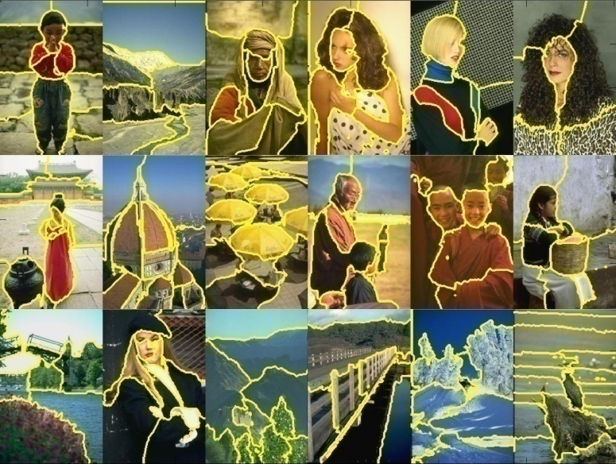
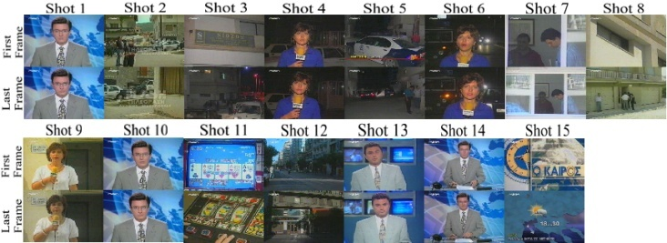
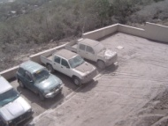
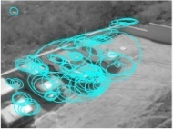
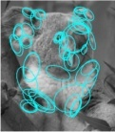
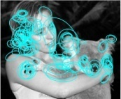
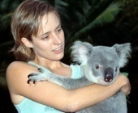
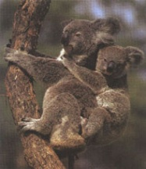
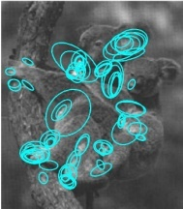
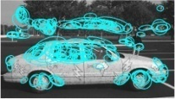
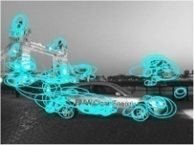
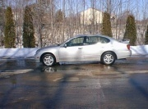
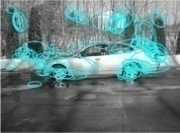
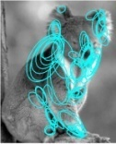
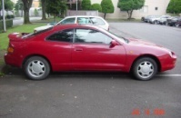
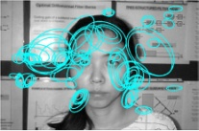
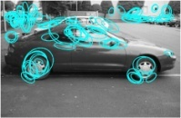
Examples of Grouping in Vision
Grouping video frames into shots
Determining image regions
What things should be grouped?
Figure-ground
What cues indicate groups?
Object-level grouping
Slide credit: Kristen Grauman

Slide 16
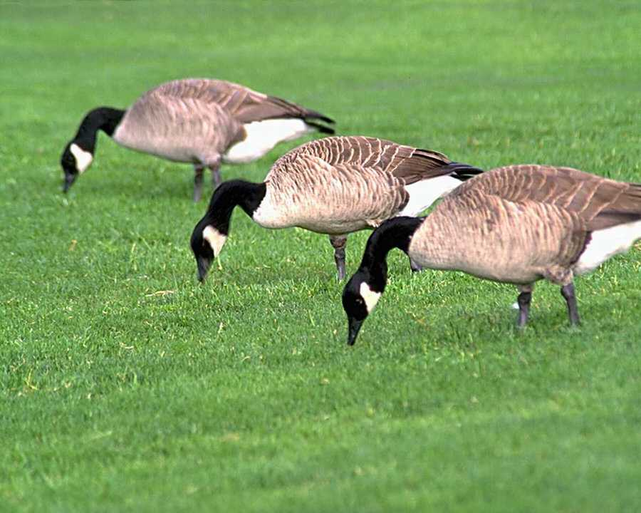
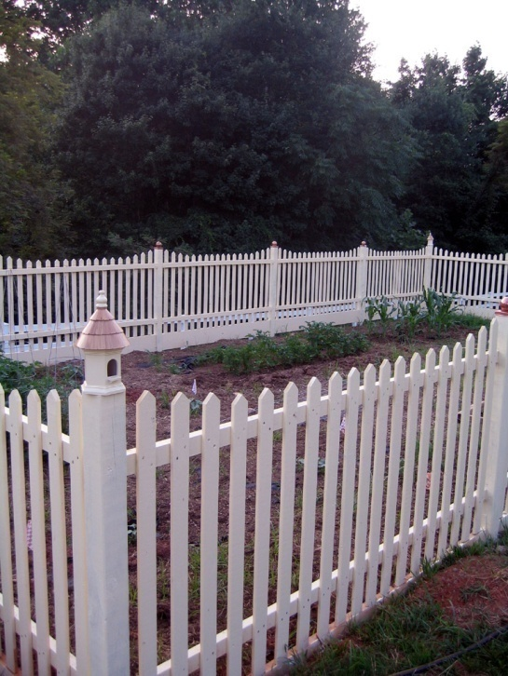
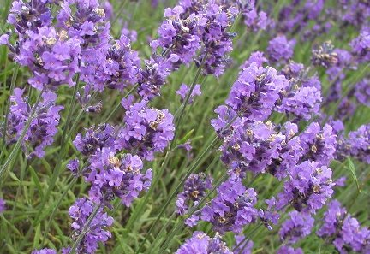
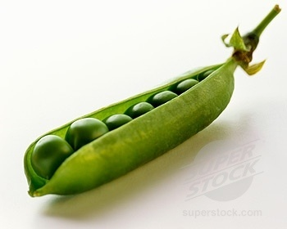
Similarity
Slide credit: Kristen Grauman

Slide 17
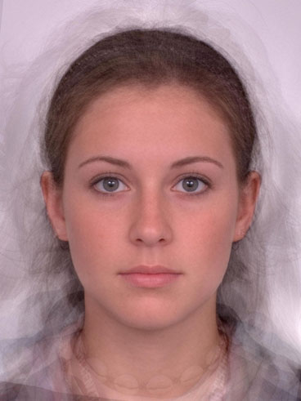
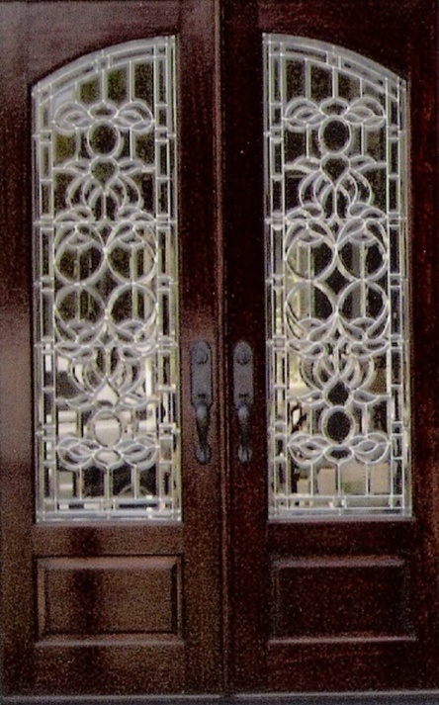
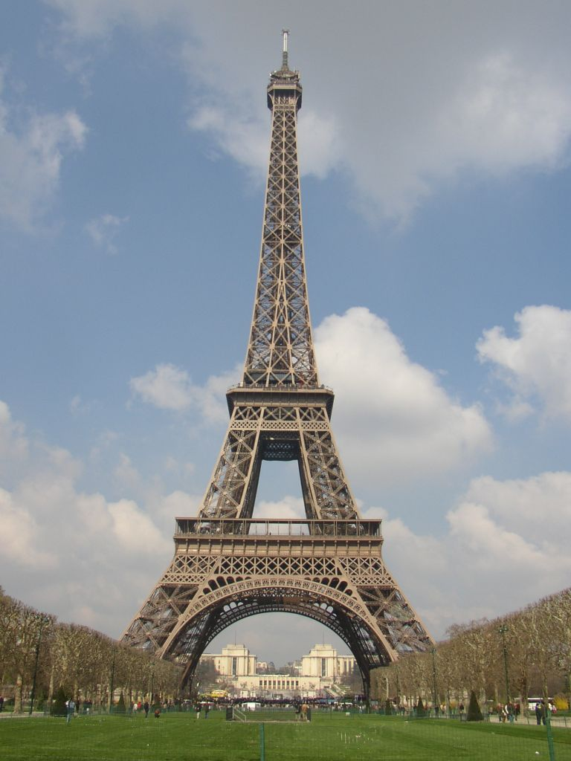
Symmetry
Slide credit: Kristen Grauman

Slide 18
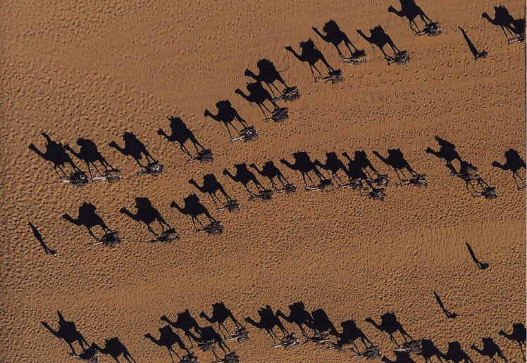
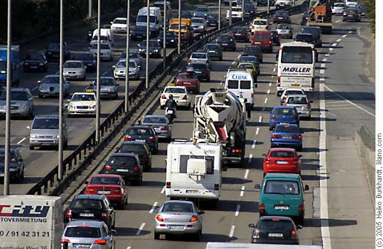
Common Fate
Image credit: Arthus-Bertrand (via F. Durand)
Slide credit: Kristen Grauman

Slide 19
Proximity
Slide credit: Kristen Grauman

Slide 20
Muller-Lyer Illusion
What makes the bottom line look longer than the top line?

Slide 21
What we will learn today
Introduction to segmentation and clustering
Gestalt theory for perceptual grouping
Agglomerative clustering
Oversegmentation

Slide 22
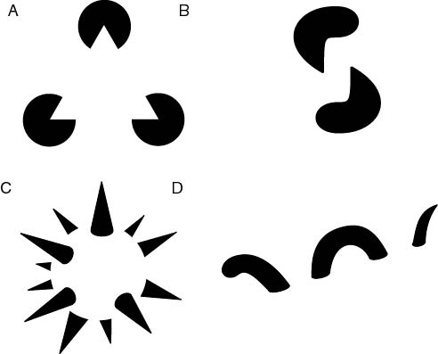
The Gestalt School
Grouping is key to visual perception
Elements in a collection can have properties that result from relationships
“The whole is greater than the sum of its parts”
Illusory/subjective contours
Occlusion
Slide credit: Svetlana Lazebnik
Familiar configuration
http://en.wikipedia.org/wiki/Gestalt_psychology

Slide 23
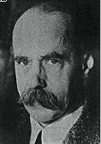
Gestalt Theory
Gestalt: whole or group
Whole is greater than sum of its parts
Relationships among parts can yield new properties/features
Psychologists identified series of factors that predispose set of elements to be grouped (by human visual system)
“I stand at the window and see a house, trees, sky. Theoretically I might say there were 327 brightnesses and nuances of colour. Do I have "327"? No. I have sky, house, and trees.”
Max Wertheimer (1880-1943)
Untersuchungen zur Lehre von der Gestalt, Psychologische Forschung, Vol. 4, pp. 301-350, 1923
http://psy.ed.asu.edu/~classics/Wertheimer/Forms/forms.htm

Slide 24
Gestalt Factors
These factors make intuitive sense, but are very difficult to translate into algorithms.
Image source: Forsyth & Ponce

Slide 25
Continuity through Occlusion Cues

Slide 26
Continuity through Occlusion Cues
Continuity, explanation by occlusion

Slide 27
Continuity through Occlusion Cues
Image source: Forsyth & Ponce

Slide 28
Continuity through Occlusion Cues
Image source: Forsyth & Ponce

Slide 29
Figure-Ground Discrimination

Slide 30
The Ultimate Gestalt?

Slide 31
What we will learn today
Introduction to segmentation and clustering
Gestalt theory for perceptual grouping
Agglomerative clustering
Oversegmentation

Slide 32
What is similarity?
Similarity is hard to define, but… “We know it when we see it” The real meaning of similarity is a philosophical question. We will take a more pragmatic approach.

Slide 33
Clustering: distance measure
Clustering is an unsupervised learning method. Given items , the goal is to group them into clusters. We need a pairwise distance/similarity function between items, and sometimes the desired number of clusters.
When data (e.g. images, objects, documents) are represented by feature vectors, a commonly used similarity measure is the cosine similarity. Let be two data vectors. There is angle between the two vectors .

Slide 34
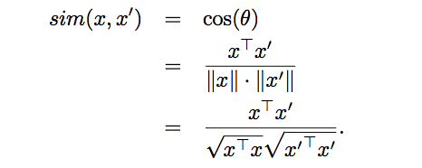
Defining Distance Measures
Let x and x’ be two objects from the universe of possible objects. The distance (similarity) between x and x’ is a real number denoted by sim(x, x’).
The euclidian similarity is defined as
In contrast, cosine distance measure would be

Slide 35
Desirable Properties of a Clustering Algorithms
Scalability (in terms of both time and space)
Ability to deal with different data types
Minimal requirements for domain knowledge to determine input parameters
Don’t need to know how many objects there are or what those object categories will be.
Interpretability and usability Optional
Incorporation of user-specified constraints

Slide 36
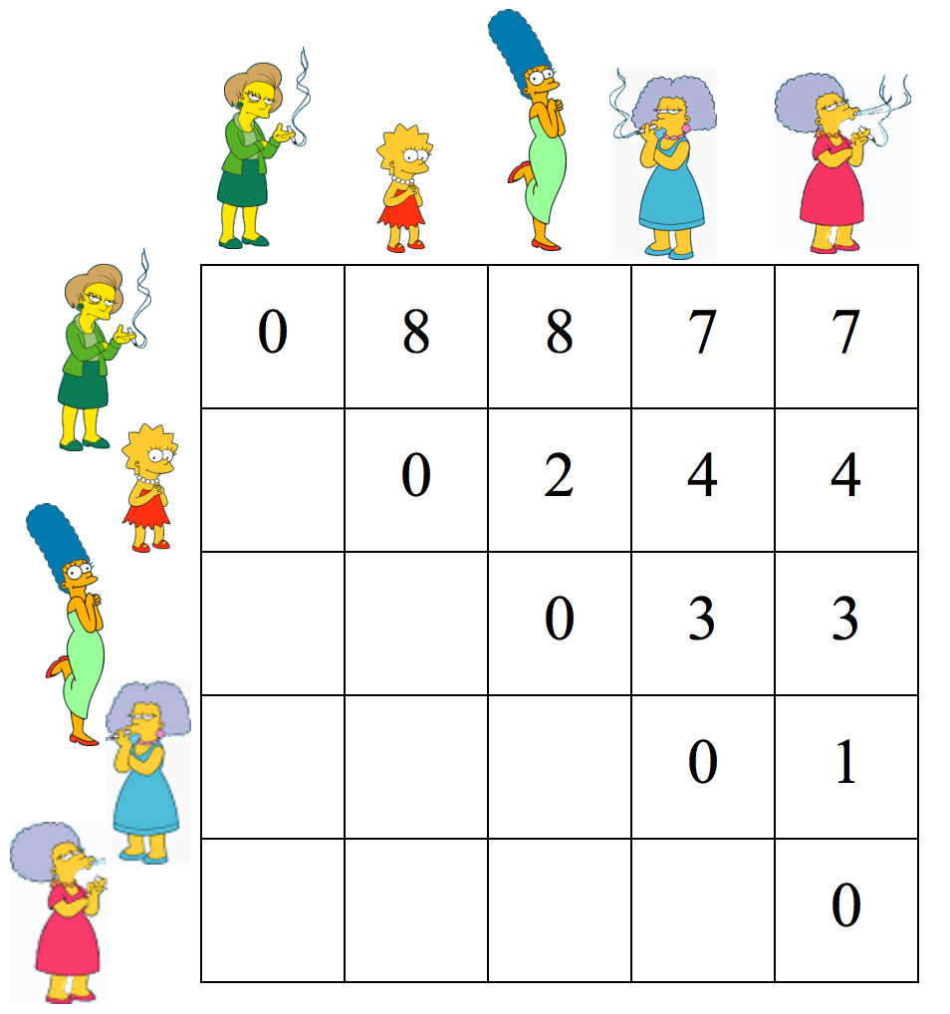
Animated example
The matrix represents distance between two elements.
Distance is usually assumed to be the inverse of similarity.
Low distance means high similarity.
source

Slide 37
Animated example
source

Slide 38
Animated example
source

Slide 39
Animated example
source

Slide 40
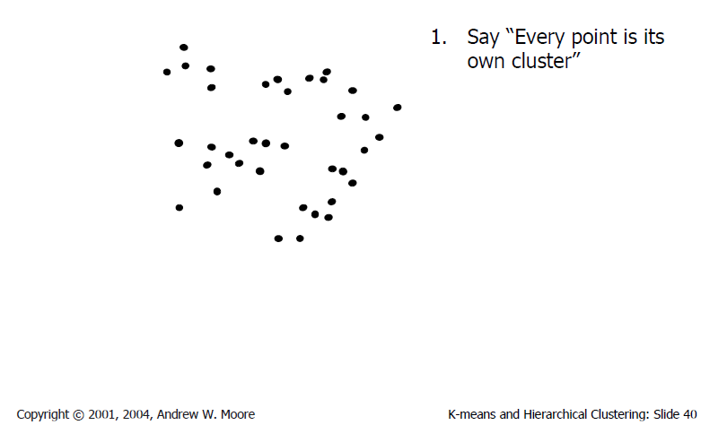
Agglomerative clustering
Slide credit: Andrew Moore

Slide 41
Agglomerative clustering
Slide credit: Andrew Moore

Slide 42
Agglomerative clustering
Slide credit: Andrew Moore

Slide 43
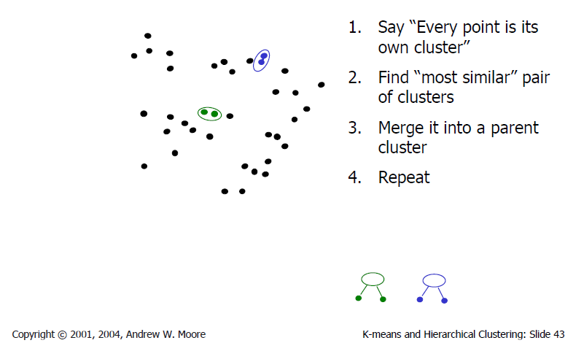
Agglomerative clustering
Slide credit: Andrew Moore

Slide 44
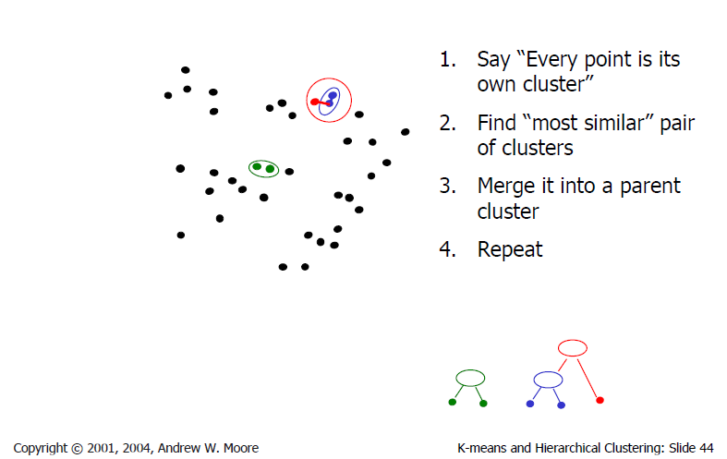
Agglomerative clustering
Slide credit: Andrew Moore

Slide 45
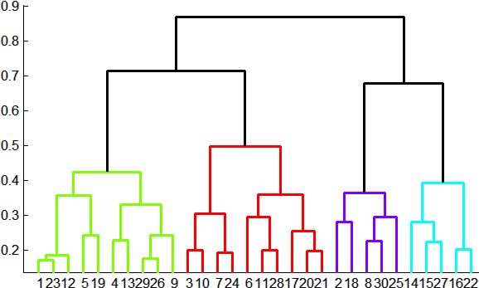
Agglomerative clustering
How to define cluster similarity?
Average distance between points,
maximum distance
minimum distance
Distance between means or medoids
How many clusters?
Clustering creates a dendrogram (a tree)
Threshold based on max number of clusters or based on distance between merges
distance

Slide 46
Agglomerative Hierarchical Clustering - Algorithm

Slide 47
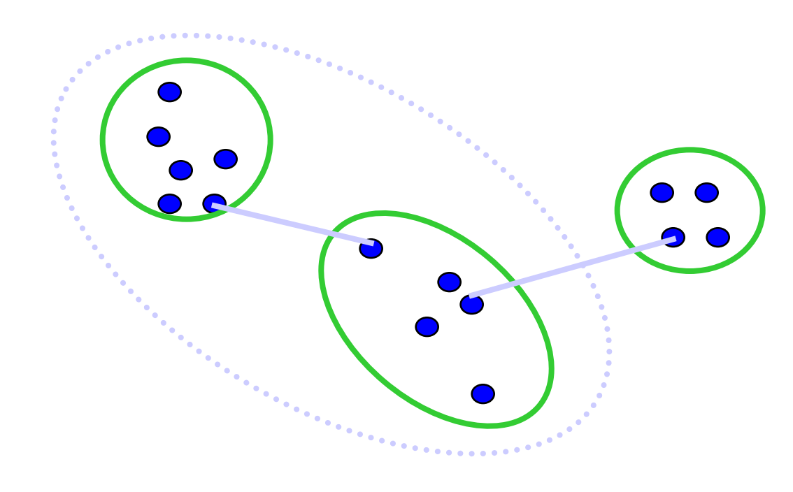
Different measures of nearest clusters
Single Link
Long, skinny clusters

Slide 48
Different measures of nearest clusters
Complete Link
Tight clusters

Slide 49
Different measures of nearest clusters
Average Link
Robust against noise.

Slide 50
Conclusions: Agglomerative Clustering
Good
Simple to implement, widespread application.
Clusters have adaptive shapes.
Provides a hierarchy of clusters.
No need to specify number of clusters in advance.
Bad
May have imbalanced clusters.
Still have to choose number of clusters or threshold.
Does not scale well. Runtime of O(n³).
Can get stuck at a local optima.

Slide 51
What we will learn today?
Introduction to segmentation and clustering
Gestalt theory for perceptual grouping
Agglomerative clustering
Oversegmentation

Slide 52
How do we segment using Clustering?
Solution: Oversegmentation algorithm
Introduced by Felzenszwalb and Huttenlocher in the paper titled Efficient Graph-Based Image Segmentation.

Slide 53
Problem Formulation
Graph G = (V, E)
V is set of nodes (i.e. pixels)
E is a set of undirected edges between pairs of pixels
w(vi , vj ) is the weight of the edge between nodes vi and vj .
S is a segmentation of a graph G such that G’ = (V, E’) where E’ ⊂ E.
S divides G into G’ such that it contains distinct clusters C.

Slide 54
Predicate for segmentation
Predicate D determines whether there is a boundary for segmentation.
Where
dif(C1 , C2 ) is the difference between two clusters.
in(C1 , C2 ) is the internal different in the clusters C1 and C2

Slide 55
Predicate for Segmentation
Predicate D determines whether there is a boundary for segmentation.
The different between two components is the minimum weight edge that connects a node vi in clusters C1 to node vj in C2

Slide 56
Predicate for Segmentation
Predicate D determines whether there is a boundary for segmentation.
In(C1, C2) is to the maximum weight edge that connects two nodes in the same component.

Slide 57
Predicate for Segmentation
k/|C| sets the threshold by which the components need to be different from the internal nodes in a component.
Properties of constant k:
If k is large, it causes a preference of larger objects.
k does not set a minimum size for components.

Slide 58
Features and weights
Project every pixel into feature space defined by:
(x, y, r, g, b).
Every pixel is connected to its 8 neighboring pixels and the weights are determined by the difference in intensities.
Weights between pixels are determined using L2 (Euclidian) distance in feature space.
Edges are chosen for only top ten nearest neighbors in feature space to ensure run time of O(n log n) where n is number of pixels.

Slide 59
Results

Slide 60
What we have learned today?
Introduction to segmentation and clustering
Gestalt theory for perceptual grouping
Agglomerative clustering
Oversegmentation

