Slide 1
Lecture: RANSAC and feature detectors
Juan Carlos Niebles and Ranjay Krishna
Stanford Vision and Learning Lab

Slide 2
What we will learn today?
A model fitting method for edge detection
  RANSAC
Local invariant features
  Motivation
  Requirements, invariances
Keypoint localization
  Harris corner detector

Slide 3
What we will learn today
A model fitting method for line detection
  RANSAC
Local invariant features
  Motivation
  Requirements, invariances
Keypoint localization
  Harris corner detector

Slide 4
Fitting as Search in Parametric Space
Choose a parametric model to represent a set of features
Membership criterion is not local
  Can’t tell whether a point belongs to a given model just by looking at that point.
Three main questions:
  What model represents this set of features best?
  Which of several model instances gets which feature?
  How many model instances are there?
Computational complexity is important
  It is infeasible to examine every possible set of parameters and every possible combination of features
Source: L. Lazebnik

Slide 5
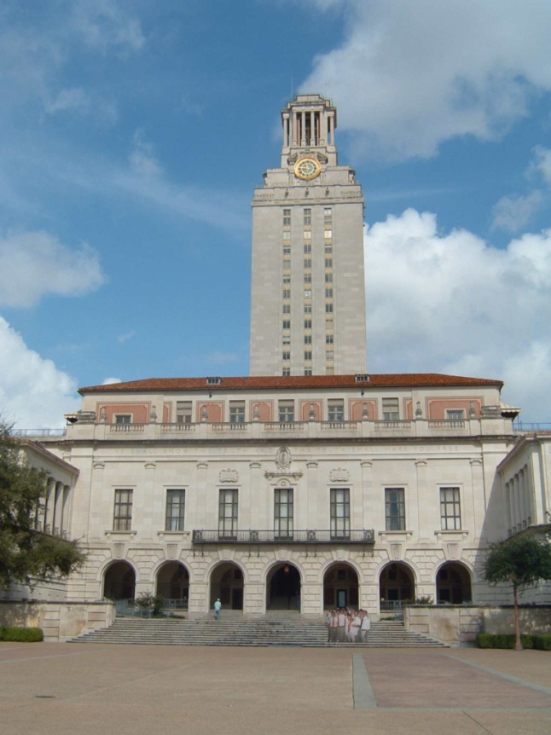
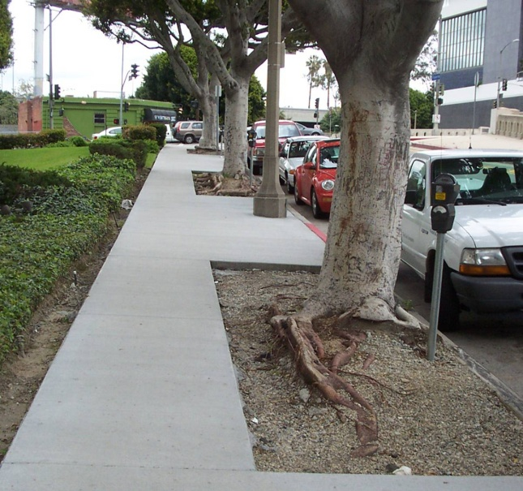
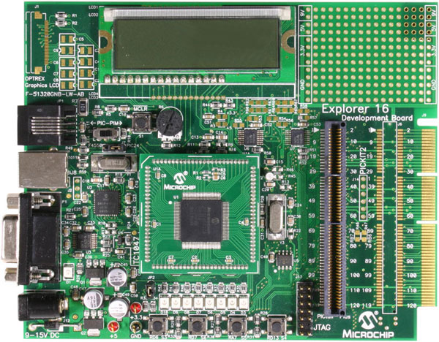
Example: Line Fitting
Why fit lines?
Many objects characterized by presence of straight lines
Wait, why aren’t we done just by running edge detection?
Slide credit: Kristen Grauman

Slide 6
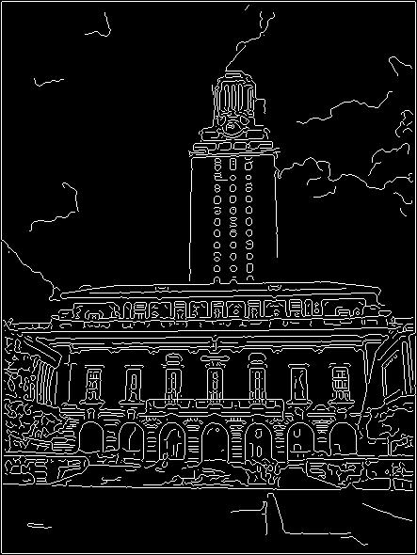

Difficulty of Line Fitting
Extra edge points (clutter), multiple models:
  Which points go with
  which line, if any?
Only some parts of each line detected, and some parts are missing:
  How to find a line that
  bridges missing evidence?
Noise in measured edge points, orientations:
  How to detect true underlying parameters?
Slide credit: Kristen Grauman

Slide 7
Voting
It’s not feasible to check all combinations of features by fitting a model to each possible subset.
Voting is a general technique where we let the features vote for all models that are compatible with it.
  Cycle through features, cast votes for model parameters.
  Look for model parameters that receive a lot of votes.
Noise & clutter features will cast votes too, but typically their votes should be inconsistent with the majority of “good” features.
Ok if some features not observed, as model can span multiple fragments.
Slide credit: Kristen Grauman

Slide 8
RANSAC [Fischler & Bolles 1981]
RANdom SAmple Consensus
Approach: we want to avoid the impact of outliers, so let’s look for “inliers”, and use only those.
Intuition: if an outlier is chosen to compute the current fit, then the resulting line won’t have much support from rest of the points.
Slide credit: Kristen Grauman

Slide 9
RANSAC [Fischler & Bolles 1981]
RANSAC loop:
Randomly select a seed group of points on which to base transformation estimate (e.g., a group of matches)
Compute transformation from seed group
Find inliers to this transformation
If the number of inliers is sufficiently large, re-compute least-squares estimate of transformation on all of the inliers
Keep the transformation with the largest number of inliers
Slide credit: Kristen Grauman

Slide 10
RANSAC Line Fitting Example
Task: Estimate the best line
  How many points do we need to estimate the line?
Slide credit: Kristen Grauman

Slide 11
RANSAC Line Fitting Example
Task: Estimate the best line
Sample two points
Slide credit: Kristen Grauman

Slide 12
RANSAC Line Fitting Example
Task: Estimate the best line
Fit a line to them
Slide credit: Kristen Grauman

Slide 13
RANSAC Line Fitting Example
Task: Estimate the best line
Total number of points within a threshold of line.
Slide credit: Kristen Grauman

Slide 14
RANSAC Line Fitting Example
Task: Estimate the best line
“7 inlier points”
Total number of points within a threshold of line.
Slide credit: Kristen Grauman

Slide 15
RANSAC Line Fitting Example
Task: Estimate the best line
Repeat, until we get a good result.
Slide credit: Kristen Grauman

Slide 16
RANSAC Line Fitting Example
Task: Estimate the best line
“11 inlier points”
Repeat, until we get a good result.
Slide credit: Kristen Grauman

Slide 17
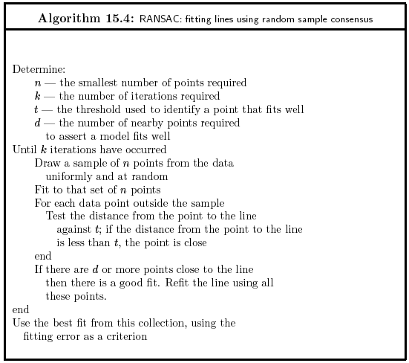

Slide 18
RANSAC: How many samples?
How many samples are needed?
  Suppose w is fraction of inliers (points from line).
  n points needed to define hypothesis (2 for lines)
  k samples chosen.
Prob. that a single sample of n points is correct:
Prob. that all k samples fail is:
⇒ Choose k high enough to keep this below desired failure rate.
Slide credit: David Lowe

Slide 19
RANSAC: Computed k (p=0.99)
Sample size n | Proportion of outliers
 | 5% | 10% | 20% | 25% | 30% | 40% | 50%
2 | 2 | 3 | 5 | 6 | 7 | 11 | 17
3 | 3 | 4 | 7 | 9 | 11 | 19 | 35
4 | 3 | 5 | 9 | 13 | 17 | 34 | 72
5 | 4 | 6 | 12 | 17 | 26 | 57 | 146
6 | 4 | 7 | 16 | 24 | 37 | 97 | 293
7 | 4 | 8 | 20 | 33 | 54 | 163 | 588
8 | 5 | 9 | 26 | 44 | 78 | 272 | 1177
Slide credit: David Lowe

Slide 20
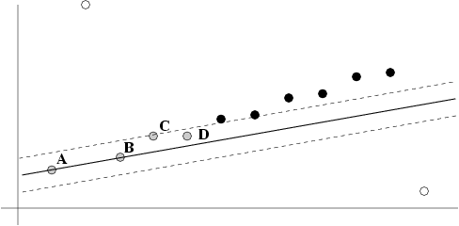
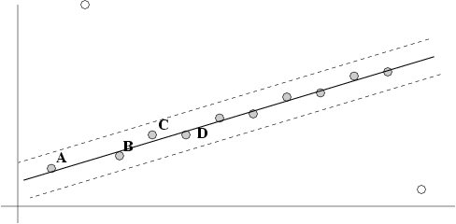
After RANSAC
RANSAC divides data into inliers and outliers and yields estimate computed from minimal set of inliers.
Improve this initial estimate with estimation over all inliers (e.g. with standard least-squares minimization).
But this may change inliers, so alternate fitting with re-classification as inlier/outlier.
Slide credit: David Lowe

Slide 21
RANSAC: Pros and Cons
Pros:
  General method suited for a wide range of model fitting problems
  Easy to implement and easy to calculate its failure rate
Cons:
  Only handles a moderate percentage of outliers without cost blowing up
  Many real problems have high rate of outliers (but sometimes selective choice of random subsets can help)
A voting strategy, The Hough transform, can handle high percentage of outliers

Slide 22
What we will learn today?
A model fitting method for edge detection
  RANSAC
Local invariant features
  Motivation
  Requirements, invariances
Keypoint localization
  Harris corner detector
Some background reading:
Rick Szeliski, Chapter 4.1.1; David Lowe, IJCV 2004

Slide 23
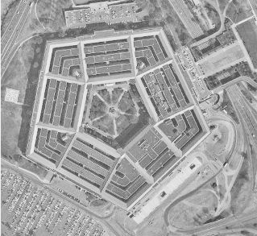
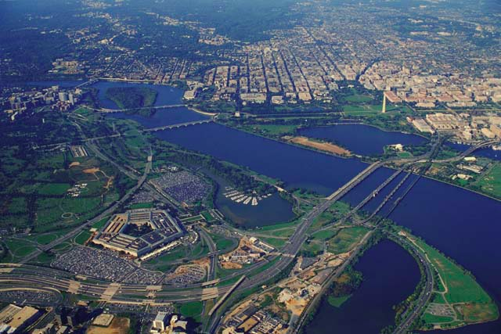
Image matching: a challenging problem
Notes:
“Global template” – not robust to:
Scale changes, rotations, view point changes, occlusions…

Slide 24
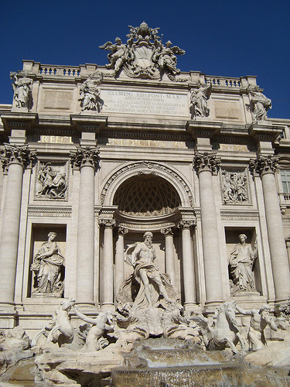
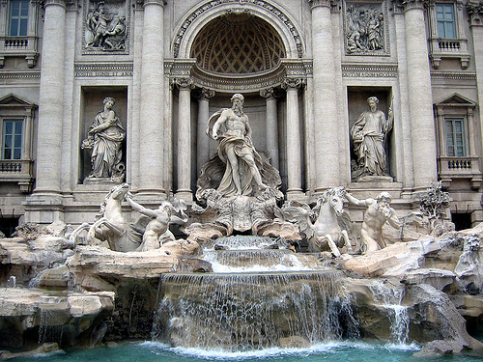
Image matching: a challenging problem
by Diva Sian
by swashford
Slide credit: Steve Seitz

Slide 25
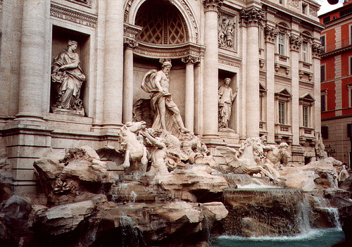
Harder Case
by Diva Sian
by scgbt
Slide credit: Steve Seitz

Slide 26


Harder Still?
NASA Mars Rover images
Slide credit: Steve Seitz

Slide 27


Answer Below (Look for tiny colored squares)
NASA Mars Rover images with SIFT feature matches
(Figure by Noah Snavely)
Slide credit: Steve Seitz

Slide 28

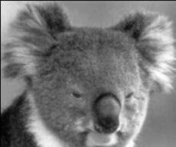
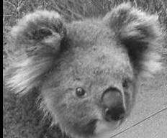
Motivation for using local features
Global representations have major limitations
Instead, describe and match only local regions
Increased robustness to
  Occlusions
  Articulation
  Intra-category variations

Slide 29




General Approach
1. Find a set of
distinctive key-
points
A₁
B₃
2. Define a region
around each
keypoint
A₂
A₃
3. Extract and
normalize the
region content
B₁
B₂
Similarity measure
4. Compute a local
descriptor from the
normalized region
N pixels
e.g. color
e.g. color
Slide credit: Bastian Leibe
N pixels
5. Match local
descriptors

Slide 30
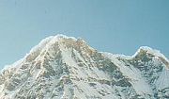

Common Requirements
Problem 1:
  Detect the same point independently in both images
No chance to match!
We need a repeatable detector!
Slide credit: Darya Frolova, Denis Simakov

Slide 31
Common Requirements
Problem 1:
  Detect the same point independently in both images
Problem 2:
  For each point correctly recognize the corresponding one
?
We need a reliable and distinctive descriptor!
Slide credit: Darya Frolova, Denis Simakov

Slide 32




Invariance: Geometric Transformations
Slide credit: Steve Seitz

Slide 33
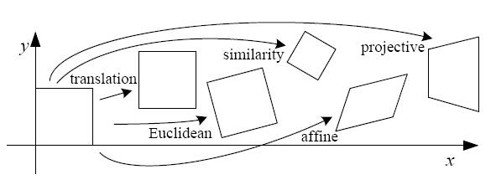
Levels of Geometric Invariance
CS131
CS231a
Slide credit: Bastian Leibe

Slide 34
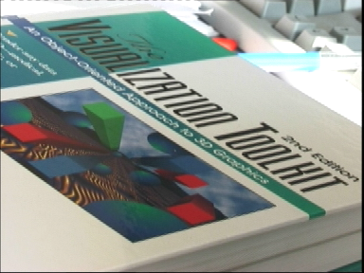
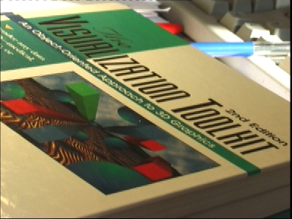
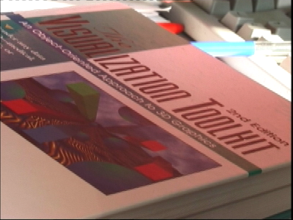
Invariance: Photometric Transformations
Often modeled as a linear
transformation:
  Scaling + Offset
Slide credit: Tinne Tuytelaars

Slide 35
Requirements
Region extraction needs to be repeatable and accurate
  Invariant to translation, rotation, scale changes
  Robust or covariant to out-of-plane (≈affine) transformations
  Robust to lighting variations, noise, blur, quantization
Locality: Features are local, therefore robust to occlusion and clutter.
Quantity: We need a sufficient number of regions to cover the object.
Distinctiveness: The regions should contain “interesting” structure.
Efficiency: Close to real-time performance.
Slide credit: Bastian Leibe

Slide 36
Many Existing Detectors Available
Hessian & Harris [Beaudet ‘78], [Harris ‘88]
Laplacian, DoG [Lindeberg ‘98], [Lowe ‘99]
Harris-/Hessian-Laplace [Mikolajczyk & Schmid ‘01]
Harris-/Hessian-Affine [Mikolajczyk & Schmid ‘04]
EBR and IBR [Tuytelaars & Van Gool ‘04]
MSER [Matas ‘02]
Salient Regions [Kadir & Brady ‘01]
Others…
Those detectors have become a basic building block for many recent applications in Computer Vision.
Slide credit: Bastian Leibe
Notes:
36

Slide 37
What we will learn today?
A model fitting method for edge detection
  RANSAC
Local invariant features
  Motivation
  Requirements, invariances
Keypoint localization
  Harris corner detector
Some background reading:
Rick Szeliski, Chapter 4.1.1; David Lowe, IJCV 2004

Slide 38
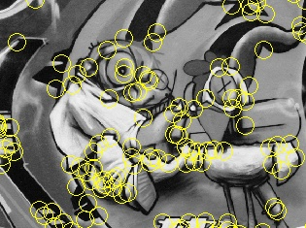
Keypoint Localization
Goals:
  Repeatable detection
  Precise localization
  Interesting content
⇒ Look for two-dimensional signal changes
Slide credit: Bastian Leibe

Slide 39
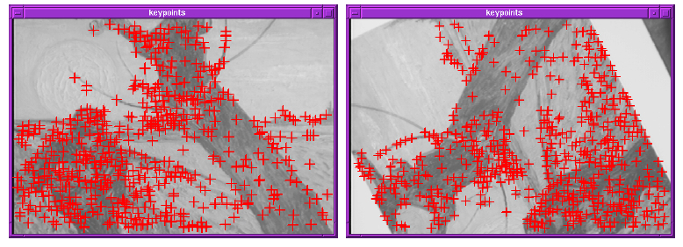
Finding Corners
Key property:
  In the region around a corner, image gradient has two or more dominant directions
Corners are repeatable and distinctive
C.Harris and M.Stephens. "A Combined Corner and Edge Detector.“ Proceedings of the 4th Alvey Vision Conference, 1988.
Slide credit: Svetlana Lazebnik

Slide 40

Corners as Distinctive Interest Points
Design criteria
  We should easily recognize the point by looking through a small window (locality)
  Shifting the window in any direction should give a large change in intensity (good localization)
“flat” region:
no change in all directions
“edge”:
no change along the edge direction
“corner”:
significant change in all directions
Slide credit: Alyosha Efros

Slide 41
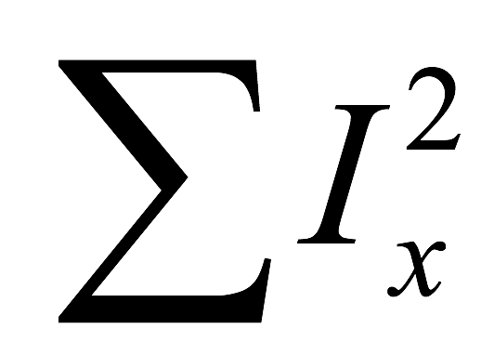
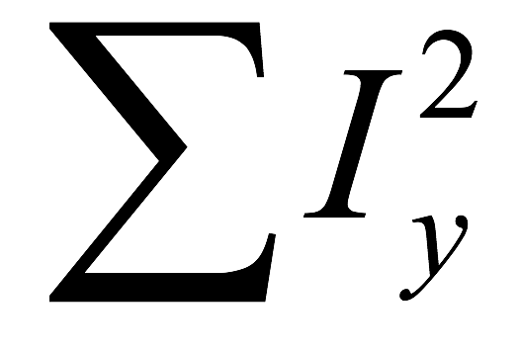
Corners versus edges
Large
Corner
Large
Small
Edge
Large
Small
Nothing
Small

Slide 42
Corners versus edges
??
Corner
??

Slide 43
Harris Detector Formulation
Change of intensity for the shift [u,v]:
Window function
Shifted intensity
Intensity
Window function w(x,y) =
or
1 in window, 0 outside
Gaussian
Slide credit: Rick Szeliski

Slide 44
Harris Detector Formulation
This measure of change can be approximated by:
where M is a 2×2 matrix computed from image derivatives:
Gradient with respect to x, times gradient with respect to y
Sum over image region – the area we are checking for corner
M
Slide credit: Rick Szeliski

Slide 45


Harris Detector Formulation
where M is a 2×2 matrix computed from image derivatives:
Image I
I_{x}
I_{y}
I_{x}I_{y}
Gradient with respect to x, times gradient with respect to y
Sum over image region – the area we are checking for corner
M
Slide credit: Rick Szeliski

Slide 46
What Does This Matrix Reveal?
First, let’s consider an axis-aligned corner:
This means:
  Dominant gradient directions align with x or y axis
  If either λ is close to 0, then this is not a corner, so look for locations where both are large.
What if we have a corner that is not aligned with the image axes?
Slide credit: David Jacobs
Notes:
Sum over neighborhood → some pixels with Ix only, some others with Iy only.

Slide 47
What Does This Matrix Reveal?
First, let’s consider an axis-aligned corner:
This means:
  Dominant gradient directions align with x or y axis
  If either λ is close to 0, then this is not a corner, so look for locations where both are large.
What if we have a corner that is not aligned with the image axes?
Slide credit: David Jacobs

Slide 48
General Case
Since M is symmetric, we have
We can visualize M as an ellipse with axis lengths determined by the eigenvalues and orientation determined by R
(Eigenvalue decomposition)
Direction of the fastest change
Direction of the slowest change
(λ_{max})^{-1/2}
(λ_{min})^{-1/2}
adapted from Darya Frolova, Denis Simakov

Slide 49
Interpreting the Eigenvalues
Classification of image points using eigenvalues of M:
λ₂
“Edge”
λ₂ >> λ₁
“Corner”
λ₁ and λ₂ are large, λ₁ ~ λ₂;
E increases in all directions
λ₁ and λ₂ are small;
E is almost constant in all directions
“Flat” region
“Edge”
λ₁ >> λ₂
λ₁
Slide credit: Kristen Grauman

Slide 50
Corner Response Function
Fast approximation
  Avoid computing the
  eigenvalues
  α: constant
  (0.04 to 0.06)
λ₂
“Edge”
θ < 0
“Corner”
θ > 0
“Flat” region
“Edge”
θ < 0
λ₁
Slide credit: Kristen Grauman

Slide 51
Window Function w(x,y)
Option 1: uniform window
  Sum over square window
  Problem: not rotation invariant
Option 2: Smooth with Gaussian
  Gaussian already performs weighted sum
  Result is rotation invariant
1 in window, 0 outside
Gaussian
Slide credit: Bastian Leibe

Slide 52

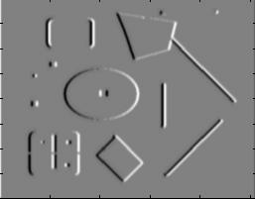
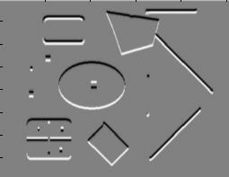
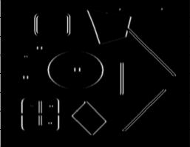
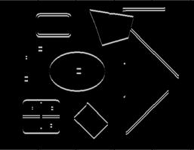
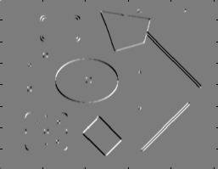
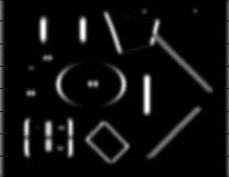
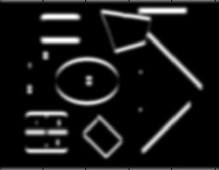
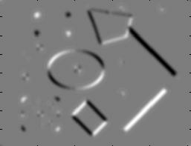
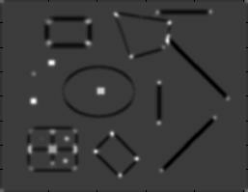
Summary: Harris Detector [Harris88]
Compute second moment matrix
(autocorrelation matrix)
I_{x}
I_{y}
1. Image
derivatives
I_{x}²
I_{y}²
I_{x}I_{y}
2. Square of
derivatives
3. Gaussian
filter g(σ_{I})
g(I_{x}²)
g(I_{y}²)
g(I_{x}I_{y})
4. Cornerness function – two strong eigenvalues
5. Perform non-maximum suppression
R
Slide credit: Krystian Mikolajczyk

Slide 53

Harris Detector: Workflow
Slide adapted from Darya Frolova, Denis Simakov

Slide 54

Harris Detector: Workflow
- computer corner responses θ
Slide adapted from Darya Frolova, Denis Simakov

Slide 55
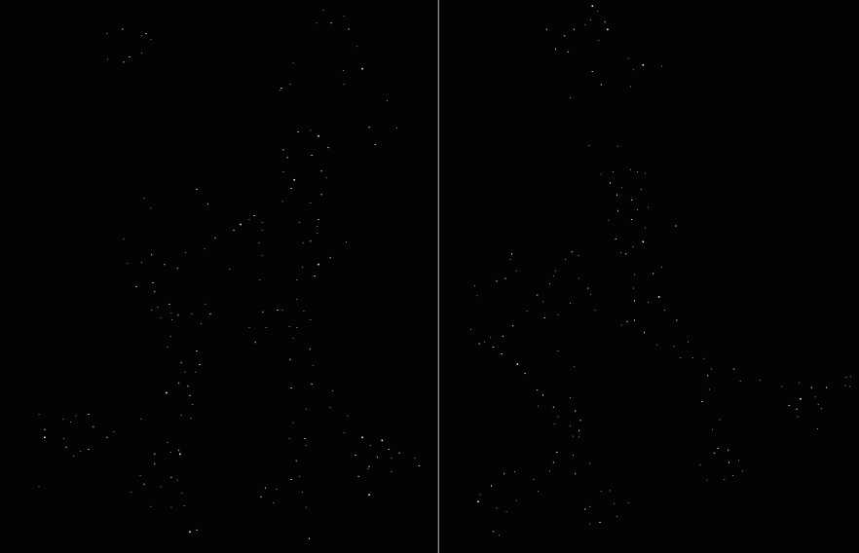
Harris Detector: Workflow
- Take only the local maxima of θ, where θ>threshold
Slide adapted from Darya Frolova, Denis Simakov

Slide 56

Harris Detector: Workflow
- Resulting Harris points
Slide adapted from Darya Frolova, Denis Simakov

Slide 57
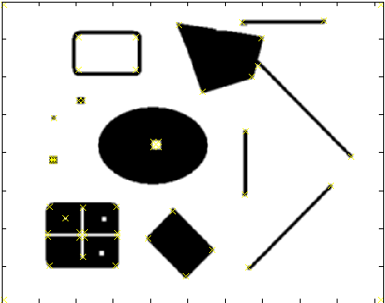
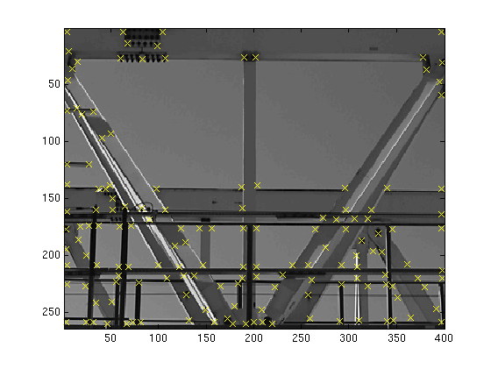
Harris Detector – Responses [Harris88]
Effect: A very precise corner detector.
Slide credit: Krystian Mikolajczyk

Slide 58
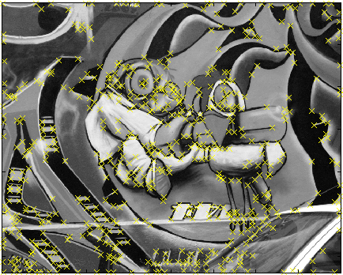
Harris Detector – Responses [Harris88]
Slide credit: Krystian Mikolajczyk

Slide 59
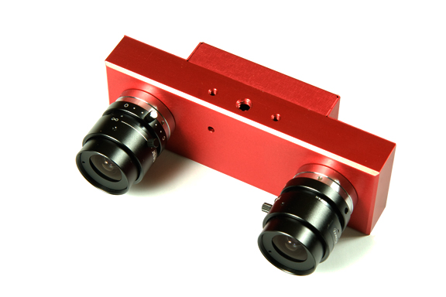
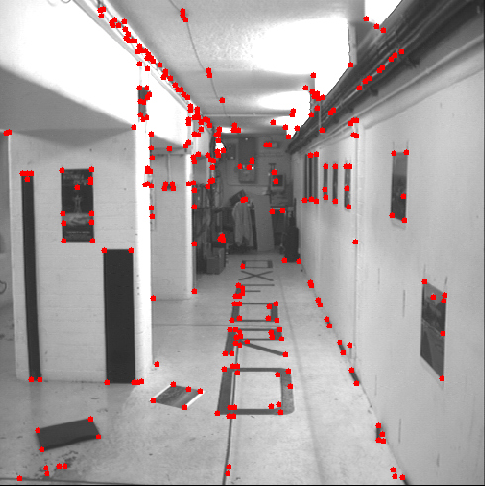
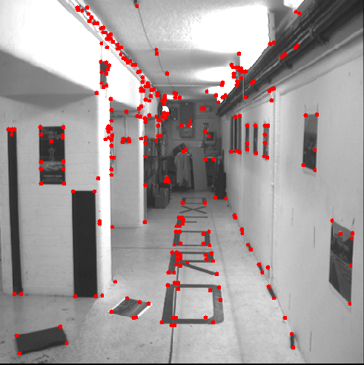
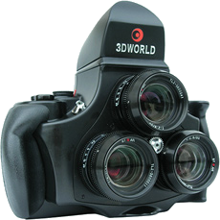
Harris Detector – Responses [Harris88]
Results are well suited for finding stereo correspondences
Slide credit: Kristen Grauman

Slide 60
Harris Detector: Properties
Translation invariance?
Slide credit: Kristen Grauman

Slide 61
Harris Detector: Properties
Translation invariance
Rotation invariance?
Ellipse rotates but its shape (i.e. eigenvalues) remains the same
Corner response θ is invariant to image rotation
Slide credit: Kristen Grauman

Slide 62
Harris Detector: Properties
Translation invariance
Rotation invariance
Scale invariance?
Corner
All points will be classified as edges!
Not invariant to image scale!
Slide credit: Kristen Grauman

Slide 63
What we are learned today?
A model fitting method for edge detection
  RANSAC
Local invariant features
  Motivation
  Requirements, invariances
Keypoint localization
  Harris corner detector

