Slide 1
Lecture: Edge Detection
Juan Carlos Niebles and Ranjay Krishna
Stanford Vision and Learning Lab
Notes:
Edges are significant local changes in the image and are important features for analyzing images.Edges typically occur on the boundary between two different regions in an image.

Slide 2
What we will learn today
Edge detection
Image Gradients
A simple edge detector
Sobel edge detector
Canny edge detector
Hough Transform
Some background reading:
Forsyth and Ponce, Computer Vision, Chapter 8

Slide 3
What we will learn today
Edge detection
Image Gradients
A simple edge detector
Sobel edge detector
Canny edge detector
Hough Transform
Some background reading:
Forsyth and Ponce, Computer Vision, Chapter 8

Slide 4


Slide 5
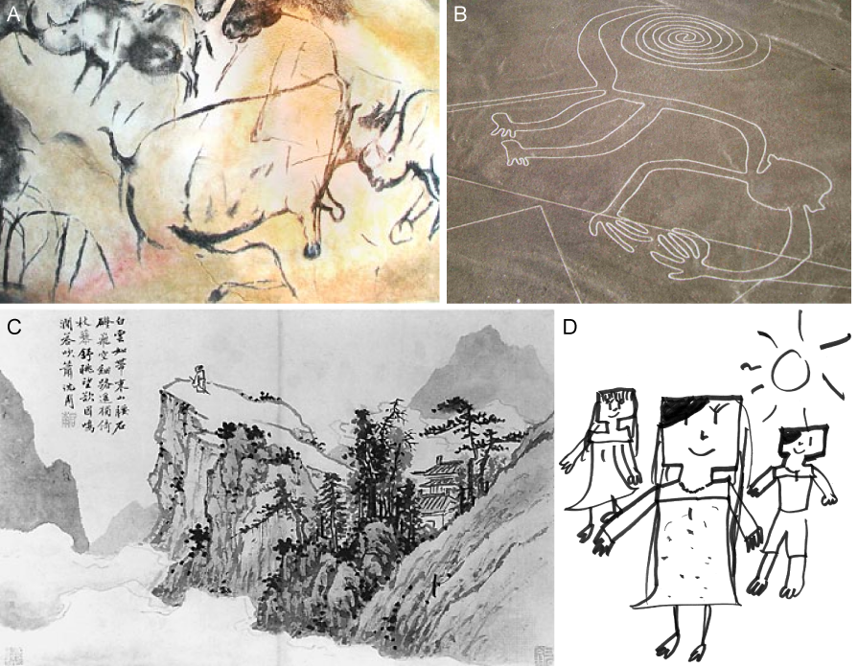
Cave painting at Chauvet, France, about 30,000 B.C.;
Aerial photograph of the picture of a monkey as part of the Nazca Lines geoglyphs, Peru, about 700 – 200 B.C.;
Shen Zhou (1427-1509 A.D.): Poet on a mountain top, ink on paper, China;
Line drawing by 7-year old I. Lleras (2010 A.D.).
Notes:
Edges are significant local changes in the image and are important features for analyzing images. Edges typically occur on the boundary between two different regions in an image.

Slide 6
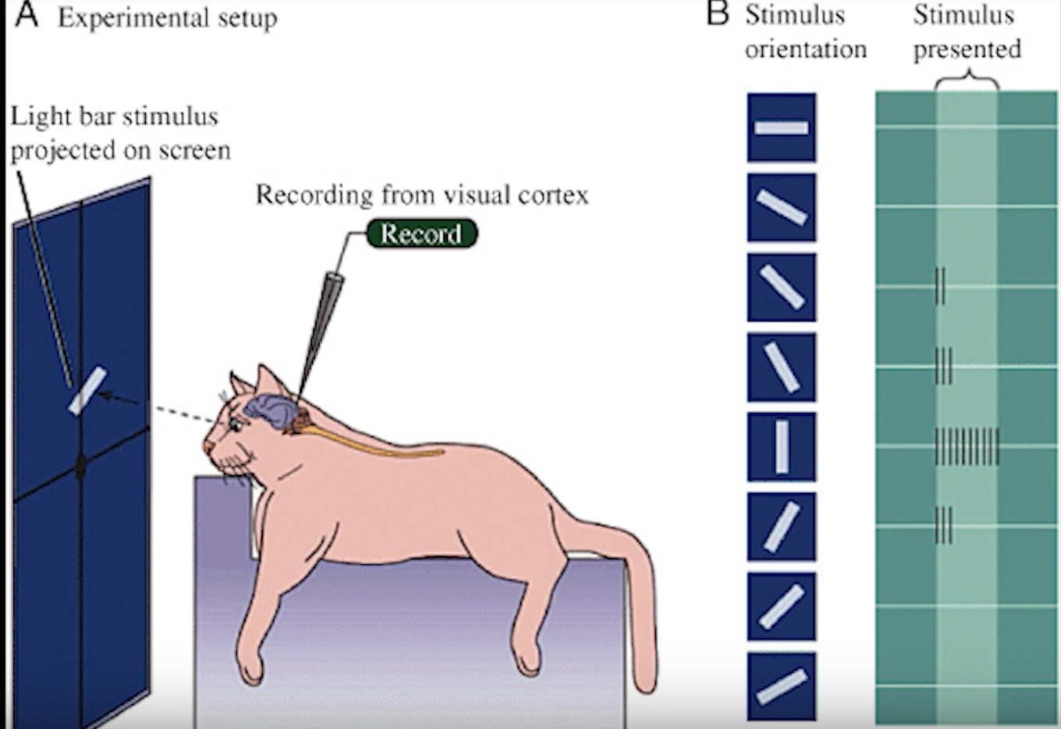
Hubel & Wiesel, 1960s

Slide 7
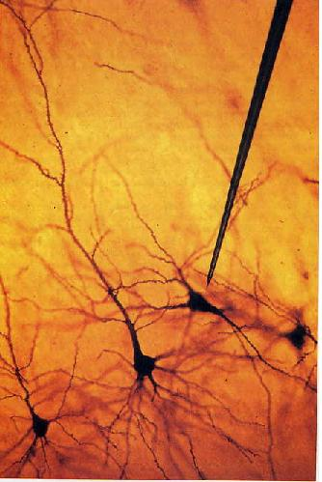
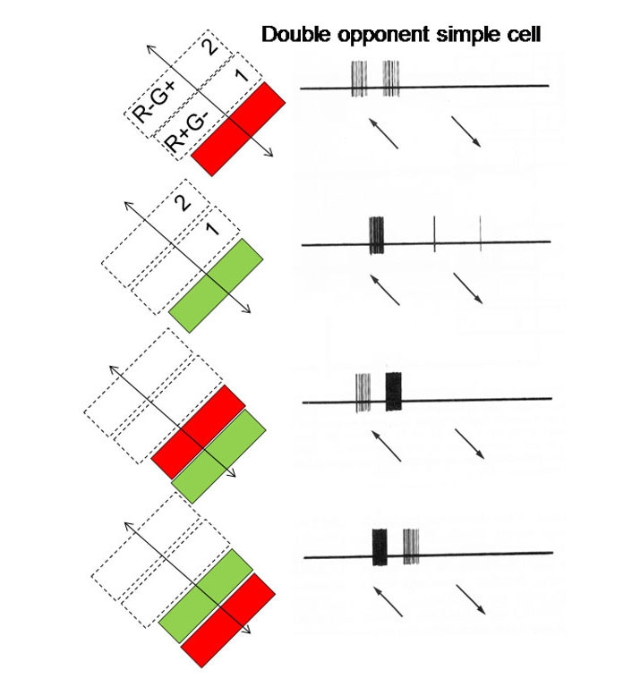
We know edges are special from human (mammalian) vision studies
Hubel & Wiesel, 1960s
Notes:
Hubel and Wiesel started out by trying to get neurons in the visual cortex to respond to traditional visual stimuli such as dots. They had little success. No matter the size or position of the circles, their neurons just couldn’t care less. Then one day while they were recording from yet another stubbornly silent neuron, it suddenly started firing like crazy as they changed the projection slide that they were using to present the stimuli. Turns out, the cell was responding to the edge of the slide. That’s when Hubel and Wiesel discovered that there are cells specialized for detecting lines—a basic feature of the visual world.

Slide 8
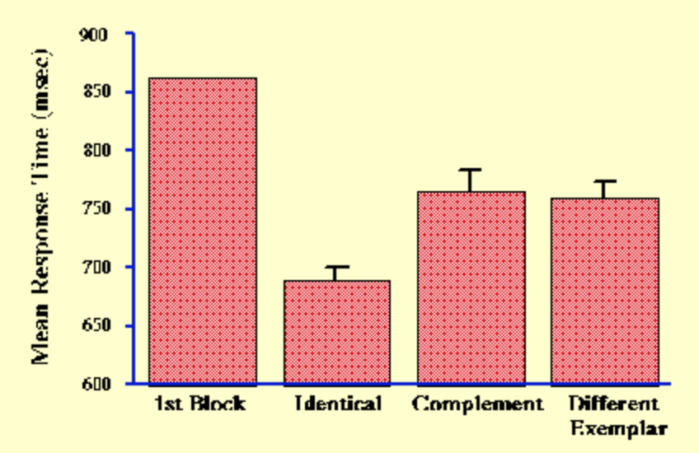
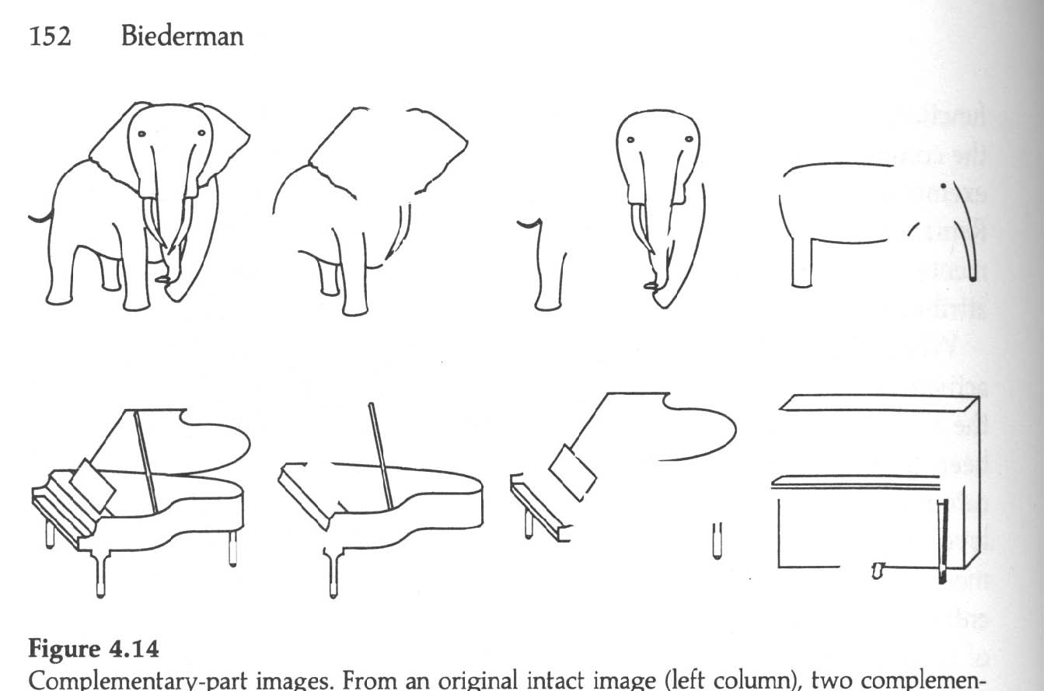
We know edges are special from human (mammalian) vision studies
Notes:
Part-deleted complementary images were created by deleting approximately half the components from each image. In this way each complementary images contained about 50% of the original contour. Put together the two complementary images would reproduce the intact line drawing. A same name, different exemplar image was also created (right column) to assess non-visual priming in a naming experiment (Biederman and Cooper, 1991).
Performance of human subjects on identical and complement images was strikingly different indicating that complementary part-deleted image pairs were not equivalent to each other for human observers. In fact, the complement image was perceived as if it were a different exemplar of the same category.

Slide 9
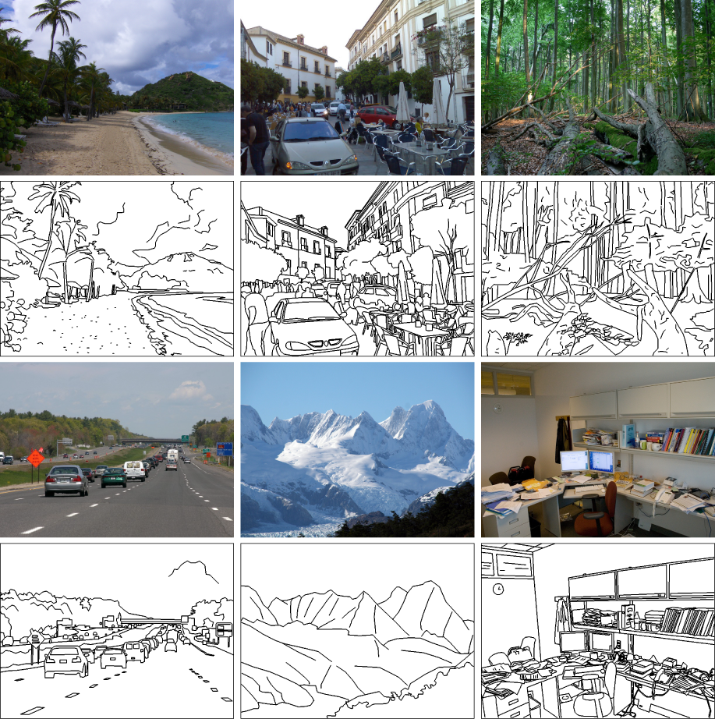
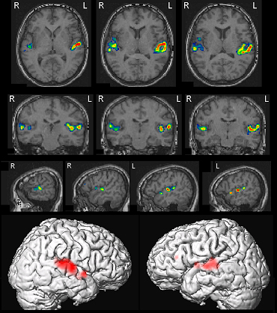
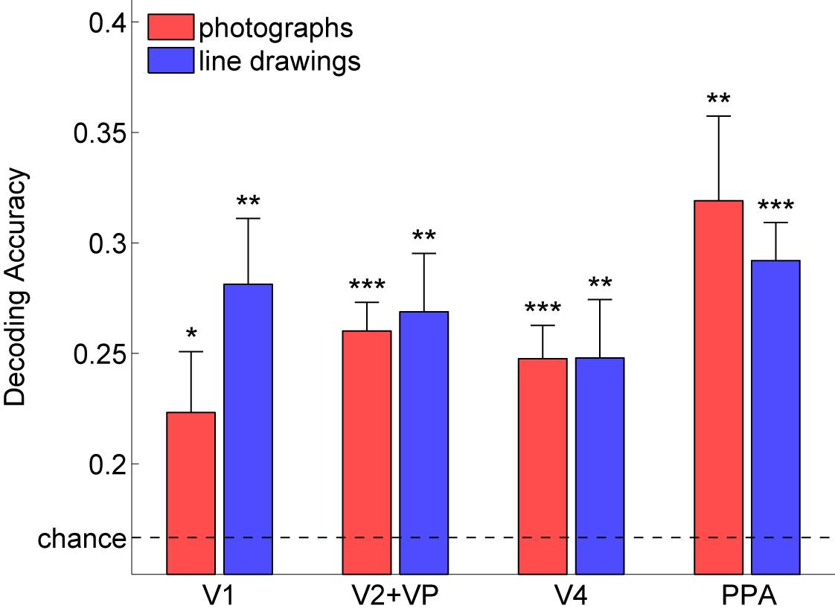
Walther, Chai, Caddigan, Beck & Fei-Fei, PNAS, 2011
Notes:
They collected fMRI data while participants viewed photographs and line drawings of beaches, city streets, forests, highways, mountains, and offices. Despite the marked difference in scene statistics, we were able to decode scene category from fMRI data for line drawings just as well as from activity for color photographs,
global scene structure, which is preserved in line drawings, plays an integral part in representing scene categories

Slide 10

Edge detection
Goal: Identify sudden changes (discontinuities) in an image
  Intuitively, most semantic and shape information from the image can be encoded in the edges
  More compact than pixels
Ideal: artist’s line drawing (but artist is also using object-level knowledge)
Source: D. Lowe

Slide 11

Why do we care about edges?
Extract information, recognize objects
Recover geometry and viewpoint
Vertical vanishing
point
(at infinity)
Vanishing
line
Vanishing
point
Vanishing
point
Source: J. Hayes

Slide 12
Origins of edges
surface normal discontinuity
depth discontinuity
surface color discontinuity
illumination discontinuity

Slide 13
Closeup of edges
Surface normal discontinuity

Slide 14
Closeup of edges
Depth discontinuity

Slide 15
Closeup of edges
Surface color discontinuity

Slide 16
What we will learn today
Edge detection
Image Gradients
A simple edge detector
Sobel edge detector
Canny edge detector
Hough Transform

Slide 17
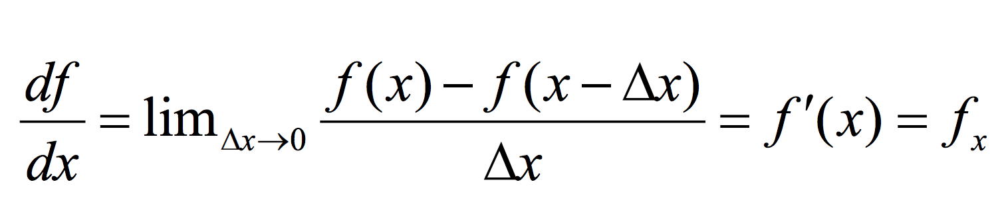
Derivatives in 1D

Slide 18
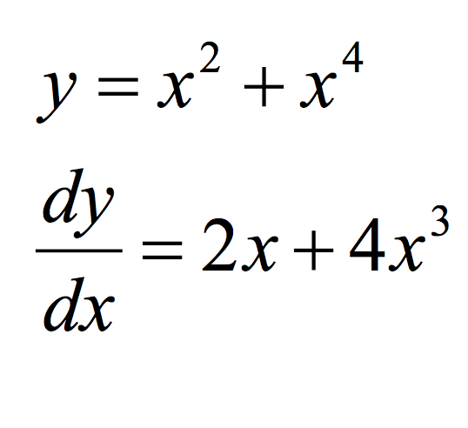
Derivatives in 1D - example

Slide 19
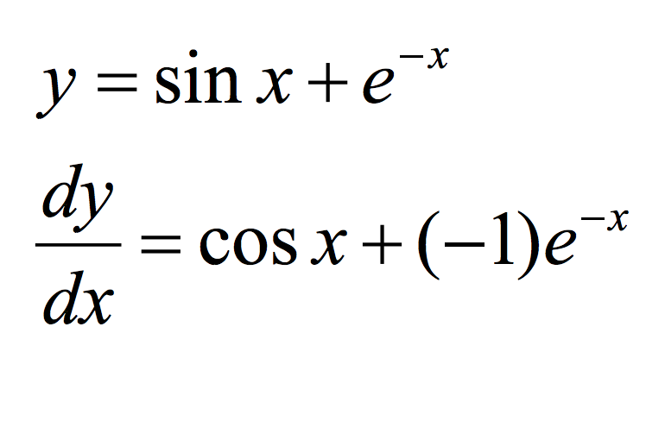
Derivatives in 1D - example

Slide 20
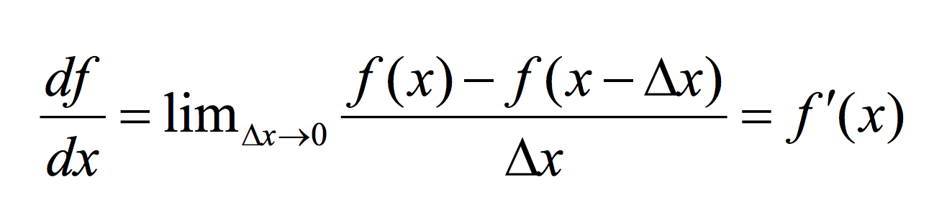
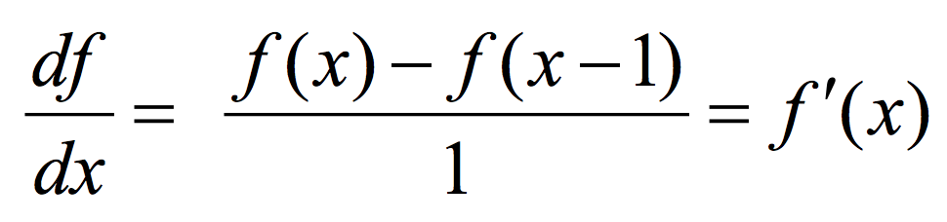
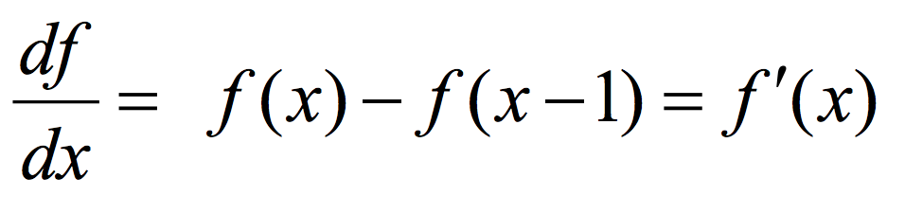
Discrete Derivative in 1D

Slide 21
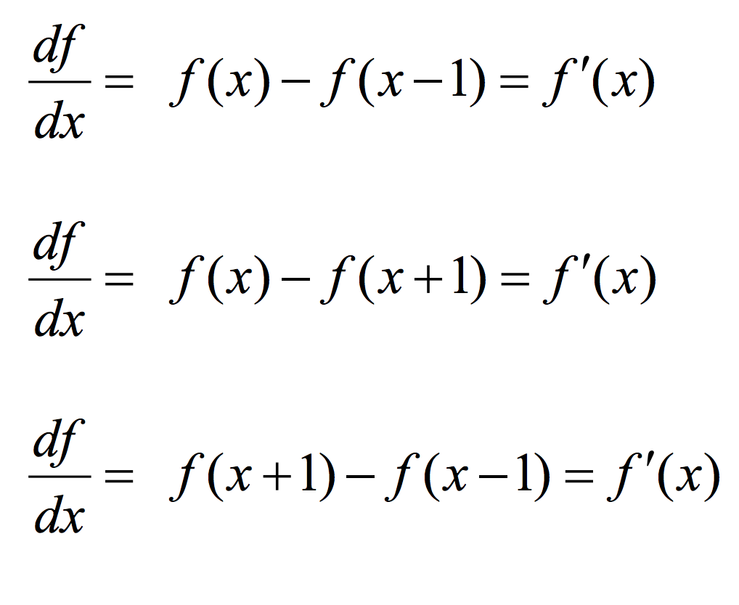
Types of Discrete derivative in 1D
Backward
Forward
Central

Slide 22
1D discrete derivate filters
Backward filter: [0 1 -1]
Forward: [-1 1 0]
Central: [ 1 0 -1]

Slide 23
1D discrete derivate filters
Backward filter: [0 1 -1]

Slide 24
1D discrete derivate filters
Backward filter: [0 1 -1]
Forward: [-1 1 0]

Slide 25
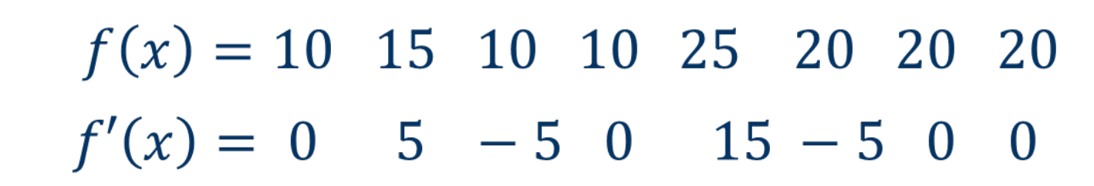
1D discrete derivate example

Slide 26
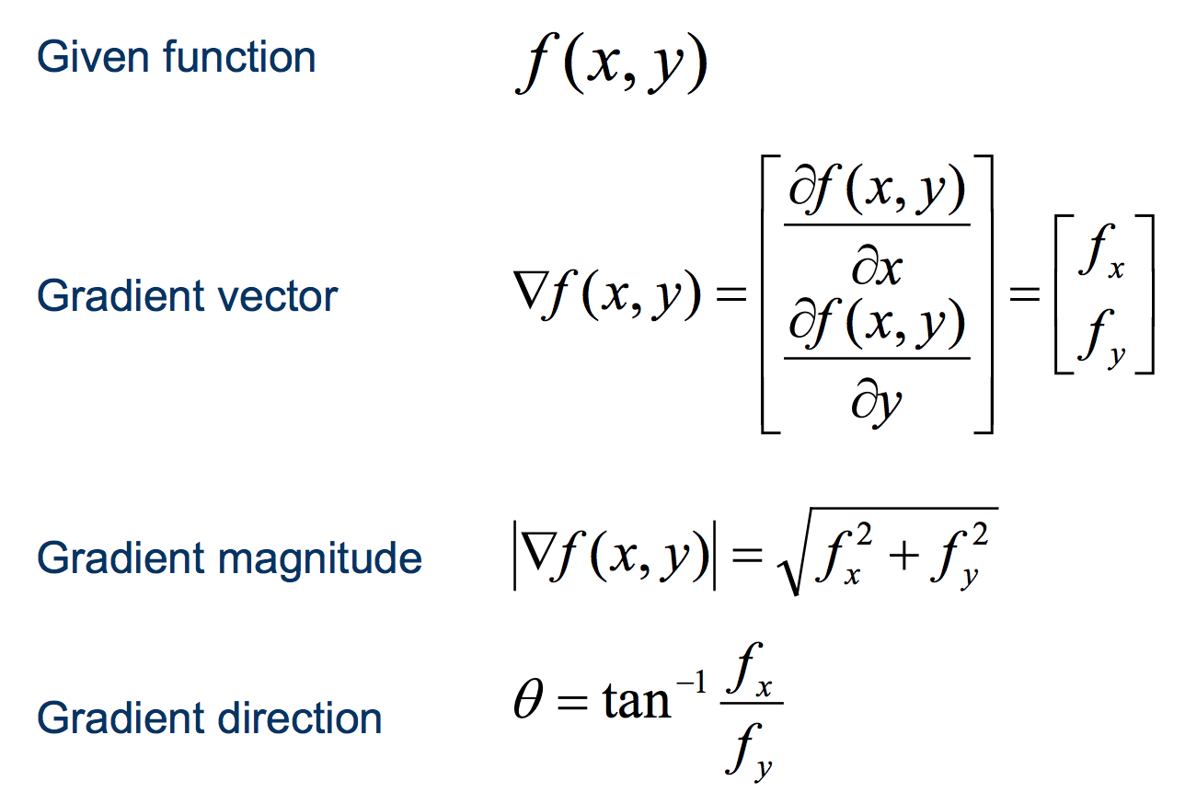
Discrete derivate in 2D

Slide 27
Discrete derivate in 2D

Slide 28

Discrete derivate in 2D

Slide 29
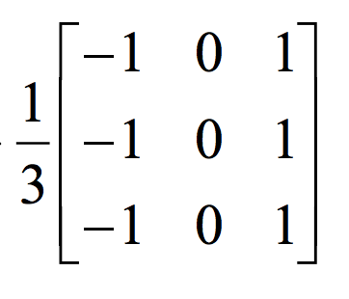
2D discrete derivative filters
What does this filter do?

Slide 30
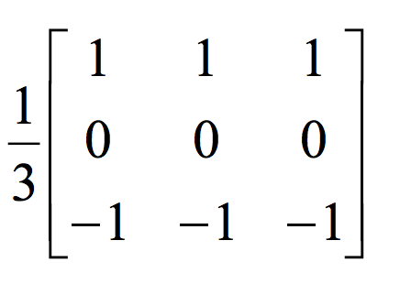
2D discrete derivative filters
What about this filter?

Slide 31
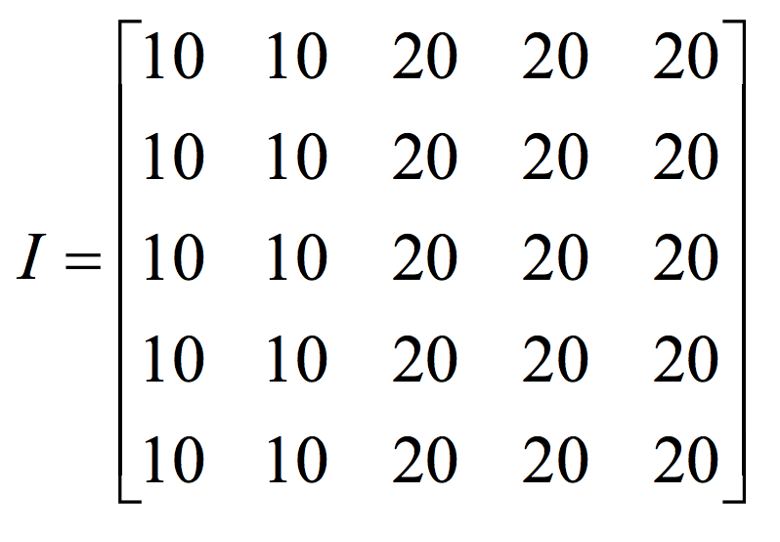
2D discrete derivative - example

Slide 32
2D discrete derivative - example
What happens when we apply this filter?

Slide 33
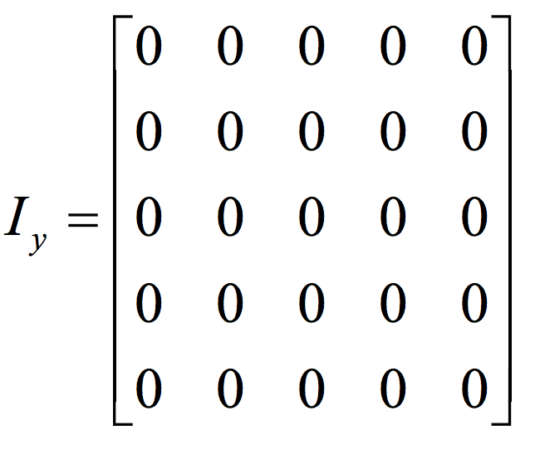
2D discrete derivative - example
What happens when we apply this filter?

Slide 34
2D discrete derivative - example
Now let’s try the other filter!

Slide 35
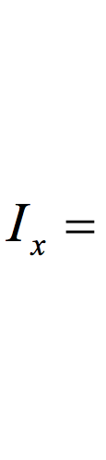
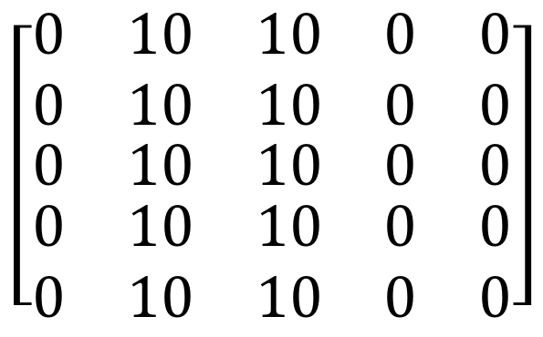
2D discrete derivative - example
What happens when we apply this filter?
$$\left[\begin{matrix}\begin{matrix}0 & 10 & 10 \\ 0 & 10 & 10\end{matrix} & \begin{matrix}0 & 0 \\ 0 & 0\end{matrix} \\ \begin{matrix}0 & 10 & 10 \\ \begin{matrix}0 \\ 0\end{matrix} & \begin{matrix}10 \\ 10\end{matrix} & \begin{matrix}10 \\ 10\end{matrix}\end{matrix} & \begin{matrix}0 & 0 \\ \begin{matrix}0 \\ 0\end{matrix} & \begin{matrix}0 \\ 0\end{matrix}\end{matrix}\end{matrix}\right]$$

Slide 36
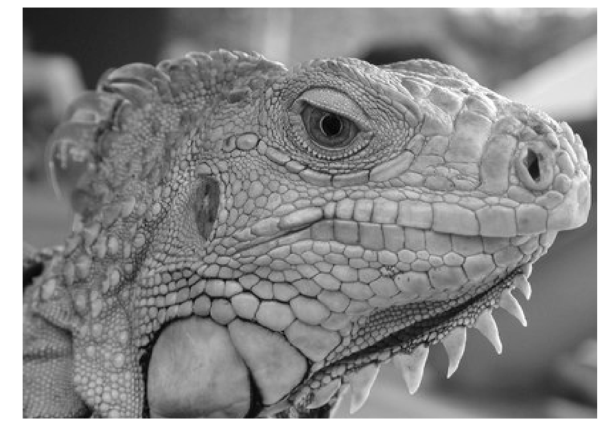
3x3 image gradient filters

Slide 37
What we will learn today
Edge detection
Image Gradients
A simple edge detector
Sobel edge detector
Canny edge detector
Hough Transform

Slide 38

Characterizing edges
An edge is a place of rapid change in the image intensity function
intensity function
(along horizontal scanline)
image
first derivative
edges correspond to
extrema of derivative

Slide 39





Image gradient
The gradient of an image:
The gradient vector points in the direction of most rapid increase in intensity
The gradient direction is given by
  how does this relate to the direction of the edge?
The edge strength is given by the gradient magnitude
Source: Steve Seitz
Notes:
give definition of partial derivative: lim h->0 [f(x+h,y) – f(x,y)]/h

Slide 40
Finite differences: example
Original
Image
Gradient magnitude
x-direction
y-direction
Which one is the gradient in the x-direction? How about y-direction?

Slide 41
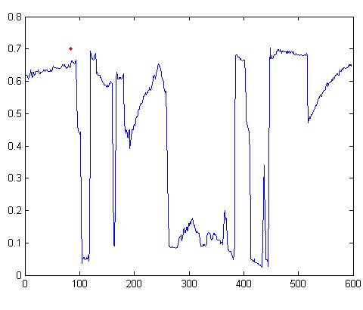
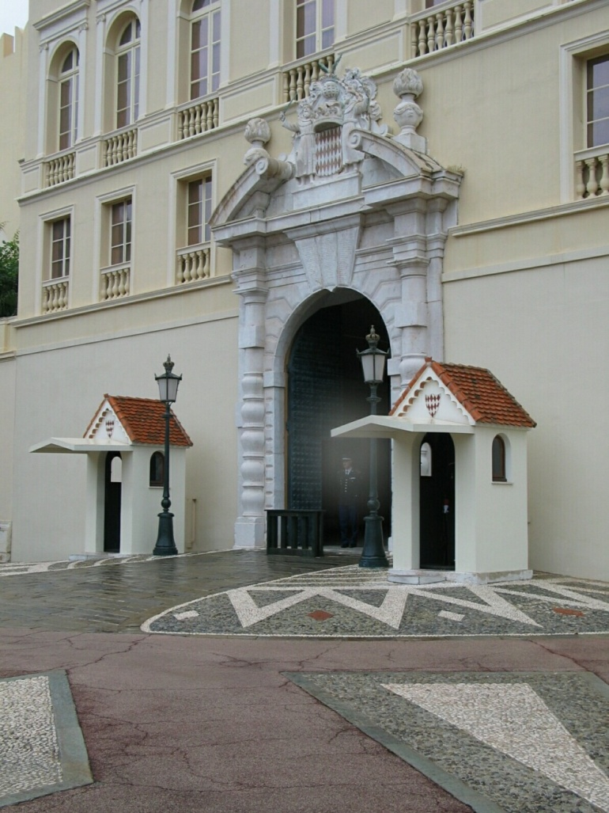
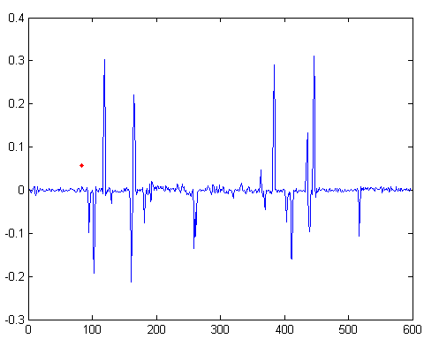
Intensity profile
Intensity
Gradient

Slide 42
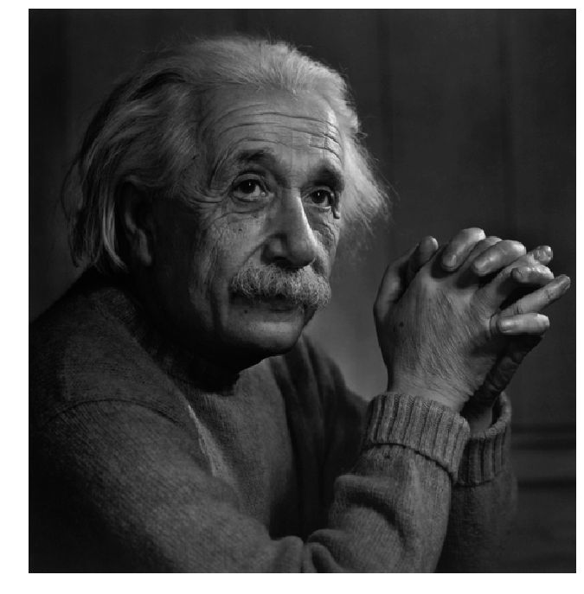
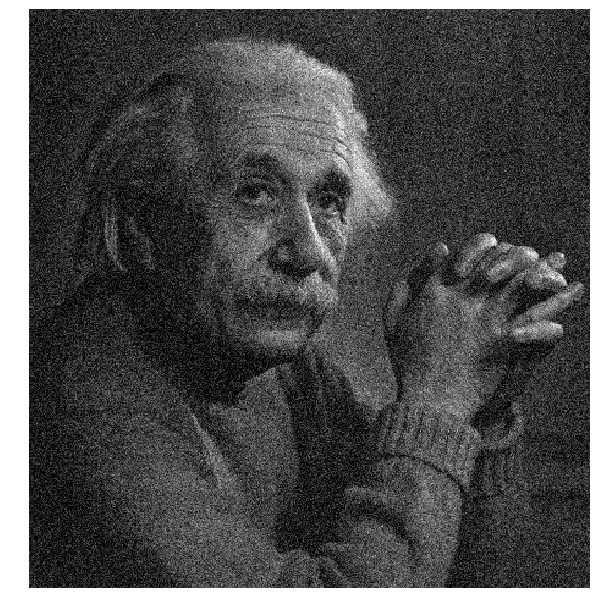
Effects of noise
Notes:
How to fix?

Slide 43




Effects of noise
Consider a single row or column of the image
  Plotting intensity as a function of position gives a signal
Where is the edge?
Source: S. Seitz
Notes:
How to fix?

Slide 44
Effects of noise
Finite difference filters respond strongly to noise
  Image noise results in pixels that look very different from their neighbors
  Generally, the larger the noise the stronger the response
What is to be done?
  Smoothing the image should help, by forcing pixels different to their neighbors (=noise pixels?) to look more like neighbors
Source: D. Forsyth

Slide 45
Effects of noise
Finite difference filters respond strongly to noise
  Image noise results in pixels that look very different from their neighbors
  Generally, the larger the noise the stronger the response
What is to be done?
  Smoothing the image should help, by forcing pixels different to their neighbors (=noise pixels?) to look more like neighbors
Source: D. Forsyth

Slide 46




Smoothing with different filters
Mean smoothing
Gaussian (smoothing * derivative)
Slide credit: Steve Seitz

Slide 47
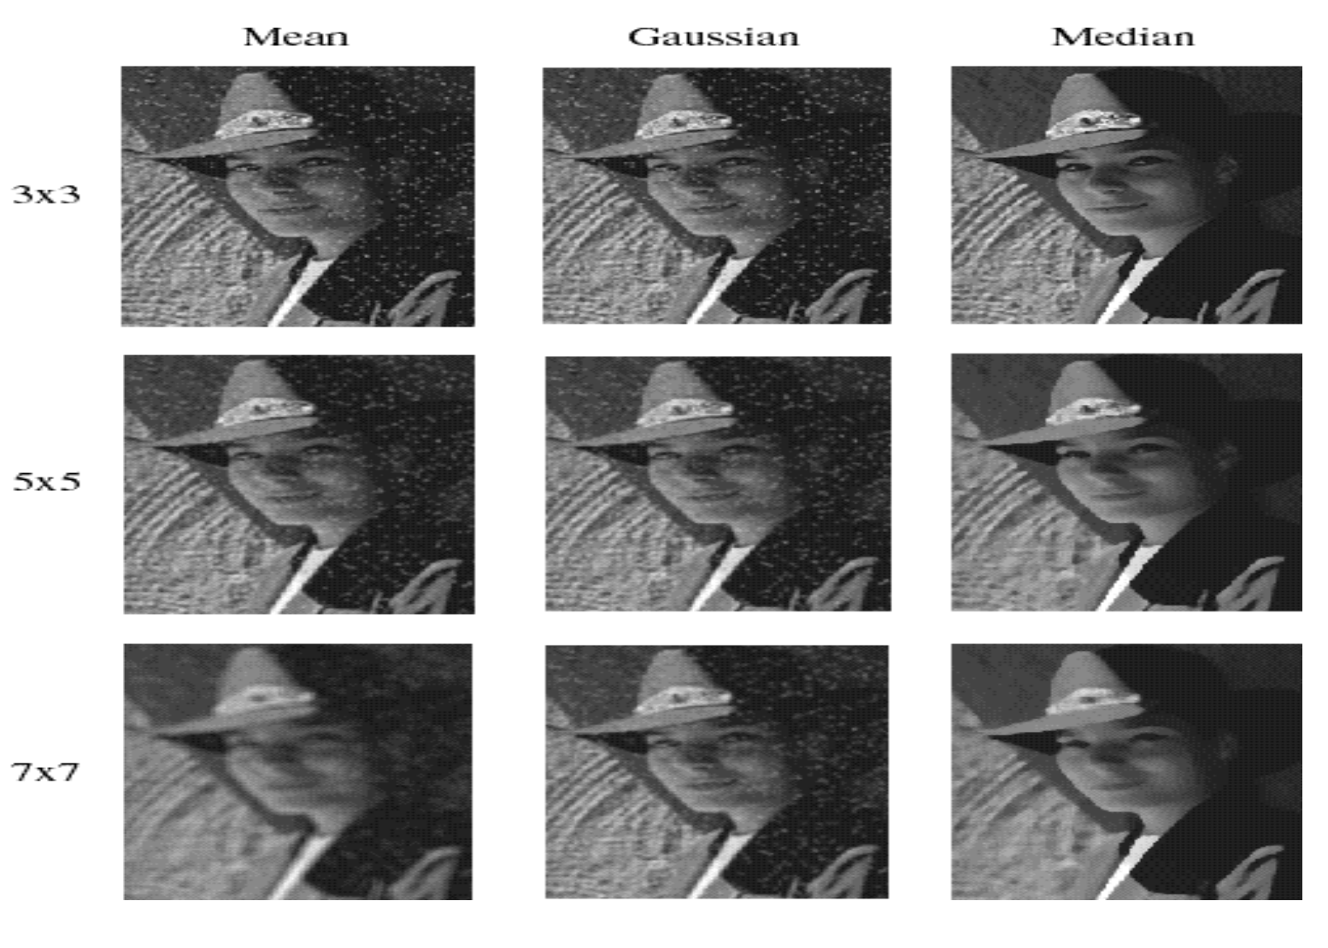
Smoothing with different filters
Slide credit: Steve Seitz

Slide 48
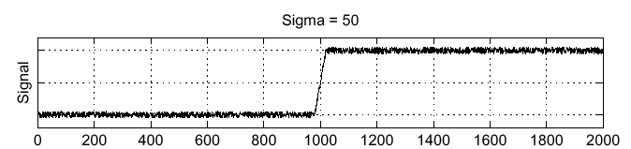
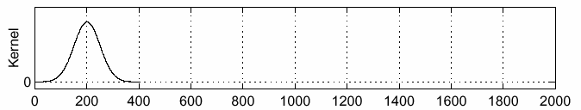
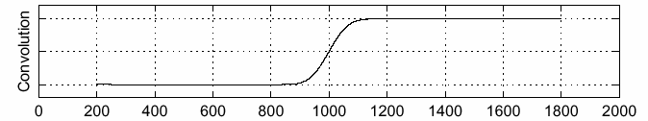
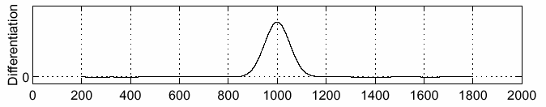
Solution: smooth first
f
g
f * g
To find edges, look for peaks in
Source: S. Seitz

Slide 49

Derivative theorem of convolution
This theorem gives us a very useful property:
This saves us one operation:
f
Source: S. Seitz

Slide 50


Derivative of Gaussian filter
* [1 0 -1] =
2D-gaussian
x - derivative

Slide 51


Derivative of Gaussian filter
x-direction
y-direction

Slide 52
Derivative of Gaussian filter

Slide 53
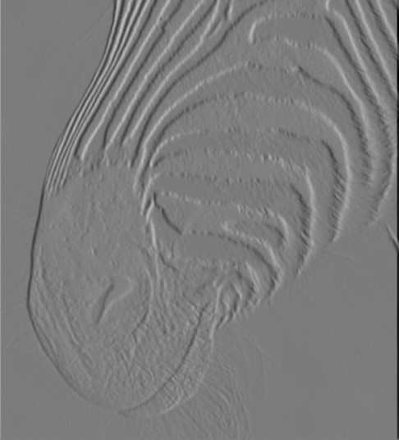
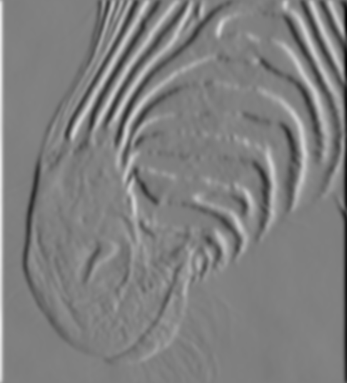
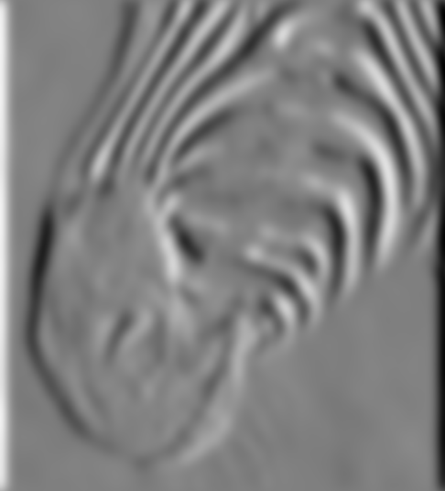
Tradeoff between smoothing at different scales
1 pixel
3 pixels
7 pixels
Smoothed derivative removes noise, but blurs edge. Also finds edges at different “scales”.
Source: D. Forsyth

Slide 54
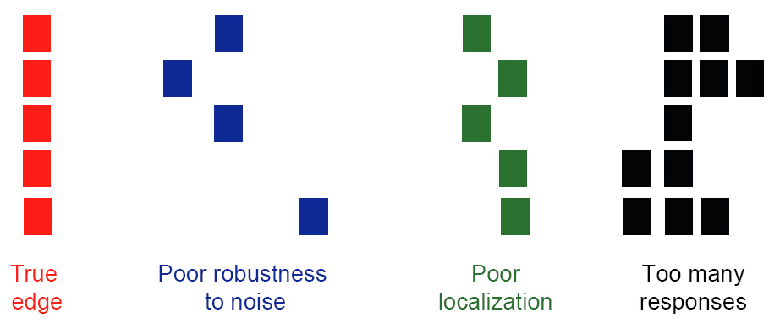
Designing an edge detector
Criteria for an “optimal” edge detector:
  Good detection: the optimal detector must minimize the probability of false positives (detecting spurious edges caused by noise), as well as that of false negatives (missing real edges)

Slide 55
Designing an edge detector
Criteria for an “optimal” edge detector:
  Good detection: the optimal detector must minimize the probability of false positives (detecting spurious edges caused by noise), as well as that of false negatives (missing real edges)
  Good localization: the edges detected must be as close as possible to the true edges

Slide 56
Designing an edge detector
Criteria for an “optimal” edge detector:
  Good detection: the optimal detector must minimize the probability of false positives (detecting spurious edges caused by noise), as well as that of false negatives (missing real edges)
  Good localization: the edges detected must be as close as possible to the true edges
  Single response: the detector must return one point only for each true edge point; that is, minimize the number of local maxima around the true edge

Slide 57
What we will learn today
Edge detection
Image Gradients
A simple edge detector
Sobel Edge detector
Canny edge detector
Hough transform

Slide 58
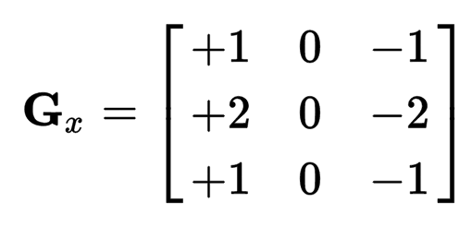
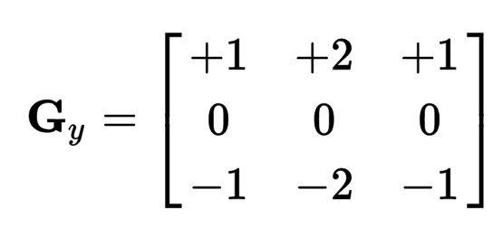
Sobel Operator
uses two 3×3 kernels which are convolved with the original image to calculate approximations of the derivatives
one for horizontal changes, and one for vertical

Slide 59
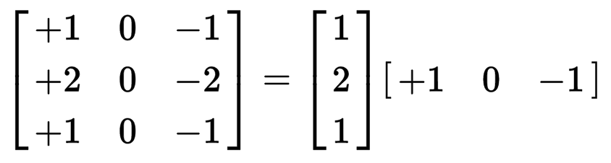
Sobel Operation
Smoothing + differentiation
Gaussian smoothing
differentiation

Slide 60
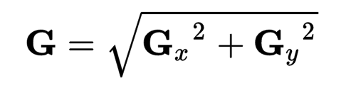
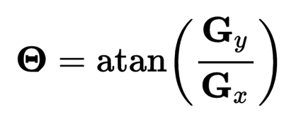
Sobel Operation
Magnitude:
Angle or direction of the gradient:
Notes:
Gradient is a vector!

Slide 61
Sobel Filter example
Notes:
We can threshold the gradient map, and choose edges to be the pixels above T.

Slide 62
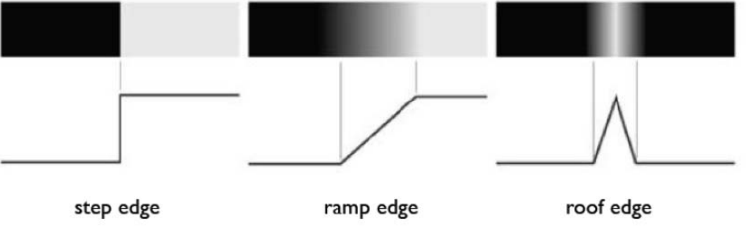
Sobel Filter Problems
Poor Localization (Trigger response in multiple adjacent pixels)
Thresholding value favors certain directions over others
  Can miss oblique edges more than horizontal or vertical edges
  False negatives
Notes:
Thresholding is….

Slide 63
What we will learn today
Edge detection
Image Gradients
A simple edge detector
Sobel Edge detector
Canny edge detector
Hough Transform

Slide 64
Canny edge detector
This is probably the most widely used edge detector in computer vision
Theoretical model: step-edges corrupted by additive Gaussian noise
Canny has shown that the first derivative of the Gaussian closely approximates the operator that optimizes the product of signal-to-noise ratio and localization
J. Canny, A Computational Approach To Edge Detection, IEEE Trans. Pattern Analysis and Machine Intelligence, 8:679-714, 1986.

Slide 65
Canny edge detector
Suppress Noise
Compute gradient magnitude and direction
Apply Non-Maximum Suppression
  Assures minimal response
Use hysteresis and connectivity analysis to detect edges

Slide 66
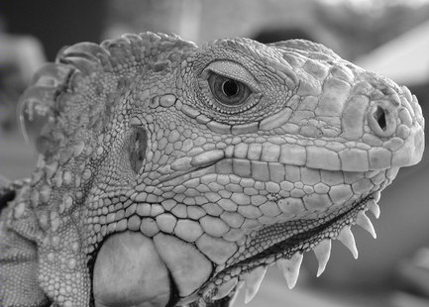
Example
original image

Slide 67
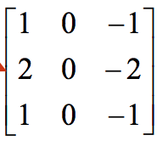
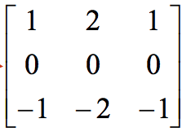
Derivative of Gaussian filter
x-direction
y-direction

Slide 68
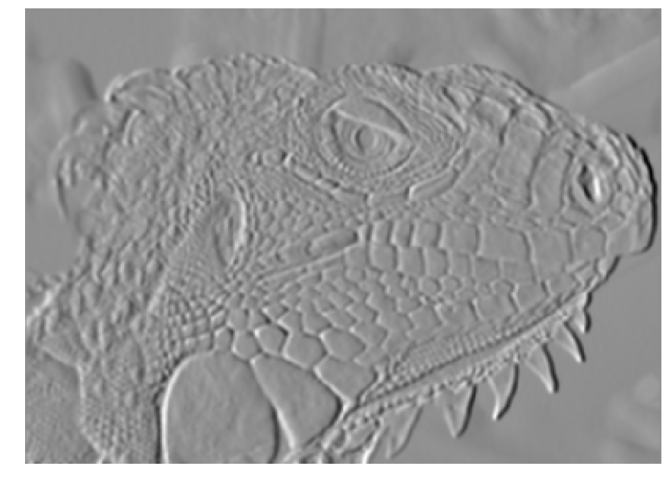
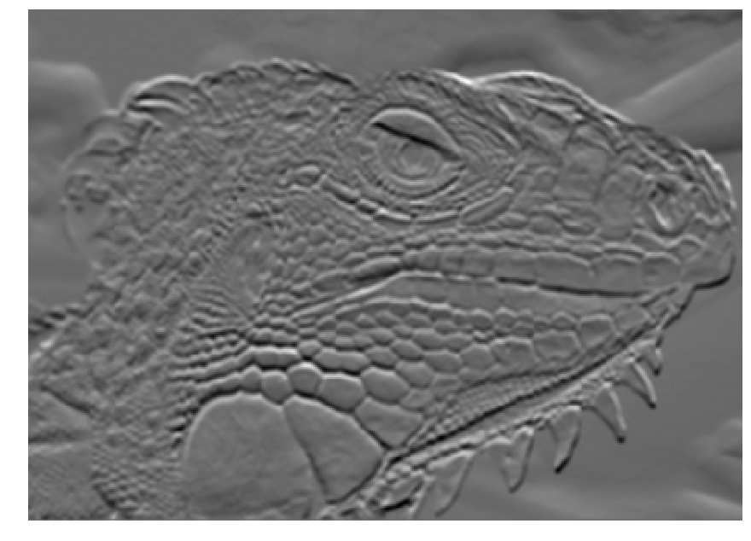

Compute gradients (DoG)
X-Derivative of Gaussian
Y-Derivative of Gaussian
Gradient Magnitude
Source: J. Hayes

Slide 69

Get orientation at each pixel
Source: J. Hayes
Notes:
Gives angle perpendicular to the edge.

Slide 70



Compute gradients (DoG)
X-Derivative of Gaussian
Y-Derivative of Gaussian
Gradient Magnitude

Slide 71
Canny edge detector
Suppress Noise
Compute gradient magnitude and direction
Apply Non-Maximum Suppression
  Assures minimal response

Slide 72
Non-maximum suppression
Edge occurs where gradient reaches a maxima
Suppress non-maxima gradient even if it passes threshold
Only eight angle directions possible
  Suppress all pixels in each direction which are not maxima
  Do this in each marked pixel neighborhood

Slide 73





Remove spurious gradients
is the gradient at pixel (x, y)
$$\left|∇G\right|\left(x,y\right)$$
$$\left|∇G\right|\left(x,y\right)$$
$$\left|∇G\right|\left(x,y\right)> \left|∇G\right|\left(x′,y′\right)$$
$$\left|∇G\right|\left(x,y\right)> \left|∇G\right|\left(x′′,y′′\right)$$

Slide 74
Non-maximum suppression
Edge occurs where gradient reaches a maxima
Suppress non-maxima gradient even if it passes threshold
Only eight angle directions possible
  Suppress all pixels in each direction which are not maxima
  Do this in each marked pixel neighborhood

Slide 75


Non-maximum suppression
At q, we have a maximum if the value is larger than those at both p and at r. Interpolate to get these values.
Source: D. Forsyth
Notes:
A more advanced version looks beyond 8 directions…

Slide 76

Non-max Suppression
Before After

Slide 77
Canny edge detector
Suppress Noise
Compute gradient magnitude and direction
Apply Non-Maximum Suppression
  Assures minimal response
Use hysteresis and connectivity analysis to detect edges

Slide 78



Slide 79
Hysteresis thresholding
Avoid streaking near threshold value
Define two thresholds: Low and High
  If less than Low, not an edge
  If greater than High, strong edge
  If between Low and High, weak edge

Slide 80
Hysteresis thresholding
If the gradient at a pixel is
above High, declare it as an ‘strong edge pixel’
below Low, declare it as a “non-edge-pixel”
between Low and High
  Consider its neighbors iteratively then declare it an “edge pixel” if it is connected to an ‘strong edge pixel’ directly or via pixels between Low and High

Slide 81
Hysteresis thresholding
strong edge pixel
weak but connected edge pixels
strong edge pixel
Source: S. Seitz
Notes:
Breadth first search in the homework.

Slide 82

Final Canny Edges

Slide 83
Canny edge detector
Filter image with x, y derivatives of Gaussian
Find magnitude and orientation of gradient
Non-maximum suppression:
  Thin multi-pixel wide “ridges” down to single pixel width
Thresholding and linking (hysteresis):
  Define two thresholds: low and high
  Use the high threshold to start edge curves and the low threshold to continue them

Slide 84





Effect of σ (Gaussian kernel spread/size)
original
Canny with
Canny with
The choice of σ depends on desired behavior
  large σ detects large scale edges
  small σ detects fine features
Source: S. Seitz

Slide 85

Gradients
(e.g. Canny)
Color
Texture
Combined
Human

Slide 86

45 years of boundary detection
Source: Arbelaez, Maire, Fowlkes, and Malik. TPAMI 2011 (pdf)

Slide 87
What we will learn today
Edge detection
Image Gradients
A simple edge detector
Sobel Edge detector
Canny edge detector
Hough Transform

Slide 88
Intro to Hough transform
The Hough transform (HT) can be used to detect lines.
It was introduced in 1962 (Hough 1962) and first used to find lines in images a decade later (Duda 1972).
The goal is to find the location of lines in images.
Caveat: Hough transform can detect lines, circles and other structures ONLY if their parametric equation is known.
It can give robust detection under noise and partial occlusion

Slide 89



Prior to Hough transform
Assume that we have performed some edge detection, and a thresholding of the edge magnitude image.
Thus, we have some pixels that may partially describe the boundary of some objects.
Notes:
What is the simplest algorithm for this?
O(N^2) pairwise

Slide 90
Detecting lines using Hough transform
We wish to find sets of pixels that make up straight lines.
Consider a point of known coordinates (x_{i};y_{i})
  There are many lines passing through the point (x_{i} ,y_{i} ).
Straight lines that pass that point have the form y_{i}= a*x_{i} + b
  Common to them is that they satisfy the equation for some set of parameters (a, b)

Slide 91
Detecting lines using Hough transform
This equation can obviously be rewritten as follows:
  b = -a*x_{i} + y_{i}
  We can now consider x and y as parameters
  a and b as variables.
This is a line in (a, b) space parameterized by x and y.
  So: a single point in x₁,y₁-space gives a line in (a,b) space.
  Another point (x₂, y₂ ) will give rise to another line (a,b) space.

Slide 92

Detecting lines using Hough transform
Notes:
What if we map all points from the red line into ab space?

Slide 93

Detecting lines using Hough transform

Slide 94
Detecting lines using Hough transform
Two points (x₁, y₁) and(x₂ y₂) define a line in the (x, y) plane.
These two points give rise to two different lines in (a,b) space.
In (a,b) space these lines will intersect in a point (a’ b’)
All points on the line defined by (x₁, y₁) and (x₂ , y₂) in (x, y) space will parameterize lines that intersect in (a’, b’) in (a,b) space.

Slide 95
Algorithm for Hough transform
Quantize the parameter space (a b) by dividing it into cells
This quantized space is often referred to as the accumulator cells.
Count the number of times a line intersects a given cell.
  For each pair of points (x₁, y₁) and (x₂, y₂) detected as an edge, find the intersection (a’,b’) in (a, b)space.
  Increase the value of a cell in the range
  [[a_{min}, a_{max}],[b_{min},b_{max}]] that (a’, b’) belongs to.
  Cells receiving more than a certain number of counts (also called ‘votes’) are assumed to correspond to lines in (x,y) space.

Slide 96

Output of Hough transform
Here are the top 20 most voted lines in the image:

Slide 97
Other Hough transformations
We can represent lines as polar coordinates instead of y = a*x + b
Polar coordinate representation:
  x*cosθ + y*sinθ = ρ
Can you figure out the relationship between
  (x y) and (ρ θ)?

Slide 98

Other Hough transformations
Note that lines in (x y) space are not lines in
(ρ θ) space, unlike (a b) space.
A horizontal line will have θ=0 and ρ equal to the intercept with the y-axis.
A vertial line will have θ=90 and ρ equal to the intercept with the x-axis.

Slide 99
Example video
https://youtu.be/4zHbI-fFIlI?t=3m35s

Slide 100
Concluding remarks
Advantages:
  Conceptually simple.
  Easy implementation
  Handles missing and occluded data very gracefully.
  Can be adapted to many types of forms, not just lines
Disadvantages:
  Computationally complex for objects with many parameters.
  Looks for only one single type of object
  Can be “fooled” by “apparent lines”.
  The length and the position of a line segment cannot be determined.
  Co-linear line segments cannot be separated.

Slide 101
What we will learn today
Edge detection
Image Gradients
A simple edge detector
Sobel Edge detector
Canny edge detector
Hough Transform

