Slide 1
Linear Algebra Primer
Juan Carlos Niebles and Ranjay Krishna
Stanford Vision and Learning Lab
Another, very in-depth linear algebra review from CS229 is available here:
http://cs229.stanford.edu/section/cs229-linalg.pdf
And a video discussion of linear algebra from EE263 is here (lectures 3 and 4):
https://see.stanford.edu/Course/EE263

Slide 2
Outline
Vectors and matrices
  Basic Matrix Operations
  Determinants, norms, trace
  Special Matrices
Transformation Matrices
  Homogeneous coordinates
  Translation
Matrix inverse
Matrix rank
Eigenvalues and Eigenvectors
Matrix Calculus

Slide 3
Outline
Vectors and matrices are just collections of ordered numbers that represent something: movements in space, scaling factors, pixel brightness, etc. We’ll define some common uses and standard operations on them.
Vectors and matrices
  Basic Matrix Operations
  Determinants, norms, trace
  Special Matrices
Transformation Matrices
  Homogeneous coordinates
  Translation
Matrix inverse
Matrix rank
Eigenvalues and Eigenvectors
Matrix Calculus

Slide 4
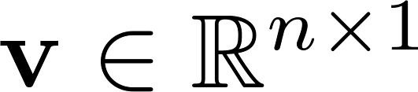
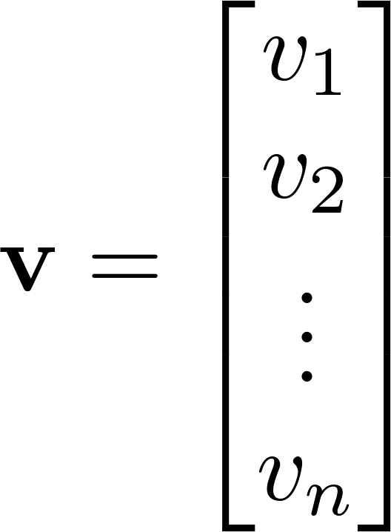
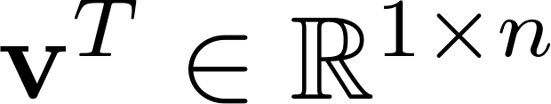
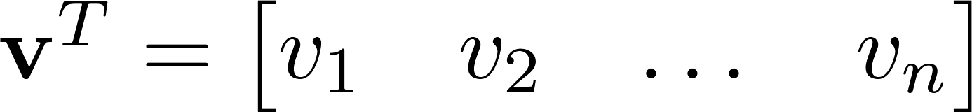

Vector
A column vector where
A row vector where
denotes the transpose operation

Slide 5
Vector
We’ll default to column vectors in this class
You’ll want to keep track of the orientation of your vectors when programming in python
You can transpose a vector V in python by writing V.t. (But in class materials, we will always use V^{T} to indicate transpose, and we will use V’ to mean “V prime”)

Slide 6
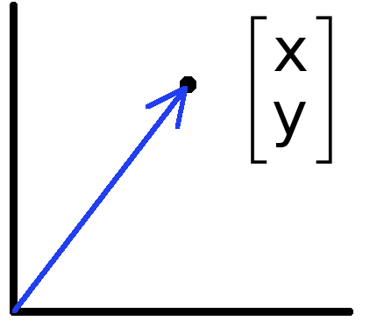

Vectors have two main uses
Data (pixels, gradients at an image keypoint, etc) can also be treated as a vector.
Such vectors don’t have a geometric interpretation, but calculations like “distance” can still have value.
Vectors can represent an offset in 2D or 3D space.
Points are just vectors from the origin.

Slide 7
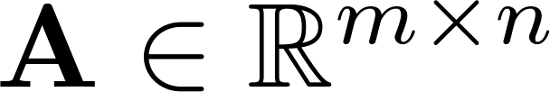
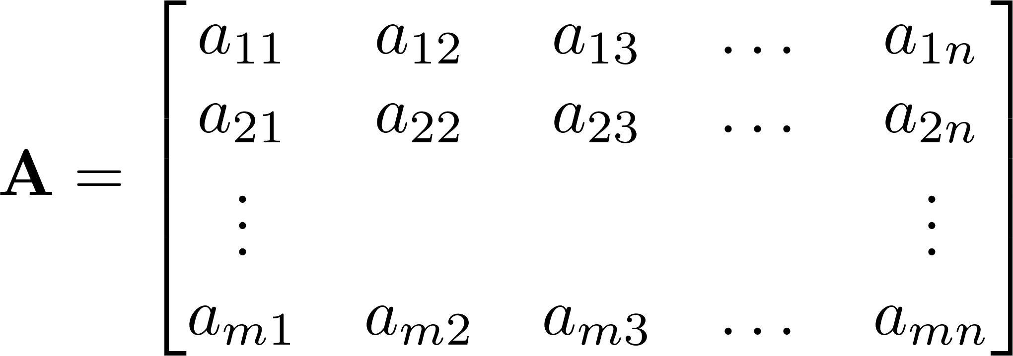


Matrix
A matrix is an array of numbers with size by , i.e. m rows and n columns.
If , we say that is square.

Slide 8

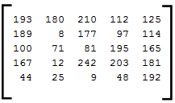
Images
=
Python represents an image as a matrix of pixel brightnesses
Note that the upper left corner is [y,x] = (0,0)
Notes:
Coordinates: [row, column]

Slide 9
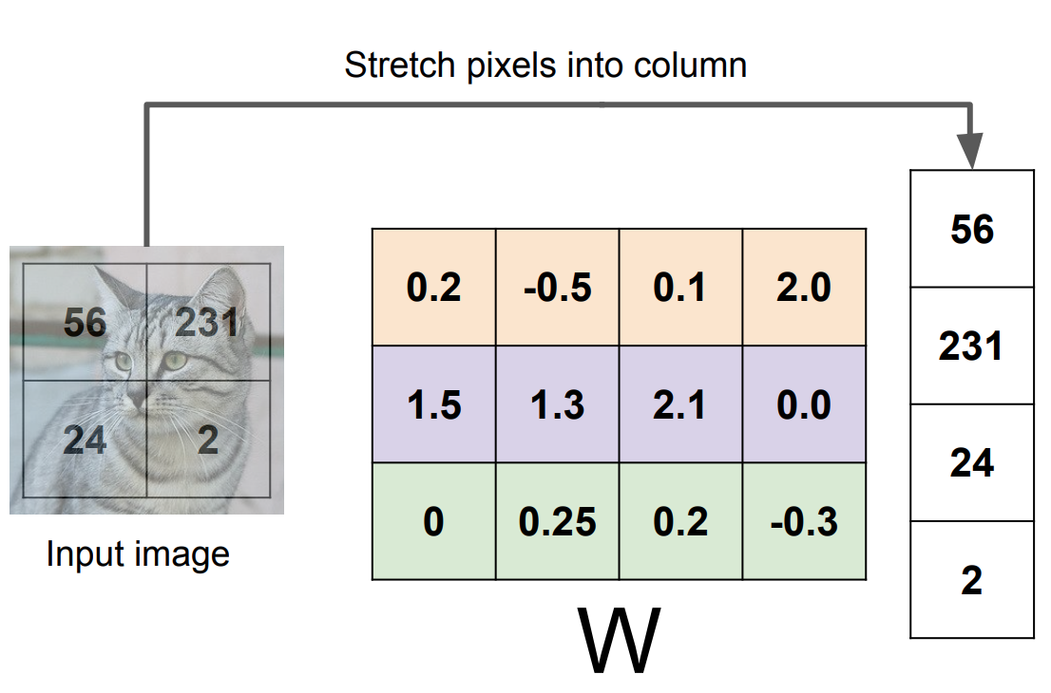
Images as both a matrix as well as a vector

Slide 10
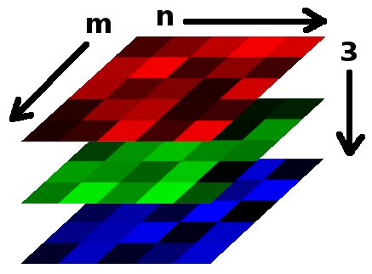

Color Images
Grayscale images have one number per pixel, and are stored as an m × n matrix.
Color images have 3 numbers per pixel – red, green, and blue brightnesses (RGB)
Stored as an m × n × 3 matrix
=

Slide 11
Basic Matrix Operations
We will discuss:
  Addition
  Scaling
  Dot product
  Multiplication
  Transpose
  Inverse / pseudoinverse
  Determinant / trace

Slide 12
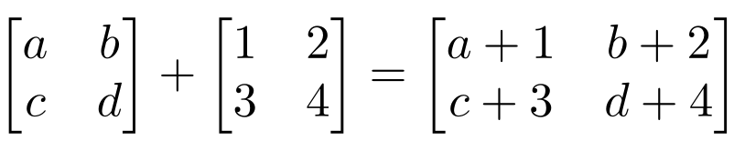
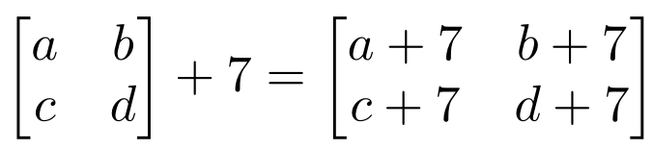
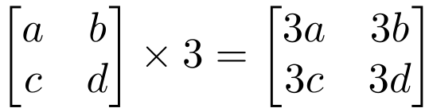
Matrix Operations
Addition
  Can only add a matrix with matching dimensions, or a scalar.
Scaling

Slide 13
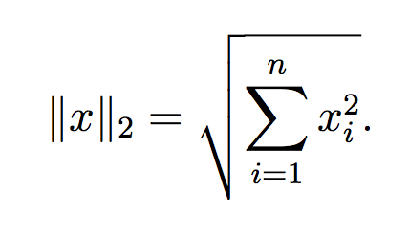




Vectors
Norm
More formally, a norm is any function
that satisfies 4 properties:
Non-negativity: For all
Definiteness: f(x) = 0 if and only if x = 0.
Homogeneity: For all
Triangle inequality: For all

Slide 14
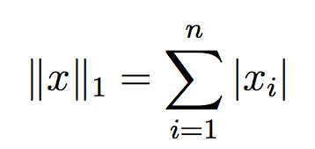
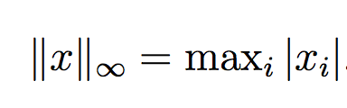

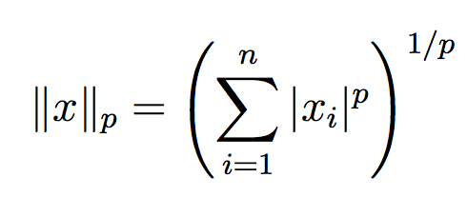
Matrix Operations
Example Norms
General norms:

Slide 15
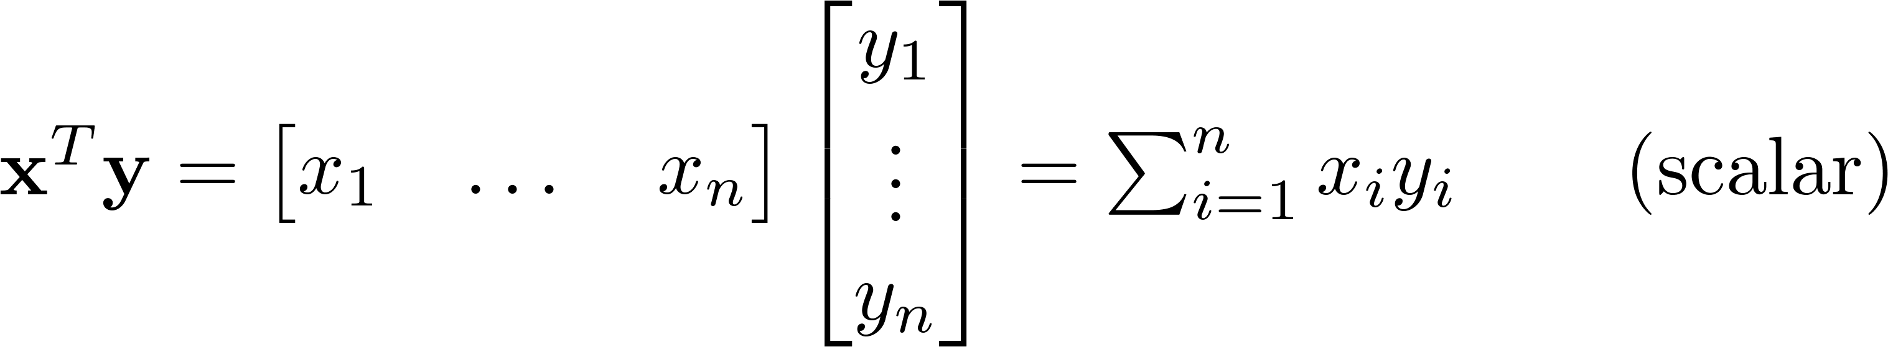
Matrix Operations
Inner product (dot product) of vectors
  Multiply corresponding entries of two vectors and add up the result
  x·y is also |x||y|Cos( the angle between x and y )

Slide 16
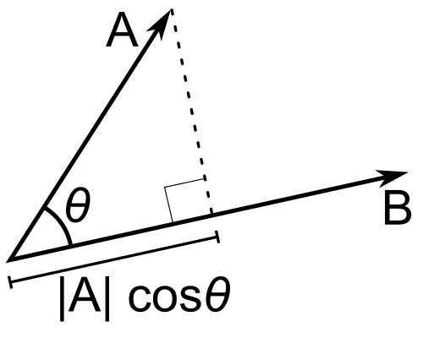
Matrix Operations
Inner product (dot product) of vectors
  If B is a unit vector, then A·B gives the length of A which lies in the direction of B

Slide 17
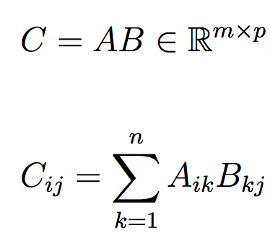


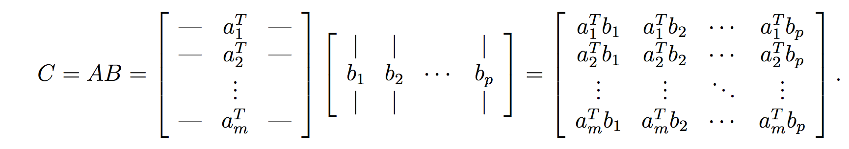
Matrix Operations
The product of two matrices

Slide 18
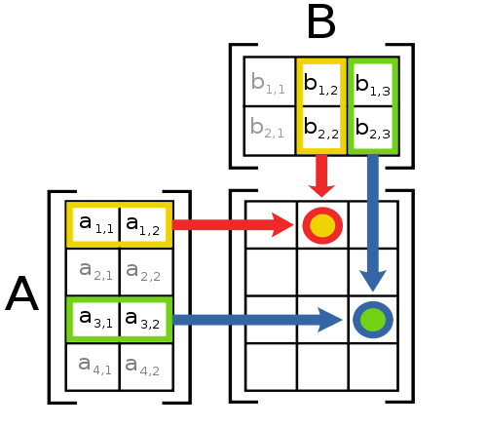
Matrix Operations
Multiplication
The product AB is:
Each entry in the result is (that row of A) dot product with (that column of B)
Many uses, which will be covered later

Slide 19
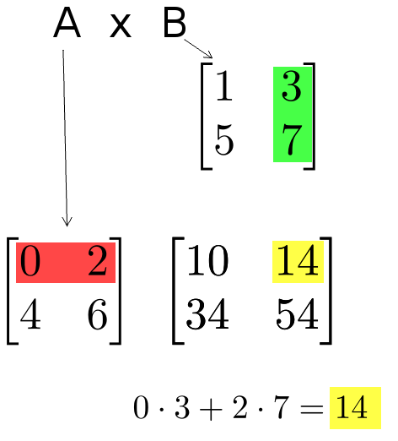
Matrix Operations
Multiplication example:
  Each entry of the matrix product is made by taking the dot product of the corresponding row in the left matrix, with the corresponding column in the right one.

Slide 20
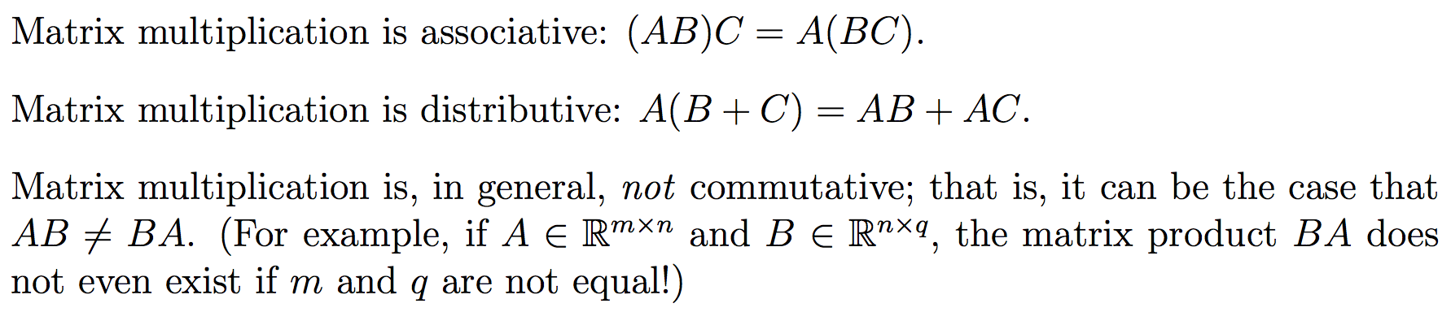
Matrix Operations
The product of two matrices

Slide 21
Matrix Operations
Powers
  By convention, we can refer to the matrix product AA as A², and AAA as A³, etc.
  Obviously only square matrices can be multiplied that way

Slide 22
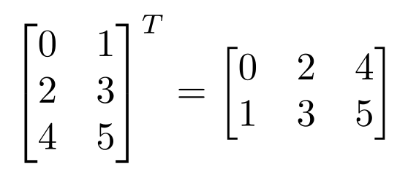
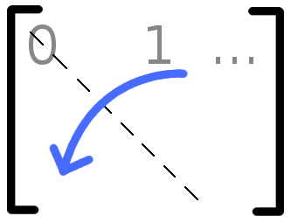

Matrix Operations
Transpose – flip matrix, so row 1 becomes column 1
A useful identity:

Slide 23
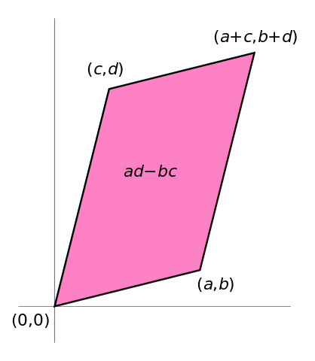

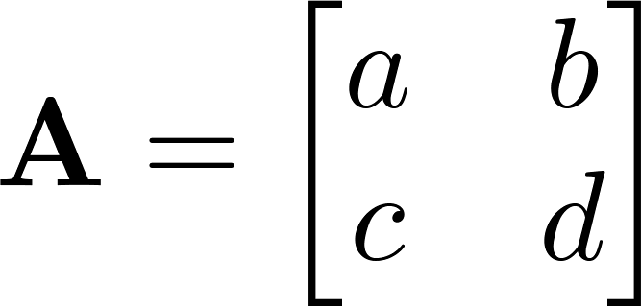

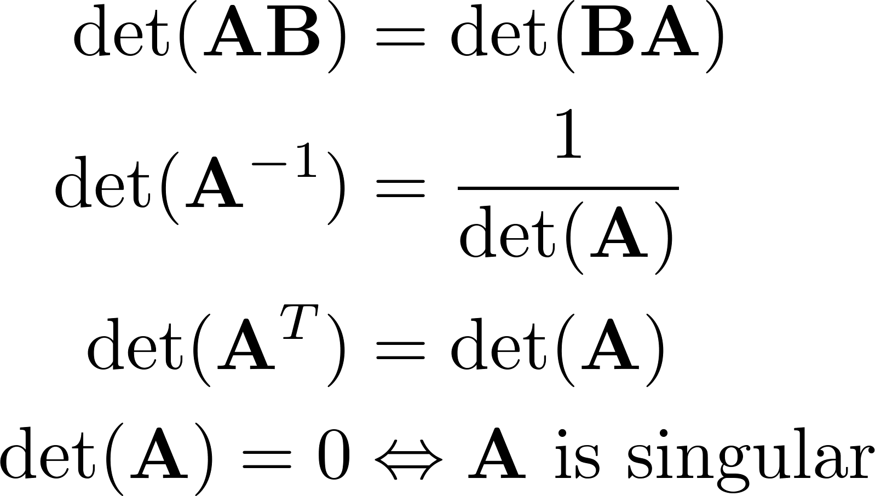
Matrix Operations
Determinant
  returns a scalar
  Represents area (or volume) of the parallelogram described by the vectors in the rows of the matrix
  For ,
  Properties:

Slide 24
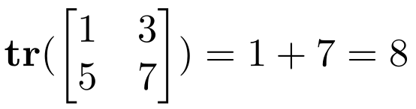
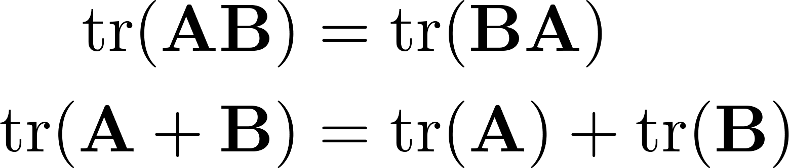
Matrix Operations
Trace
  Invariant to a lot of transformations, so it’s used sometimes in proofs. (Rarely in this class though.)
  Properties:

Slide 25
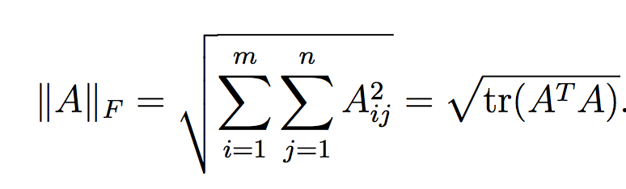
Matrix Operations
Vector Norms
Matrix norms: Norms can also be defined for matrices, such as the Frobenius norm:

Slide 26
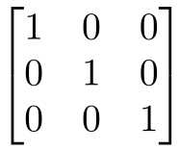
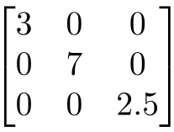
Special Matrices
Identity matrix I
  Square matrix, 1’s along diagonal, 0’s elsewhere
  I ∙ [another matrix] = [that matrix]
Diagonal matrix
  Square matrix with numbers along diagonal, 0’s elsewhere
  A diagonal ∙ [another matrix] scales the rows of that matrix

Slide 27
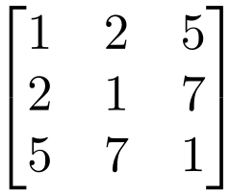


Special Matrices
Symmetric matrix
Skew-symmetric matrix

Slide 28
Outline
Vectors and matrices
  Basic Matrix Operations
  Determinants, norms, trace
  Special Matrices
Transformation Matrices
  Homogeneous coordinates
  Translation
Matrix inverse
Matrix rank
Eigenvalues and Eigenvectors
Matrix Calculus
Matrix multiplication can be used to transform vectors. A matrix used in this way is called a transformation matrix.

Slide 29
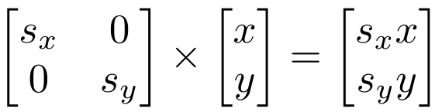
Transformation
Matrices can be used to transform vectors in useful ways, through multiplication: x’= Ax
Simplest is scaling:
  (Verify to yourself that the matrix multiplication works out this way)

Slide 30
Transformation

Slide 31

Rotation
$$θ={45}^{°}$$

Slide 32
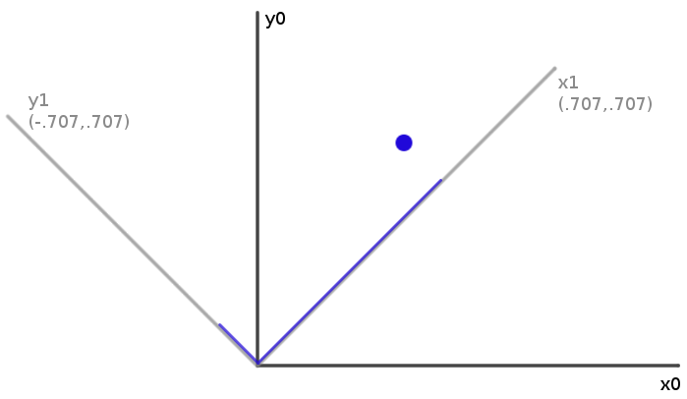
Rotation
How can you convert a vector represented in frame “0” to a new, rotated coordinate frame “1”?

Slide 33
Rotation
How can you convert a vector represented in frame “0” to a new, rotated coordinate frame “1”?
Remember what a vector is:
[component in direction of the frame’s x axis, component in direction of y axis]

Slide 34
Rotation
So to rotate it we must produce this vector:
[component in direction of new x axis, component in direction of new y axis]
We can do this easily with dot products!
New x coordinate is [original vector] dot [the new x axis]
New y coordinate is [original vector] dot [the new y axis]

Slide 35
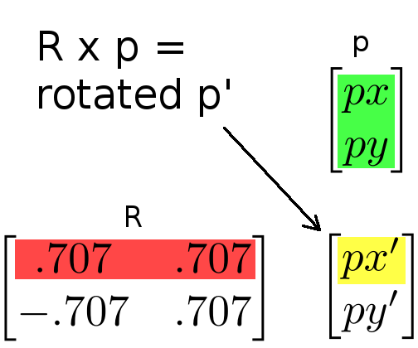
Rotation
Insight: this is what happens in a matrix*vector multiplication
  Result x coordinate is:
  [original vector] dot [matrix row 1]
  So matrix multiplication can rotate a vector p:
Notes:
RED is rotation matrix

Slide 36
Rotation
Suppose we express a point in the new coordinate system which is rotated left
If we plot the result in the original coordinate system, we have rotated the point right
  Thus, rotation matrices can be used to rotate vectors. We’ll usually think of them in that sense-- as operators to rotate vectors
Notes:
Left rotation of axis == right rotation of point

Slide 37
2D Rotation Matrix Formula
Counter-clockwise rotation by an angle θ
P’
y’
θ
y
P
x’
x

Slide 38
Transformation Matrices
Multiple transformation matrices can be used to transform a point:
p’=R₂ R₁ S p
The effect of this is to apply their transformations one after the other, from right to left.
In the example above, the result is
(R₂ (R₁ (S p)))
The result is exactly the same if we multiply the matrices first, to form a single transformation matrix:
p’=(R₂ R₁ S) p

Slide 39
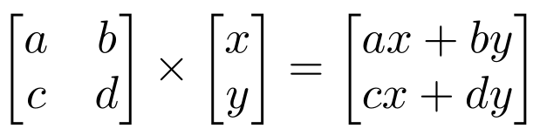
Homogeneous system
In general, a matrix multiplication lets us linearly combine components of a vector
  This is sufficient for scale, rotate, skew transformations.
  But notice, we can’t add a constant! ☹

Slide 40
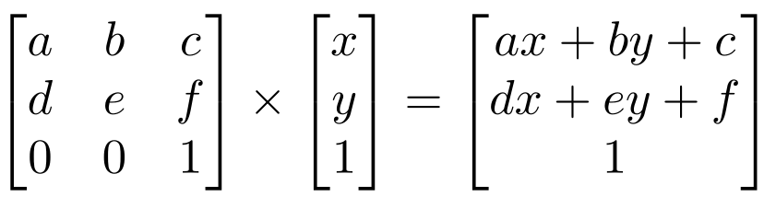
Homogeneous system
  The (somewhat hacky) solution? Stick a “1” at the end of every vector:
  Now we can rotate, scale, and skew like before, AND translate (note how the multiplication works out, above)
  This is called “homogeneous coordinates”

Slide 41
Homogeneous system
  In homogeneous coordinates, the multiplication works out so the rightmost column of the matrix is a vector that gets added.
  Generally, a homogeneous transformation matrix will have a bottom row of [0 0 1], so that the result has a “1” at the bottom too.

Slide 42
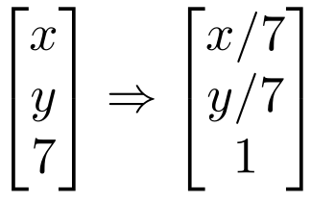
Homogeneous system
One more thing we might want: to divide the result by something
  For example, we may want to divide by a coordinate, to make things scale down as they get farther away in a camera image
  Matrix multiplication can’t actually divide
  So, by convention, in homogeneous coordinates, we’ll divide the result by its last coordinate after doing a matrix multiplication

Slide 43
2D Translation
P’
P
t

Slide 44
2D Translation using Homogeneous Coordinates
P’
t
ty
P
y
P
x
tx

Slide 45
2D Translation using Homogeneous Coordinates
P’
t
ty
P
y
P
x
tx

Slide 46
2D Translation using Homogeneous Coordinates
P’
t
ty
P
y
P
x
tx

Slide 47
2D Translation using Homogeneous Coordinates
P’
t
ty
P
y
P
x
tx

Slide 48
2D Translation using Homogeneous Coordinates
P’
t
ty
P
t
y
P
x
tx

Slide 49
Scaling
P’
P

Slide 50
Scaling Equation
P’
s_{y} y
P
y
x
s_{x} x

Slide 51
Scaling Equation
P’
s_{y} y
P
y
x
s_{x} x

Slide 52
Scaling Equation
P’
s_{y} y
P
y
x
s_{x} x

Slide 53
Scaling & Translating
P’’
P
P’=S∙P
P’’=T∙P’
P’’=T ∙ P’=T ∙(S ∙ P)= T ∙ S ∙P

Slide 54
Scaling & Translating
A

Slide 55
Scaling & Translating

Slide 56
Translating & Scaling != Scaling & Translating

Slide 57
Translating & Scaling != Scaling & Translating

Slide 58
Translating & Scaling != Scaling & Translating

Slide 59
Rotation
P’
P

Slide 60
Rotation Equations
Counter-clockwise rotation by an angle θ
P’
y’
θ
y
P
x’
x

Slide 61
Rotation Matrix Properties
A 2D rotation matrix is 2x2
Note: R belongs to the category of normal matrices
and satisfies many interesting properties:

Slide 62
Rotation Matrix Properties
Transpose of a rotation matrix produces a rotation in the opposite direction
The rows of a rotation matrix are always mutually perpendicular (a.k.a. orthogonal) unit vectors
  (and so are its columns)

Slide 63
Scaling + Rotation + Translation
P’= (T R S) P
This is the form of the general-purpose transformation matrix

Slide 64
Outline
Vectors and matrices
  Basic Matrix Operations
  Determinants, norms, trace
  Special Matrices
Transformation Matrices
  Homogeneous coordinates
  Translation
Matrix inverse
Matrix rank
Eigenvalues and Eigenvectors
Matrix Calculate
The inverse of a transformation matrix reverses its effect

Slide 65
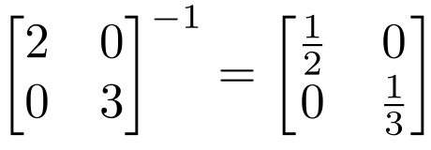
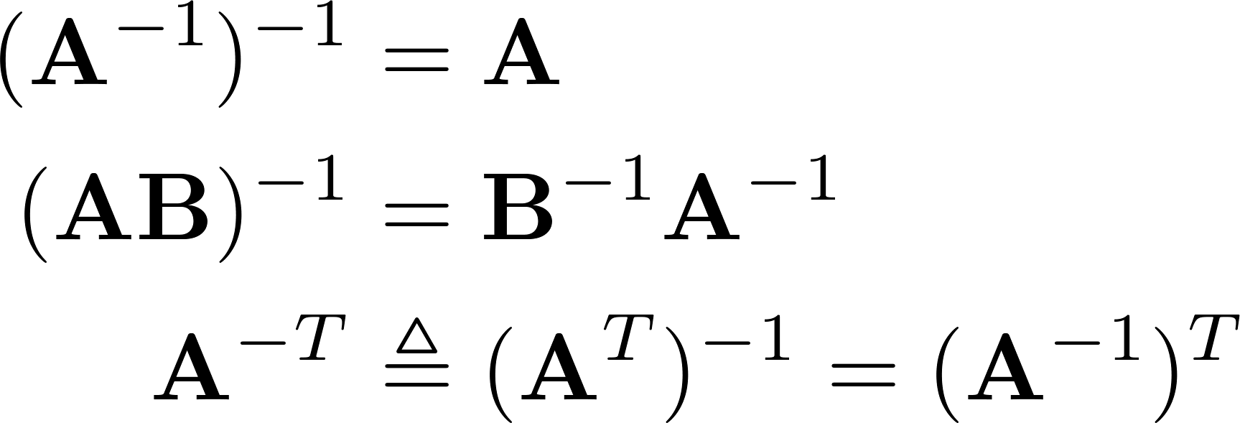
Inverse
Given a matrix A, its inverse A⁻¹ is a matrix such that AA⁻¹ = A⁻¹A = I
E.g.
Inverse does not always exist. If A⁻¹ exists, A is invertible or non-singular. Otherwise, it’s singular.
Useful identities, for matrices that are invertible:

Slide 66
Matrix Operations
Pseudoinverse
  Fortunately, there are workarounds to solve AX=B in these situations. And python can do them!
  Instead of taking an inverse, directly ask python to solve for X in AX=B, by typing np.linalg.solve(A, B)
  Python will try several appropriate numerical methods (including the pseudoinverse if the inverse doesn’t exist)
  Python will return the value of X which solves the equation
    If there is no exact solution, it will return the closest one
    If there are many solutions, it will return the smallest one

Slide 67

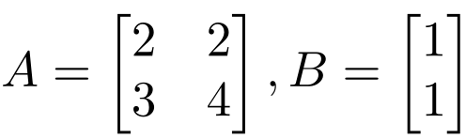
Matrix Operations
Python example:
>> import numpy as np
>> x = np.linalg.solve(A,B)
x =
1.0000
-0.5000

Slide 68
Outline
Vectors and matrices
  Basic Matrix Operations
  Determinants, norms, trace
  Special Matrices
Transformation Matrices
  Homogeneous coordinates
  Translation
Matrix inverse
Matrix rank
Eigenvalues and Eigenvectors
Matrix Calculate
The rank of a transformation matrix tells you how many dimensions it transforms a vector to.

Slide 69
Linear independence
Suppose we have a set of vectors v₁, …, v_{n}
If we can express v₁ as a linear combination of the other vectors v₂…v_{n}, then v₁ is linearly dependent on the other vectors.
  The direction v₁ can be expressed as a combination of the directions v₂…v_{n}. (E.g. v₁ = .7 v₂ -.7 v₄)
Notes:
Second bullet point: define linear combination in blackboard

Slide 70
Linear independence
Suppose we have a set of vectors v₁, …, v_{n}
If we can express v₁ as a linear combination of the other vectors v₂…v_{n}, then v₁ is linearly dependent on the other vectors.
  The direction v₁ can be expressed as a combination of the directions v₂…v_{n}. (E.g. v₁ = .7 v₂ -.7 v₄)
If no vector is linearly dependent on the rest of the set, the set is linearly independent.
  Common case: a set of vectors v₁, …, v_{n} is always linearly independent if each vector is perpendicular to every other vector (and non-zero)
Notes:
Second bullet point: define linear combination in blackboard

Slide 71
Linear independence
Linearly independent set
Not linearly independent
Notes:
Geometric interpretation

Slide 72
Matrix rank
Column/row rank
  Column rank always equals row rank
Matrix rank

Slide 73
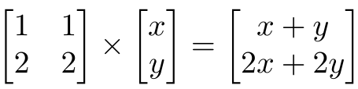
Matrix rank
For transformation matrices, the rank tells you the dimensions of the output
E.g. if rank of A is 1, then the transformation
p’=Ap
maps points onto a line.
Here’s a matrix with rank 1:
All points get mapped to the line y=2x
Notes:
Example of how a rank deficient matrix can collapse all the space (any point) into a line

Slide 74
Matrix rank
If an m x m matrix is rank m, we say it’s “full rank”
  Maps an m x 1 vector uniquely to another m x 1 vector
  An inverse matrix can be found
If rank < m, we say it’s “singular”
  At least one dimension is getting collapsed. No way to look at the result and tell what the input was
  Inverse does not exist
Inverse also doesn’t exist for non-square matrices
Notes:
Geometrically: transformation is like a rotation, scale, translation…
Singular -> cannot go back to original data

Slide 75
Outline
Vectors and matrices
  Basic Matrix Operations
  Determinants, norms, trace
  Special Matrices
Transformation Matrices
  Homogeneous coordinates
  Translation
Matrix inverse
Matrix rank
Eigenvalues and Eigenvectors(SVD)
Matrix Calculus

Slide 76
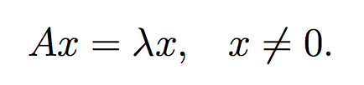
Eigenvector and Eigenvalue
An eigenvector x of a linear transformation A is a non-zero vector that, when A is applied to it, does not change direction.

Slide 77
Eigenvector and Eigenvalue
An eigenvector x of a linear transformation A is a non-zero vector that, when A is applied to it, does not change direction.
Applying A to the eigenvector only scales the eigenvector by the scalar value λ, called an eigenvalue.

Slide 78

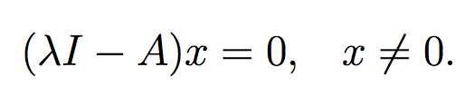
Eigenvector and Eigenvalue
We want to find all the eigenvalues of A:
Which can we written as:
Therefore:

Slide 79
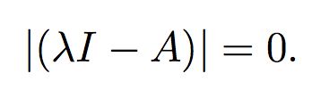
Eigenvector and Eigenvalue
We can solve for eigenvalues by solving:
Since we are looking for non-zero x, we can instead solve the above equation as:

Slide 80
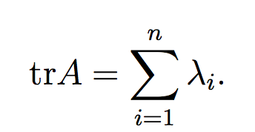
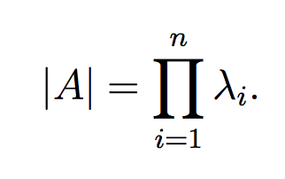
Properties
The trace of a A is equal to the sum of its eigenvalues:
The determinant of A is equal to the product of its eigenvalues
The rank of A is equal to the number of non-zero eigenvalues of A.
The eigenvalues of a diagonal matrix D = diag(d1, . . . dn) are just the diagonal entries d1, . . . dn

Slide 81

Spectral theory
We call an eigenvalue λ and an associated eigenvector an eigenpair.
The space of vectors where (A − λI) = 0 is often called the eigenspace of A associated with the eigenvalue λ.
The set of all eigenvalues of A is called its spectrum:

Slide 82

Spectral theory
The magnitude of the largest eigenvalue (in magnitude) is called the spectral radius
  Where C is the space of all eigenvalues of A

Slide 83

Spectral theory
The spectral radius is bounded by infinity norm of a matrix:
Proof: Turn to a partner and prove this!

Slide 84

Spectral theory
The spectral radius is bounded by infinity norm of a matrix:
Proof: Let λ and v be an eigenpair of A:

Slide 85
Diagonalization
An n × n matrix A is diagonalizable if it has n linearly independent eigenvectors.
Most square matrices (in a sense that can be made mathematically rigorous) are diagonalizable:
  Normal matrices are diagonalizable
  Matrices with n distinct eigenvalues are diagonalizable
Lemma: Eigenvectors associated with distinct eigenvalues are linearly independent.

Slide 86
Diagonalization
An n × n matrix A is diagonalizable if it has n linearly independent eigenvectors.
Most square matrices are diagonalizable:
  Normal matrices are diagonalizable
  Matrices with n distinct eigenvalues are diagonalizable
Lemma: Eigenvectors associated with distinct eigenvalues are linearly independent.

Slide 87


Diagonalization
Eigenvalue equation:
  Where D is a diagonal matrix of the eigenvalues

Slide 88

Diagonalization
Eigenvalue equation:
Assuming all λ_{i}’s are unique:
    Remember that the inverse of an orthogonal matrix is just its transpose and the eigenvectors are orthogonal

Slide 89
Symmetric matrices
Properties:
  For a symmetric matrix A, all the eigenvalues are real.
  The eigenvectors of A are orthonormal.

Slide 90




Symmetric matrices
Therefore:
  where
So, what can you say about the vector x that satisfies the following optimization?

Slide 91
Symmetric matrices
Therefore:
  where
So, what can you say about the vector x that satisfies the following optimization?
  Is the same as finding the eigenvector that corresponds to the largest eigenvalue of A.

Slide 92
Some applications of Eigenvalues
PageRank
Schrodinger’s equation
PCA
We are going to use it to compress images in future classes

Slide 93
Outline
Vectors and matrices
  Basic Matrix Operations
  Determinants, norms, trace
  Special Matrices
Transformation Matrices
  Homogeneous coordinates
  Translation
Matrix inverse
Matrix rank
Eigenvalues and Eigenvectors(SVD)
Matrix Calculus

Slide 94


Matrix Calculus – The Gradient
Let a function take as input a matrix A of size m × n and return a real value.
Then the gradient of f:

Slide 95


Matrix Calculus – The Gradient
Every entry in the matrix is:
the size of ∇_{A}f(A) is always the same as the size of A. So if A is just a vector x:

Slide 96


Exercise
Example:
Find:

Slide 97


Exercise
Example:
From this we can conclude that:

Slide 98

Matrix Calculus – The Gradient
Properties

Slide 99


Matrix Calculus – The Hessian
The Hessian matrix with respect to x, written or simply as H:
The Hessian of n-dimensional vector is the n × n matrix.

Slide 100

Matrix Calculus – The Hessian
Each entry can be written as:
Exercise: Why is the Hessian always symmetric?

Slide 101

Matrix Calculus – The Hessian
Each entry can be written as:
The Hessian is always symmetric, because
This is known as Schwarz's theorem: The order of partial derivatives don’t matter as long as the second derivative exists and is continuous.

Slide 102
Matrix Calculus – The Hessian
Note that the hessian is not the gradient of whole gradient of a vector (this is not defined). It is actually the gradient of every entry of the gradient of the vector.

Slide 103

Matrix Calculus – The Hessian
Eg, the first column is the gradient of

Slide 104


Exercise
Example:

Slide 105
Exercise

Slide 106
Exercise
Divide the summation into 3 parts depending on whether:
i == k or
j == k

Slide 107
Exercise

Slide 108
Exercise

Slide 109
Exercise

Slide 110
Exercise

Slide 111
Exercise

Slide 112
Exercise

Slide 113

Exercise

Slide 114
Exercise

Slide 115

Exercise

Slide 116
What we have learned
Vectors and matrices
  Basic Matrix Operations
  Special Matrices
Transformation Matrices
  Homogeneous coordinates
  Translation
Matrix inverse
Matrix rank
Eigenvalues and Eigenvectors
Matrix Calculate

