Slide 1
Lecture 20:
Final Review
Juan Carlos Niebles and Ranjay Krishna
Stanford Vision and Learning Lab
Notes:
Edges are significant local changes in the image and are important features for analyzing images.Edges typically occur on the boundary between two different regions in an image.

Slide 2
Exam details
Monday, December 11
12:15 to 3:15pm
Location: 320-105
Practice exam available online.
Make-up exam for those with conflicts
  You should have received an email about this.

Slide 3
Class overview
68% assignments
5% class notes
7% extra credit
20% final exam
Don’t be worried about the final.
Optimal strategy:
  Go over all the materials we covered in class.
  Read through the entire final first and work on the problems you find easy first.

Slide 4
Exam overview
100 points in total
15 points for multiple choice
20 points for true false
25 points for filters, edges, corners, RANSAC, Hough transform
15 points for segmentation and seam carving
15 points for recognition and detection
10 points for optical flow and tracking

Slide 5
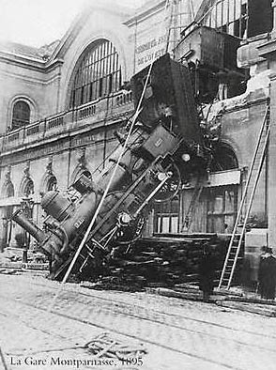
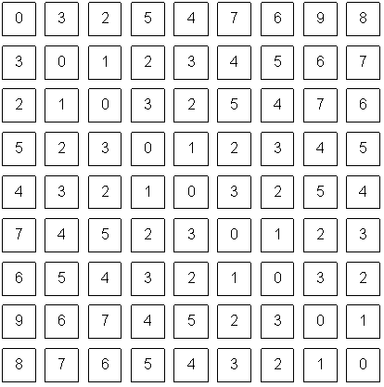
The goal of computer vision
To bridge the gap between pixels and “meaning”
Source: S. Narasimhan
What we see
What a computer sees

Slide 6
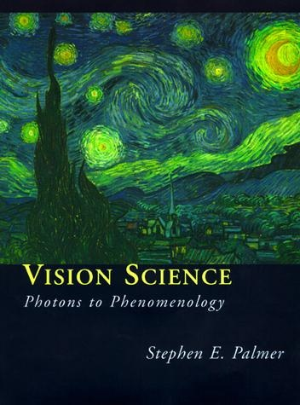
What is color?
The result of interaction between physical light in the environment and our visual system.
A psychological property of our visual experiences when we look at objects and lights, not a physical property of those objects or lights.
Slide credit: Lana Lazebnik

Slide 7
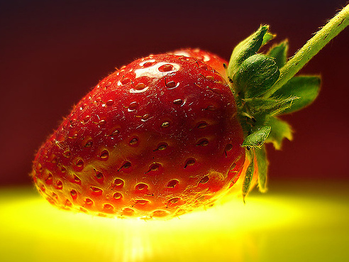
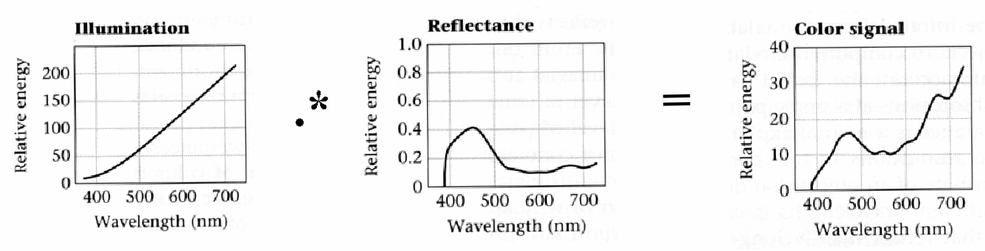
Interaction of light and surfaces
Reflected color is the result of interaction of light source spectrum with surface reflectance
Spectral radiometry
  All definitions and units are now “per unit wavelength”
  All terms are now “spectral”
From Foundation of Vision by Brian Wandell, Sinauer Associates, 1995

Slide 8

White balance
Von Kries adaptation
  Multiply each channel by a gain factor
  A more general transformation would correspond to an arbitrary 3x3 matrix
Best way: gray card
  Take a picture of a neutral object (white or gray)
  Deduce the weight of each channel
    If the object is recoded as r_{w}, g_{w}, b_{w}
    use weights 1/r_{w}, 1/g_{w}, 1/b_{w}
Slide: F. Durand

Slide 9
White balance
Without gray cards: we need to “guess” which pixels correspond to white objects
Gray world assumption
  The image average r_{ave}, g_{ave}, b_{ave} is gray
  Use weights 1/r_{ave}, 1/g_{ave}, 1/b_{ave}
Brightest pixel assumption (non-staurated)
  Highlights usually have the color of the light source
  Use weights inversely proportional to the values of the brightest pixels
Gamut mapping
  Gamut: convex hull of all pixel colors in an image
  Find the transformation that matches the gamut of the image to the gamut of a “typical” image under white light
Use image statistics, learning techniques
Slide: F. Durand

Slide 10
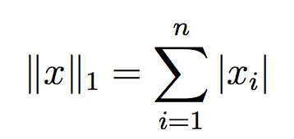
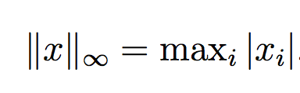

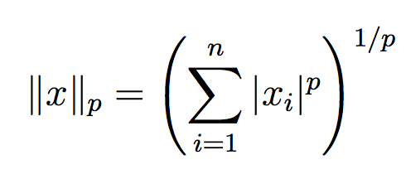
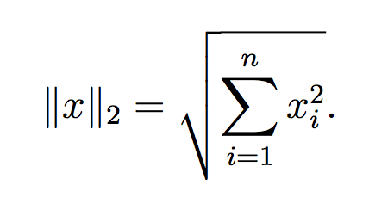
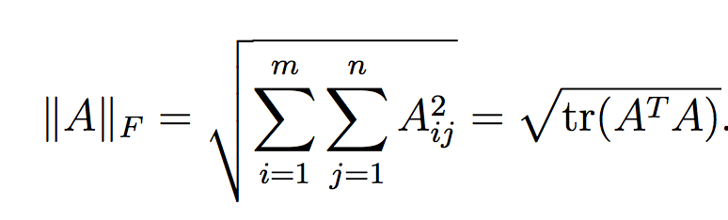
Norms

Slide 11
Linear algebra
Singular value decompositon
Eigenvalues and eigenvectors
Spectral theory
Symmetric and singular matrices
Matrix gradient
The Hessian
Matrix rank

Slide 12
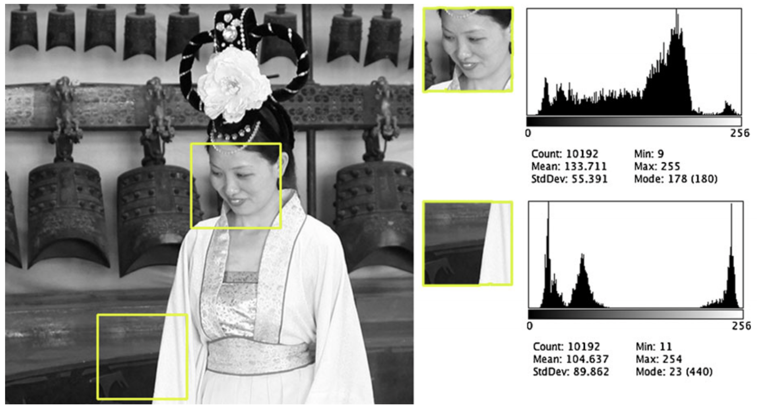
Histogram
Slide credit: Dr. Mubarak Shah

Slide 13
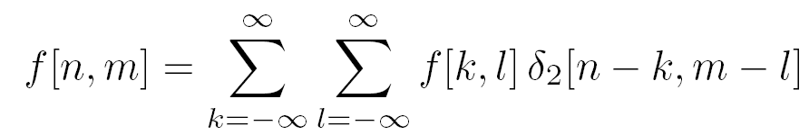
Convolution and Cross-correlation
Convolution is an integral that expresses the amount of overlap of one function as it is shifted over another function
Cross-correlation compares the similarity of two sets of data
Convolution with Impulse function

Slide 14




Properties of systems
Amplitude properties:
  Additivity
  Homogeneity
  Superposition
  Stability
  Invertibility

Slide 15

Properties of systems
Spatial properties
  Causality
  Shift invariance:

Slide 16
Image support and edge effect
A computer will only convolve finite support signals.
  That is: images that are zero for n,m outside some rectangular region
numpy’s convolution performs 2D DS convolution of finite-support signals.
=
*
(N1 + N2 − 1) × (M1 +M2 − 1)
N2 ×M2
N1 ×M1

Slide 17

Characterizing edges
An edge is a place of rapid change in the image intensity function
intensity function
(along horizontal scanline)
image
first derivative
edges correspond to
extrema of derivative

Slide 18
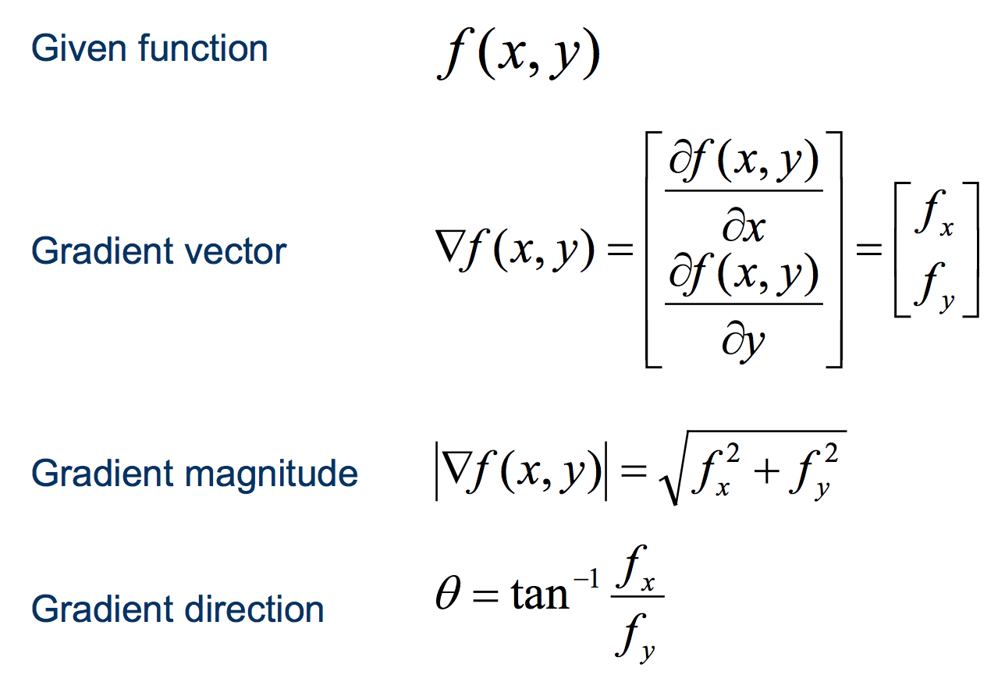
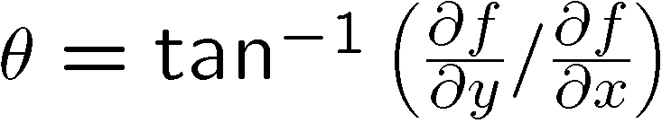
Discrete derivate in 2D

Slide 19
Finite differences: example
Original
Image
Gradient magnitude
x-direction
y-direction
Which one is the gradient in the x-direction? How about y-direction?

Slide 20
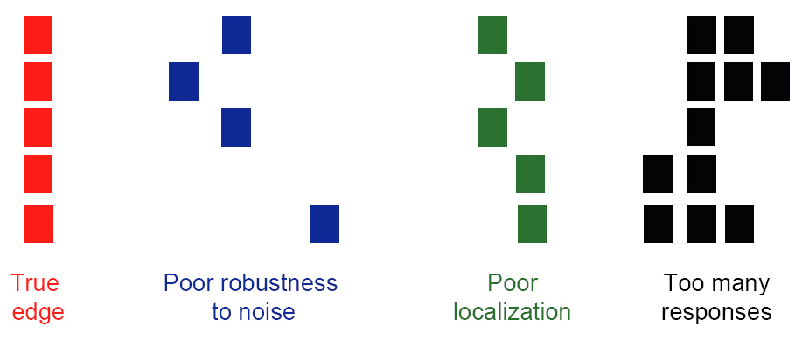
Designing an edge detector
Criteria for an “optimal” edge detector:
  Good detection: the optimal detector must minimize the probability of false positives (detecting spurious edges caused by noise), as well as that of false negatives (missing real edges)
  Good localization: the edges detected must be as close as possible to the true edges
  Single response: the detector must return one point only for each true edge point; that is, minimize the number of local maxima around the true edge

Slide 21
Canny edge detector
Suppress Noise
Compute gradient magnitude and direction
Apply Non-Maximum Suppression
  Assures minimal response
Use hysteresis and connectivity analysis to detect edges

Slide 22
Detecting lines using Hough transform
Two points (x₁, y₁) and(x₂ y₂) define a line in the (x, y) plane.
These two points give rise to two different lines in (a,b) space.
In (a,b) space these lines will intersect in a point (a’ b’)
All points on the line defined by (x₁, y₁) and (x₂ , y₂) in (x, y) space will parameterize lines that intersect in (a’, b’) in (a,b) space.

Slide 23
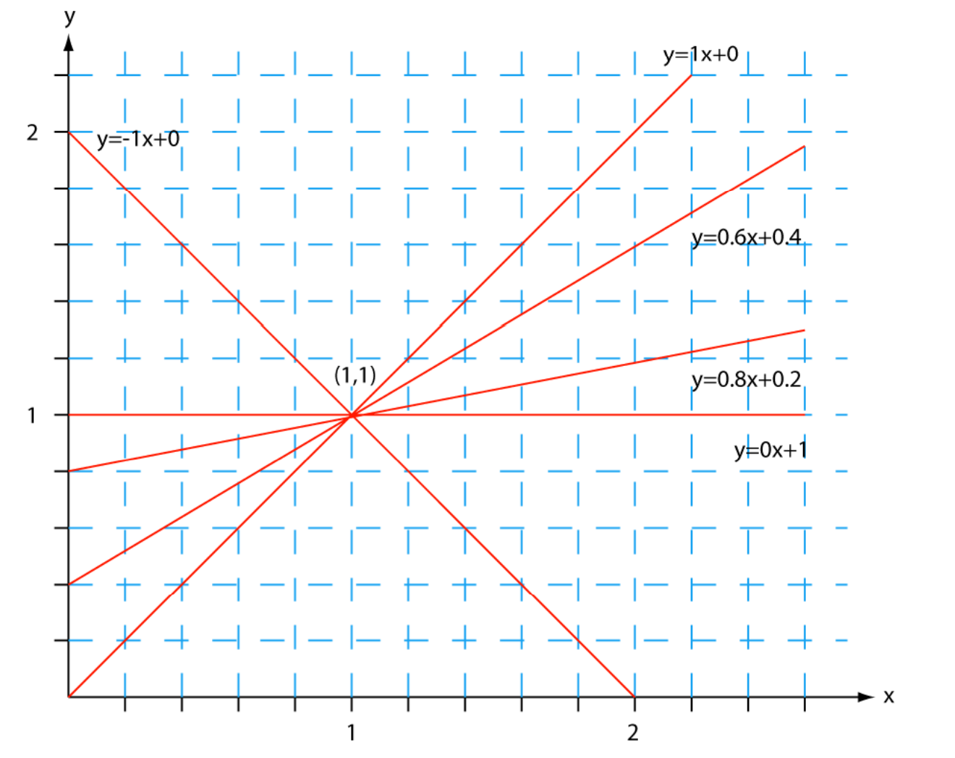
Detecting lines using Hough transform

Slide 24
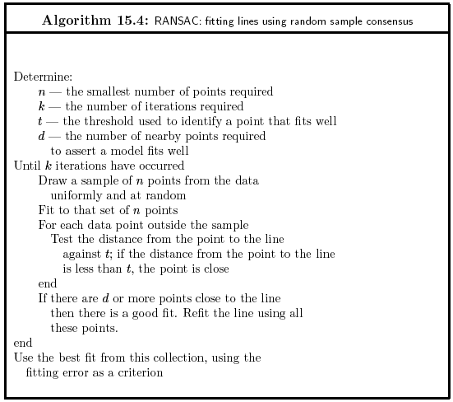

Slide 25
RANSAC: Pros and Cons
Pros:
  General method suited for a wide range of model fitting problems
  Easy to implement and easy to calculate its failure rate
Cons:
  Only handles a moderate percentage of outliers without cost blowing up
  Many real problems have high rate of outliers (but sometimes selective choice of random subsets can help)
A voting strategy, The Hough transform, can handle high percentage of outliers

Slide 26
Requirements for keypoint localization
Region extraction needs to be repeatable and accurate
  Invariant to translation, rotation, scale changes
  Robust or covariant to out-of-plane (≈affine) transformations
  Robust to lighting variations, noise, blur, quantization
Locality: Features are local, therefore robust to occlusion and clutter.
Quantity: We need a sufficient number of regions to cover the object.
Distinctiveness: The regions should contain “interesting” structure.
Efficiency: Close to real-time performance.
Slide credit: Bastian Leibe

Slide 27
Harris corner detector and second moment matrix
First, let’s consider an axis-aligned corner:
This means:
  Dominant gradient directions align with x or y axis
  If either λ is close to 0, then this is not a corner, so look for locations where both are large.
What if we have a corner that is not aligned with the image axes?
Slide credit: David Jacobs
Notes:
Sum over neighborhood → some pixels with Ix only, some others with Iy only.

Slide 28
Harris Detector: Properties
Translation invariance
Rotation invariance
Scale invariance?
Corner
All points will be classified as edges!
Slide credit: Kristen Grauman
Not invariant to image scale!

Slide 29
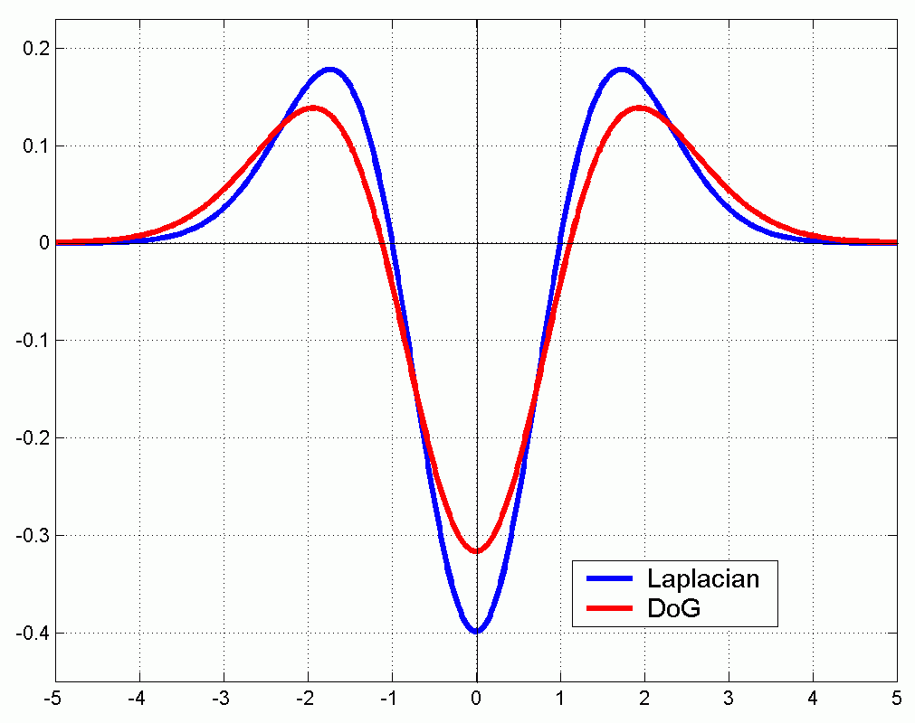
Scale Invariant Detection
Functions for determining scale
Kernels:
(Laplacian)
(Difference of Gaussians)
where Gaussian
Note: both kernels are invariant to scale and rotation

Slide 30
Scale Invariant Detectors
scale
Harris-Laplacian¹
Find local maximum of:
  Harris corner detector in space (image coordinates)
  Laplacian in scale
← Laplacian →
y
← Harris →
x
SIFT (Lowe)²
Find local maximum of:
  Difference of Gaussians in space and scale
scale
← DoG →
y
← DoG →
x
¹ K.Mikolajczyk, C.Schmid. “Indexing Based on Scale Invariant Interest Points”. ICCV 2001
² D.Lowe. “Distinctive Image Features from Scale-Invariant Keypoints”. IJCV 2004
Notes:
1- do harris to find 2d points, then compute laplacian across scales and pick max response
2- instead of 2 functions, faster to use a single function...
do DoG and check neighbor pixels in space and scale.

Slide 31
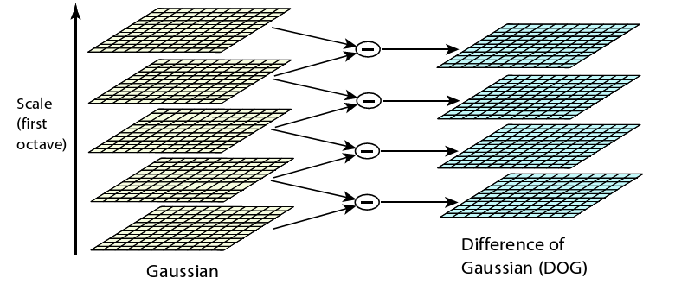
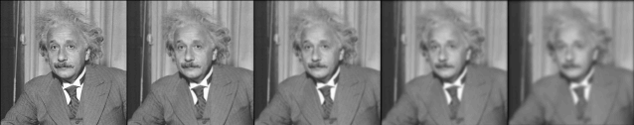
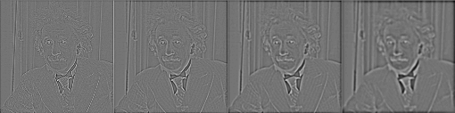
Difference-of-Gaussians

Slide 32
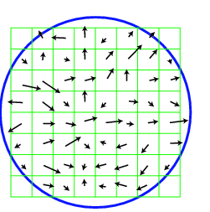
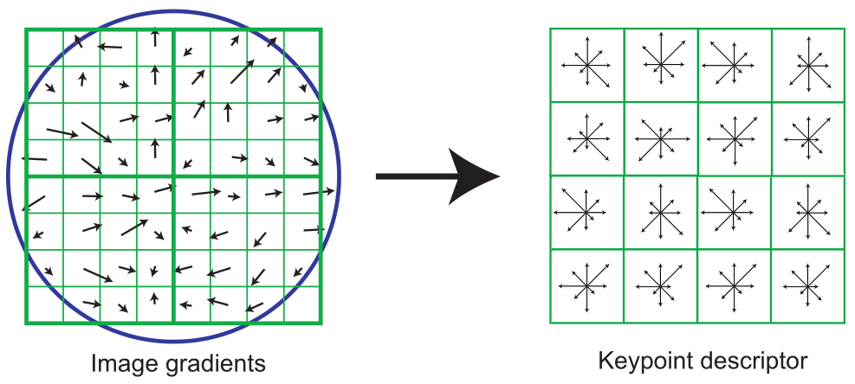
SIFT descriptor formation
0
2
π
Using precise gradient locations is fragile. We’d like to allow some “slop” in the image, and still produce a very similar descriptor
Create array of orientation histograms (a 4x4 array is shown)
Put the rotated gradients into their local orientation histograms
  A gradients’s contribution is divided among the nearby histograms based on distance. If it’s halfway between two histogram locations, it gives a half contribution to both.
  Also, scale down gradient contributions for gradients far from the center
The SIFT authors found that best results were with 8 orientation bins per histogram.

Slide 33
SIFT descriptor formation
Using precise gradient locations is fragile. We’d like to allow some “slop” in the image, and still produce a very similar descriptor
Create array of orientation histograms (a 4x4 array is shown)
Put the rotated gradients into their local orientation histograms
  A gradients’s contribution is divided among the nearby histograms based on distance. If it’s halfway between two histogram locations, it gives a half contribution to both.
  Also, scale down gradient contributions for gradients far from the center
The SIFT authors found that best results were with 8 orientation bins per histogram, and a 4x4 histogram array.

Slide 34
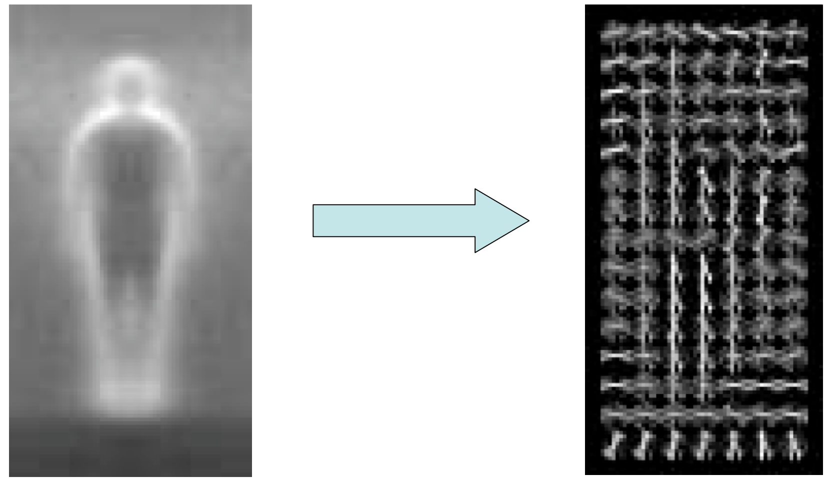
Histogram of Oriented Gradients

Slide 35
Difference between HoG and SIFT
HoG is usually used to describe entire images. SIFT is used for key point matching
SIFT histrograms are oriented towards the dominant gradient. HoG is not.
HoG gradients are normalized using neighborhood bins.
SIFT descriptors use varying scales to compute multiple descriptors.

Slide 36
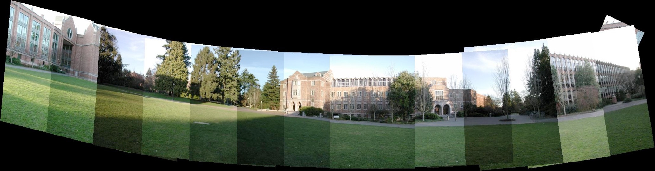
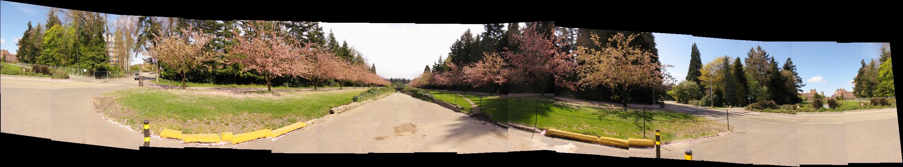
Panorama

Slide 37

Seam Carving
Assume m x n → m x n’, n’<n (summarization)
Basic Idea: remove unimportant pixels from the image
  Unimportant = pixels with less “energy”
Intuition for gradient-based energy:
  Preserve strong contours
  Human vision more sensitive to edges – so try remove content from smoother areas
  Simple enough for producing some nice results

Slide 38
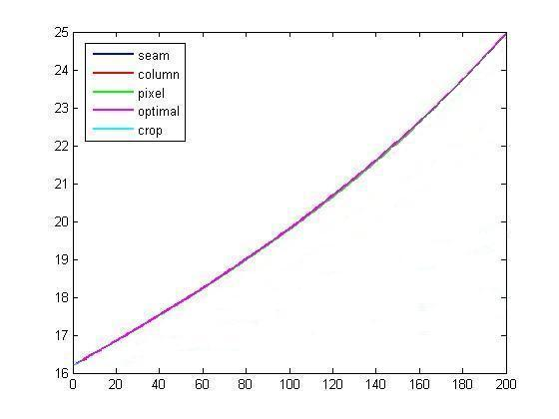
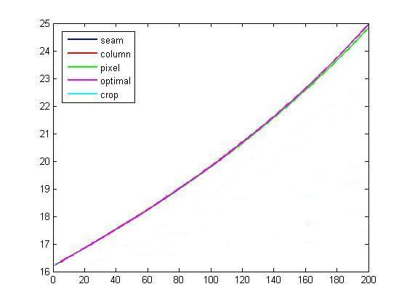
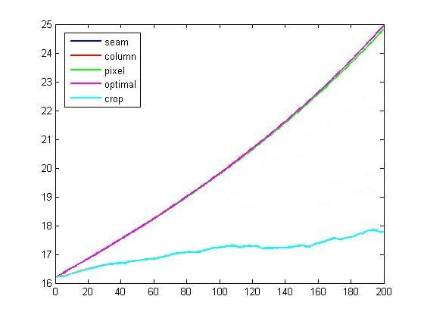
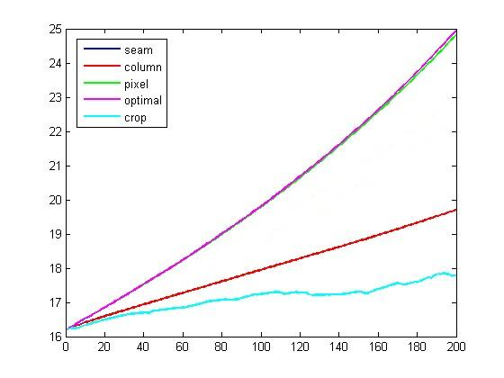
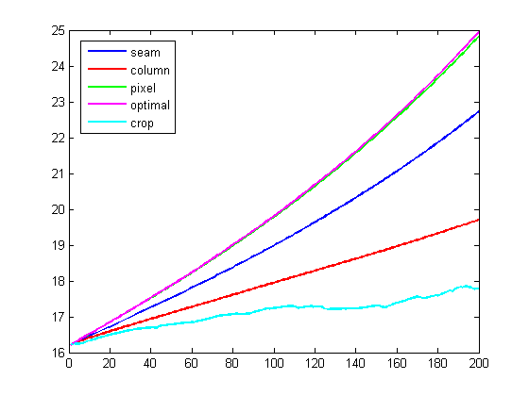
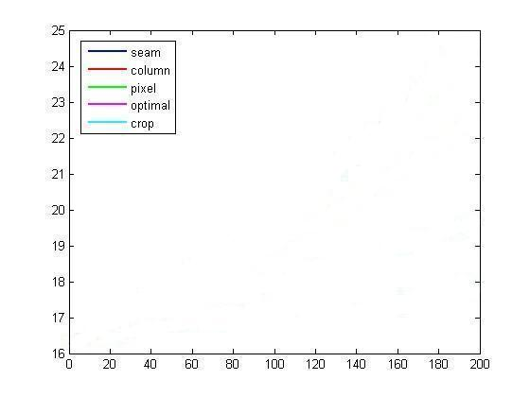
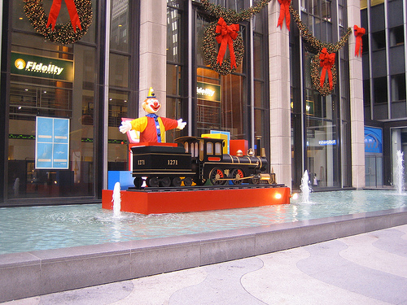
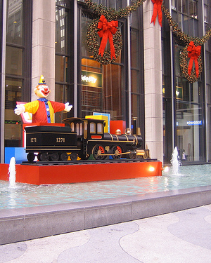
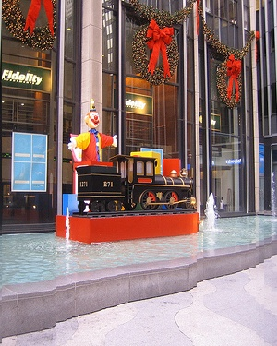
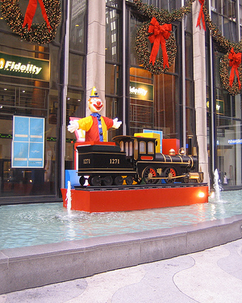
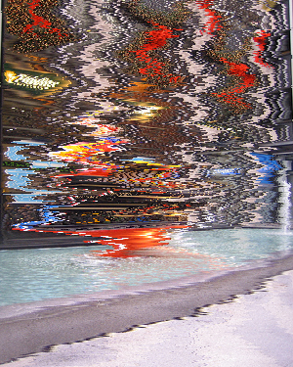
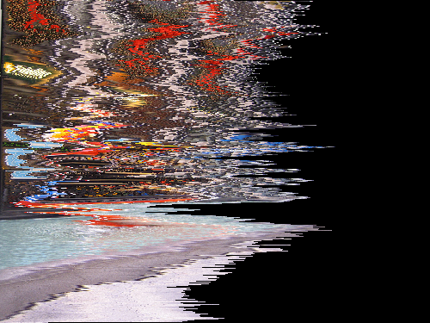
Preserved Energy
Average Pixel Energy
Image Reduction
crop
column
seam
pixel
optimal

Slide 39

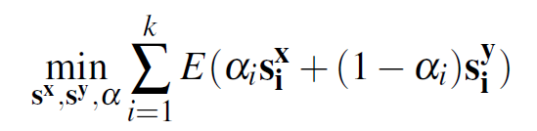
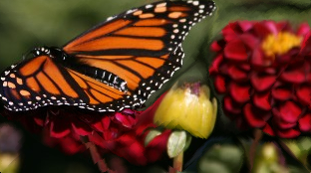
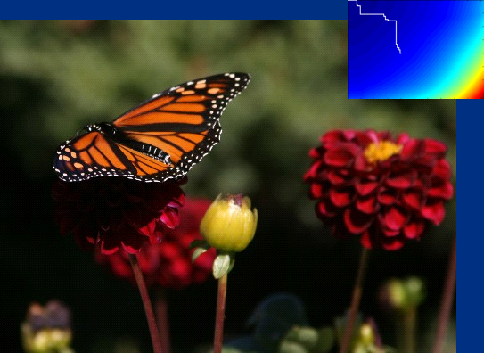
Retargeting in Both Dimensions
The recursion relation:

Slide 40
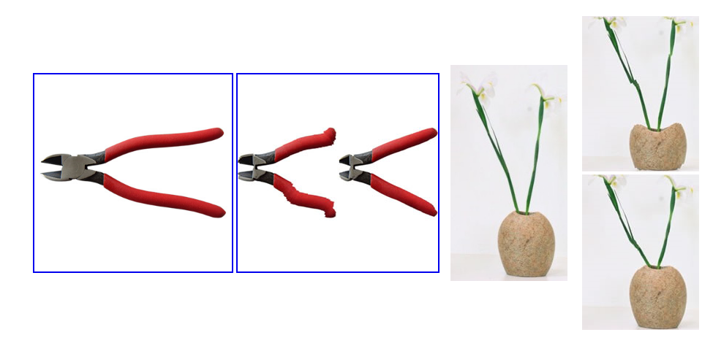
Backward versus forward energy
Backward
Input
Backward
Forward
Input
Forward

Slide 41
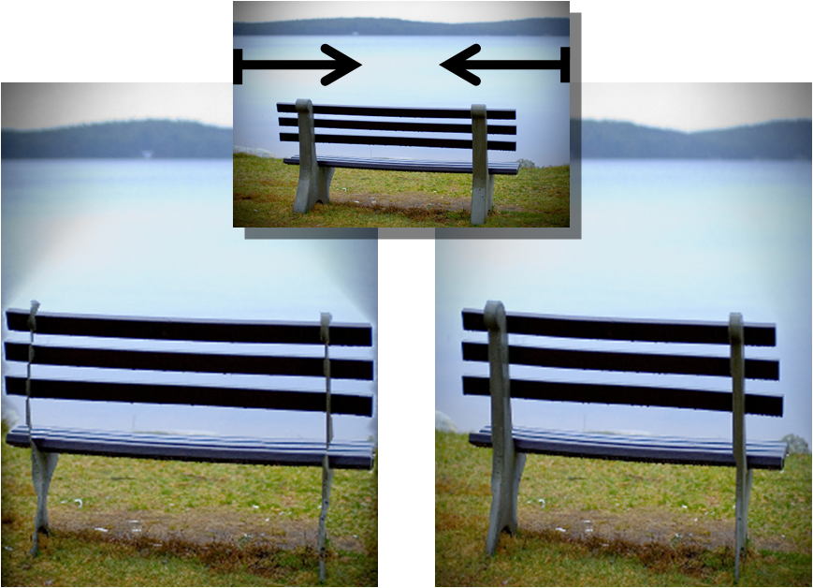
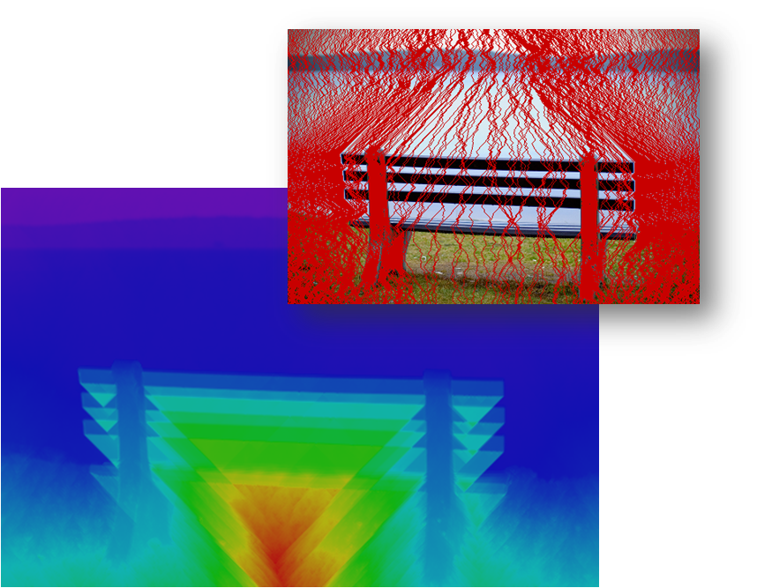
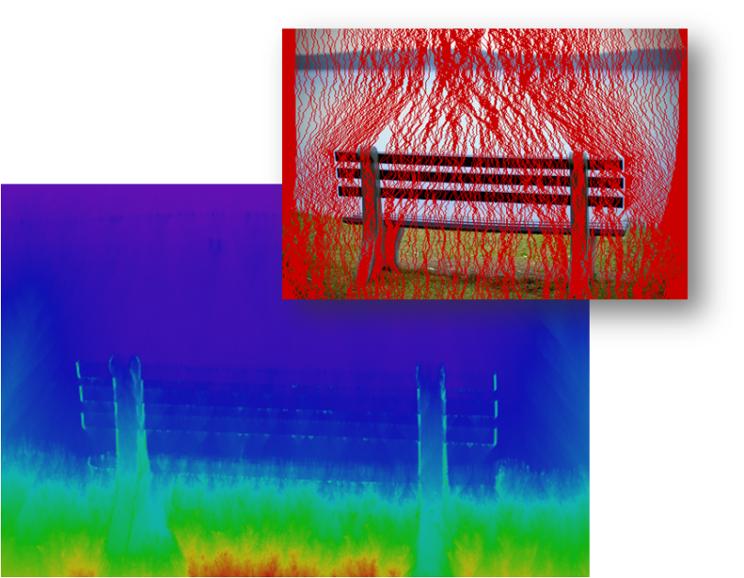
Results

Slide 42
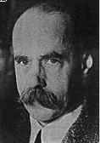
Gestalt Theory
Gestalt: whole or group
  Whole is greater than sum of its parts
  Relationships among parts can yield new properties/features
Psychologists identified series of factors that predispose set of elements to be grouped (by human visual system)
        “I stand at the window and see a house, trees, sky.
        Theoretically I might say there were 327 brightnesses
        and nuances of colour. Do I have "327"? No. I have sky, house, and trees.”
        Max Wertheimer
        (1880-1943)
Untersuchungen zur Lehre von der Gestalt,
Psychologische Forschung, Vol. 4, pp. 301-350, 1923
http://psy.ed.asu.edu/~classics/Wertheimer/Forms/forms.htm

Slide 43
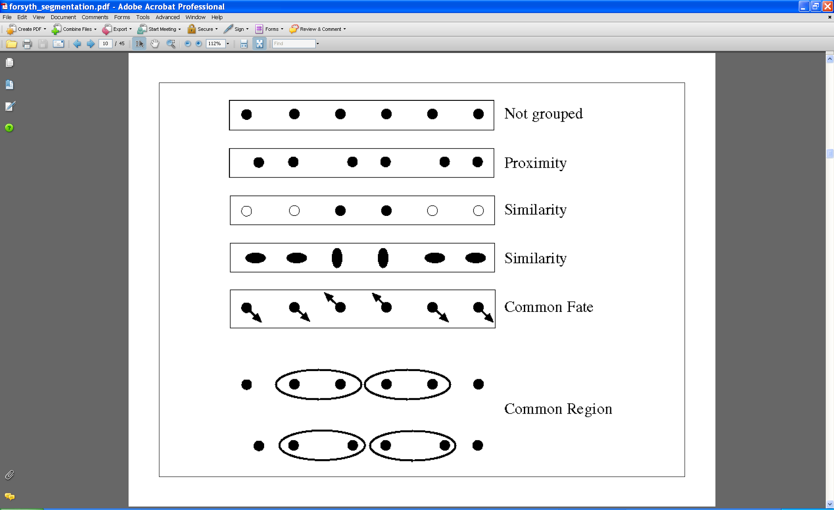
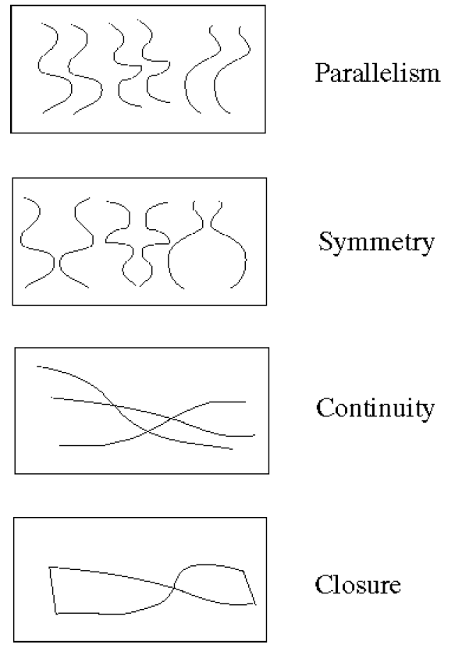
Gestalt Factors
These factors make intuitive sense, but are very difficult to translate into algorithms.
Image source: Forsyth & Ponce

Slide 44
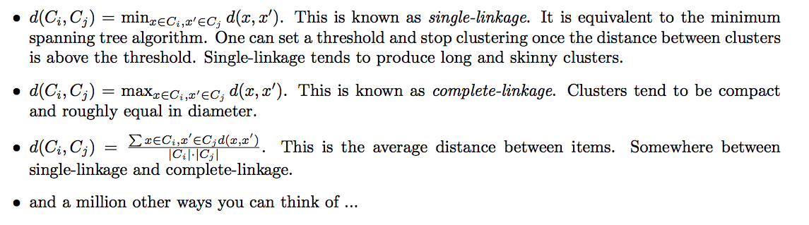
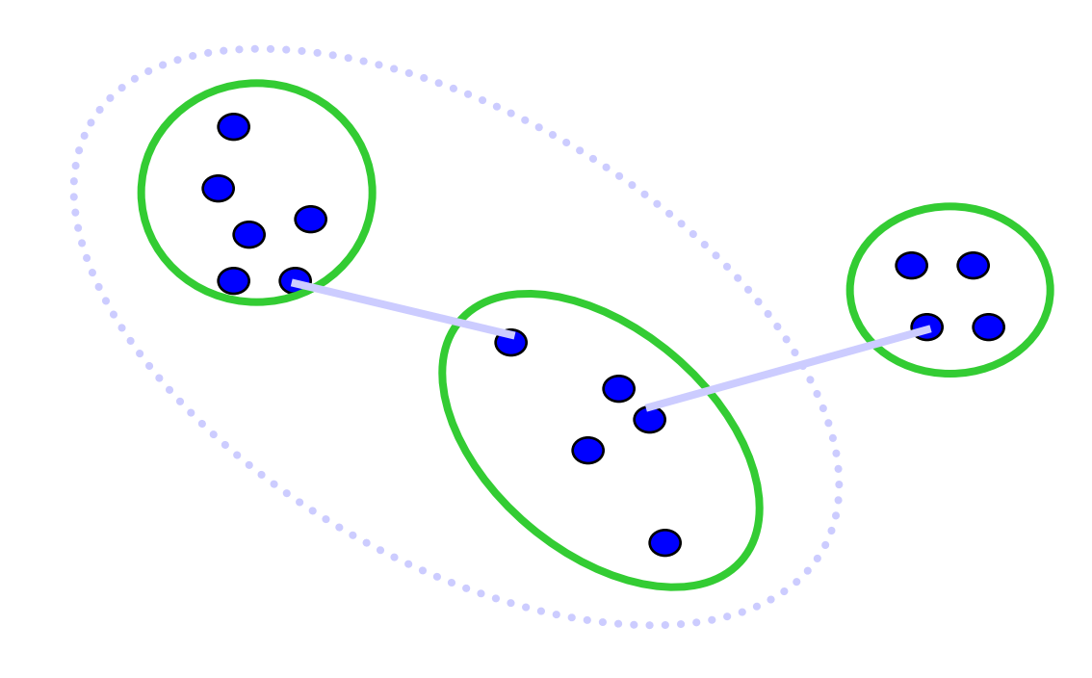
Different measures of nearest clusters
Single Link
Long, skinny clusters

Slide 45

Different measures of nearest clusters
Complete Link
Tight clusters

Slide 46
Conclusions: Agglomerative Clustering
Good
Simple to implement, widespread application.
Clusters have adaptive shapes.
Provides a hierarchy of clusters.
No need to specify number of clusters in advance.
Bad
May have imbalanced clusters.
Still have to choose number of clusters or threshold.
Does not scale well. Runtime of O(n³).
Can get stuck at a local optima.

Slide 47




K-means clustering
1. Initialize Cluster Centers
2. Assign Points to Clusters
3. Re-compute Means
Repeat (2) and (3)
Java demo:
http://home.dei.polimi.it/matteucc/Clustering/tutorial_html/AppletKM.html
Illustration Source: wikipedia

Slide 48

Feature Space
Depending on what we choose as the feature space, we can group pixels in different ways.
Grouping pixels based
on color similarity
Feature space: color value (3D)
R=255
G=200
B=250
B
G
R=245
G=220
B=248
R
R=15
G=189
B=2
R=3
G=12
B=2
Slide credit: Kristen Grauman

Slide 49


Feature Space
Depending on what we choose as the feature space, we can group pixels in different ways.
Grouping pixels based
on texture similarity
Feature space: filter bank responses (e.g., 24D)
F₁
F₂
Filter bank of 24 filters
…
F₂₄
Slide credit: Kristen Grauman

Slide 50
Segmentation as Clustering
Depending on what we choose as the feature space, we can group pixels in different ways.
Grouping pixels based on
intensity+position similarity
⇒ Way to encode both similarity and proximity.
Intensity
Y
X
Slide credit: Kristen Grauman
Notes:
Both regions are black, but if we also include position (x,y), then we could group the two into distinct segments; way to encode both similarity & proximity.

Slide 51

Mean-Shift Clustering
Cluster: all data points in the attraction basin of a mode
Attraction basin: the region for which all trajectories lead to the same mode
Slide by Y. Ukrainitz & B. Sarel

Slide 52
Problem: Computational Complexity
Slide credit: Bastian Leibe
Need to shift many windows…
Many computations will be redundant.

Slide 53
Speedups: Basin of Attraction
r
Slide credit: Bastian Leibe
Assign all points within radius r of end point to the mode.

Slide 54
Speedups
Slide credit: Bastian Leibe
Assign all points within radius r/c of the search path to the mode -> reduce the number of data points to search.

Slide 55
Summary Mean-Shift
Pros
  General, application-independent tool
  Model-free, does not assume any prior shape (spherical, elliptical, etc.) on data clusters
  Just a single parameter (window size h)
    h has a physical meaning (unlike k-means)
  Finds variable number of modes
  Robust to outliers
Cons
  Output depends on window size
  Window size (bandwidth) selection is not trivial
  Computationally (relatively) expensive (~2s/image)
  Does not scale well with dimension of feature space
Slide credit: Svetlana Lazebnik

Slide 56
The machine learning framework
y = f(x)
Training: given a training set of labeled examples {(x₁,y₁), …, (x_{N},y_{N})}, estimate the prediction function f by minimizing the prediction error on the training set
Testing: apply f to a never before seen test example x and output the predicted value y = f(x)
output
prediction function
Image feature
Slide credit: L. Lazebnik

Slide 57
Nearest Neighbor Classifier
Assign label of nearest training data point to each test data point
Compute Distance
Test image
Training images
Choose k of the “nearest” records
Source: N. Goyal

Slide 58










Image features
Input image
Color: Quantize RGB values
Invariance?
? Translation
? Scale
? Rotation
? Occlusion
Global shape: PCA space
Invariance?
? Translation
? Scale
? Rotation
? Occlusion
Local shape: shape context
Invariance?
? Translation
? Scale
? Rotation (in-planar)
? Occlusion
Texture: Filter banks
Invariance?
? Translation
? Scale
? Rotation (in-planar)
? Occlusion

Slide 59
Bias versus variance
Components of generalization error
  Bias: how much the average model over all training sets differ from the true model?
    Error due to inaccurate assumptions/simplifications made by the model
  Variance: how much models estimated from different training sets differ from each other
Underfitting: model is too “simple” to represent all the relevant class characteristics
  High bias and low variance
  High training error and high test error
Overfitting: model is too “complex” and fits irrelevant characteristics (noise) in the data
  Low bias and high variance
  Low training error and high test error
Slide credit: L. Lazebnik

Slide 60
Bias versus variance trade off

Slide 61
K-NN: issues to keep in mind
Choosing the value of k:
  If too small, sensitive to noise points
  If too large, neighborhood may include points from other classes
  Solution: cross validate!
Can produce counter-intuitive results (using Euclidean measure)
  Solution: normalize the vectors to unit length
Curse of Dimensionality
  Solution: no good one

Slide 62

Curse of dimensionality
Assume 5000 points uniformly distributed in the unit hypercube and we want to apply 5-NN. Suppose our query point is at the origin.
  In 1-dimension, we must go a distance of 5/5000=0.001 on the average to capture 5 nearest neighbors.
  In 2 dimensions, we must go to get a square that contains 0.001 of the volume.
  In d dimensions, we must go

Slide 63
Image compression through PCA
Covariance between the two axis is high. Can we reduce the number of dimensions to just 1?

Slide 64

Rule of thumb for finding the number of PCA components
A natural measure is to pick the eigenvectors that explain p% of the data variability
  Can be done by plotting the ratio r_{k} as a function of k
  E.g. we need 3 eigenvectors to cover 70% of the variability of this dataset
Slide inspired by N. Vasconcelos

Slide 65

Fischer’s Linear Discriminant Analysis
Goal: find the best separation between two classes
Slide inspired by N. Vasconcelos
Notes:
We explicitly would like to use the label information when doing the project. This is something that PCA does not do. PCA is an unsupervised dimensionality reduction. We want to use the labels to also do the projections.

Slide 66
Fischer’s Linear Discriminant Analysis
Between class scatter
Within class scatter
Slide inspired by N. Vasconcelos
Notes:
We explicitly would like to use the label information when doing the project. This is something that PCA does not do. PCA is an unsupervised dimensionality reduction. We want to use the labels to also do the projections.

Slide 67





Bag of features: outline
Extract features
Learn “visual vocabulary”
Quantize features using visual vocabulary
Represent images by frequencies of “visual words”

Slide 68

Bag of words + pyramids

Slide 69


Naïve Bayes
Classify image using histograms of occurrences on visual words:
if only present/absence of a word is taken into account:
Naïve Bayes classifier assumes that visual words are conditionally independent given object class
Csurka Bray, Dance & Fan, 2004

Slide 70
Object Detection
Problem: Detecting and localizing generic objects from various categories, such as cars, people, etc.
Challenges:
  Illumination,
  viewpoint,
  deformations,
  Intra-class
  variability

Slide 71

Object Detection Benchmarks
PASCAL VOC Challenge
20 categories
Annual classification, detection, segmentation, … challenges
Notes:
Key to progress!
Good design of data
Large scale
Large variations

Slide 72




$$precision= \frac{TP}{TP+FP}$$
$$recall= \frac{TP}{TP+FN}$$

Slide 73


Detecting a person with their parts
For example, a person can be modelled as having a head, left arm, right arm, etc.
All parts can be modelled relative to the global person detector

Slide 74
DPM - discussion
Approach
  Manually selected set of parts - Specific detector trained for each part
  Spatial model trained on part activations
  Evaluate joint likelihood of part activations
Advantages
  Parts have intuitive meaning.
  Standard detection approaches can be used for each part.
  Works well for specific categories.
Disadvantages
  Parts need to be selected manually
  Semantically motivated parts sometimes don’t have a simple appearance distribution
  No guarantee that some important part hasn’t been missed
When switching to another category, the model has to be rebuilt from scratch.

Slide 75


From Pascal VOC to ImageNet
PASCAL VOC [Everingham et al. 2006-2012]
Notes:
So to make computers recognize everything, we need to take a huge leap from 20 to tens of thousands, or millions of classes. How is it possible? What has changed from the past decades to make it even conceivable?

Slide 76

Image classification using Semantic hierarchy
entity
$0
All Correct
mammal
$1
vehicle
$2
zebra
kangaroo
boat
car
Deng, Krause, Berg, Fei-Fei, CVPR2012
Notes:
But clearly we prefer a prediction of zebra than entity. So we will also setup a reward to measure how specific the prediction is. The reward can be defined according to applications. For example, we can define the reward as the number of bits in this prediction.

Slide 77

A global, fixed scalar parameter λ≥0
Increase each reward by λ
λ
Test image
Expected rewards
Predict the best
posterior for all nodes
Deng, Krause, Berg, Fei-Fei, CVPR2012
Notes:
Here’s how it works. We have only one global, fixed scalar parameter called lambda. Given a test image, we get the posterier probabilities for all nodes. Then we increase the reward we assigned to each node by lambda. Then we compute the expected reward for each node by multiplying the posterior with the increased reward. Then we predict the node with the best expected reward. What does lambda do? Suppose lambda is infinity, what happens is that all nodes will have equal reward because everybody is infinity. Now the node with the best expected reward will be the root node, because its posterior probability is always 100%. So as lambda increases, the decision will be more accurate but less specific.

Slide 78






Fine-grained categories are a lot harder
Entity
Entity
Artifact
Artifact
Vehicle
Vehicle
Average Semantic Distance
Finer
Coarser
Deng, Berg, Li, & Fei-Fei, ECCV2010
Notes:
To further confirm this, we did a control experiment that compares the classification accuracy of about 200 classes sampled in different ways. For example, we can sample 200 classes only from the vehicle subtree. [click] Or we can sample it uniformly from all the 10K classes. [click] The 200 vehicles are finer grained while the 200 random classes are coarser grained. [click] This plot shows how the classification accuracy changes with the way we sample our classes. The X axis is the average semantic distances between classes. Here we clearly see that finer-grained classes are much more difficult.

Slide 79





Fine-Grained Recognition
…
Cardigan Welsh Corgi
?
…
What breed is this dog?
Pembroke Welsh Corgi
Key: Find the right features.
Notes:
Now, what’s the key to fine-grained recognition? Let’s look at this dog, what breed is it? It turns out that it looks like these two, cardigan welsh corgi and pembroke welsh corgi. Which one is it? In fact, to make the right classification, we need to look at the tails. One breed has a longer tail than the other. So the key is finding the right features.

Slide 80








The Bubbles game
1
2
?
Notes:
Now, I am offering you two choices, bubble 1 and bubble 2. And you can choose one of them to see the full details under it. Which one would you choose? Raise your hand if you choose bubble 1. Raise your hand if you choose bubble 2? You are very good at the game.

Slide 81
Estimating optical flow
I(x,y,t–1)
I(x,y,t)
Given two subsequent frames, estimate the apparent motion field u(x,y), v(x,y) between them
Key assumptions
  Brightness constancy: projection of the same point looks the same in every frame
  Small motion: points do not move very far
  Spatial coherence: points move like their neighbors
Source: Silvio Savarese

Slide 82



Lucas Kande optical flow
  Optimal (u, v) satisfies Lucas-Kanade equation
When is This Solvable?
  A^{T}A should be invertible
  A^{T}A should not be too small due to noise
    eigenvalues λ₁ and λ ₂ of A^{T}A should not be too small
  A^{T}A should be well-conditioned
    λ ₁/ λ ₂ should not be too large (λ ₁ = larger eigenvalue)
Source: Silvio Savarese
Does this remind anything to you?

Slide 83
Errors in Lukas-Kanade
What are the potential causes of errors in this procedure?
  Suppose A^{T}A is easily invertible
  Suppose there is not much noise in the image
When our assumptions are violated
  Brightness constancy is not satisfied
  The motion is not small
  A point does not move like its neighbors
    window size is too large
    what is the ideal window size?
* From Khurram Hassan-Shafique CAP5415 Computer Vision 2003

Slide 84

Horn-Schunk method for optical flow
The flow is formulated as a global energy function which is should be minimized:
The second part is the smoothness constraint. It’s trying to make sure that the changes between frames are small.

Slide 85

Iterative Horn-Schunk
But since the solution depends on the neighboring values of the flow field, it must be repeated once the neighbors have been updated.
So instead, we can iteratively solve for u and v using:

Slide 86
Coarse-to-fine optical flow estimation
run iterative L-K
warp & upsample
run iterative L-K
.
.
.
image J
image I
image 1
image 2
Source: Silvio Savarese
Gaussian pyramid of image 1 (t)
Gaussian pyramid of image 2 (t+1)

Slide 87

Tracking
Slide credit: Yonsei Univ.

Slide 88
Challenges in Feature tracking
Figure out which features can be tracked
  Efficiently track across frames
Some points may change appearance over time
  e.g., due to rotation, moving into shadows, etc.
Drift: small errors can accumulate as appearance model is updated
Points may appear or disappear.
  need to be able to add/delete tracked points.

Slide 89

Tracking movement
Video credit: Kanade

Slide 90

Affine motion
Affine motion includes scaling + rotation + translation.
x’ = a₁x + a₂y + b1
y’ = a₃x + a₄y + b₂
$W=\left[\begin{matrix}a1 & a2 & b1 \\ a3 & a4 & b2\end{matrix}\right]$
$p= \left[\begin{matrix}a1 & \text{a}\text{2} & \text{b}\text{1} & a3 & a4 & b2\end{matrix}\right]T$
$\frac{∂W}{∂p}(x;p)=\left[\begin{matrix}x & y & 1 & 0 & 0 & 0 \\ 0 & 0 & 0 & x & y & 1\end{matrix}\right]$

Slide 91

Overall KLT tracker algorithm
Given the features from Harris detector:
Initialize $p0$and $∆p$.
Compute the initial templates $T\left(x\right)$ for each feature.
Transform the features in the image $I$ with $W\left(x;p0\right)$.
Measure the error: $I(W\left(x;p0\right))− T\left(x\right)$.
Compute the image gradients $∇I= \left[\begin{matrix}Ix & Iy\end{matrix}\right]$.
Evaluate the Jacobian $\frac{∂W}{∂p}$.
Compute steepest descent $∇I\frac{∂W}{∂p}$.
Compute Inverse Hessian $H^{−1}$
Calculate the change in parameters $∆p$
Update parameters $p0=p0+ ∆p$
Repeat 2 to 10 until $∆p$ is small.

Slide 92
Challenges to consider
Implementation issues
Window size
  Small window more sensitive to noise and may miss larger motions (without pyramid)
  Large window more likely to cross an occlusion boundary (and it’s slower)
  15x15 to 31x31 seems typical
Weighting the window
  Common to apply weights so that center matters more (e.g., with Gaussian)

Slide 93
What should you take away from this class?
A broad understanding of computer vision as a field.
Learning to use common softwares like github, jupyter notebooks.
Writing math equations using latex
Converting between math equations and python code.
Learning to communicate ideas and algorithms in formal writing.

Slide 94
Next classes to take
Continue learning more about computer vision
  CS 231A – camera models and 3D vision
  CS 231N – Convolutional neural networks
  CS 331B – Representation learning
Take more machine learning and AI classes:
  CS 229 – machine learning fundamentals (must take)
  CS 221 – similar to this class as it covers a breath of AI tasks
  CS 228 – probabilistic graphical models
  CS 362a – convex optimization (to truly understand machine learning)

Slide 95
Come work with us
Come TA for us next year
  It will be significantly less work next year
Join the vision and learning lab as a researcher
  From self driving cars to never ending learning AI systems.
  Publish papers with us!
  We expect 10-15 hours a week of research commitment.

Slide 96
How to find research opportunities?
Find papers you are interested in from vision conferences:
  Ex, CVPR2017, ICCV2017
Find who in vision works on similar projects.
  Link to people in the vision lab.
Take the classes you need to be resourceful.
Email us with ideas you want to work with.
For undergraduates: apply to be a CURIS research summer internship.

Slide 97
Feedback – it matters a lot
Feel free to email me with feedback.
  Highly appreciated.
Fill out anonymous class evaluations on axess.stanford.edu
Fill out reviews on carta.stanford.edu

Slide 98
Feedback – it matters a lot!
Assignments
  Which assignments were too easy? Too hard?
Topics
  Which topics did you enjoy the most and would recommend we keep and which ones did we not cover that you would like to include?
Class notes and extra credit
  Did you find them to be educational?
Lectures
  Were they engaging? How can we improve them?

