Slide 1

Lecture:
Introduction to Deep Learning
Juan Carlos Niebles and Ranjay Krishna
Stanford Vision and Learning Lab
Slides adapted from Justin Johnson

Slide 2
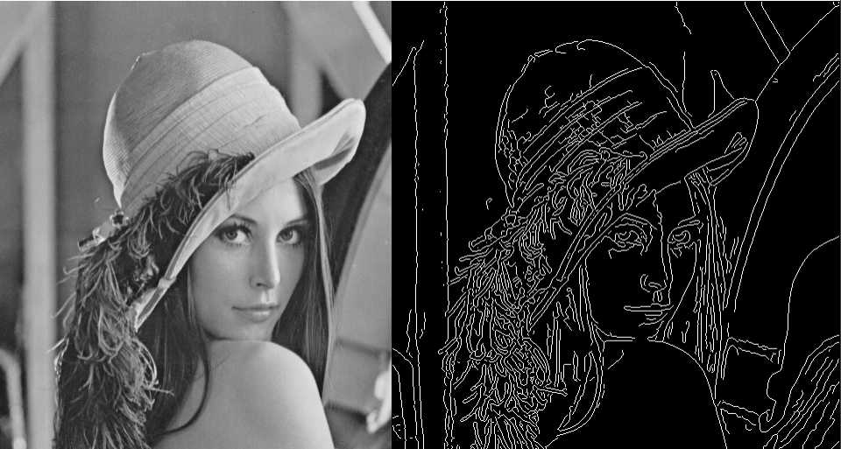
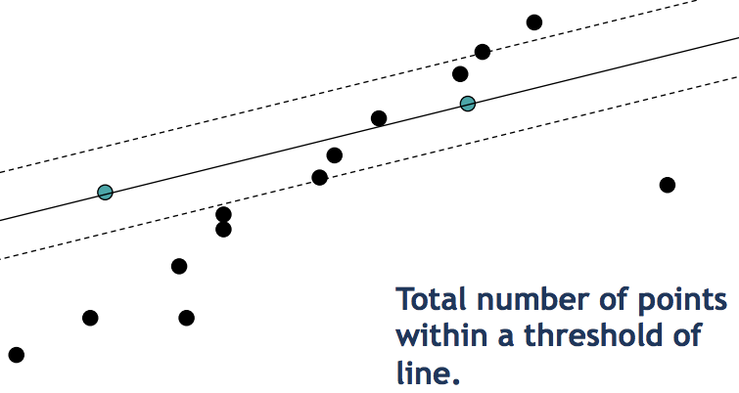
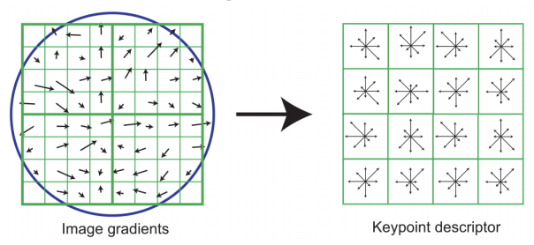
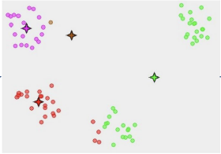
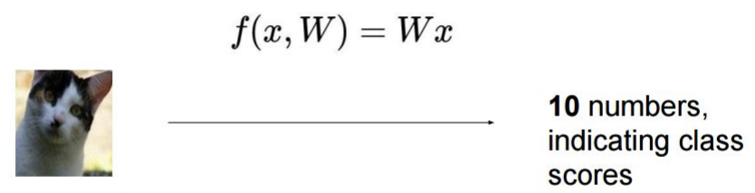
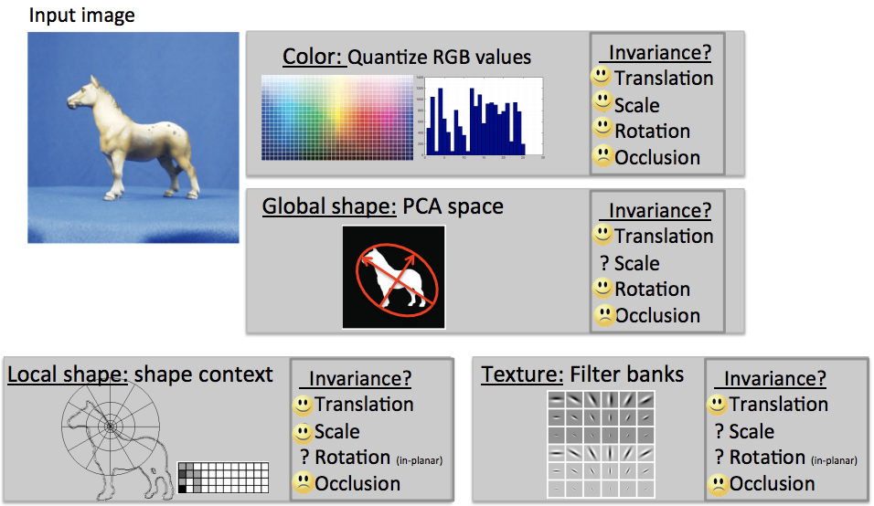
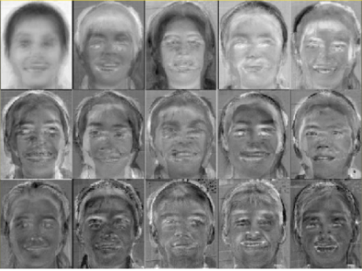
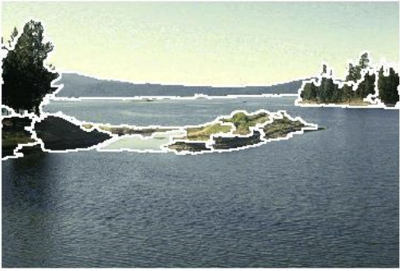
So far this quarter
Edge detection
SIFT
RANSAC
K-Means
Linear classifiers
Image features
PCA / Eigenfaces
Mean-shift

Slide 3
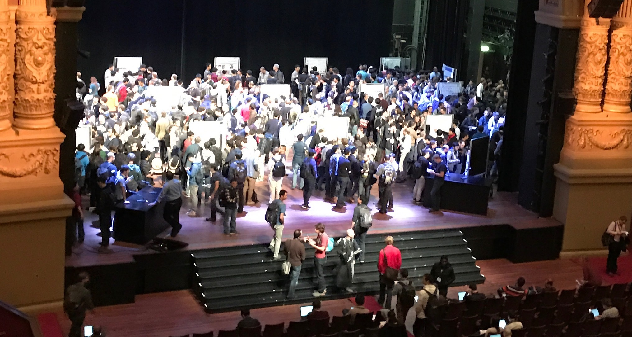
Current Research
ECCV 2016
(photo credit: Justin Johnson)

Slide 4
Current Research
Convolutional neural networks
Recurrent neural networks
Autoencoders
Fully convolutional networks
Multilayer perceptrons
ECCV 2016
(photo credit: Justin Johnson)
What are these things?
Why are they important?

Slide 5
Deep Learning
Learning hierarchical representations from data
End-to-end learning: raw inputs to predictions
Can use a small set of simple tools to solve many problems
Has led to rapid progress on many problems
(Very loosely!) Inspired by the brain
Today: 1 hour introduction to deep learning fundamentals
To learn more take CS 231n in the Spring

Slide 6
Deep learning for many different problems

Slide 7
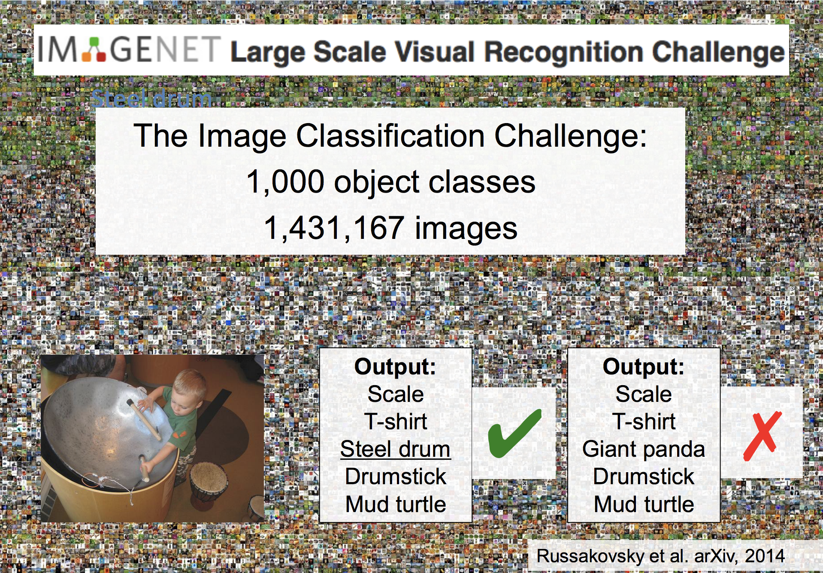

Slide 8
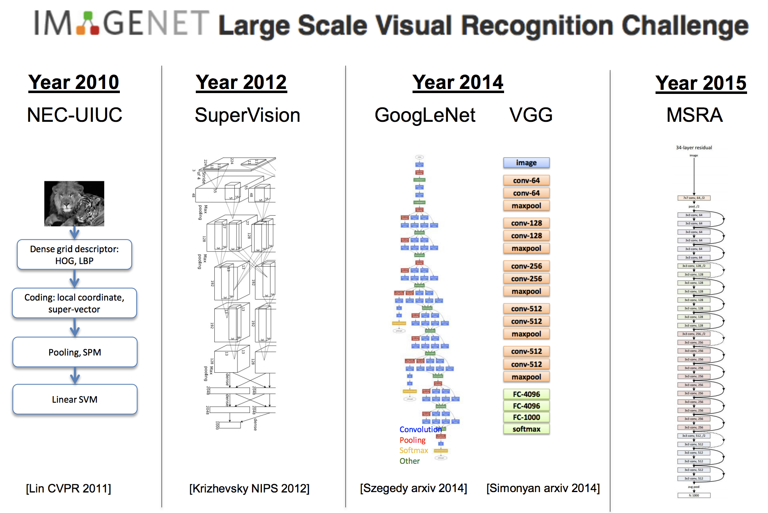
Slide credit: CS 231n, Lecture 1, 2016

Slide 9
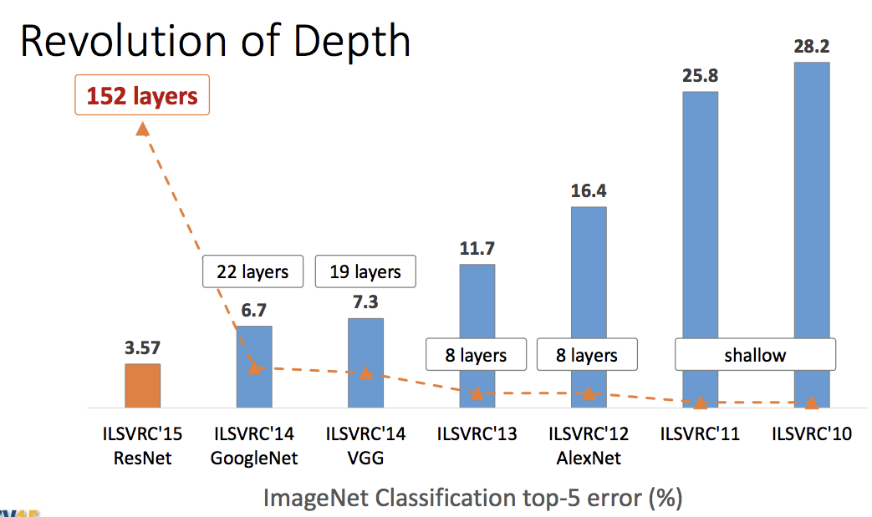
Slide credit: Kaiming He, ICCV 2015

Slide 10
≈5.1
Human
Human benchmark from Russakovsky et al, “ImageNet Large Scale Visual Recognition Challenge”, IJCV 2015
Slide credit: Kaiming He, ICCV 2015

Slide 11
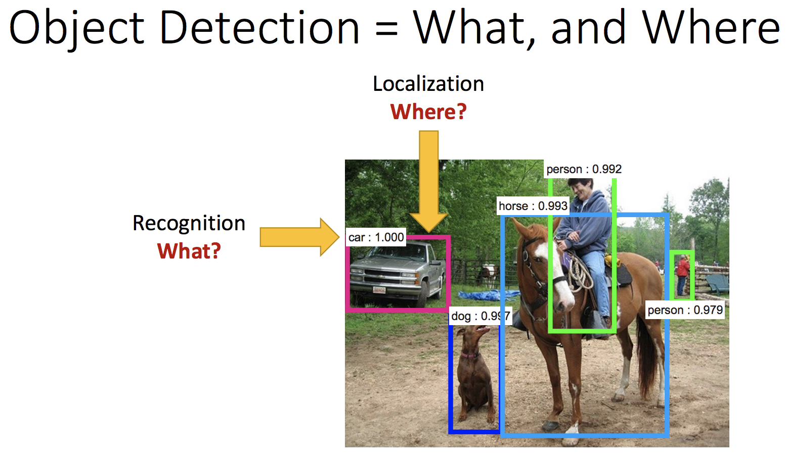
Slide credit: Kaiming He, ICCV 2015

Slide 12
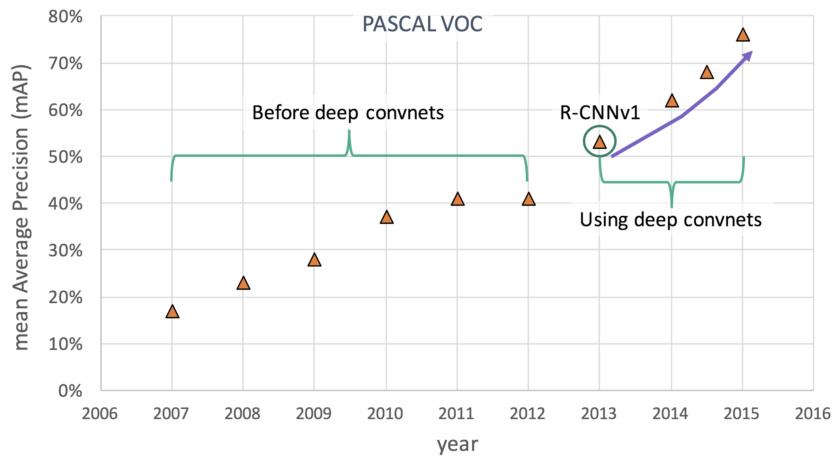
Deep Learning for Object Detection
Slide credit: Ross Girshick, ICCV 2015

Slide 13
Deep Learning for Object Detection
Current SOTA: 85.6
He et al, “Deep Residual Learning for Image Recognition”, CVPR 2016
Slide credit: Ross Girshick, ICCV 2015

Slide 14
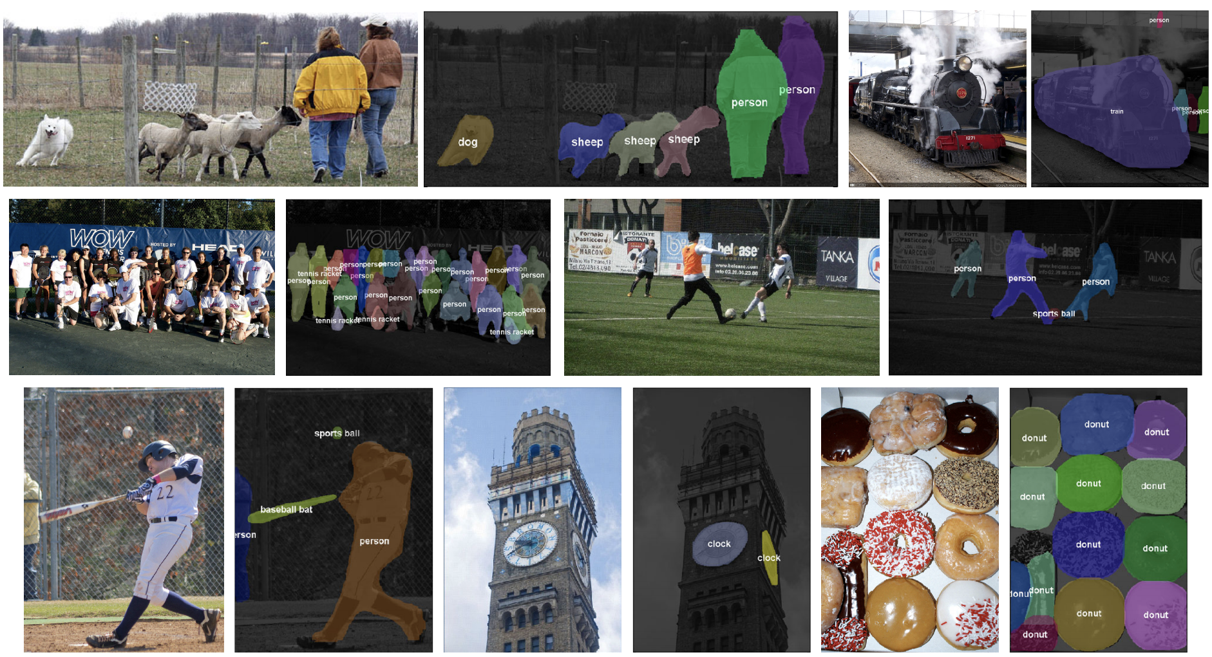
Object segmentation
Figure credit: Dai, He, and Sun, “Instance-aware Semantic Segmentation via Multi-task Network Cascades”, CVPR 2016

Slide 15
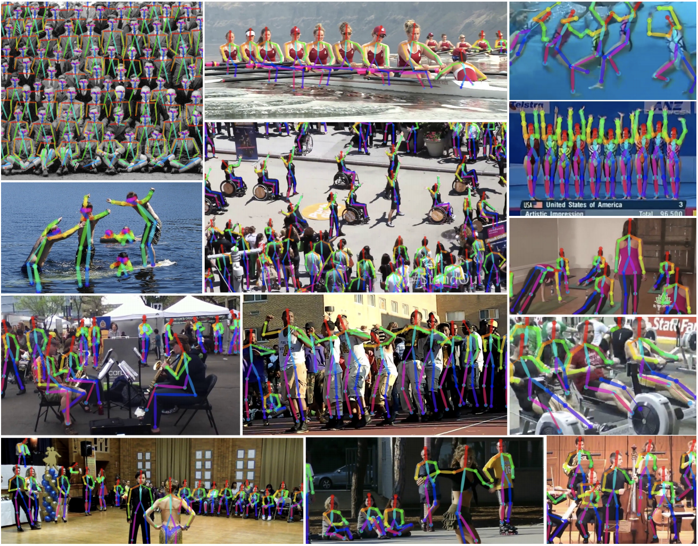
Pose Estimation
Figure credit: Cao et al, “Realtime Multi-Person 2D Pose Estimation using Part Affinity Fields”, arXiv 2016

Slide 16
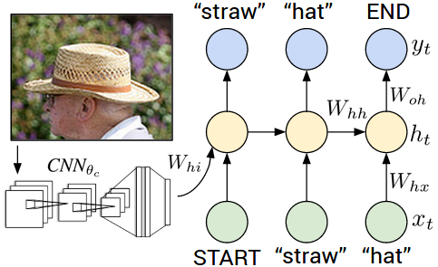
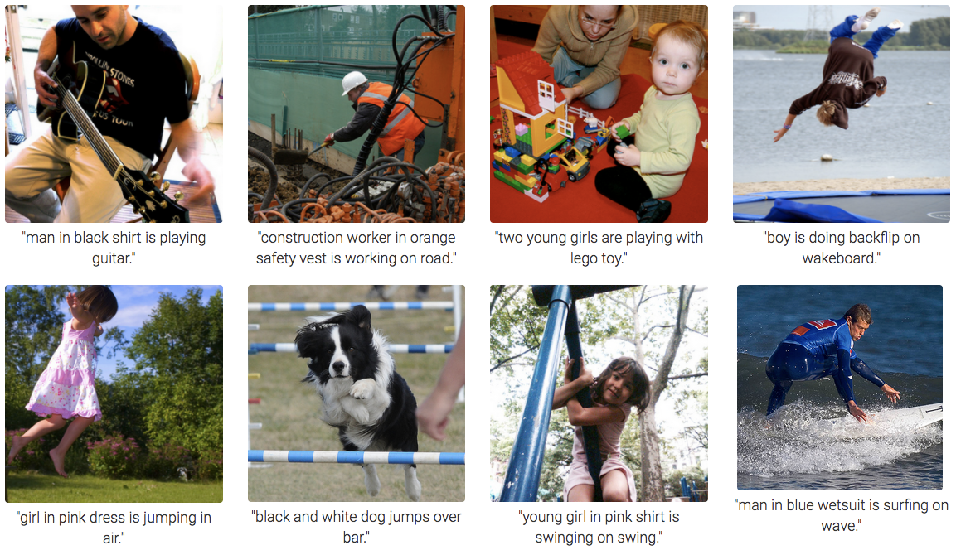
Deep Learning for Image Captioning
Figure credit: Karpathy and Fei-Fei, “Deep Visual-Semantic Alignments for Generating Image Descriptions”, CVPR 2015

Slide 17
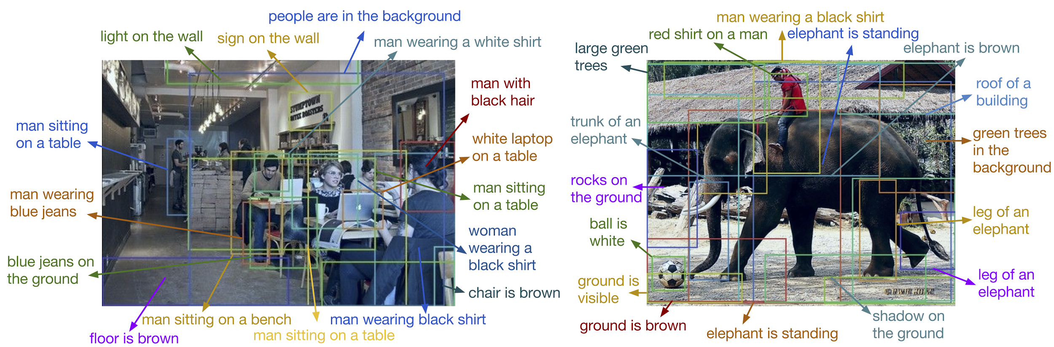
Dense Image Captioning
Figure credit: Johnson*, Karpathy*, and Fei-Fei, “DenseCap: Fully Convolutional Localization Networks for Dense Captioning”, CVPR 2016

Slide 18
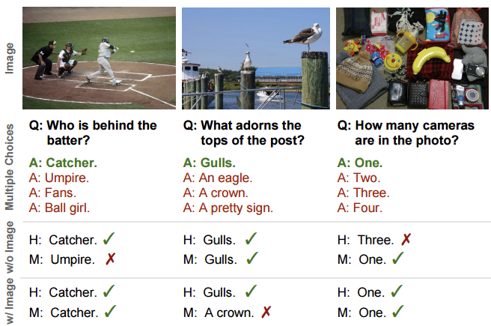
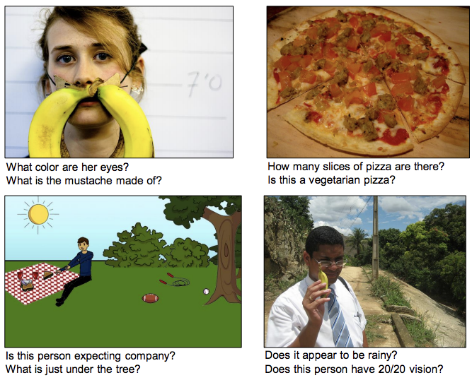
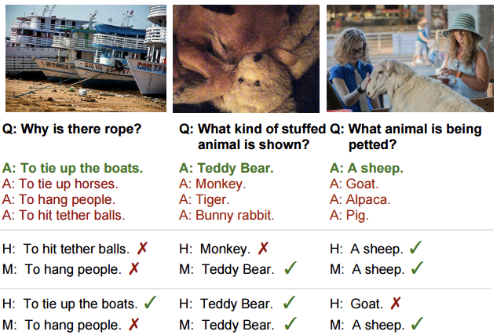
Visual Question Answering
Figure credit: Agrawal et al, “VQA: Visual Question Answering”, ICCV 2015
Figure credit: Zhu et al, “Visual7W: Grounded Question Answering in Images”, CVPR 2016

Slide 19
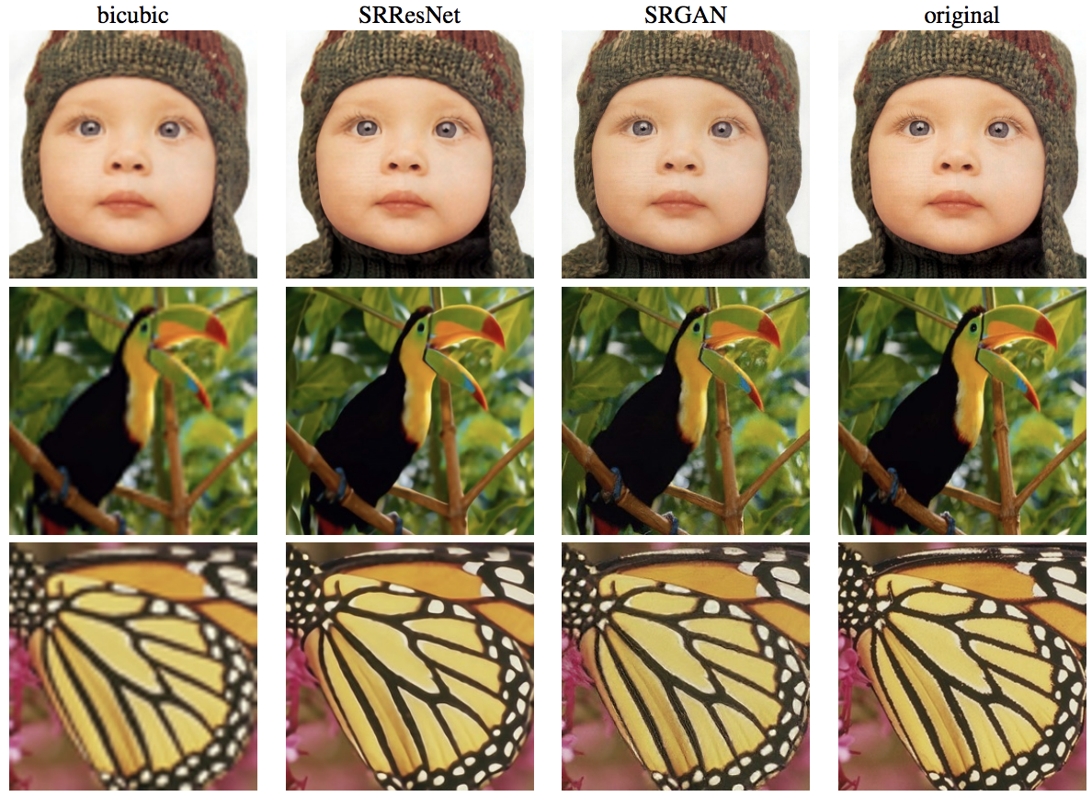
Image Super-Resolution
Figure credit: Ledig et al, “Photo-Realistic Single Image Super-Resolution Using a Generative Adversarial Network”, arXiv 2016

Slide 20
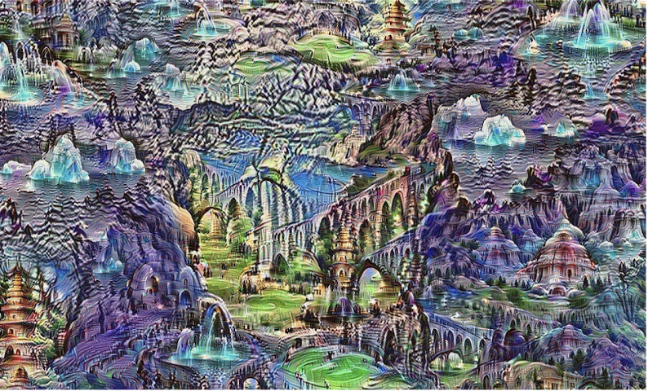
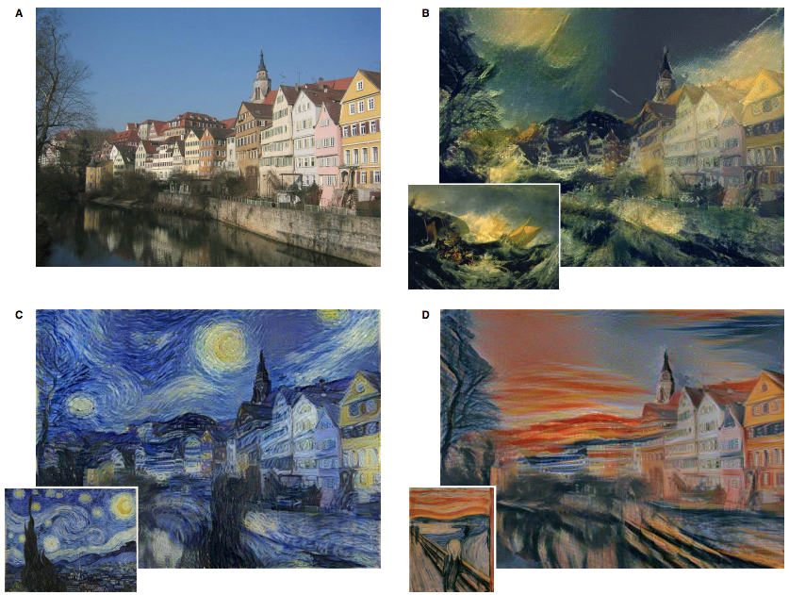
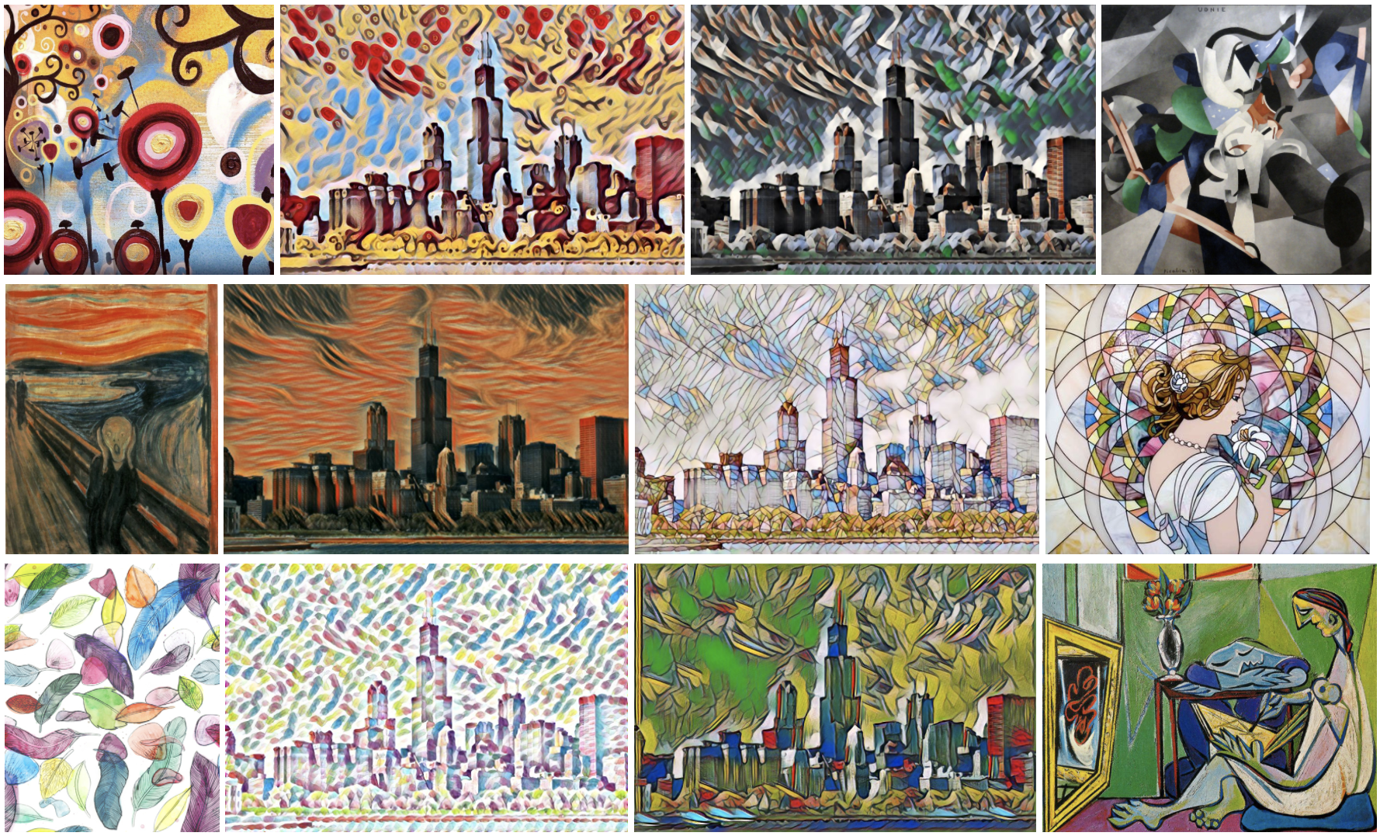
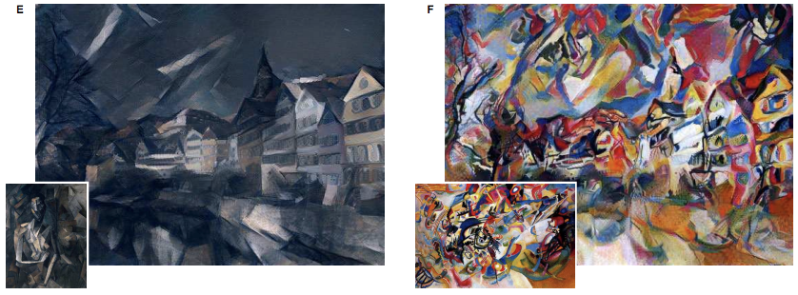
Generating Art
Figure credit: Mordvintsev, Olah, and Tyka, “Inceptionism: Going Deeper into Neural Networks”, https://research.googleblog.com/2015/06/inceptionism-going-deeper-into-neural.html
Figure credit: Gatys, Ecker, and Bethge, “Image Style Transfer using Convolutional Neural Networks”, CVPR 2016
Figure credit: Johnson, Alahi, and Fei-Fei: “Perceptual Losses for Real-Time Style Transfer and Super-Resolution”, ECCV 2016, https://github.com/jcjohnson/fast-neural-style

Slide 21
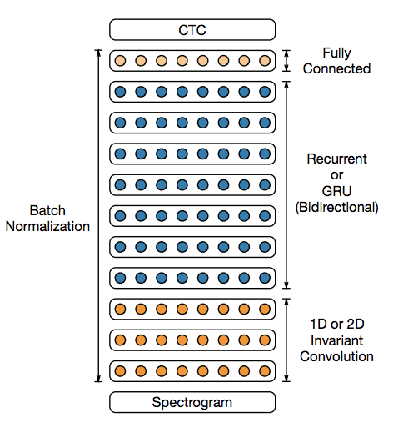
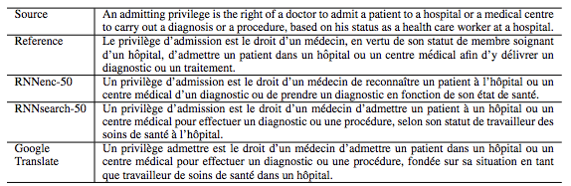
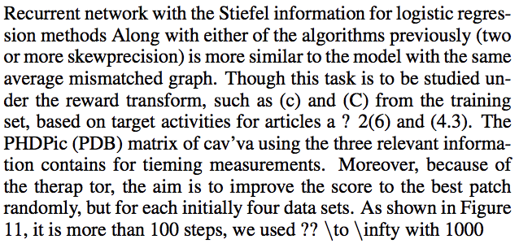

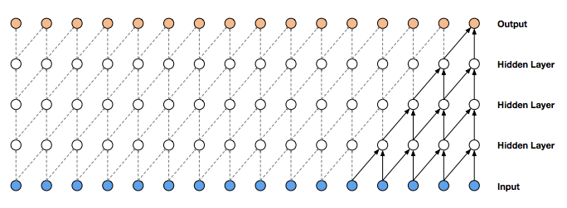
Outside Computer Vision
Speech Recognition
Machine Translation
Figure credit: Bahdanau, Cho, and Bengio, “Neural Machine Translation by jointly learning to align and translate”, ICLR 2015
Text Synthesis
Figure credit: Amodei et al, “Deep Speech 2: End-to-End Speech Recognition in English and Mandarin”, arXiv 2015
Speech Synthesis
Figure credit: Sutskever, Martens, and Hinton, “Generating Text with Recurrent Neural Networks”, ICML 2011
Figure credit: var der Oord et al, “WaveNet: A Generative Model for Raw Audio”, arXiv 2016, https://deepmind.com/blog/wavenet-generative-model-raw-audio/

Slide 22
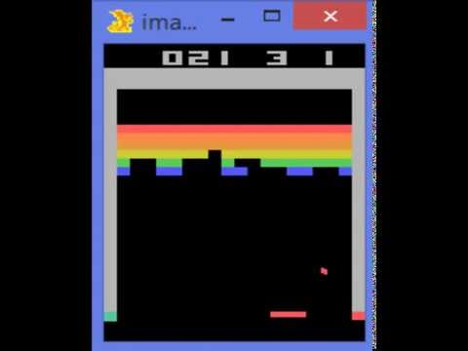
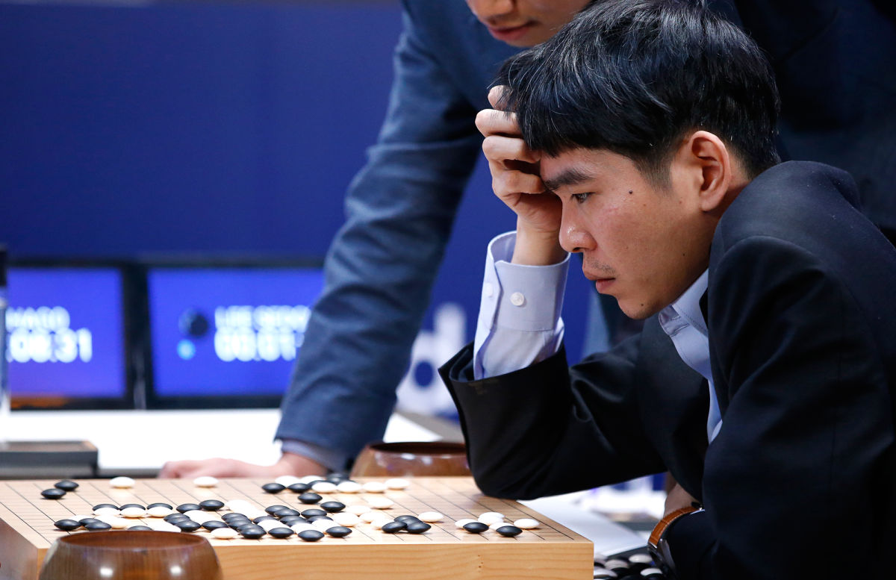
Deep Reinforcement Learning
Playing Atari games
AlphaGo beats Lee Sedol
Silver et al, “Mastering the game of Go with deep
neural networks and tree search”, Nature 2016
Image credit: http://www.newyorker.com/tech/elements/alphago-lee-sedol-and-the-reassuring-future-of-humans-and-machines
Mnih et al, “Human-level control through deep reinforcement learning”, Nature 2015

Slide 23
Outline
Applications
Motivation
Supervised learning
Gradient descent
Backpropagation
Convolutional Neural Networks

Slide 24
Outline
Applications
Motivation
Supervised learning
Gradient descent
Backpropagation
Convolutional Neural Networks

Slide 25
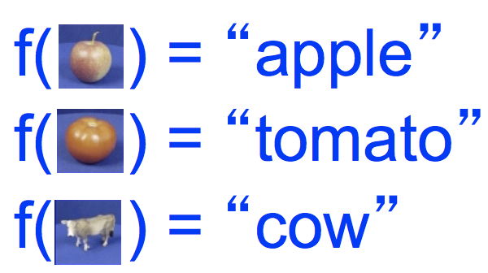

Recall: Image Classification
Write a function that maps images to labels
(also called object recognition)
Dataset: ETH-80, by B. Leibe; Slide credit: L. Lazebnik
No obvious way to implement this function!
Slide credit: CS 231n, Lecture 2, 2016

Slide 26
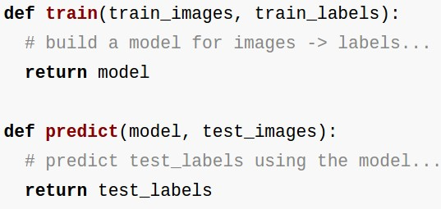
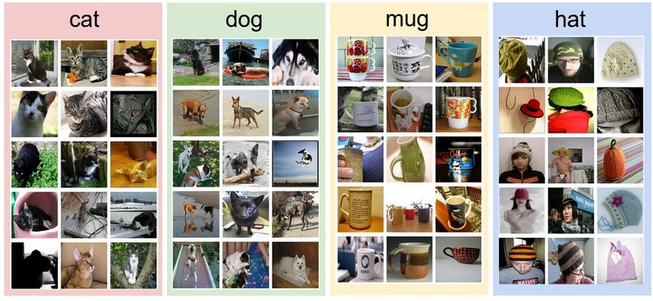
Recall: Image Classification
Data-driven approach:
Collect a dataset of images and labels
Use Machine Learning to train an image classifier
Evaluate the classifier on a withheld set of test images
Example training set
Slide credit: CS 231n, Lecture 2, 2016

Slide 27
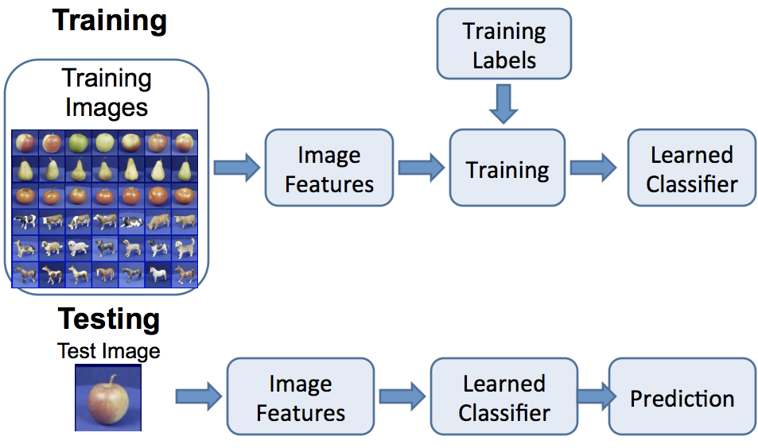
Recall: Image Classification
Figure credit: D. Hoiem, L. Lazebnik

Slide 28
Recall: Image Classification
Features remain fixed
Classifier is learned from data
Figure credit: D. Hoiem, L. Lazebnik

Slide 29
Recall: Image Classification
Features remain fixed
Classifier is learned from data
Problem:
How do we know which features to use? We may need different features for each problem!
Figure credit: D. Hoiem, L. Lazebnik

Slide 30
Recall: Image Classification
Features remain fixed
Classifier is learned from data
Problem:
How do we know which features to use? We may need different features for each problem!
Solution:
Learn the features jointly with the classifier!
Figure credit: D. Hoiem, L. Lazebnik

Slide 31
Image Classification: Feature Learning
Training labels
Training
Learned Model
Learned features
Image features
Classifier
Learned Classifier
Learned Model
Learned features
Prediction
Learned Classifier

Slide 32
Image Classification: Deep Learning
Training labels
Learned Model
Training
Low-level features
Low-level features
Classifier
Mid-level features
Model is deep: it has many layers
Mid-level features
High-level features
High-level features
Classifier
Models can learn hierarchical features

Slide 33
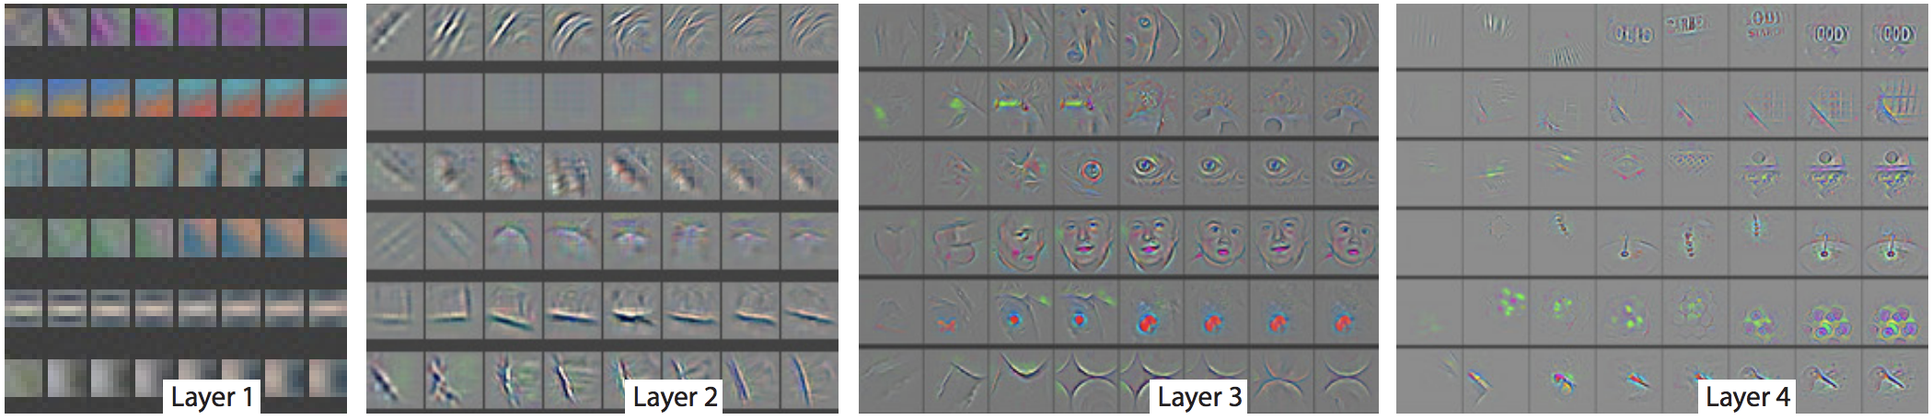
Image Classification: Deep Learning
Training labels
Learned Model
Training
Low-level features
Low-level features
Classifier
Mid-level features
Model is deep: it has many layers
Mid-level features
High-level features
High-level features
Classifier
Models can learn hierarchical features
Figure credit: Zeiler and Fergus, “Visualizing and Understanding Convolutional Networks”, ECCV 2014

Slide 34
Outline
Applications
Motivation
Supervised learning
Gradient descent
Backpropagation
Convolutional Neural Networks

Slide 35
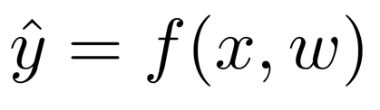
Supervised Learning in 3 easy steps
How to learn models from data
Step 1:
Define Model

Slide 36
Supervised Learning in 3 easy steps
How to learn models from data
Step 1:
Define Model
Predicted output (image label)
Model
structure
Input data
(Image pixels)
Model
weights

Slide 37
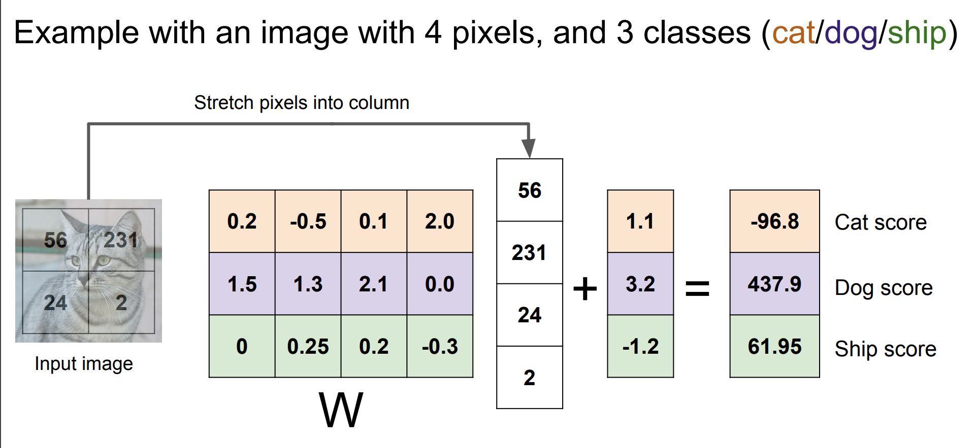
Supervised learning
b

Slide 38
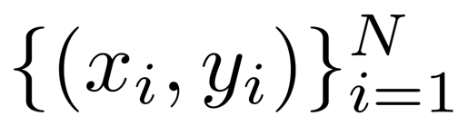
Supervised Learning in 3 easy steps
How to learn models from data
Step 2: Collect data
Step 1:
Define Model
Predicted output (image label)
Model
structure
Input data
(Image pixels)
Model
weights
Training
input
True output

Slide 39
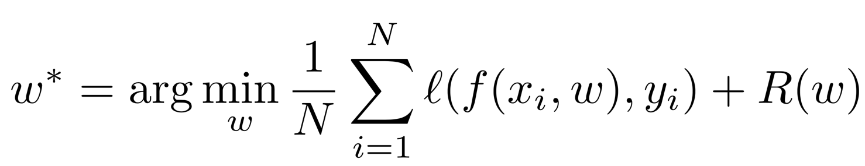
Supervised Learning in 3 easy steps
How to learn models from data
Step 2: Collect data
Step 1:
Define Model
Predicted output (image label)
Model
structure
Input data
(Image pixels)
Model
weights
Training
input
True output
Step 3: Learn the model

Slide 40
Supervised Learning in 3 easy steps
How to learn models from data
Step 2: Collect data
Step 1:
Define Model
Predicted output (image label)
Model
structure
Input data
(Image pixels)
Model
weights
Training
input
True output
Step 3: Learn the model
Predicted output
Loss function:
Measures “badness” of prediction
Regularizer:
Penalizes complex models
Learned
weights
Minimize average loss over training set

Slide 41
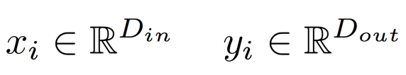
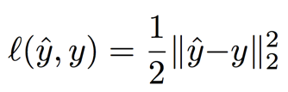

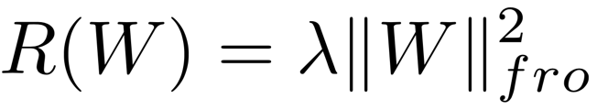
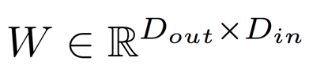
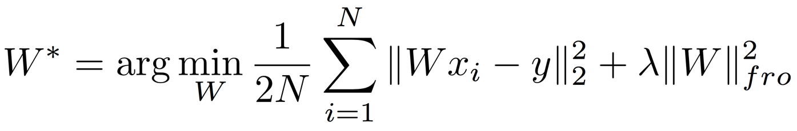
Supervised Learning: Linear regression
Sometimes called “Ridge Regression” with regularizer
Input and output are vectors
Loss is Euclidean distance
Linear Regression
Regularizer is Frobenius norm of matrix (sum of squares of entries)
Model is just a matrix multiply
Learning Problem

Slide 42
Supervised learning
b

Slide 43
Supervised Learning: Linear regression
Sometimes called “Ridge Regression” with regularizer
Input and output are vectors
Loss is Euclidean distance
Linear Regression
Regularizer is Frobenius norm of matrix (sum of squares of entries)
Model is just a matrix multiply
Learning Problem

Slide 44



Supervised Learning: Neural Network
Sometimes called “Fully-Connected Network” or “Multilayer Perceptron”
Input and output are vectors
Loss is Euclidean distance
Linear Regression
New Model
Model is just a matrix multiply
Model is two matrix multiplies

Slide 45
Supervised Learning: Neural Network
Sometimes called “Fully-Connected Network” or “Multilayer Perceptron”
Input and output are vectors
Loss is Euclidean distance
Linear Regression
New Model
Model is just a matrix multiply
Model is two matrix multiplies
Question: Is the new model “more powerful” than Linear Regression? Can it represent any functions that Linear Regression cannot?

Slide 46

Supervised Learning: Neural Network
Sometimes called “Fully-Connected Network” or “Multilayer Perceptron”
Input and output are vectors
Loss is Euclidean distance
Linear Regression
New Model
Model is just a matrix multiply
Model is two matrix multiplies
Question: Is the new model “more powerful” than Linear Regression? Can it represent any functions that Linear Regression cannot?
Answer: NO! We can write
And recover Linear Regression

Slide 47


Supervised Learning: Neural Network
Sometimes called “Fully-Connected Network” or “Multilayer Perceptron”
Input and output are vectors
Loss is Euclidean distance
Linear Regression
Neural Network
Model is just a matrix multiply
Model is two matrix multiplies, with an elementwise nonlinearity

Slide 48

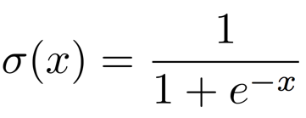
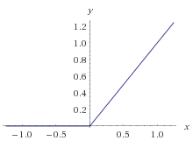
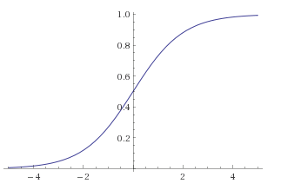
Supervised Learning: Neural Network
Sometimes called “Fully-Connected Network” or “Multilayer Perceptron”
Input and output are vectors
Loss is Euclidean distance
Linear Regression
Neural Network
Model is just a matrix multiply
Common nonlinearities:
Model is two matrix multiplies, with an elementwise nonlinearity
Rectified Linear (ReLU)
Logistic Sigmoid

Slide 49
Supervised Learning: Neural Network
Sometimes called “Fully-Connected Network” or “Multilayer Perceptron”
Input and output are vectors
Loss is Euclidean distance
Linear Regression
Neural Network
Model is just a matrix multiply
Common nonlinearities:
Model is two matrix multiplies, with an elementwise nonlinearity
Rectified Linear (ReLU)
Logistic Sigmoid
Neural Network is more powerful than Linear Regression!

Slide 50

Neural Networks with many layers
Sometimes called “Fully-Connected Network” or “Multilayer Perceptron”
Two Layer network

Slide 51


Neural Networks with many layers
Sometimes called “Fully-Connected Network” or “Multilayer Perceptron”
Three Layer network
Two Layer network

Slide 52
Neural Networks with many layers
Sometimes called “Fully-Connected Network” or “Multilayer Perceptron”
Three Layer network
Two Layer network
Hidden layers are learned feature representations of the input!

Slide 53
Outline
Applications
Motivation
Supervised learning
Gradient descent
Backpropagation
Convolutional Neural Networks

Slide 54

How to find best weights ?

Slide 55


How to find best weights ?
Slide credit: CS 231n, Lecture 3

Slide 56
How to find best weights ?
Idea #1: Closed Form Solution
Works for some models (linear regression) but in general very hard (even for one-layer net)
Slide credit: CS 231n, Lecture 3

Slide 57
How to find best weights ?
Idea #1: Closed Form Solution
Works for some models (linear regression) but in general very hard (even for one-layer net)
Idea #2: Random Search
Try a bunch of random values for w, keep the best one
Extremely inefficient in high dimensions
Slide credit: CS 231n, Lecture 3

Slide 58
How to find best weights ?
Idea #1: Closed Form Solution
Works for some models (linear regression) but in general very hard (even for one-layer net)
Idea #2: Random Search
Try a bunch of random values for w, keep the best one
Extremely inefficient in high dimensions
Idea #3: Go downhill
Start somewhere random, take tiny steps downhill and repeat
Good idea!
Slide credit: CS 231n, Lecture 3

Slide 59

Which way is downhill?
Recall from single-variable calculus:
If w is a scalar the derivative tells us how much g will change if w changes a little bit

Slide 60


Which way is downhill?
Recall from single-variable calculus:
If w is a scalar the derivative tells us how much g will change if w changes a little bit
And multivariable calculus:
If w is a vector then we can take partial derivatives with respect to each component
The gradient is the vector of all partial derivatives; it has the same shape as w

Slide 61
Which way is downhill?
Recall from single-variable calculus:
If w is a scalar the derivative tells us how much g will change if w changes a little bit
And multivariable calculus:
If w is a vector then we can take partial derivatives with respect to each component
The gradient is the vector of all partial derivatives; it has the same shape as w
Useful fact: The gradient of g at w gives the direction of steepest increase

Slide 62

Gradient descent
The simple algorithm behind all deep learning
Initialize w randomly
While true:
Compute gradient at current point
Move downhill a little bit:

Slide 63
Gradient descent
The simple algorithm behind all deep learning
Initialize w randomly
While true:
Compute gradient at current point
Move downhill a little bit:
Learning rate: How big each step should be

Slide 64
Gradient descent
The simple algorithm behind all deep learning
In practice we estimate the gradient using a small minibatch of data
(Stochastic gradient descent)
Initialize w randomly
While true:
Compute gradient at current point
Move downhill a little bit:
Learning rate: How big each step should be

Slide 65
Gradient descent
The simple algorithm behind all deep learning
In practice we estimate the gradient using a small minibatch of data
(Stochastic gradient descent)
Initialize w randomly
While true:
Compute gradient at current point
Move downhill a little bit:
The update rule is the formula for updating the weights at each iteration; in practice people use fancier rules
(momentum, RMSProp, Adam, etc)
Learning rate: How big each step should be

Slide 66

Gradient descent
The simple algorithm behind all deep learning
Image credit: Alec Radford

Slide 67
Outline
Applications
Motivation
Supervised learning
Gradient descent
Backpropagation
Convolutional Neural Networks

Slide 68


How to compute gradients?
Work it out on paper?
Linear Regression
?
Doable for simple models

Slide 69


How to compute gradients?
Work it out on paper?
Three layer network
Gets hairy for more complex models

Slide 70


Backpropagation
Computational graph
e.g. x = -2, y = 5, z = -4
Slide credit: CS 231n, Lecture 4

Slide 71





Backpropagation
Computational graph
e.g. x = -2, y = 5, z = -4
Want:
Slide credit: CS 231n, Lecture 4

Slide 72

Backpropagation
Computational graph
e.g. x = -2, y = 5, z = -4
Want:
Slide credit: CS 231n, Lecture 4

Slide 73
Backpropagation
Computational graph
e.g. x = -2, y = 5, z = -4
Want:
Slide credit: CS 231n, Lecture 4

Slide 74
Backpropagation
Computational graph
e.g. x = -2, y = 5, z = -4
Want:
Slide credit: CS 231n, Lecture 4

Slide 75
Backpropagation
Computational graph
e.g. x = -2, y = 5, z = -4
Want:
Slide credit: CS 231n, Lecture 4

Slide 76

Backpropagation
Computational graph
e.g. x = -2, y = 5, z = -4
Want:
Slide credit: CS 231n, Lecture 4

Slide 77
Backpropagation
Computational graph
e.g. x = -2, y = 5, z = -4
Want:
Slide credit: CS 231n, Lecture 4

Slide 78
Backpropagation
Computational graph
e.g. x = -2, y = 5, z = -4
Want:
Slide credit: CS 231n, Lecture 4

Slide 79

Backpropagation
Computational graph
e.g. x = -2, y = 5, z = -4
Chain rule:
Want:
Slide credit: CS 231n, Lecture 4

Slide 80
Backpropagation
Computational graph
e.g. x = -2, y = 5, z = -4
Want:
Slide credit: CS 231n, Lecture 4

Slide 81
Backpropagation
Computational graph
e.g. x = -2, y = 5, z = -4
Chain rule:
Want:
Slide credit: CS 231n, Lecture 4

Slide 82
Backpropagation
Computational graph nodes can be vectors or matrices or n-dimensional tensors
W₁
W₂
x
*
*
y

Slide 83
Backpropagation
Computational graph nodes can be vectors or matrices or n-dimensional tensors
W₁
W₂
x
*
*
y
Forward pass: Run graph “forward” to compute loss
Backward pass: Run graph “backward” to compute gradients with respect to loss
Easily compute gradients for big, complex models!

Slide 84

Backpropagation
Computational graph nodes can be vectors or matrices or n-dimensional tensors
W₁
W₂
x
*
*
y
Forward pass: Run graph “forward” to compute loss
Backward pass: Run graph “backward” to compute gradients with respect to loss
Easily compute gradients for big, complex models!
Tensors flow along edges in the graph

Slide 85

A two-layer neural network in 25 lines of code

Slide 86
A two-layer neural network in 25 lines of code
Randomly initialize weights

Slide 87
A two-layer neural network in 25 lines of code
Get a batch of (random) data

Slide 88
A two-layer neural network in 25 lines of code
ReLU nonlinearity
Forward pass: compute loss
Loss is Euclidean distance

Slide 89
A two-layer neural network in 25 lines of code
Backward pass: compute gradients

Slide 90
A two-layer neural network in 25 lines of code
Update weights

Slide 91

A two-layer neural network in 25 lines of code
When you run this code: loss goes down!

Slide 92
Outline
Applications
Motivation
Supervised learning
Gradient descent
Backpropagation
Convolutional Neural Networks

Slide 93
Convolution Layer
32x32x3 image
32
height
32
width
3
depth
Slide credit: CS 231n, Lecture 7

Slide 94
Convolution Layer
32x32x3 image
5x5x3 filter
32
Convolve the filter with the image
i.e. “slide over the image spatially, computing dot products”
32
3
Slide credit: CS 231n, Lecture 7

Slide 95
Convolution Layer
Filters always extend the full depth of the input volume
32x32x3 image
5x5x3 filter
32
Convolve the filter with the image
i.e. “slide over the image spatially, computing dot products”
32
3
Slide credit: CS 231n, Lecture 7

Slide 96


Convolution Layer
32x32x3 image
5x5x3 filter
32
1 number:
the result of taking a dot product between the filter and a small 5x5x3 chunk of the image
(i.e. 5*5*3 = 75-dimensional dot product + bias)
32
3
Slide credit: CS 231n, Lecture 7

Slide 97
Convolution Layer
activation map
32x32x3 image
5x5x3 filter
32
28
convolve (slide) over all spatial locations
32
28
3
1
Translation Invariance!
Slide credit: CS 231n, Lecture 7

Slide 98
Convolution Layer
consider a second, green filter
32x32x3 image
5x5x3 filter
activation maps
32
28
convolve (slide) over all spatial locations
32
28
3
1
Slide credit: CS 231n, Lecture 7

Slide 99
Convolution Layer
For example, if we had 6 5x5 filters, we’ll get 6 separate activation maps:
activation maps
32
28
Convolution Layer
32
28
3
6
We stack these up to get a “new image” of size 28x28x6!
Slide credit: CS 231n, Lecture 7

Slide 100
Convolutional Neural Networks (CNN)
A CNN is a sequence of convolution layers and nonlinearities
32
28
24
….
CONV,
ReLU
e.g. 6 5x5x3 filters
CONV,
ReLU
e.g. 10 5x5x6 filters
CONV,
ReLU
32
28
24
3
6
10
Slide credit: CS 231n, Lecture 7

Slide 101


Case Study: GoogLeNet
[Szegedy et al., 2014]
Inception module
ILSVRC 2014 winner (6.7% top 5 error)
Slide credit: CS 231n, Lecture 7

Slide 102
Recap
Applications
Motivation
Supervised learning
Gradient descent
Backpropagation
Convolutional Neural Networks

