Slide 1
Lecture: Object detection
Juan Carlos Niebles and Ranjay Krishna
Stanford Vision and Learning Lab

Slide 2
What we will learn today
Object detection
Task and evaluation
A simple detector
Deformable parts model

Slide 3
What we will learn today
Object detection
Task and evaluation
A simple detector
Deformable parts model

Slide 4
Object Detection
Credit: Flickr user neilalderney123
What do you see in the image?

Slide 5
Object Detection
Problem: Detecting and localizing generic objects from various categories, such as cars, people, etc.
Challenges:
Illumination,
viewpoint,
deformations,
Intra-class variability

Slide 6
Object Detection Benchmarks
PASCAL VOC Challenge
20 categories
Annual classification, detection, segmentation, … challenges
Notes:
Key to progress!
Good design of data
Large scale
Large variations

Slide 7
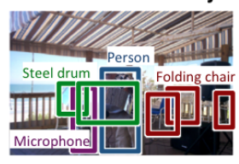
Object Detection Benchmarks
PASCAL VOC Challenge
ImageNet Large Scale Visual Recognition Challenge (ILSVR)
200 Categories for detection
Notes:
Key to progress!
Good design of data
Large scale
Large variations

Slide 8
Object Detection Benchmarks
PASCAL VOC Challenge
ImageNet Large Scale Visual Recognition Challenge (ILSVR)
Common Objects in Context (COCO)
80 Object categories
Notes:
Key to progress!
Good design of data
Large scale
Large variations

Slide 9
How do we evaluate object detection?
predictions
ground truth

Slide 10
How do we evaluate object detection?
predictions
ground truth
True positive:
- The overlap of the prediction with the ground truth is MORE than 0.5

Slide 11
How do we evaluate object detection?
predictions
ground truth
True positive:
False positive:
- The overlap of the prediction with the ground truth is LESS than 0.5

Slide 12
How do we evaluate object detection?
predictions
ground truth
True positive:
False positive:
False negative:
- The objects that our model doesn’t find

Slide 13
How do we evaluate object detection?
predictions
ground truth
True positive:
False positive:
False negative:
- The objects that our model doesn’t find
What is a True Negative?

Slide 14
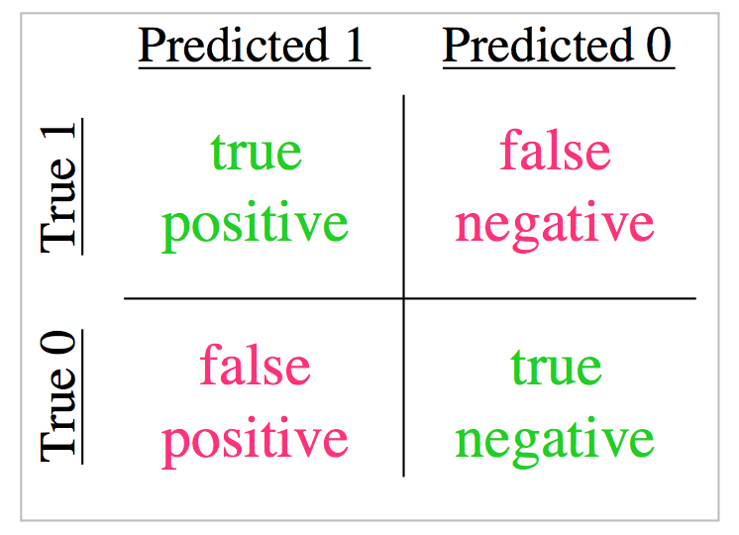

Slide 15
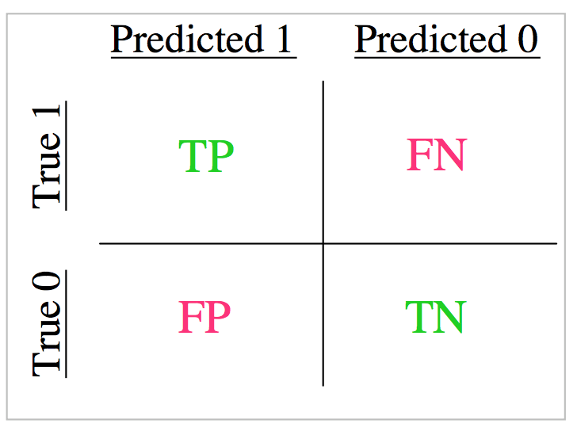

Slide 16
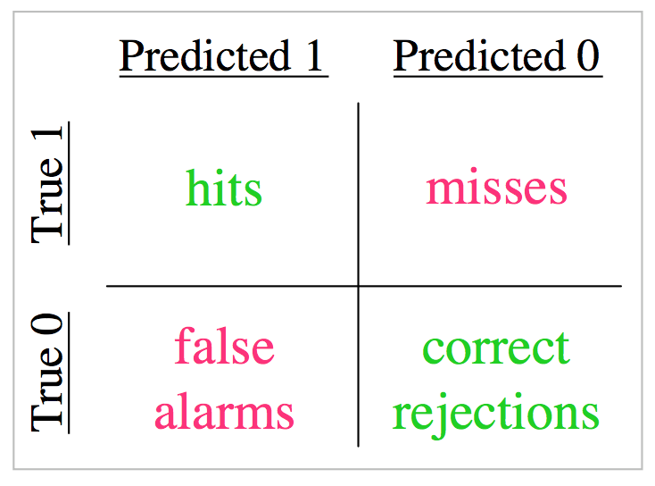

Slide 17
$$precision= \frac{TP}{TP+FP}$$
$$recall= \frac{TP}{TP+FN}$$

Slide 18
How do we evaluate object detection?
predictions
ground truth
True positive: 1
False positive: 2
False negative: 1
So what is the
- precision?
- recall?

Slide 19
Precision versus recall
Precision:
how many of the object detections are correct precision
Recall:
how many of the ground truth objects can the model detect?

Slide 20
In reality, our model makes a lot of predictions with varying scores between 0 and 1
predictions
ground truth
Here are all the boxes that are predicted with score > 0.
This means that our
Recall is perfect!
But our precision is BAD!

Slide 21
In reality, our model makes a lot of predictions with varying scores between 0 and 1
predictions
ground truth
There are no boxes that are predicted with score = 1.
This means that our
Precision is undefined!
And our recall is BAD!

Slide 22
How do we evaluate object detection?
predictions
ground truth
Here are all the boxes that are predicted with score > 0.5
We are setting a threshold of 0.5

Slide 23
Precision – recall curve (PR curve)

Slide 24
Which model is the best?

Slide 25
Which model is the best?
Notes:
Area under curve,
Operating point

Slide 31
What we will learn today
Object detection
Task and evaluation
A simple detector
Deformable parts model

Slide 32
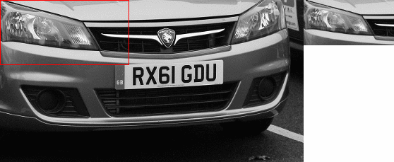
Dalal-Triggs method
sliding window

Slide 33
Recap – HOG features
Find a HOG template and use as filter

Slide 34
Sliding window + hog features
Slide through the image and check if there is an object at every location
No person here

Slide 35
Sliding window + hog features
Slide through the image and check if there is an object at every location
YES!! Person match found

Slide 36
Sliding window + hog features
But what if we were looking for buses?
No bus found

Slide 37
Sliding window + hog features
But what if we were looking for buses?
No bus found

Slide 38
Sliding window + hog features
We will never find the object we don’t choose our window size wisely!
No bus found

Slide 39
Sliding window + hog features
We need to do multi scale sliding window

Slide 40
Create a feature pyramid

Slide 41
What we will learn today
Object detection
Task and evaluation
A simple detector
Deformable parts model

Slide 42
Recap – bag of visual words
We can present images as a set of words
Where each word represents a part of the image.
Can we do the same for objects within those images?

Slide 43
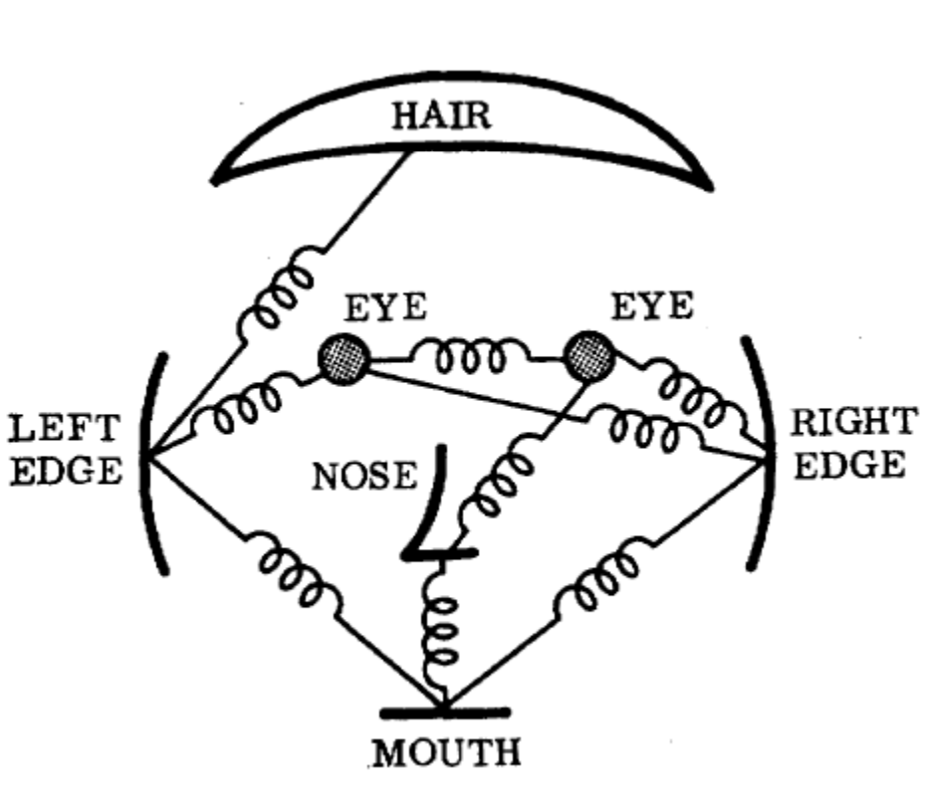
Deformable parts model
Represents an object as a collection of parts arranged in a deformable configuration
Each part represents local appearances
Spring-like connections between certain pairs of parts
Fischler and Elschlager, Pictoral Structures,
1973

Slide 44
Deformable parts model
The parts of an object form pairwise relationships.
We can model this using a “star model”
where every part is defined relative to a root.

Slide 45
Detecting a person with their parts
For example, a person can be modelled as having a head, left arm, right arm, etc.
All parts can be modelled relative to the global person detector

Slide 46
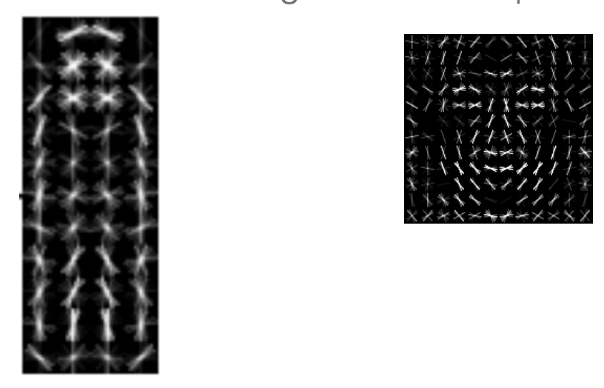
Deformable parts model
Mixture of deformable part models
Each component has global component + deformable parts
Part filters have finer details

Slide 47
Deformable parts model
Each model will have a global filter. And a set of part filters. Here is an example of a global person filter with it’s ‘head’ part filter:

Slide 48
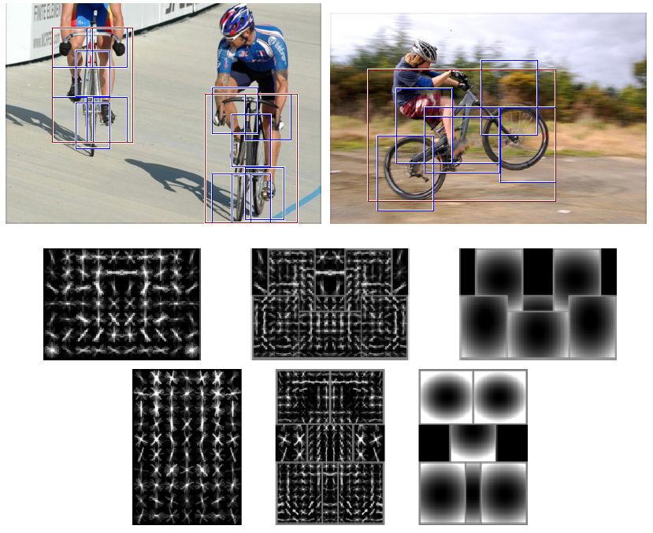
Two-component bicycle model
“side” component
“frontal” component

Slide 49
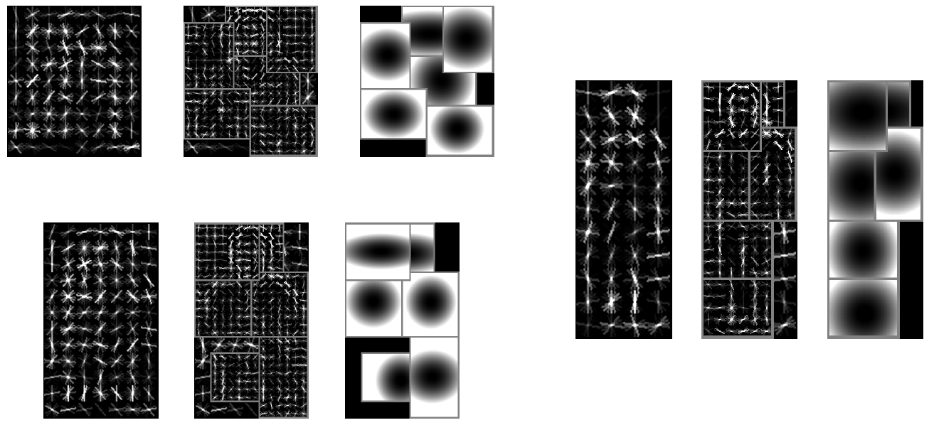
Six-component person model

Slide 50
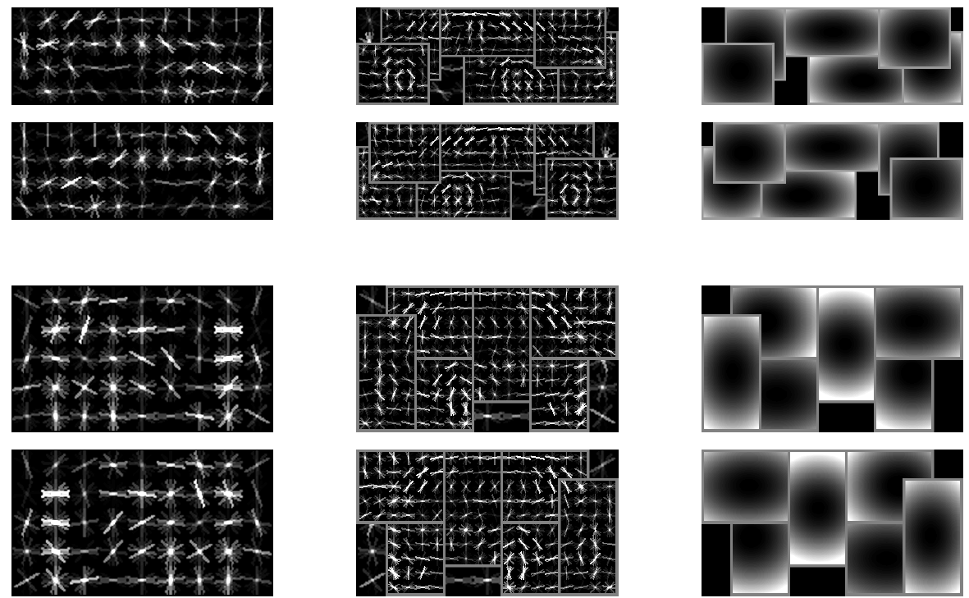
Six-component car model
side view
frontal view
root filters (coarse)
part filters (fine)
deformation models

Slide 51
Remember from Dalal and Triggs

Slide 52
Deformable parts model

Slide 53
Deformable parts calculates a score for each part along with a global score

Slide 54
Calculating the score for a detection
The score for a detection is defined as the score for the global detector minus the sum of deformation costs for each part.
This means that if a detection’s
parts are really far away from
where they should be, it’s
probably a false positive.

Slide 55
Calculating the score for a detection
The score for a detection is defined as the score for the global detector minus the sum of deformation costs for each part.

Slide 56
Calculating the score for a detection
The score for a detection is defined as the score for the global detector minus the sum of deformation costs for each part.
$$detection score= \prod_{i=0}^{n}{Fi φ\left(pi, H\right)− \sum_{i=1}^{n}{di (dxi, dyi,dxi2, dyi2)}}$$

Slide 57
Calculating the score for a detection
$$detection score= \prod_{i=0}^{n}{Fi φ\left(pi, H\right)}− \sum_{i=1}^{n}{di (dxi, dyi,dxi2, dyi2)}$$
Scores for each part filter + global filter (same as Dalal and Triggs).

Slide 58
Calculating the score for a detection
$$detection score= \prod_{i=0}^{n}{Fi φ\left(pi, H\right)}− \sum_{i=1}^{n}{di (dxi, dyi, dxi2, dyi2)}$$
The deformation costs for each part. $dxi$ measures the distance in the x-direction from where part_{i} should be. $dyi$ measures the same in the y-axis direction. $di$ is the weight associated for part_{i} that penalizes the part for being away.

Slide 59
Calculating the score for a detection
$$detection score= \prod_{i=0}^{n}{Fi φ\left(pi, H\right)}− \sum_{i=1}^{n}{di (dxi, dyi, dxi2, dyi2)}$$
If $di$ = (0, 0, 1, 0). What does this mean?

Slide 60
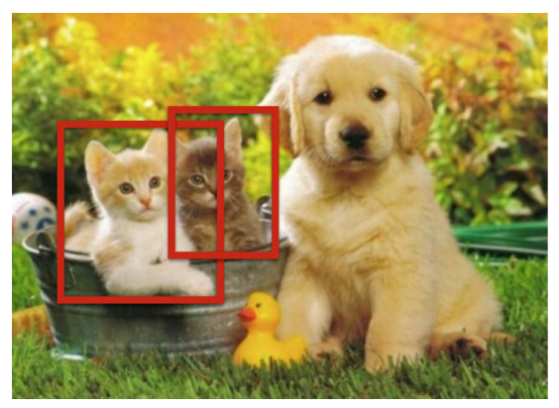
Detection pipeline
So, to make a detection, we use the sliding window technique and use the global filter first.
Whenever, the global filters detects an object, we use the part filters to calculate it’s score.

Slide 61
Overall detection pipeline Let’s break this down

Slide 62
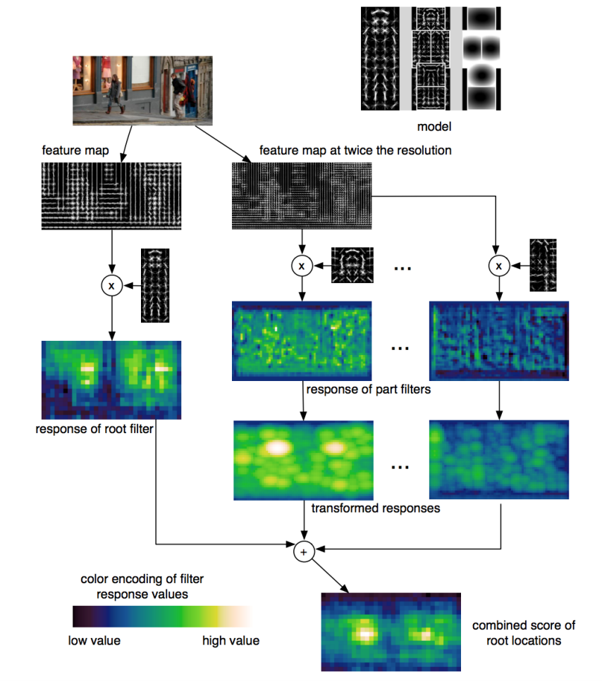
Detection pipeline
First, make sure you have filters for the global and the parts: $Fi$

Slide 63
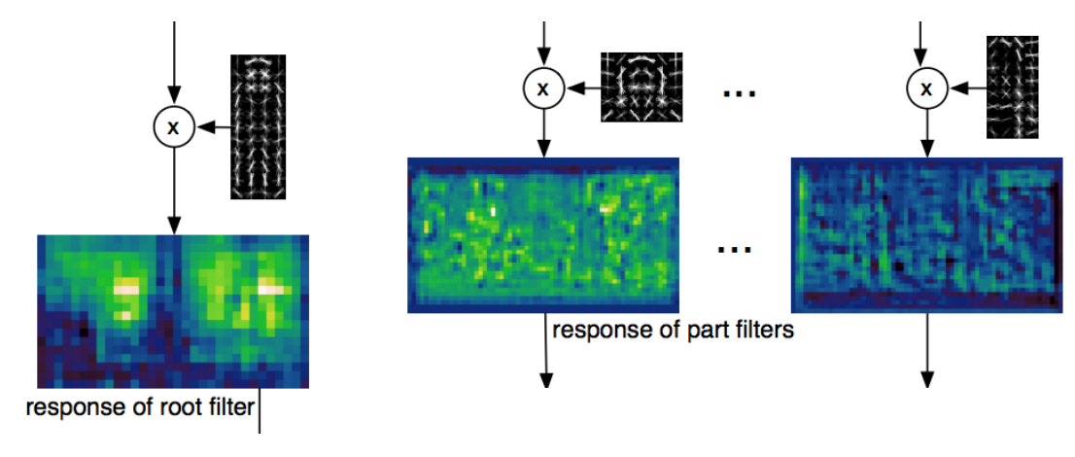
Detection pipeline
Apply the filters:
$$\prod_{i=0}^{n}{Fi φ\left(pi, H\right)}$$

Slide 64
Transformation
Given the location for the detected head, we can guess where the body should be.
The body should be in the direction calculated from the root person filter.
head
body

Slide 65
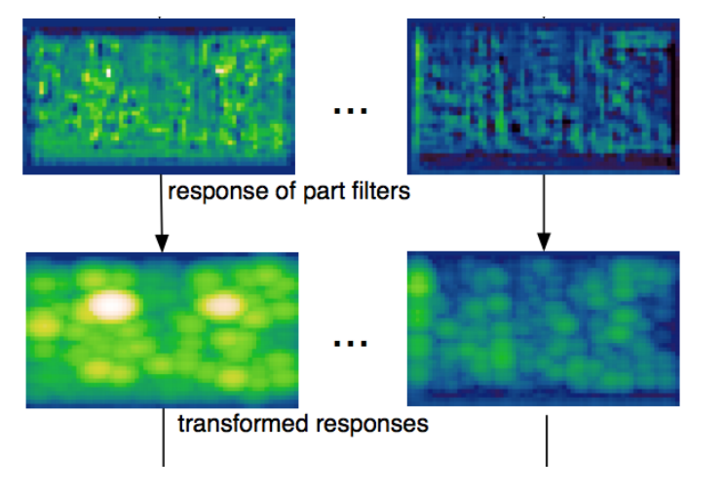
Detection pipeline
Now apply the spatial costs:
$$detection score= \prod_{i=1}^{n}{Fi φ\left(pi, H\right)− \sum_{i=1}^{n}{di (dxi, dyi,dxi2, dyi2)}}$$

Slide 66
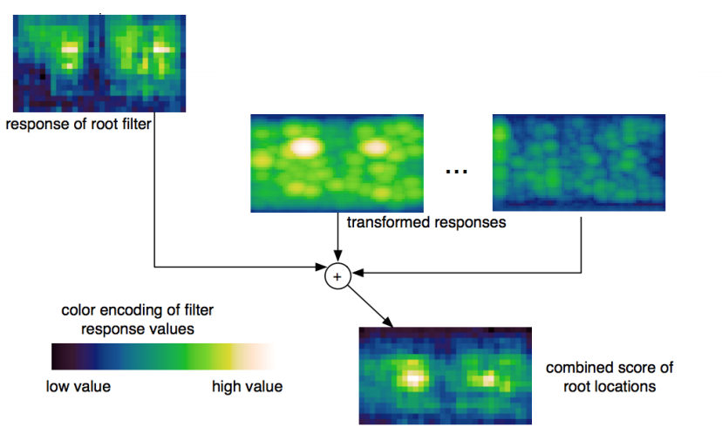
Detection pipeline
Now add the global filter:
$$detection score=F0+\prod_{i=1}^{n}{Fi φ\left(pi, H\right)− \sum_{i=1}^{n}{di (dxi, dyi,dxi2, dyi2)}}$$

Slide 67
DPM - bicycle

Slide 68
DPM - person

Slide 69
DPM - bottle

Slide 70
Results – car detection

Slide 71
Results – Person detection

Slide 72
Results – horse detection

Slide 73
DPM - discussion
Approach
Manually selected set of parts - Specific detector trained for each part
Spatial model trained on part activations
Evaluate joint likelihood of part activations
Advantages
Parts have intuitive meaning.
Standard detection approaches can be used for each part.
Works well for specific categories.
Disadvantages
Parts need to be selected manually
Semantically motivated parts sometimes don’t have a simple appearance distribution
No guarantee that some important part hasn’t been missed
When switching to another category, the model has to be rebuilt from scratch.

Slide 74
Extensions - From star shaped model to constellation model

Slide 75
What we have learned today
Object detection
Task and evaluation
A simple detector
Deformable parts model

