Slide 1
Lecture:
Visual Bag of Words
Juan Carlos Niebles and Ranjay Krishna
Stanford Vision and Learning Lab

Slide 2
What we will learn today
Visual bag of words (BoW)
Spatial Pyramid Matching
Naive Bayes

Slide 3
What we will learn today
Visual bag of words (BoW)
Spatial Pyramid Matching
Naïve Bayes

Slide 4
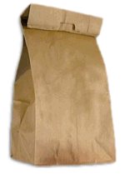
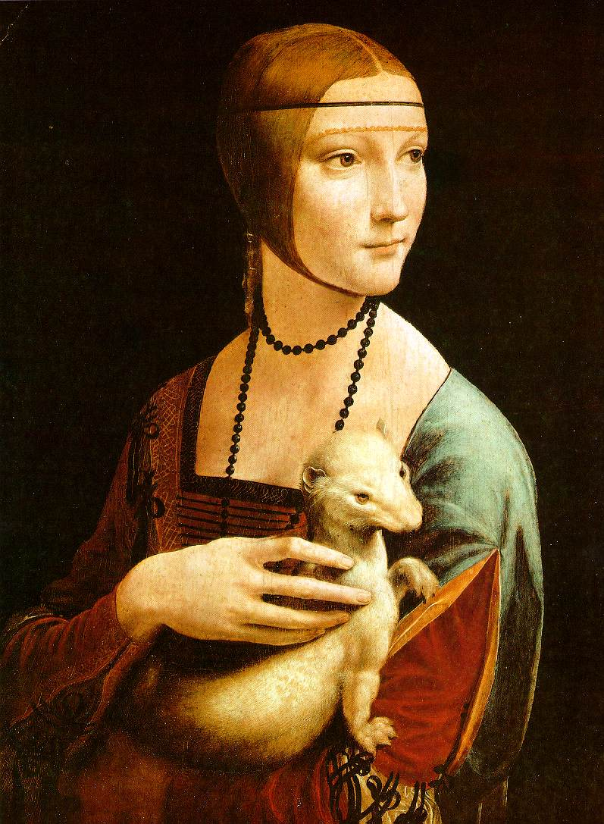
Bag of Words
Models
Adapted from slides by Rob Fergus and Svetlana Lazebnik

Slide 5
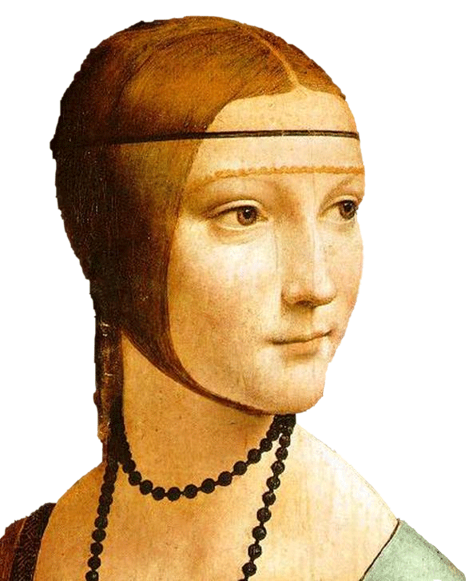
Object
Bag of ‘words’

Slide 6
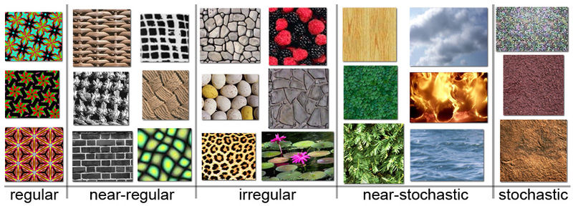
Origin 1: Texture Recognition
Example textures (from Wikipedia)

Slide 7

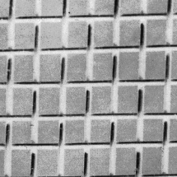
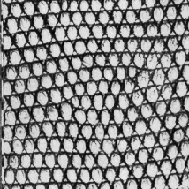



Origin 1: Texture recognition
Texture is characterized by the repetition of basic elements or textons
Julesz, 1981; Cula & Dana, 2001; Leung & Malik 2001; Mori, Belongie & Malik, 2001; Schmid 2001; Varma & Zisserman, 2002, 2003; Lazebnik, Schmid & Ponce, 2003

Slide 8




Origin 1: Texture recognition
histogram
Universal texton dictionary
Universal texton dictionary

Slide 9
Origin 2: Bag-of-words models
Orderless document representation: frequencies of words from a dictionary Salton & McGill (1983)

Slide 10
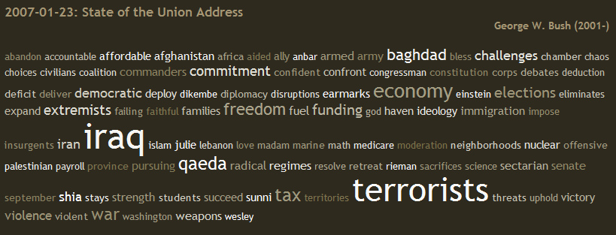
Origin 2: Bag-of-words models
Orderless document representation: frequencies of words from a dictionary Salton & McGill (1983)
US Presidential Speeches Tag Cloud
http://chir.ag/phernalia/preztags/

Slide 11
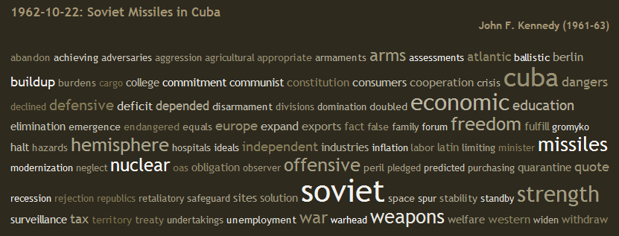
Origin 2: Bag-of-words models
Orderless document representation: frequencies of words from a dictionary Salton & McGill (1983)
US Presidential Speeches Tag Cloud
http://chir.ag/phernalia/preztags/

Slide 12
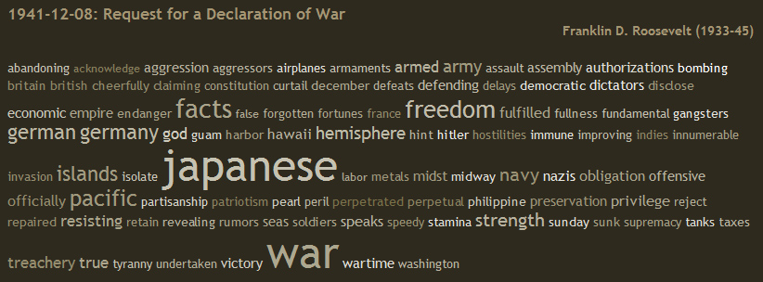
Origin 2: Bag-of-words models
Orderless document representation: frequencies of words from a dictionary Salton & McGill (1983)
US Presidential Speeches Tag Cloud
http://chir.ag/phernalia/preztags/

Slide 13
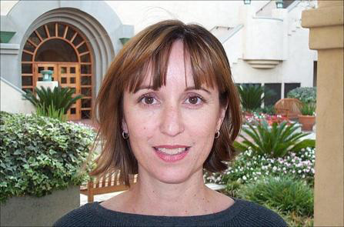
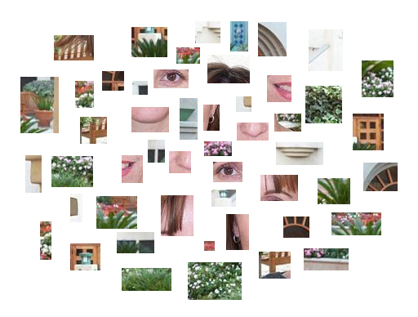
Bags of features for object recognition
face, flowers, building
Works pretty well for image-level classification and for recognizing object instances
Csurka et al. (2004), Willamowski et al. (2005), Grauman & Darrell (2005), Sivic et al. (2003, 2005)

Slide 14
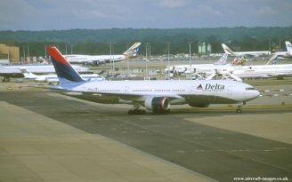
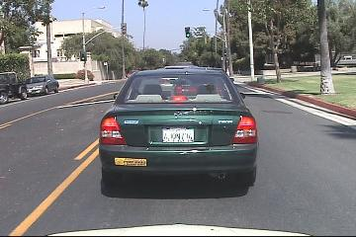
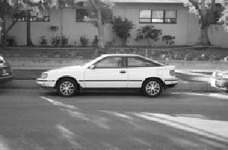

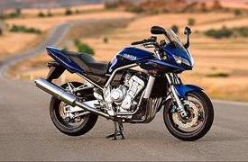
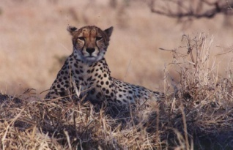
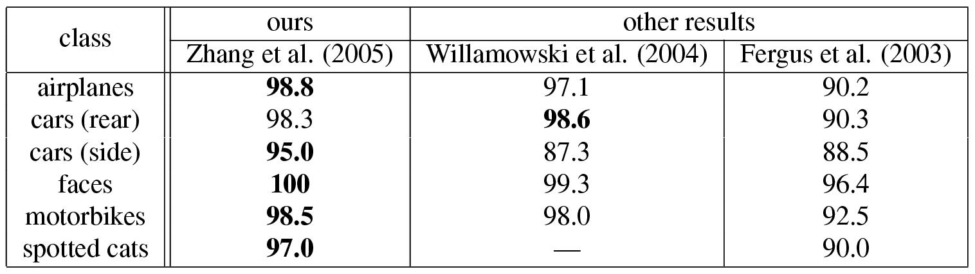
Bags of features for object recognition
Caltech6 dataset
bag of features
bag of features
Parts-and-shape model

Slide 15
Bag of features
First, take a bunch of images, extract features, and build up a “dictionary” or “visual vocabulary” – a list of common features
Given a new image, extract features and build a histogram – for each feature, find the closest visual word in the dictionary

Slide 16
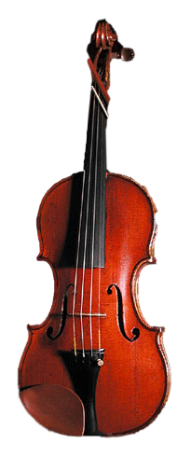
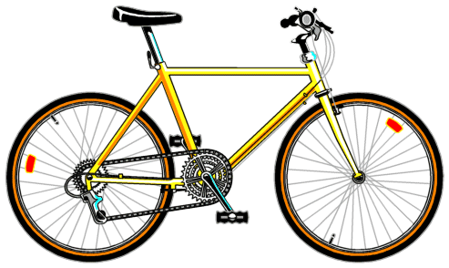
Bag of features: outline
Extract features

Slide 17
Bag of features: outline
Extract features
Learn “visual vocabulary”

Slide 18
Bag of features: outline
Extract features
Learn “visual vocabulary”
Quantize features using visual vocabulary

Slide 19

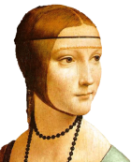
Bag of features: outline
Extract features
Learn “visual vocabulary”
Quantize features using visual vocabulary
Represent images by frequencies of
“visual words”

Slide 20
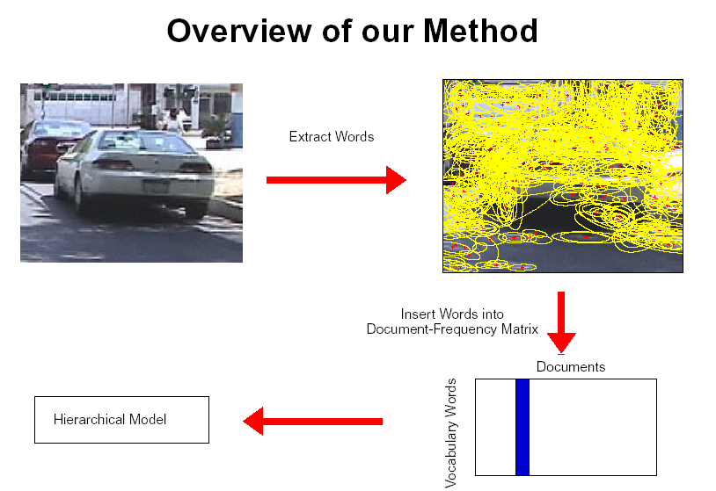
1. Feature extraction
Regular grid
  Vogel & Schiele, 2003
  Fei-Fei & Perona, 2005

Slide 21
1. Feature extraction
Regular grid
  Vogel & Schiele, 2003
  Fei-Fei & Perona, 2005
Interest point detector
  Csurka et al. 2004
  Fei-Fei & Perona, 2005
  Sivic et al. 2005

Slide 22
1. Feature extraction
Regular grid
  Vogel & Schiele, 2003
  Fei-Fei & Perona, 2005
Interest point detector
  Csurka et al. 2004
  Fei-Fei & Perona, 2005
  Sivic et al. 2005
Other methods
  Random sampling (Vidal-Naquet & Ullman, 2002)
  Segmentation-based patches (Barnard et al. 2003)

Slide 23
2. Learning the visual vocabulary
…

Slide 24
2. Learning the visual vocabulary
…
Clustering
Slide credit: Josef Sivic

Slide 25
2. Learning the visual vocabulary
Visual vocabulary
…
Clustering
Slide credit: Josef Sivic

Slide 26
K-means clustering recap
Want to minimize sum of squared Euclidean distances between points x_{i} and their nearest cluster centers m_{k}
Algorithm:
Randomly initialize K cluster centers
Iterate until convergence:
  Assign each data point to the nearest center
  Recompute each cluster center as the mean of all points assigned to it

Slide 27
From clustering to vector quantization
Clustering is a common method for learning a visual vocabulary or codebook
  Unsupervised learning process
  Each cluster center produced by k-means becomes a codevector
  Codebook can be learned on separate training set
  Provided the training set is sufficiently representative, the codebook will be “universal”
The codebook is used for quantizing features
  A vector quantizer takes a feature vector and maps it to the index of the nearest codevector in a codebook
  Codebook = visual vocabulary
  Codevector = visual word

Slide 28
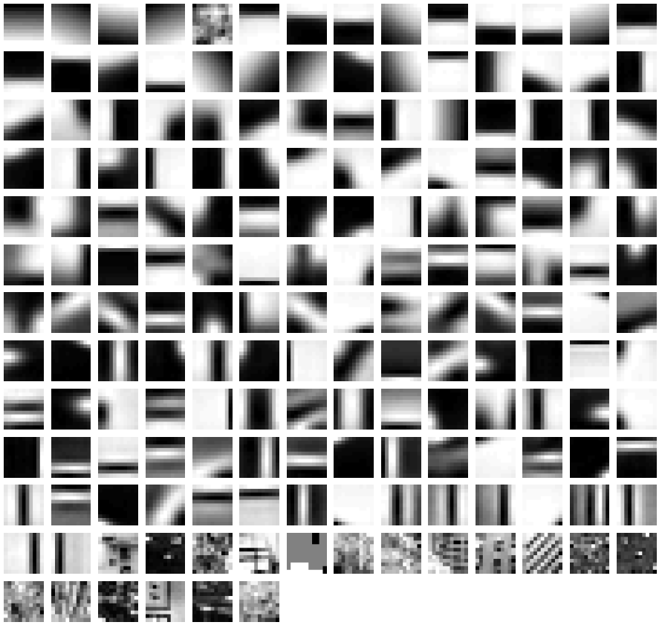
Example visual vocabulary
Fei-Fei et al. 2005

Slide 29
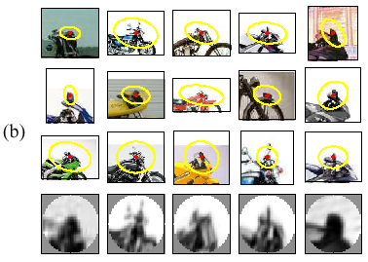
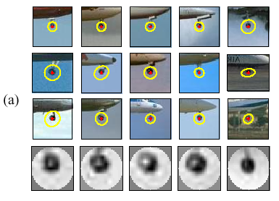
Image patch examples of visual words
Sivic et al. 2005

Slide 30
Visual vocabularies: Issues
How to choose vocabulary size?
  Too small: visual words not representative of all patches
  Too large: quantization artifacts, overfitting
Computational efficiency
  Vocabulary trees
  (Nister & Stewenius, 2006)

Slide 31
3. Image representation
frequency
…..
codewords

Slide 32
Image classification
Given the bag-of-features representations of images from different classes, how do we learn a model for distinguishing them?

Slide 33
Uses of BoW representation
Treat as feature vector for standard classifier
  e.g k-nearest neighbors, support vector machine
Cluster BoW vectors over image collection
  Discover visual themes

Slide 34

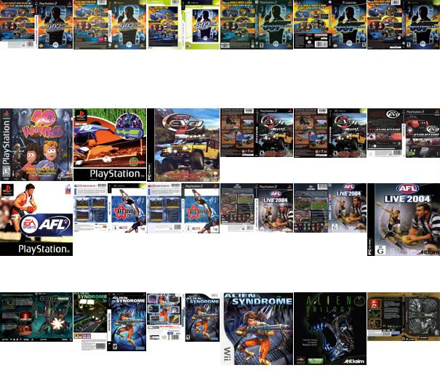
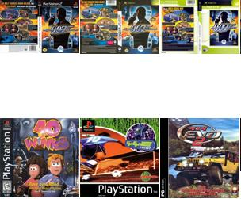
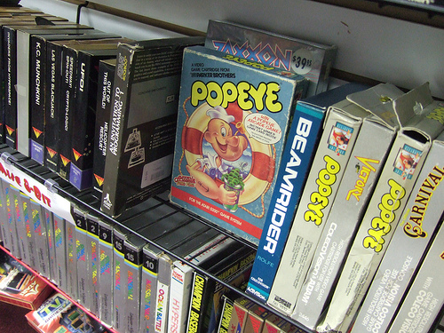
Large-scale image matching
Bag-of-words models have been useful in matching an image to a large database of object instances
11,400 images of game covers
(Caltech games dataset)
how do I find this image in the database?

Slide 35
Large-scale image search
Build the database:
  Extract features from the database images
  Learn a vocabulary using k-means (typical k: 100,000)
  Compute weights for each word
  Create an inverted file mapping words → images

Slide 36
Weighting the words
Just as with text, some visual words are more discriminative than others
the bigger fraction of the documents a word appears in, the less useful it is for matching
  e.g., a word that appears in all documents is not helping us
the, and, or vs. cow, AT&T, Cher

Slide 37
TF-IDF weighting
Instead of computing a regular histogram distance, we’ll weight each word by it’s inverse document frequency
inverse document frequency (IDF) of word j =
log
number of documents
number of documents in which j appears

Slide 38
TF-IDF weighting
To compute the value of bin j in image I:
term frequency of j in I
x
inverse document frequency of j

Slide 39
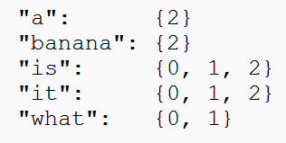
Inverted file
Each image has ~1,000 features
We have ~100,000 visual words
  each histogram is extremely sparse (mostly zeros)
Inverted file
  mapping from words to documents

Slide 40
Inverted file
Can quickly use the inverted file to compute similarity between a new image and all the images in the database
  Only consider database images whose bins overlap the query image

Slide 41
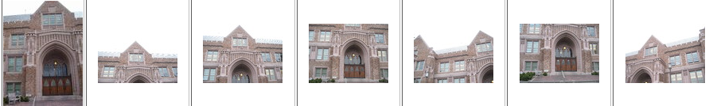
Large-scale image search
query image
top 6 results
Cons:
  performance degrades as the database grows

Slide 42
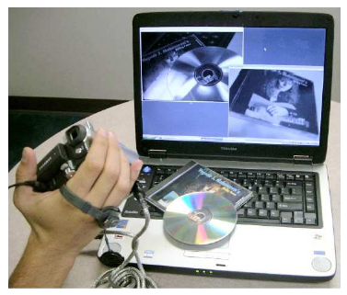
Large-scale image search
Pros:
  Works well for CD covers, movie posters
  Real-time performance possible
real-time retrieval from a database of 40,000 CD covers
Nister & Stewenius, Scalable Recognition with a Vocabulary Tree

Slide 43
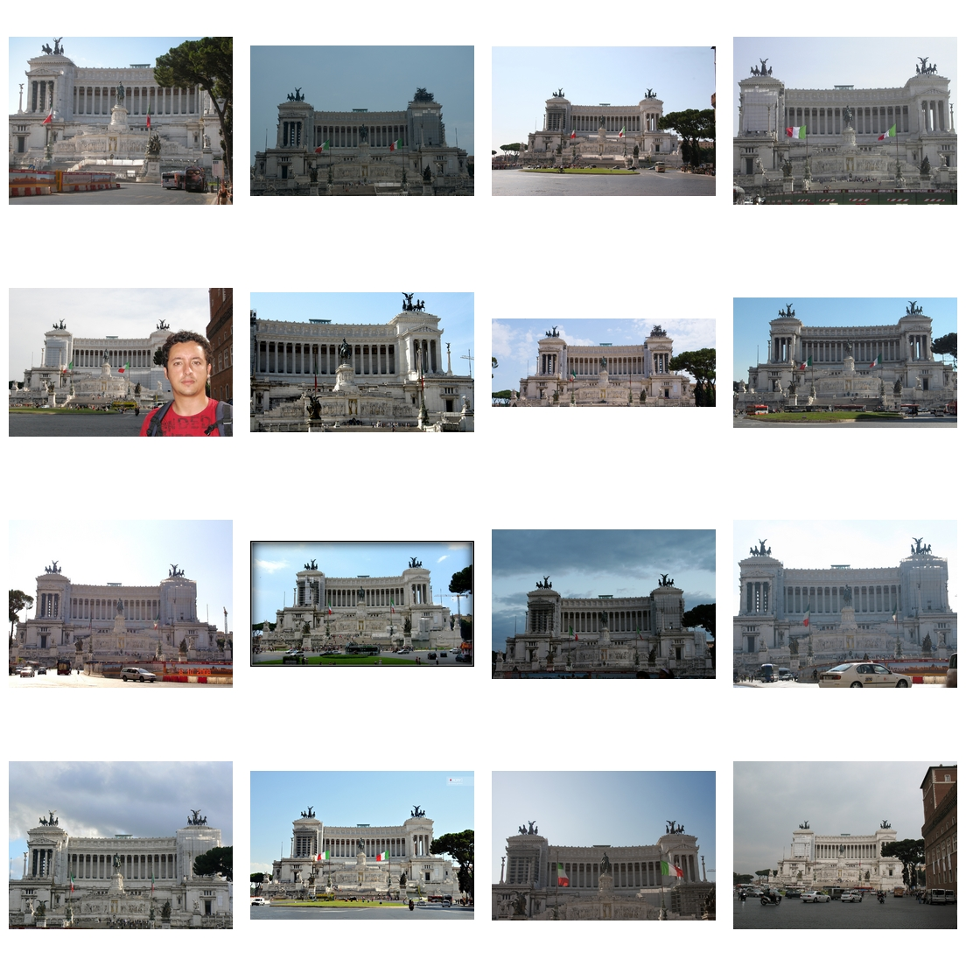
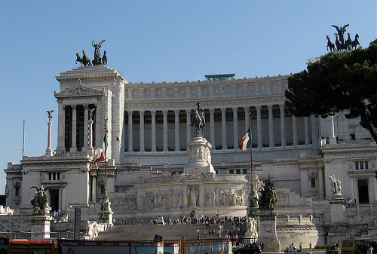
Example bag-of-words matches

Slide 44
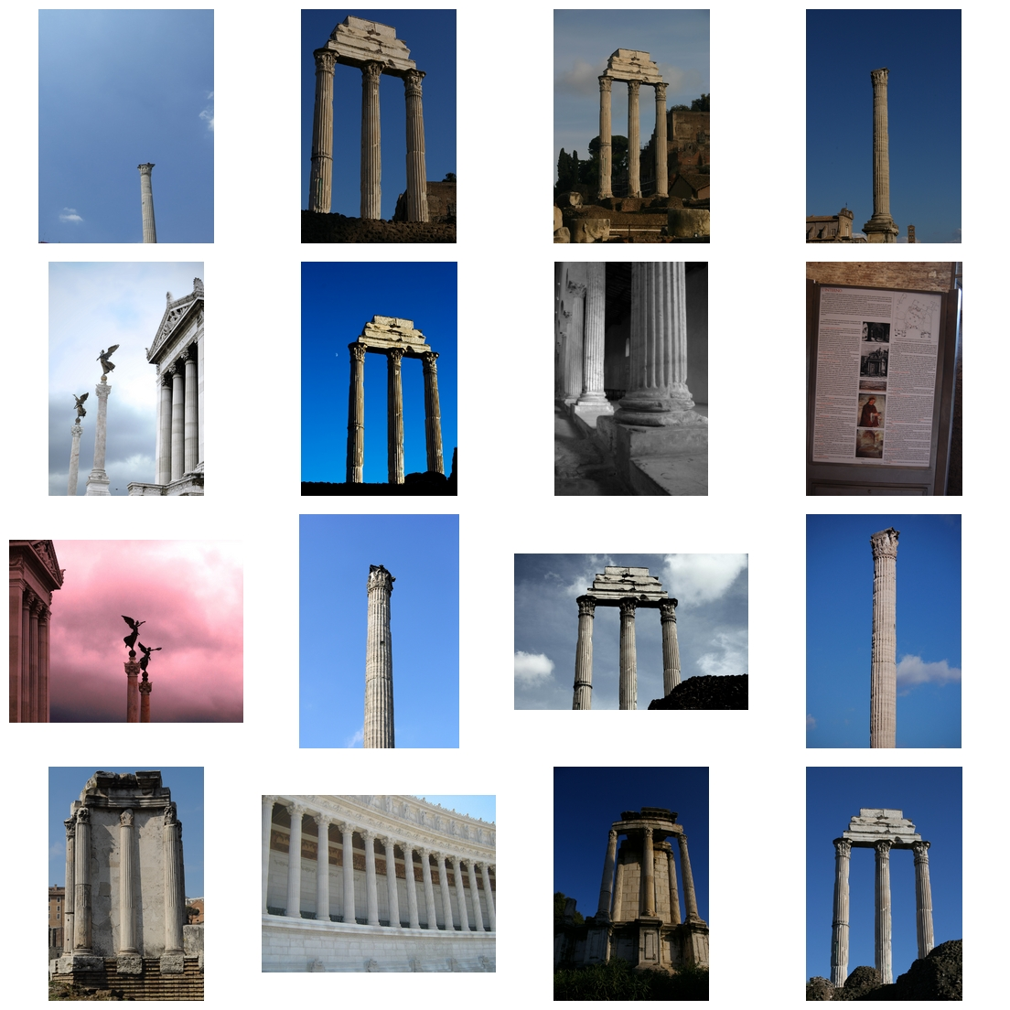
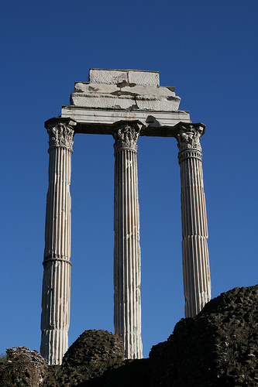
Example bag-of-words matches

Slide 45
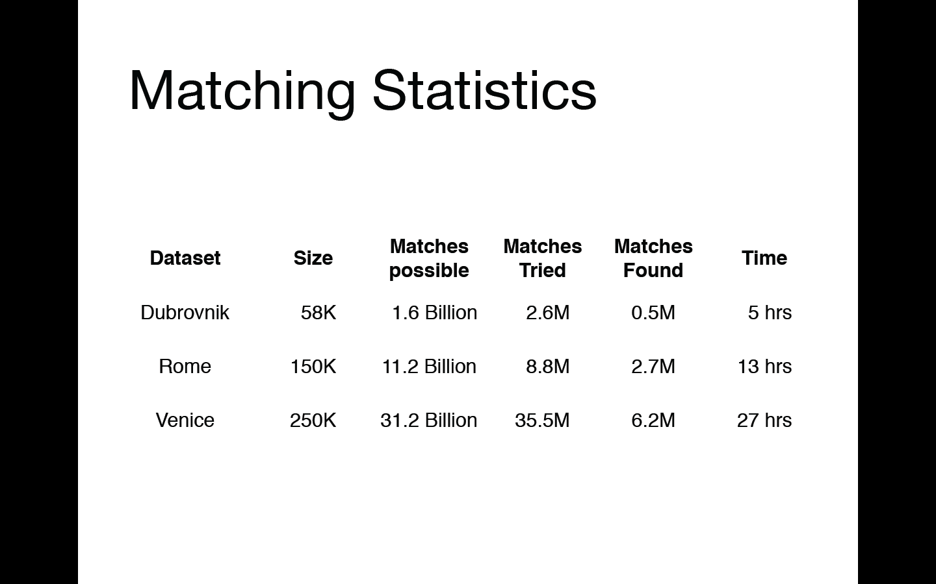

Slide 46




What about spatial info?
?

Slide 47
What we will learn today
Visual bag of words (BoW)
Spatial Pyramid Matching
Naïve Bayes

Slide 48
Pyramids
Very useful for representing images.
Pyramid is built by using multiple copies of image.
Each level in the pyramid is 1/4 of the size of previous level.
The lowest level is of the highest resolution.
The highest level is of the lowest resolution.

Slide 49
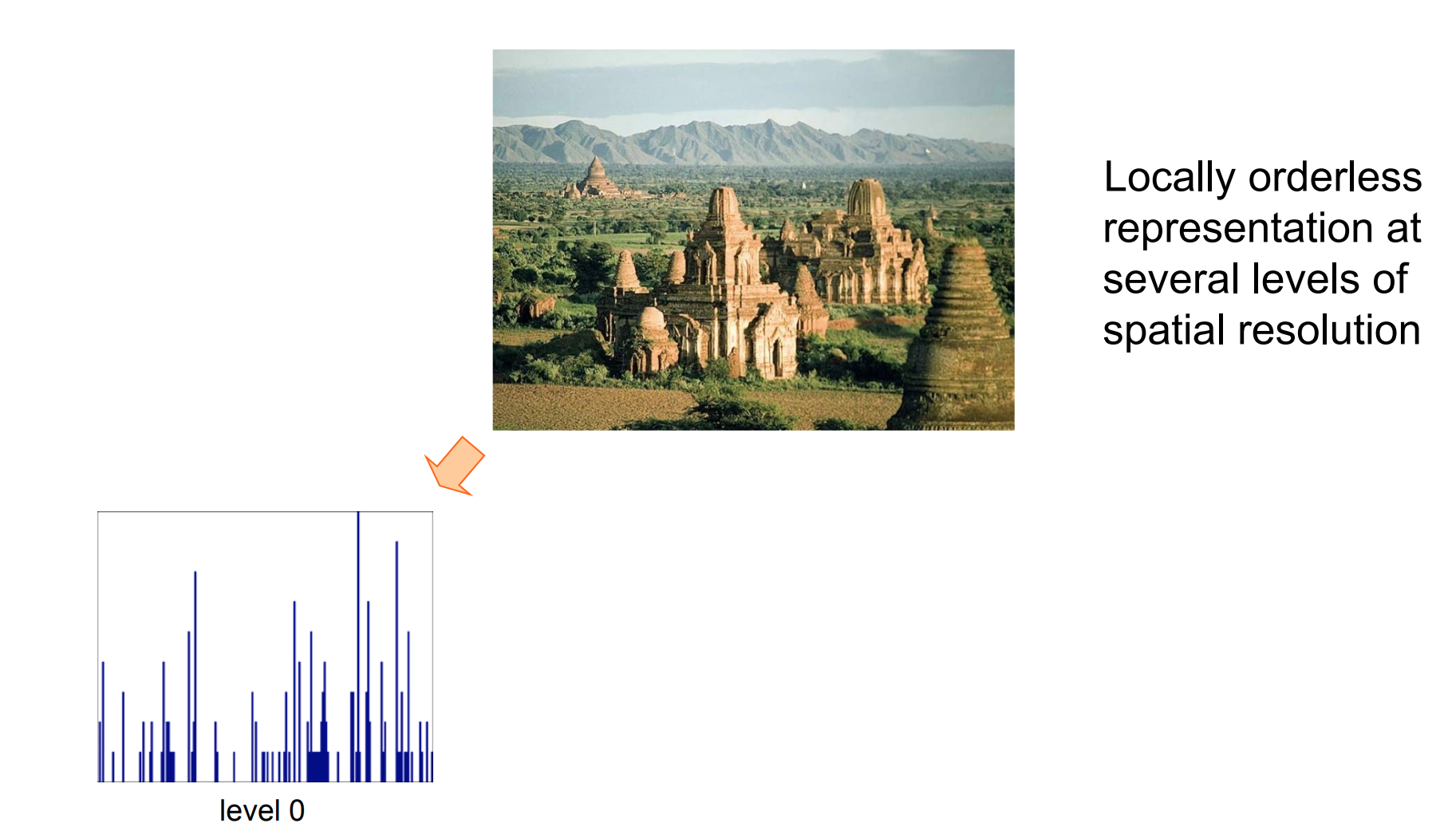
Bag of words + pyramids

Slide 50
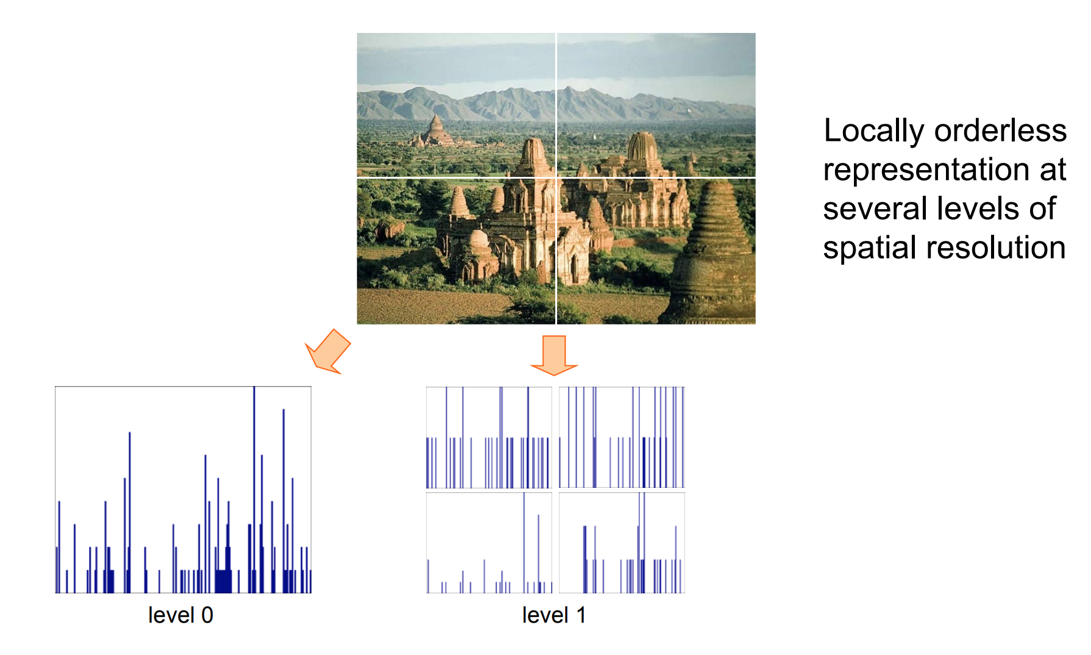
Bag of words + pyramids

Slide 51
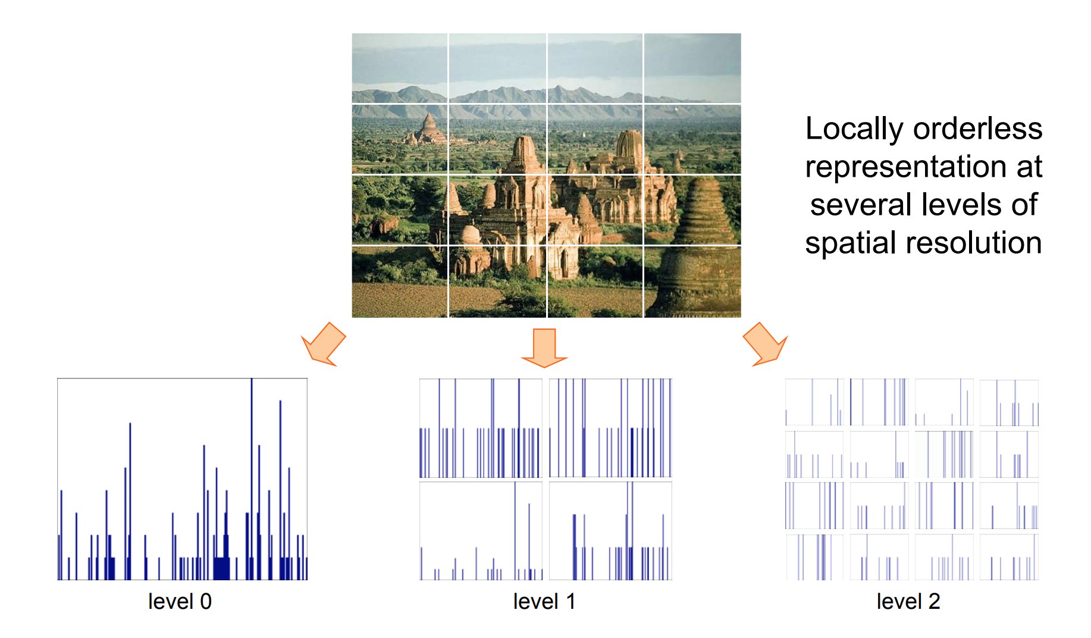
Bag of words + pyramids

Slide 52
What we will learn today
Visual bag of words (BoW)
Spatial Pyramid Matching
Naïve Bayes

Slide 53
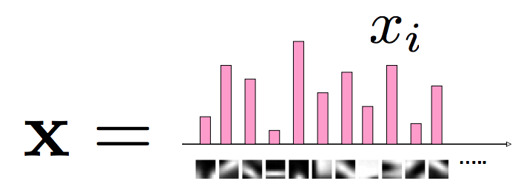
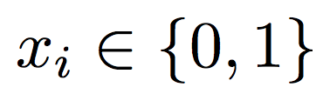
Naïve Bayes
Classify image using histograms of occurrences on visual words:
if only present/absence of a word is taken into account:
Naïve Bayes classifier assumes that visual words are conditionally independent given object class
Csurka Bray, Dance & Fan, 2004

Slide 54
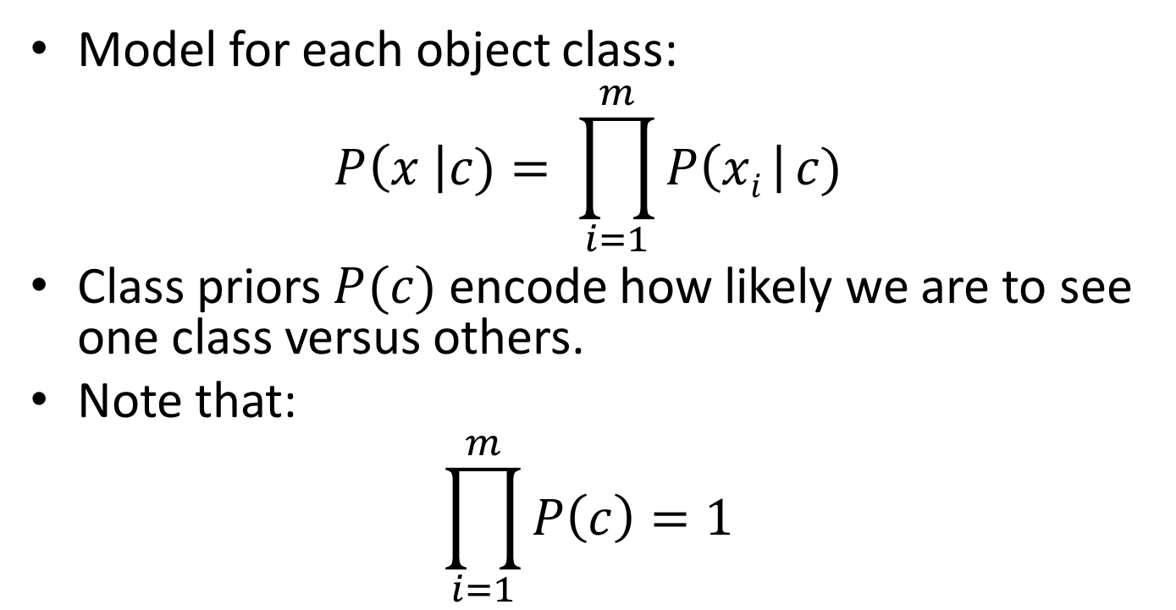
Naïve Bayes - prior
Model for each object class:
$$P\left(x \right|c)= \prod_{i=1}^{m}{P\left(xi \right| c)}$$
Class priors $P(c)$ encode how likely we are to see one class versus others.
Note that:
$$\prod_{i=1}^{m}{P\left(c\right)=1}$$
Csurka Bray, Dance & Fan, 2004

Slide 55
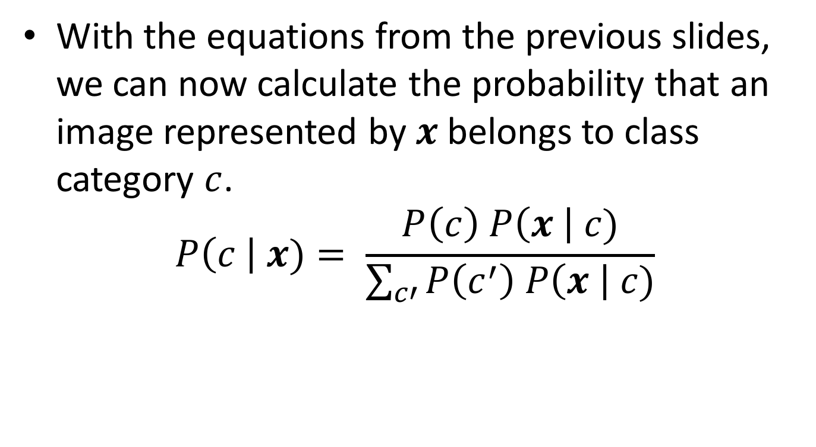
Naïve Bayes - posterior
With the equations from the previous slides, we can now calculate the probability that an image represented by $x$belongs to class category $c$.
$$P\left(c \right| x)= \frac{P\left(c\right) P\left(x \right| c)}{\sum_{c′}{P\left(c^{′}\right) P\left(x \right| c)}}$$
Bayes Theorem

Slide 56
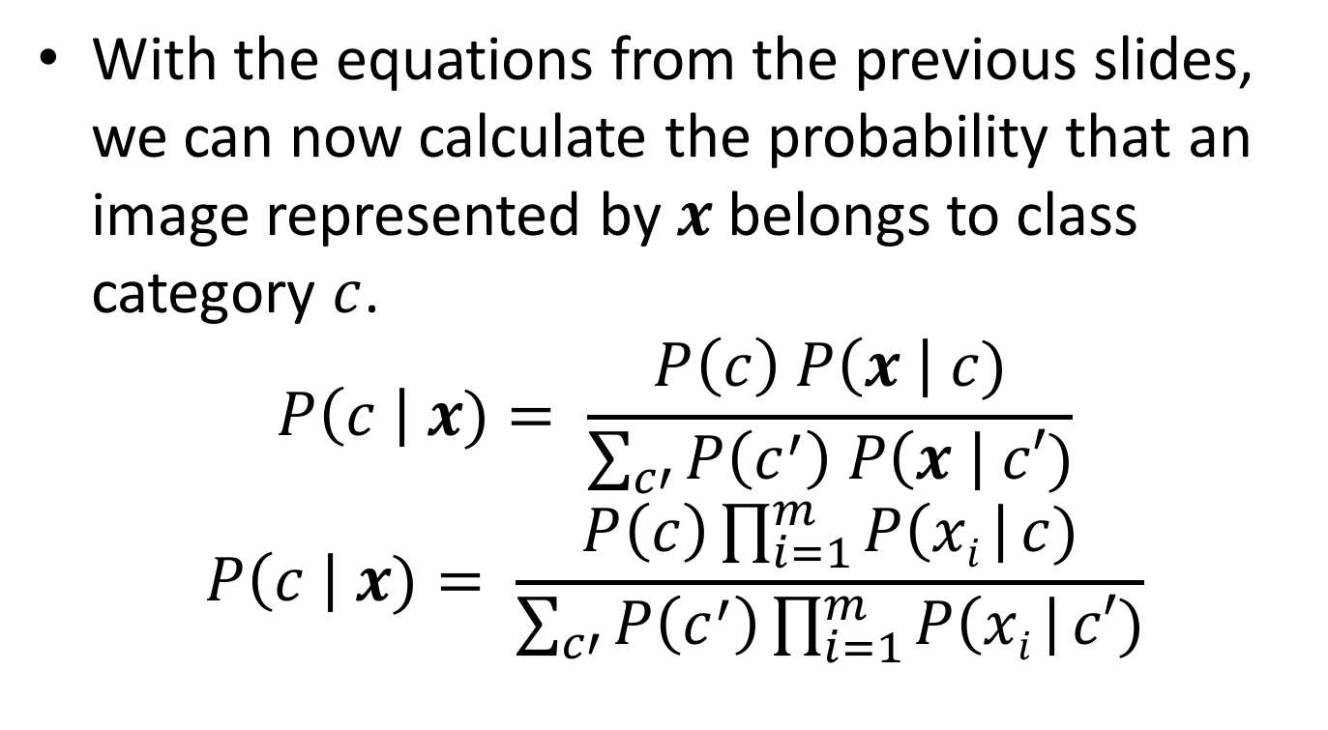
Naïve Bayes – posterior
With the equations from the previous slides, we can now calculate the probability that an image represented by $x$belongs to class category $c$.
$$P\left(c \right| x)= \frac{P\left(c\right) P\left(x \right| c)}{\sum_{c′}{P\left(c^{′}\right) P\left(x \right| c′)}}$$
$$P\left(c \right| x)= \frac{P\left(c\right)\prod_{i=1}^{m}{P\left(xi \right| c)}}{\sum_{c′}{P\left(c^{′}\right)\prod_{i=1}^{m}{P\left(xi \right| c′)}}}$$

Slide 57
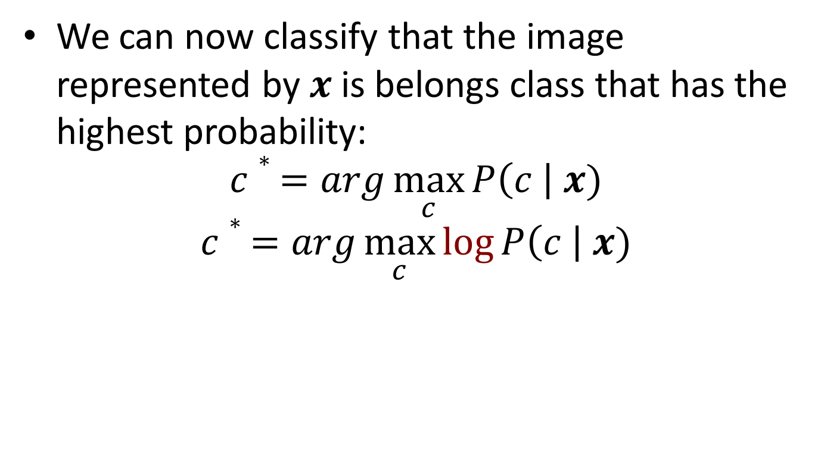
Naïve Bayes - classification
We can now classify that the image represented by $x$is belongs class that has the highest probability:
$$c∗ =arg\max_{c}{P\left(c \right| x)}$$
$$c∗ =arg\max_{c}{\log{P\left(c \right| x)}}$$

Slide 58
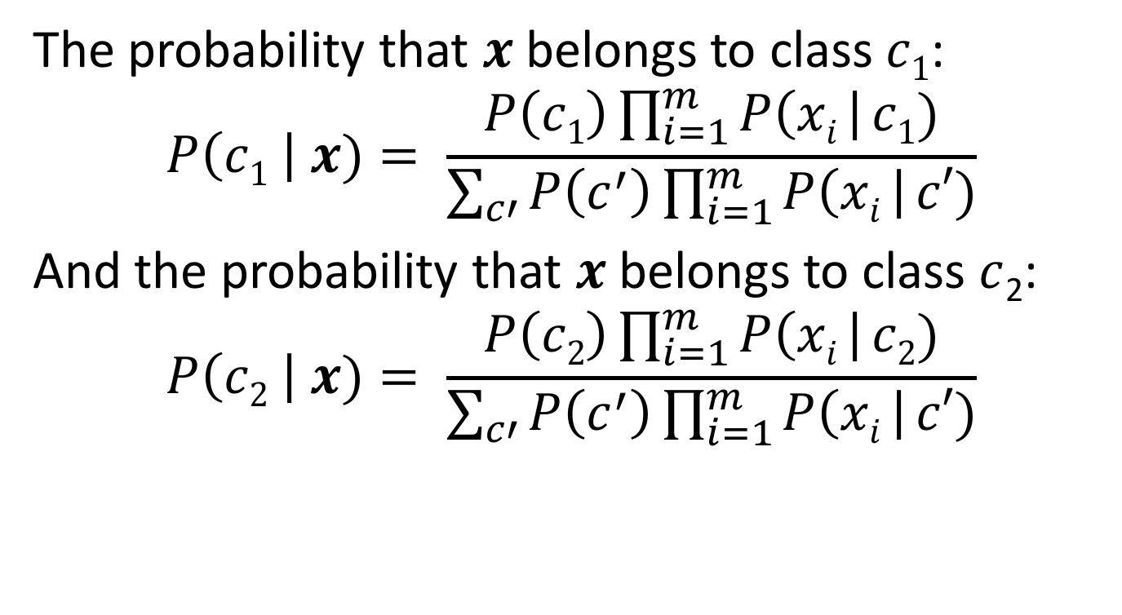
Let’s break down the posterior
The probability that $x$belongs to class $c1$:
$$P\left(c1 \right| x)= \frac{P\left(c1\right)\prod_{i=1}^{m}{P\left(xi \right| c1)}}{\sum_{c′}{P\left(c^{′}\right)\prod_{i=1}^{m}{P\left(xi \right| c′)}}}$$
And the probability that $x$belongs to class $c$₂:
$$P\left(c2 \right| x)= \frac{P\left(c2\right)\prod_{i=1}^{m}{P\left(xi \right| c2)}}{\sum_{c′}{P\left(c^{′}\right)\prod_{i=1}^{m}{P\left(xi \right| c′)}}}$$

Slide 59
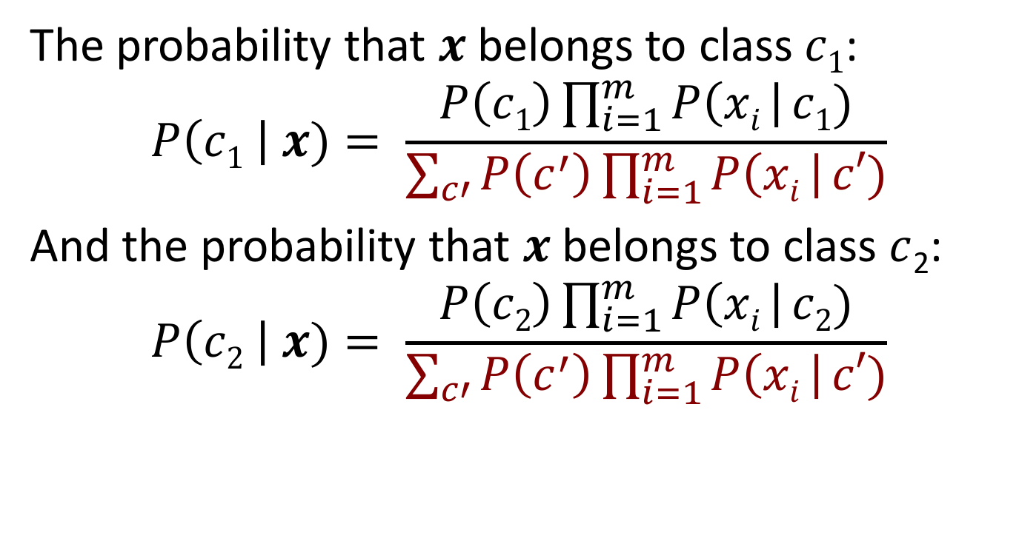
Both their denominators are the same
The probability that $x$belongs to class $c1$:
$$P\left(c1 \right| x)= \frac{P\left(c1\right)\prod_{i=1}^{m}{P\left(xi \right| c1)}}{\sum_{c′}{P\left(c^{′}\right)\prod_{i=1}^{m}{P\left(xi \right| c′)}}}$$
And the probability that $x$belongs to class $c$₂:
$$P\left(c2 \right| x)= \frac{P\left(c2\right)\prod_{i=1}^{m}{P\left(xi \right| c2)}}{\sum_{c′}{P\left(c^{′}\right)\prod_{i=1}^{m}{P\left(xi \right| c′)}}}$$

Slide 60
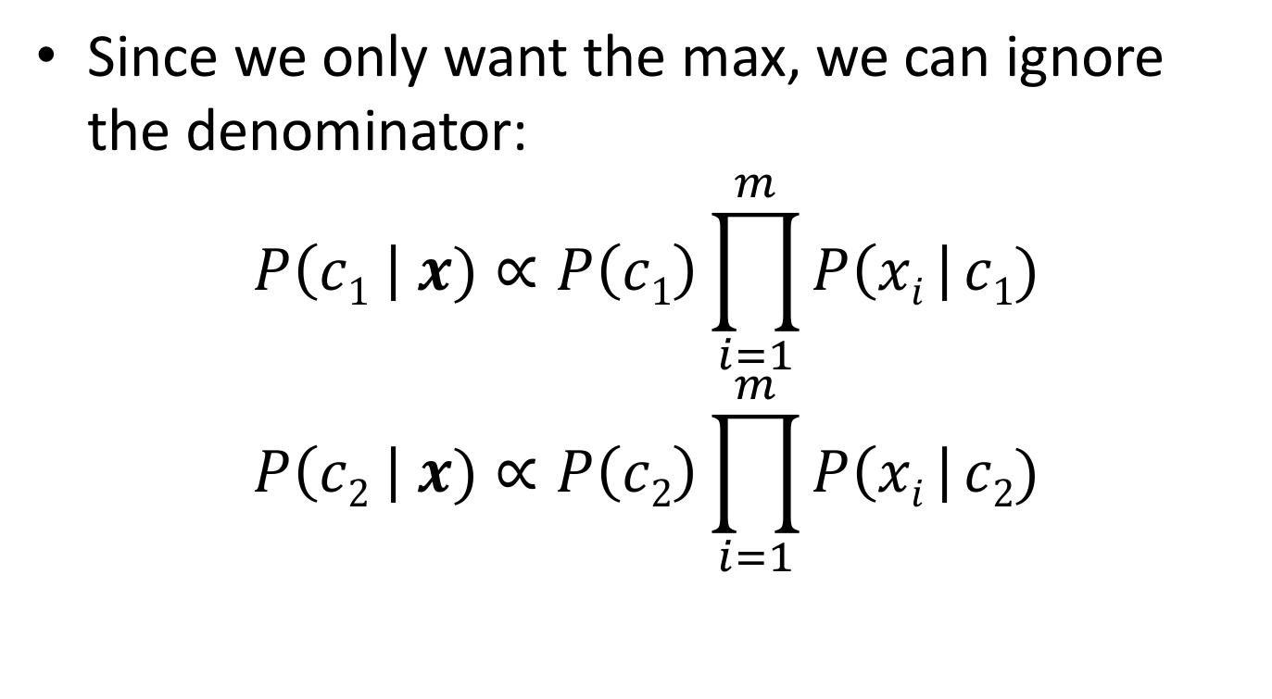
Both their denominators are the same
Since we only want the max, we can ignore the denominator:
$$P\left(c1 \right| x)∝P\left(c1\right)\prod_{i=1}^{m}{P\left(xi \right| c1)}$$
$$P\left(c2 \right| x)∝P\left(c2\right)\prod_{i=1}^{m}{P\left(xi \right| c2)}$$

Slide 61

For the general class c,
$$P\left(c \right| x)∝P\left(c\right)\prod_{i=1}^{m}{P\left(xi \right| c)}$$

Slide 62
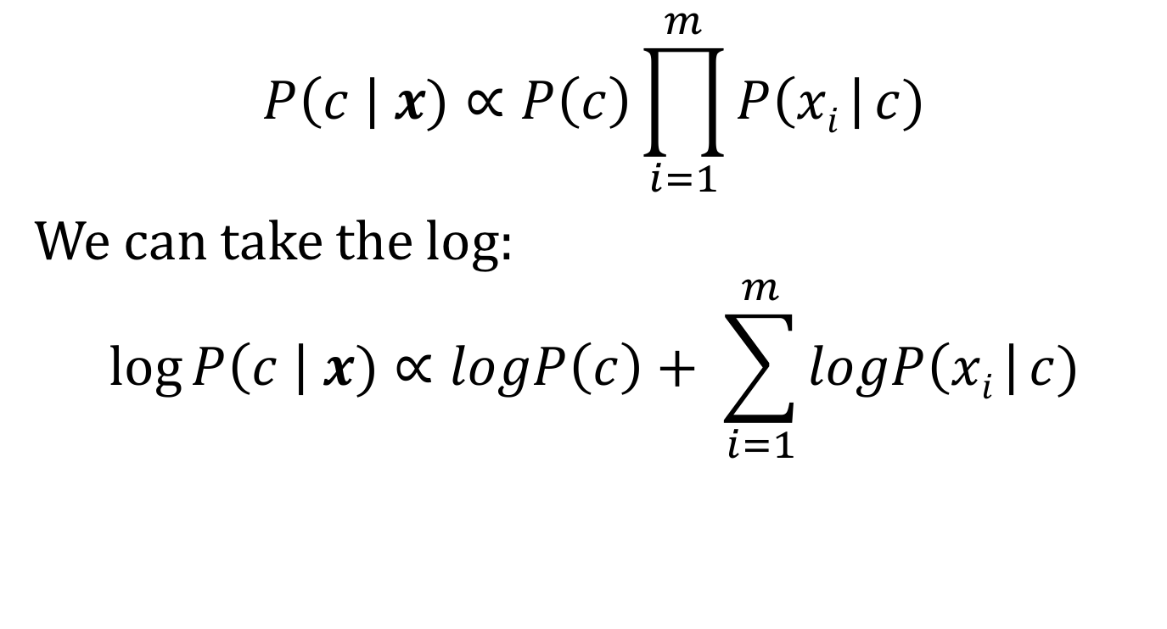
For the general class c,
$$P\left(c \right| x)∝P\left(c\right)\prod_{i=1}^{m}{P\left(xi \right| c)}$$
We can take the log:
$$\log{P\left(c \right| x)}∝logP\left(c\right)+ \sum_{i=1}^{m}{logP\left(xi \right| c)}$$

Slide 63
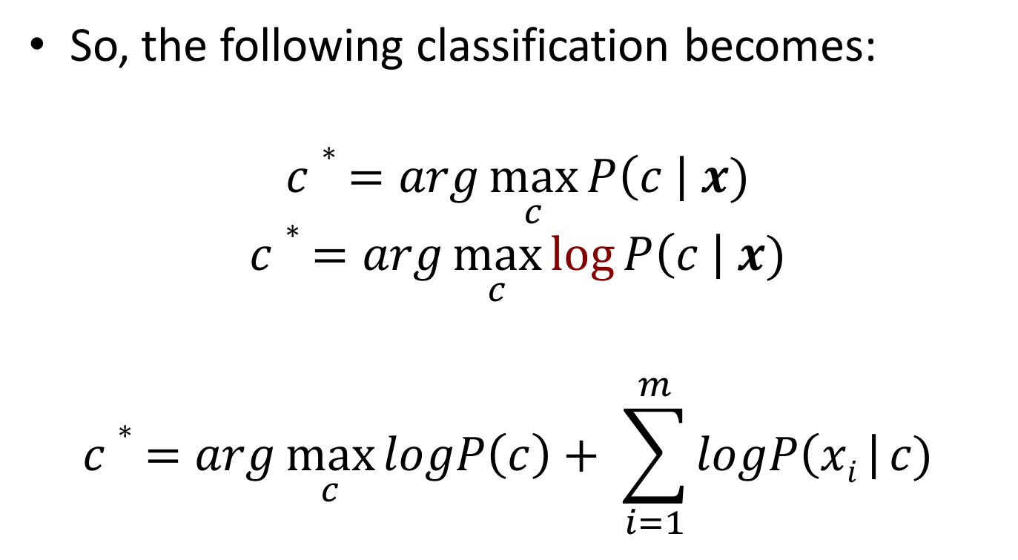
Naïve Bayes - classification
So, the following classification becomes:
$$c∗ =arg\max_{c}{P\left(c \right| x)}$$
$$c∗ =arg\max_{c}{\log{P\left(c \right| x)}}$$
$$c∗ =arg\max_{c}{logP\left(c\right)+ \sum_{i=1}^{m}{logP\left(xi \right| c)} }$$

Slide 64


Scene category dataset
Multi-class classification results
(100 training images per class)
Lazebnik, Schmid & Ponce (CVPR 2006)
Slide credit: Svetlana Lazebnik

Slide 65















Caltech101 dataset
http://www.vision.caltech.edu/Image_Datasets/Caltech101/Caltech101.html
Multi-class classification results (30 training images per class)
Slide credit: Svetlana Lazebnik

Slide 66

Bags of features for action recognition
Space-time interest points
Juan Carlos Niebles, Hongcheng Wang and Li Fei-Fei, Unsupervised Learning of Human Action Categories Using Spatial-Temporal Words, IJCV 2008.

Slide 67

Bags of features for action recognition
Juan Carlos Niebles, Hongcheng Wang and Li Fei-Fei, Unsupervised Learning of Human Action Categories Using Spatial-Temporal Words, IJCV 2008.

Slide 68
What we have learned today
Visual bag of words (BoW)
Spatial Pyramid Matching
Naïve Bayes

