Slide 1
Lecture:
Face Recognition
Juan Carlos Niebles and Ranjay Krishna
Stanford Vision and Learning Lab

Slide 2
What we will learn today
Introduction to face recognition
The Eigenfaces Algorithm
Linear Discriminant Analysis (LDA)
Turk and Pentland, Eigenfaces for Recognition, Journal of Cognitive Neuroscience 3 (1): 71–86.
P. Belhumeur, J. Hespanha, and D. Kriegman. "Eigenfaces vs. Fisherfaces: Recognition
Using Class Specific Linear Projection". IEEE Transactions on pattern analysis and machine
intelligence 19 (7): 711. 1997.

Slide 3
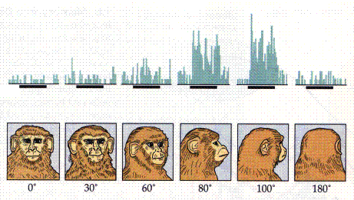
“Faces” in the brain
Courtesy of Johannes M. Zanker

Slide 4
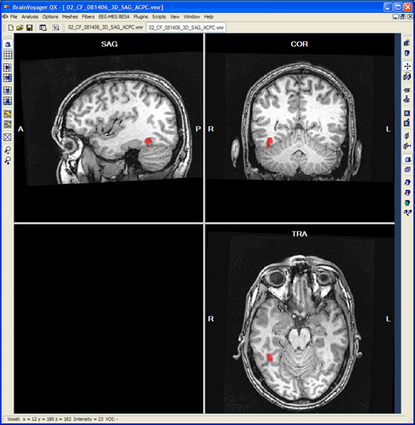
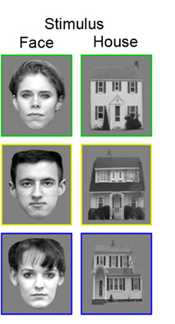
“Faces” in the brain fusiform face area
Kanwisher, et al. 1997

Slide 5
Detection versus Recognition
Detection finds the faces in images
Recognition recognizes WHO the person is

Slide 6
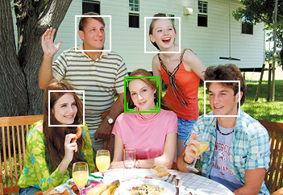
Face Recognition
Digital photography

Slide 7
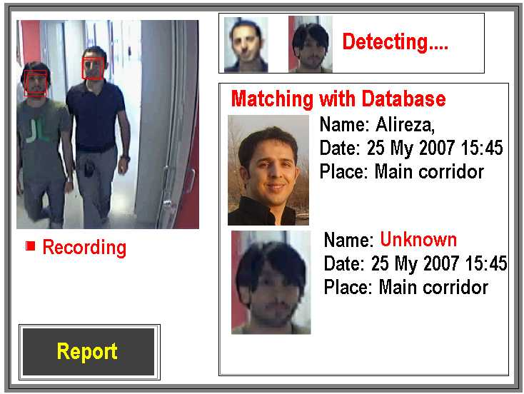
Face Recognition
Digital photography
Surveillance

Slide 8
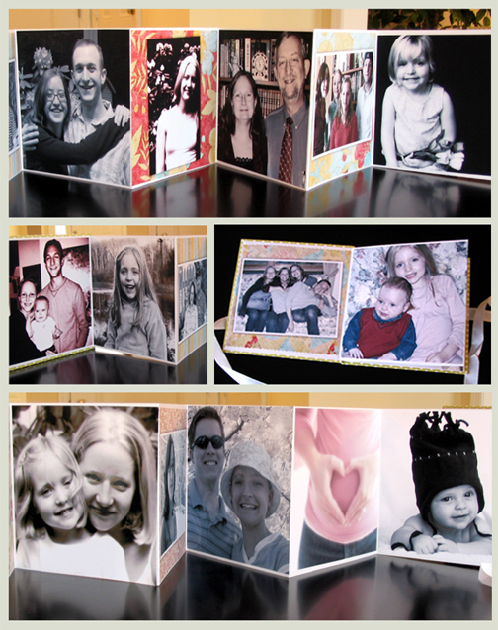
Face Recognition
Digital photography
Surveillance
Album organization

Slide 9
Face Recognition
Digital photography
Surveillance
Album organization
Person tracking/id.

Slide 10
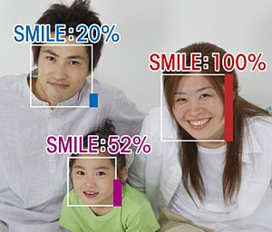
Face Recognition
Digital photography
Surveillance
Album organization
Person tracking/id.
Emotions and expressions

Slide 11
Face Recognition
Digital photography
Surveillance
Album organization
Person tracking/id.
Emotions and expressions
Security/warfare
Tele-conferencing
Etc.

Slide 12
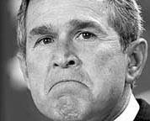

The Space of Faces
An image is a point in a high dimensional space
  If represented in grayscale intensity, an N x M image is a point in R^{NM}
  E.g. 100x100 image = 10,000 dim
Slide credit: Chuck Dyer, Steve Seitz, Nishino

Slide 13
100x100 images can contain many things other than faces!

Slide 14
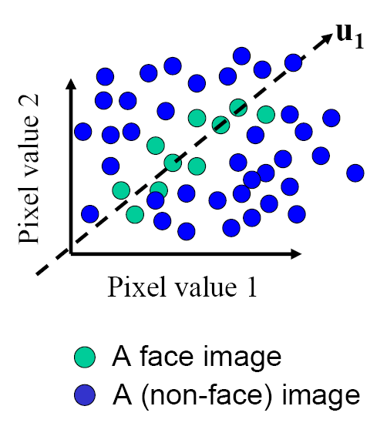
The Space of Faces
ɸ₁
An image is a point in a high dimensional space
  If represented in grayscale intensity, an N x M image is a point in R^{NM}
  E.g. 100x100 image = 10,000 dim
However, relatively few high dimensional vectors correspond to valid face images
We want to effectively model the subspace of face images
Slide credit: Chuck Dyer, Steve Seitz, Nishino

Slide 15
Where have we seen something like this before?
ɸ₁

Slide 16
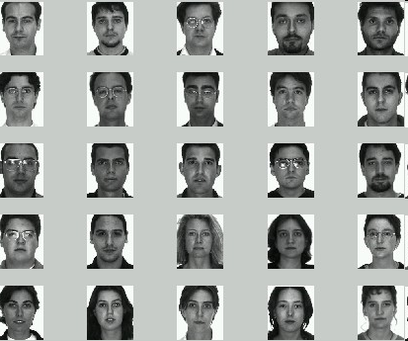
Image
space
Face space
  Compute n-dim subspace such that the projection of the data points onto the subspace has the largest variance among all n-dim subspaces.
Maximize the scatter of the training images in face space

Slide 17
Key Idea
So, compress them to a low-dimensional subspace that
captures key appearance characteristics of the visual DOFs.
USE PCA for estimating the sub-space
(dimensionality reduction)
Compare two faces by projecting the images into the subspace and measuring the EUCLIDEAN distance between them.

Slide 18
What we will learn today
Introduction to face recognition
The Eigenfaces Algorithm
Linear Discriminant Analysis (LDA)
Turk and Pentland, Eigenfaces for Recognition, Journal of Cognitive Neuroscience 3 (1): 71–86.
P. Belhumeur, J. Hespanha, and D. Kriegman. "Eigenfaces vs. Fisherfaces: Recognition
Using Class Specific Linear Projection". IEEE Transactions on pattern analysis and machine
intelligence 19 (7): 711. 1997.

Slide 19
Eigenfaces: key idea
Assume that most face images lie on a low-dimensional subspace determined by the first k (k<<d) directions of maximum variance
Use PCA to determine the vectors or “eigenfaces” that span that subspace
Represent all face images in the dataset as linear combinations of eigenfaces
M. Turk and A. Pentland, Face Recognition using Eigenfaces, CVPR 1991

Slide 20
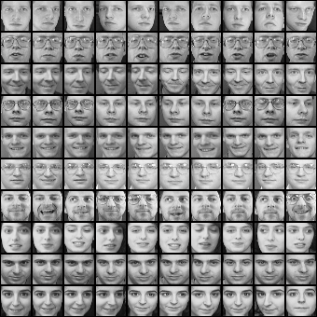
Training images: x₁,…,x_{N}

Slide 21
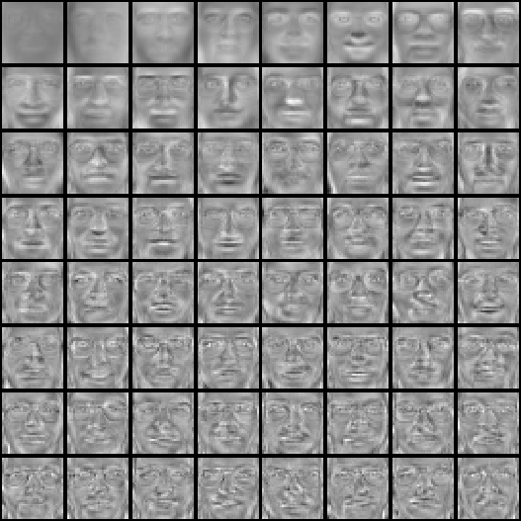
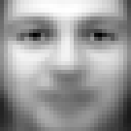
Top eigenvectors: ɸ₁,…,ɸ_{k}
Mean: μ

Slide 22
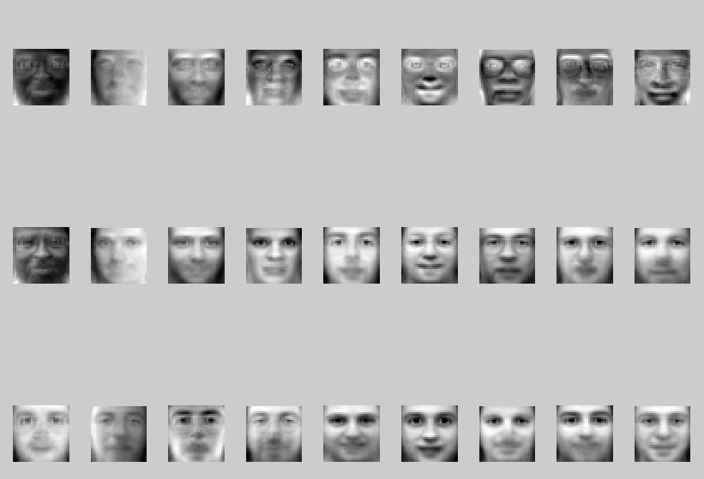
Visualization of eigenfaces
Principal component (eigenvector) ɸ_{k}
μ + 3σ_{k}ɸ_{k}
μ – 3σ_{k}ɸ_{k}

Slide 23
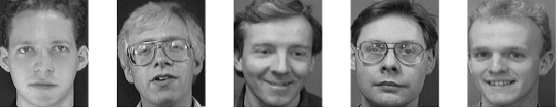
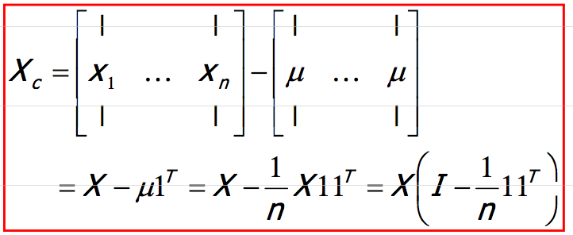
Eigenface algorithm
Training
  Align training images x₁, x₂, …, x_{N}
  Compute average face
  Compute the difference image (the centered data matrix)
Note that each image is formulated into a long vector!

Slide 24
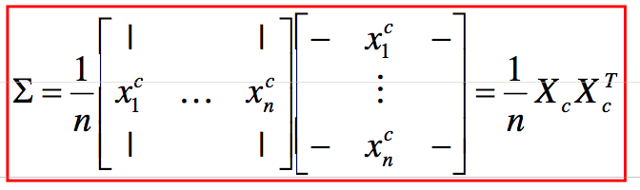
Eigenface algorithm
  Compute the covariance matrix
  Compute the eigenvectors of the covariance matrix Σ
  Compute each training image x_{i} ‘s projections as
  Visualize the estimated training face x_{i}

Slide 25
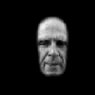
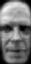











Eigenface algorithm
  Compute each training image x_{i} ‘s projections as
  Visualize the reconstructed training face x_{i}
$$x_{i}$$
Reconstructed training face

Slide 26
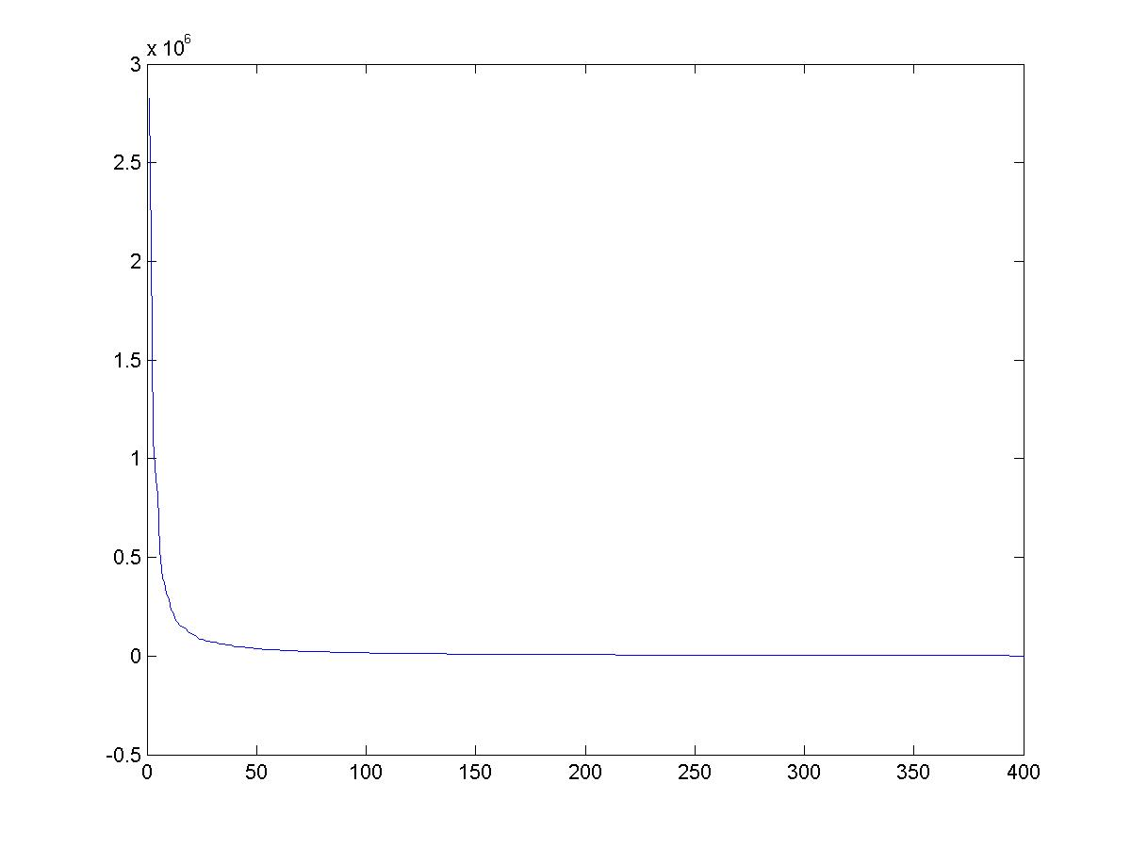
Eigenvalues (variance along eigenvectors)

Slide 27
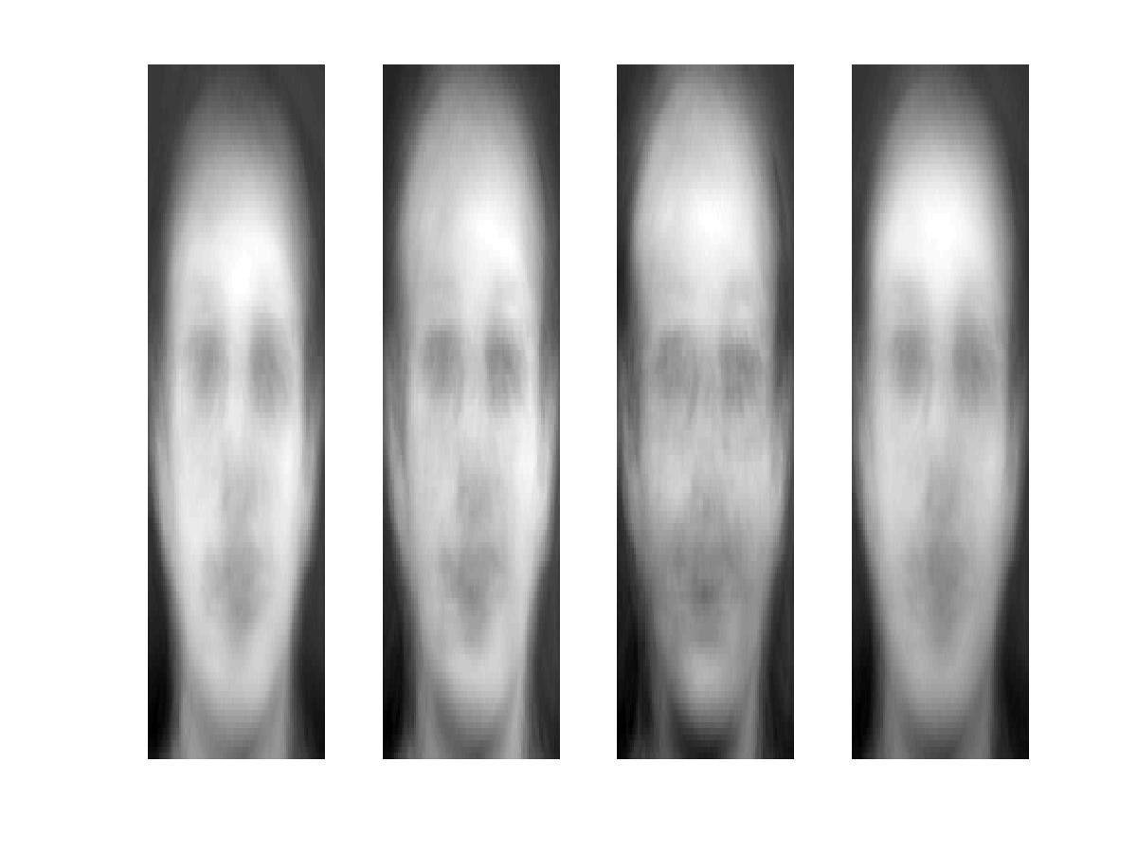
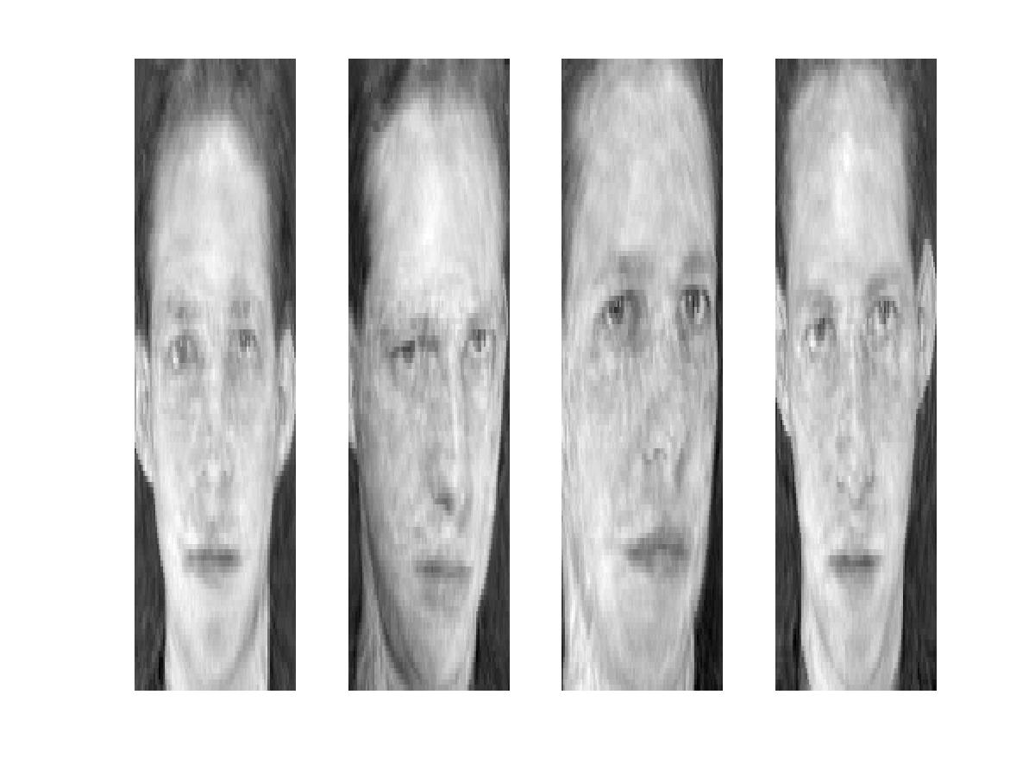
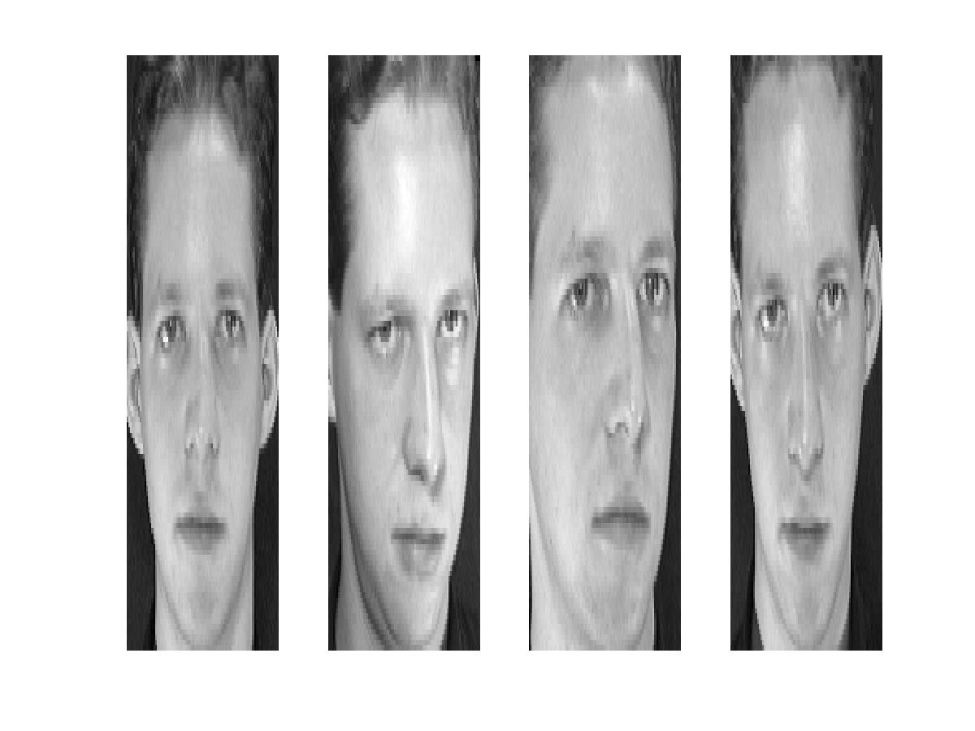
Reconstruction and Errors
K = 4
K = 200
K = 400
Only selecting the top K eigenfaces → reduces the dimensionality.
Fewer eigenfaces result in more information loss, and hence less discrimination between faces.

Slide 28
Eigenface algorithm
Testing
  Take query image t
  Project into eigenface space and compute projection
  Compare projection w with all N training projections
    Simple comparison metric: Euclidean
    Simple decision: K-Nearest Neighbor
    (note: this “K” refers to the k-NN algorithm, is different from the previous K’s referring to the # of principal components)

Slide 29
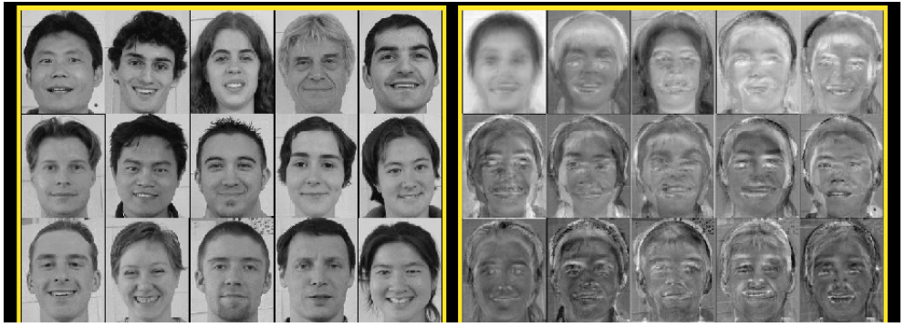
Visualization of eigenfaces
Eigenfaces look somewhat like generic faces.

Slide 30
Shortcomings
Requires carefully controlled data:
  All faces centered in frame
  Same size
  Some sensitivity to angle
Alternative:
  “Learn” one set of PCA vectors for each angle
  Use the one with lowest error
Method is completely knowledge free
  (sometimes this is good!)
  Doesn’t know that faces are wrapped around 3D objects (heads)
  Makes no effort to preserve class distinctions

Slide 31
Summary for Eigenface
Pros
Non-iterative, globally optimal solution
Limitations
PCA projection is optimal for reconstruction from a low dimensional basis, but may NOT be optimal for discrimination…

Slide 32
Besides face recognitions, we can also do
Facial expression recognition

Slide 33
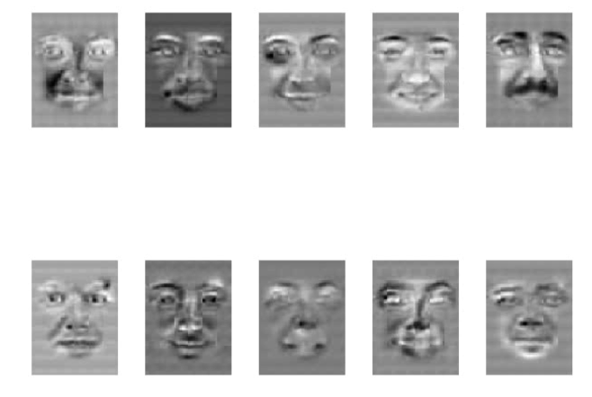
Happiness subspace (method A)

Slide 34
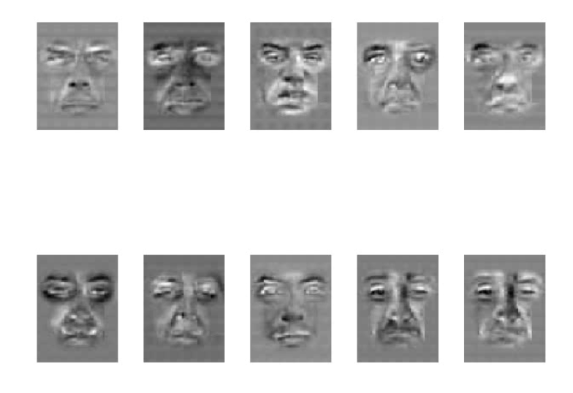
Disgust subspace (method A)

Slide 35
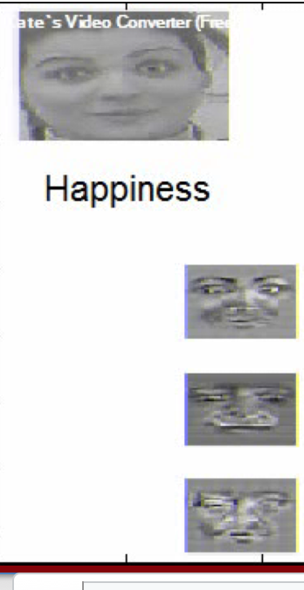
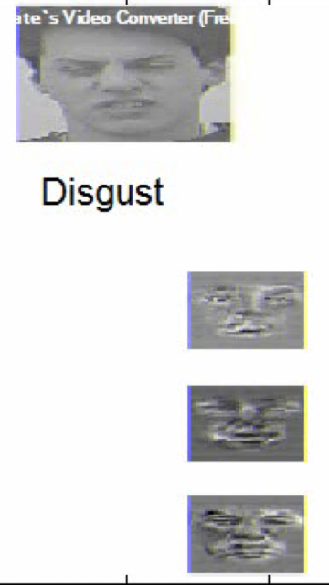
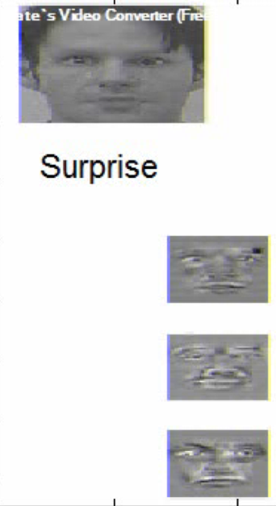
Facial Expression Recognition
Movies (method A)

Slide 36
What we will learn today
Introduction to face recognition
The Eigenfaces Algorithm
Linear Discriminant Analysis (LDA)
Turk and Pentland, Eigenfaces for Recognition, Journal of Cognitive Neuroscience 3 (1): 71–86.
P. Belhumeur, J. Hespanha, and D. Kriegman. "Eigenfaces vs. Fisherfaces: Recognition
Using Class Specific Linear Projection". IEEE Transactions on pattern analysis and machine
intelligence 19 (7): 711. 1997.

Slide 37
Which direction will is the first principle component?

Slide 38
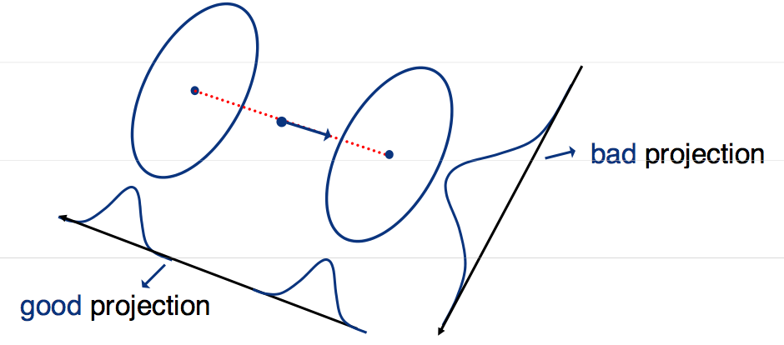
Fischer’s Linear Discriminant Analysis
Goal: find the best separation between two classes
Slide inspired by N. Vasconcelos
Notes:
We explicitly would like to use the label information when doing the project. This is something that PCA does not do. PCA is an unsupervised dimensionality reduction. We want to use the labels to also do the projections.

Slide 39
Difference between PCA and LDA
PCA preserves maximum variance
LDA preserves discrimination
  Find projection that maximizes scatter between classes and minimizes scatter within classes

Slide 40
Illustration of the Projection
Using two classes as example:
x2
x2
x1
x1
Poor Projection
Good

Slide 41
Basic intuition: PCA vs. LDA

Slide 42
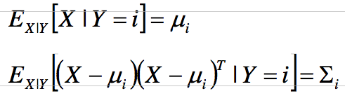
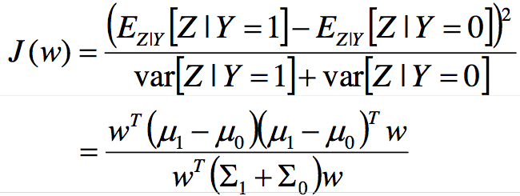
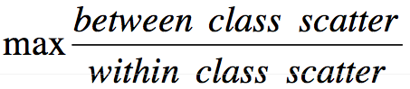

LDA with 2 variables
We want to learn a projection W such that the projection converts all the points from x to a new space (For this example, assume m == 1):
Let the per class means be:
And the per class covariance matrices be:
We want a projection that maximizes:
$$z=w^{T}x$$

Slide 43
Fischer’s Linear Discriminant Analysis
Between class scatter
Within class scatter
Slide inspired by N. Vasconcelos
Notes:
We explicitly would like to use the label information when doing the project. This is something that PCA does not do. PCA is an unsupervised dimensionality reduction. We want to use the labels to also do the projections.

Slide 44
LDA with 2 variables
The following objective function:
Can be written as

Slide 45
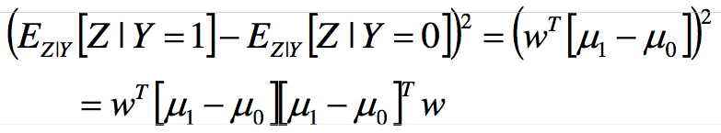
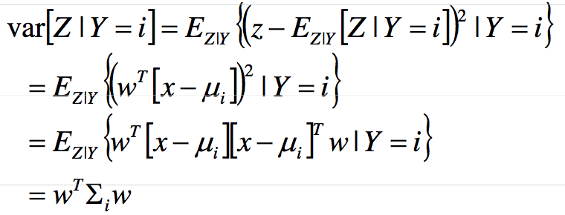
LDA with 2 variables
We can write the between class scatter as:
Also, the within class scatter becomes:
Slide inspired by N. Vasconcelos

Slide 46
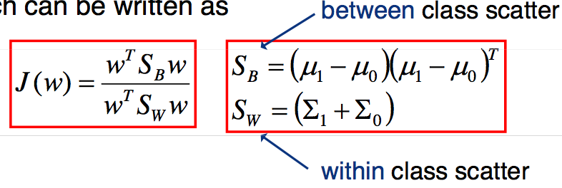
LDA with 2 variables
We can plug in these scatter values to our objective function:
And our objective becomes:
Slide inspired by N. Vasconcelos

Slide 47
LDA with 2 variables
The scatter variables
Slide inspired by N. Vasconcelos

Slide 48
Visualization
x2
Within class scatter
x1
Between class scatter

Slide 49
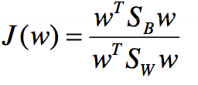


Linear Discriminant Analysis (LDA)
Maximizing the ratio
Is equivalent to maximizing the numerator while keeping the denominator constant, i.e.
And can be accomplished using Lagrange multipliers, where we define the Lagrangian as
And maximize with respect to both w and λ
Slide inspired by N. Vasconcelos

Slide 50




Linear Discriminant Analysis (LDA)
Setting the gradient of
With respect to w to zeros we get
or
This is a generalized eigenvalue problem
The solution is easy when exists
Slide inspired by N. Vasconcelos

Slide 51




Linear Discriminant Analysis (LDA)
In this case
And using the definition of S_{B}
Noting that (μ₁-μ₀)^{T}w=α is a scalar this can be written as
and since we don’t care about the magnitude of w
Slide inspired by N. Vasconcelos

Slide 52
LDA with N variables and C classes

Slide 53
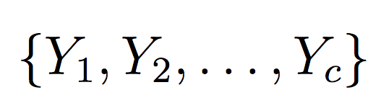

Variables
N Sample images:
C classes:
Average of each class:
Average of all data:

Slide 54
Scatter Matrices
Scatter of class i:
Within class scatter:
Between class scatter:

Slide 55

Mathematical Formulation
Recall that we want to learn a projection W such that the projection converts all the points from x to a new space z:
After projection:
  Between class scatter
  Within class scatter
So, the objective becomes:
$$z=w^{T}x$$

Slide 56
Mathematical Formulation
Solve generalized eigenvector problem:

Slide 57
Mathematical Formulation
Solution: Generalized Eigenvectors
Rank of W_{opt} is limited
  Rank(S_{B}) <= |C|-1
  Rank(S_{W}) <= N-C

Slide 58
PCA vs. LDA
Eigenfaces exploit the max scatter of the training images in face space
Fisherfaces attempt to maximise the between class scatter, while minimising the within class scatter.

Slide 59
Basic intuition: PCA vs. LDA

Slide 60
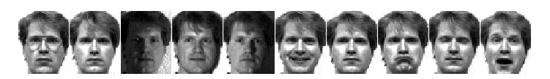
Results: Eigenface vs. Fisherface
Input: 160 images of 16 people
Train: 159 images
Test: 1 image
Variation in Facial Expression, Eyewear, and Lighting
With glasses
Without glasses
3 Lighting conditions
5 expressions

Slide 61
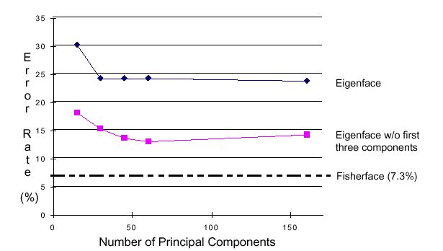
Eigenface vs. Fisherface

Slide 62
What we have learned today
Introduction to face recognition
The Eigenfaces Algorithm
Linear Discriminant Analysis (LDA)
Turk and Pentland, Eigenfaces for Recognition, Journal of Cognitive Neuroscience 3 (1): 71–86.
P. Belhumeur, J. Hespanha, and D. Kriegman. "Eigenfaces vs. Fisherfaces: Recognition
Using Class Specific Linear Projection". IEEE Transactions on pattern analysis and machine
intelligence 19 (7): 711. 1997.

