Slide 1
Lecture:
Face Recognition and Feature Reduction
Juan Carlos Niebles and Ranjay Krishna
Stanford Vision and Learning Lab

Slide 2
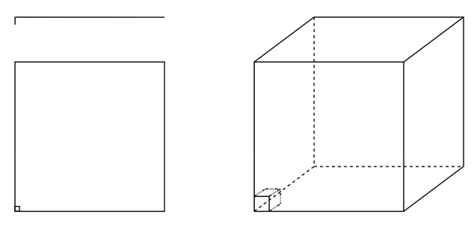
Recap - Curse of dimensionality
Assume 5000 points uniformly distributed in the unit hypercube and we want to apply 5-NN. Suppose our query point is at the origin.
  In 1-dimension, we must go a distance of 5/5000=0.001 on the average to capture 5 nearest neighbors.
  In 2 dimensions, we must go to get a square that contains 0.001 of the volume.
  In d dimensions, we must go

Slide 3
What we will learn today
Singular value decomposition
Principal Component Analysis (PCA)
Image compression

Slide 4
What we will learn today
Singular value decomposition
Principal Component Analysis (PCA)
Image compression

Slide 5
Singular Value Decomposition (SVD)
There are several computer algorithms that can “factorize” a matrix, representing it as the product of some other matrices
The most useful of these is the Singular Value Decomposition.
Represents any matrix A as a product of three matrices: UΣV^{T}
Python command:
  [U,S,V]= numpy.linalg.svd(A)

Slide 6
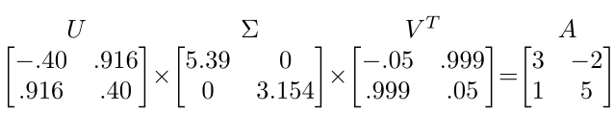
Singular Value Decomposition (SVD)
UΣV^{T} = A
Where U and V are rotation matrices, and Σ is a scaling matrix. For example:

Slide 7
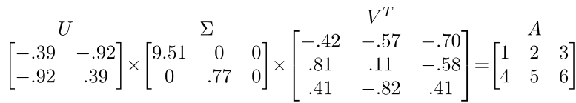
Singular Value Decomposition (SVD)
Beyond 2x2 matrices:
  In general, if A is m x n, then U will be m x m, Σ will be m x n, and V^{T} will be n x n.
  (Note the dimensions work out to produce m x n after multiplication)

Slide 8
Singular Value Decomposition (SVD)
U and V are always rotation matrices.
  Geometric rotation may not be an applicable concept, depending on the matrix. So we call them “unitary” matrices – each column is a unit vector.
Σ is a diagonal matrix
  The number of nonzero entries = rank of A
  The algorithm always sorts the entries high to low

Slide 9
SVD Applications
We’ve discussed SVD in terms of geometric transformation matrices
But SVD of an image matrix can also be very useful
To understand this, we’ll look at a less geometric interpretation of what SVD is doing

Slide 10
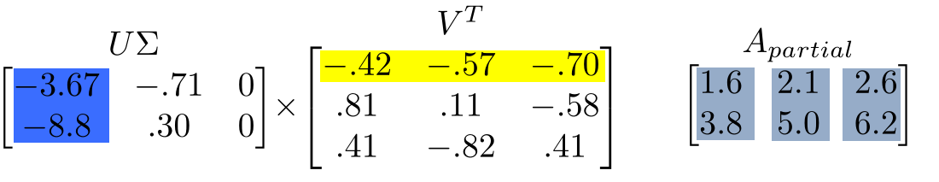
SVD Applications
Look at how the multiplication works out, left to right:
Column 1 of U gets scaled by the first value from Σ.
The resulting vector gets scaled by row 1 of V^{T} to produce a contribution to the columns of A

Slide 11
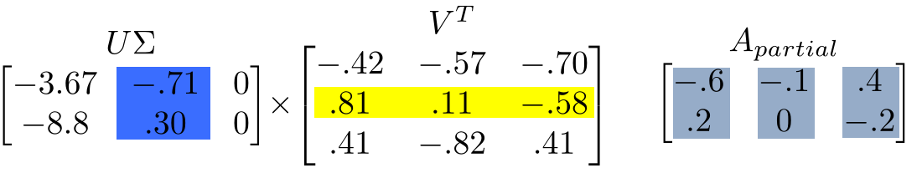
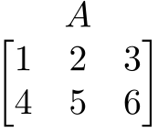
SVD Applications
+
=
Each product of (column i of U)∙(value i from Σ)∙(row i of V^{T}) produces a component of the final A.

Slide 12
SVD Applications
We’re building A as a linear combination of the columns of U
Using all columns of U, we’ll rebuild the original matrix perfectly
But, in real-world data, often we can just use the first few columns of U and we’ll get something close (e.g. the first A_{partial}, above)

Slide 13
SVD Applications
We can call those first few columns of U the Principal Components of the data
They show the major patterns that can be added to produce the columns of the original matrix
The rows of V^{T} show how the principal components are mixed to produce the columns of the matrix

Slide 14
SVD Applications
We can look at Σ to see that the first column has a large effect
while the second column has a much smaller effect in this example

Slide 15
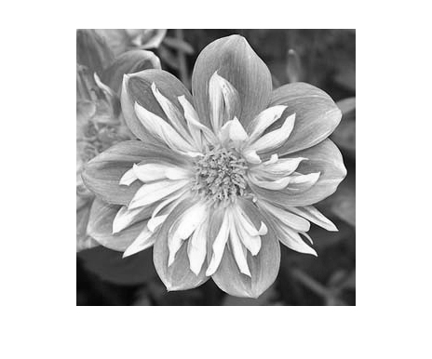

SVD Applications
For this image, using only the first 10 of 300 principal components produces a recognizable reconstruction
So, SVD can be used for image compression

Slide 16

SVD for symmetric matrices
If A is a symmetric matrix, it can be decomposed as the following:
Compared to a traditional SVD decomposition, U = V^{T} and is an orthogonal matrix.

Slide 17
Principal Component Analysis
Remember, columns of U are the Principal Components of the data: the major patterns that can be added to produce the columns of the original matrix
One use of this is to construct a matrix where each column is a separate data sample
Run SVD on that matrix, and look at the first few columns of U to see patterns that are common among the columns
This is called Principal Component Analysis (or PCA) of the data samples

Slide 18
Principal Component Analysis
Often, raw data samples have a lot of redundancy and patterns
PCA can allow you to represent data samples as weights on the principal components, rather than using the original raw form of the data
By representing each sample as just those weights, you can represent just the “meat” of what’s different between samples.
This minimal representation makes machine learning and other algorithms much more efficient

Slide 19
How is SVD computed?
For this class: tell PYTHON to do it. Use the result.
But, if you’re interested, one computer algorithm to do it makes use of Eigenvectors!

Slide 20
Eigenvector definition
Suppose we have a square matrix A. We can solve for vector x and scalar λ such that Ax= λx
In other words, find vectors where, if we transform them with A, the only effect is to scale them with no change in direction.
These vectors are called eigenvectors (German for “self vector” of the matrix), and the scaling factors λ are called eigenvalues
An m x m matrix will have ≤ m eigenvectors where λ is nonzero

Slide 21
Finding eigenvectors
Computers can find an x such that Ax= λx using this iterative algorithm:
  X = random unit vector
  while(x hasn’t converged)
    X = Ax
    normalize x
x will quickly converge to an eigenvector
Some simple modifications will let this algorithm find all eigenvectors

Slide 22
Finding SVD
Eigenvectors are for square matrices, but SVD is for all matrices
To do svd(A), computers can do this:
  Take eigenvectors of AA^{T} (matrix is always square).
    These eigenvectors are the columns of U.
    Square root of eigenvalues are the singular values (the entries of Σ).
  Take eigenvectors of A^{T}A (matrix is always square).
    These eigenvectors are columns of V (or rows of V^{T})

Slide 23
Finding SVD
Moral of the story: SVD is fast, even for large matrices
It’s useful for a lot of stuff
There are also other algorithms to compute SVD or part of the SVD
  Python’s np.linalg.svd() command has options to efficiently compute only what you need, if performance becomes an issue
A detailed geometric explanation of SVD is here:
http://www.ams.org/samplings/feature-column/fcarc-svd

Slide 24
What we will learn today
Introduction to face recognition
Principal Component Analysis (PCA)
Image compression

Slide 25
Covariance
Variance and Covariance are a measure of the “spread” of a set of points around their center of mass (mean)
Variance – measure of the deviation from the mean for points in one dimension e.g. heights
Covariance as a measure of how much each of the dimensions vary from the mean with respect to each other.
Covariance is measured between 2 dimensions to see if there is a relationship between the 2 dimensions e.g. number of hours studied & marks obtained.
The covariance between one dimension and itself is the variance

Slide 26
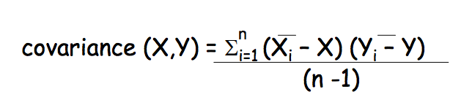
Covariance
So, if you had a 3-dimensional data set (x,y,z), then you could measure the covariance between the x and y dimensions, the y and z dimensions, and the x and z dimensions. Measuring the covariance between x and x , or y and y , or z and z would give you the variance of the x , y and z dimensions respectively

Slide 27
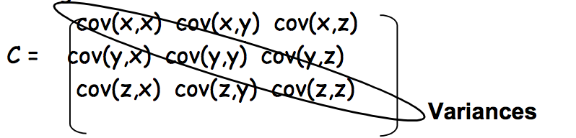
Covariance matrix
Representing Covariance between dimensions as a matrix e.g. for 3 dimensions
Diagonal is the variances of x, y and z
cov(x,y) = cov(y,x) hence matrix is symmetrical about the diagonal
N-dimensional data will result in NxN covariance matrix

Slide 28
Covariance
What is the interpretation of covariance calculations?
  e.g.: 2 dimensional data set
  x: number of hours studied for a subject
  y: marks obtained in that subject
  covariance value is say: 104.53
  what does this value mean?

Slide 29
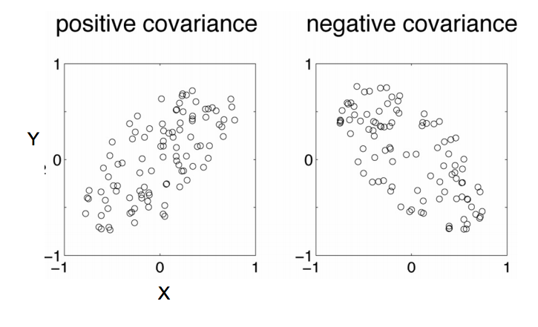
Covariance interpretation

Slide 30
Covariance interpretation
Exact value is not as important as it’s sign.
A positive value of covariance indicates both dimensions increase or decrease together e.g. as the number of hours studied increases, the marks in that subject increase.
A negative value indicates while one increases the other decreases, or vice-versa e.g. active social life at PSU vs performance in CS dept.
If covariance is zero: the two dimensions are independent of each other e.g. heights of students vs the marks obtained in a subject

Slide 31
Example data
Covariance between the two axis is high. Can we reduce the number of dimensions to just 1?

Slide 32
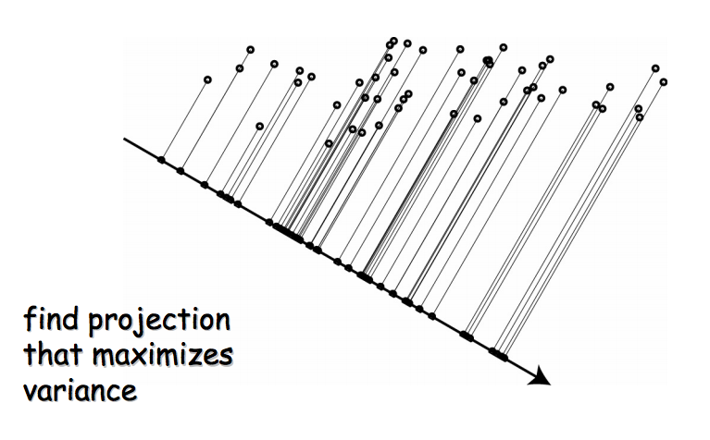
Geometric interpretation of PCA

Slide 33
Geometric interpretation of PCA
Let’s say we have a set of 2D data points x. But we see that all the points lie on a line in 2D.
So, 2 dimensions are redundant to express the data. We can express all the points with just one dimension.
1D subspace in 2D

Slide 34
PCA: Principle Component Analysis
Given a set of points, how do we know if they can be compressed like in the previous example?
  The answer is to look into the correlation between the points
  The tool for doing this is called PCA

Slide 35
PCA Formulation
Basic idea:
  If the data lives in a subspace, it is going to look very flat when viewed from the full space, e.g.
1D subspace in 2D
2D subspace in 3D
Slide inspired by N. Vasconcelos

Slide 36
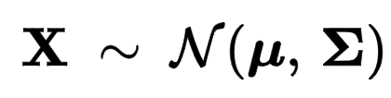
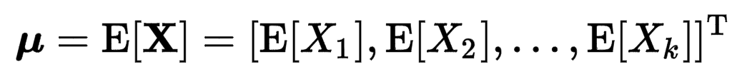
PCA Formulation
Assume x is Gaussian with covariance Σ.
Recall that a gaussian is defined with it’s mean and variance:
Recall that μ and Σ of a gaussian are defined as:
x₂
φ₁
φ₂
λ₁
λ₂
x₁

Slide 37


PCA formulation
Since gaussians are symmetric, it’s covariance matrix is also a symmetric matrix. So we can express it as:
  Σ = UΛU^{T} = UΛ^{1/2}(UΛ^{1/2})^{T}

Slide 38
PCA Formulation
If x is Gaussian with covariance Σ,
  Principal components φ_{i} are the
  eigenvectors of Σ
  Principal lengths λ_{i} are the
  eigenvalues of Σ
by computing the eigenvalues we know the data is
  Not flat if λ₁ ≈ λ₂
  Flat if λ₁ >> λ₂
x₂
φ₁
φ₂
λ₁
λ₂
x₁
Slide inspired by N. Vasconcelos

Slide 39
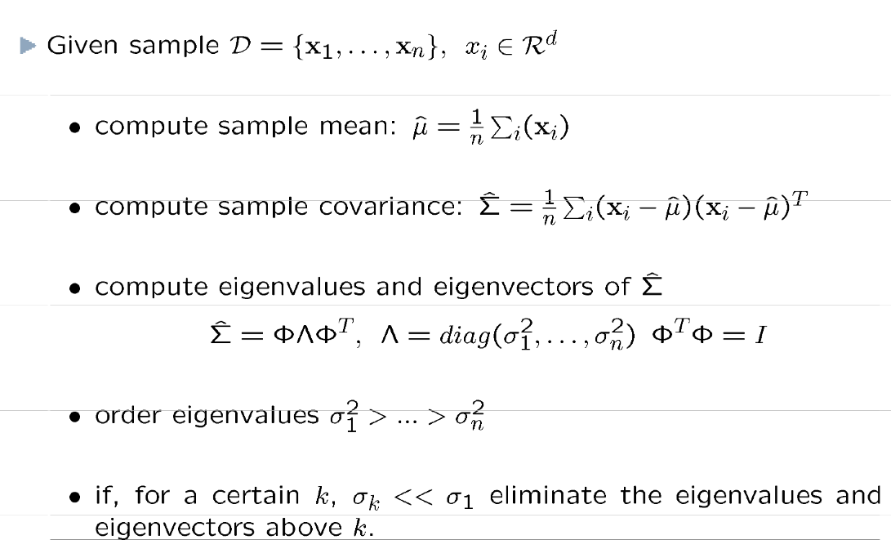
PCA Algorithm (training)
Slide inspired by N. Vasconcelos

Slide 40
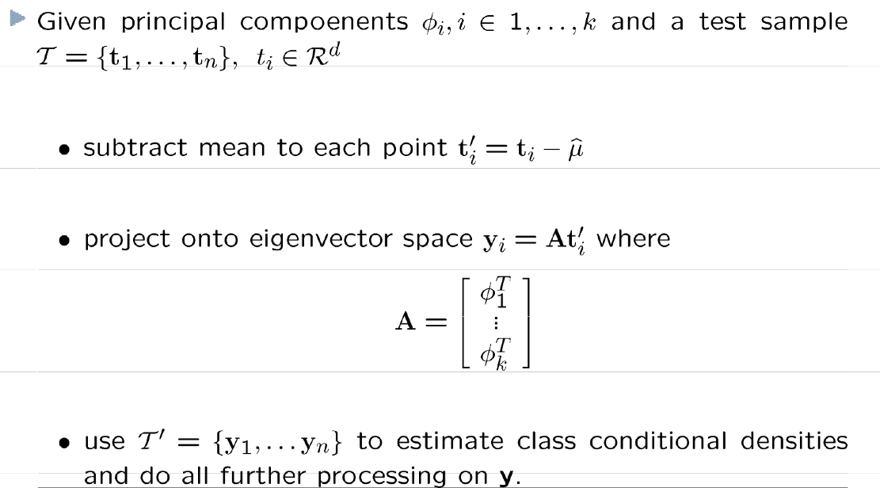
PCA Algorithm (testing)
Slide inspired by N. Vasconcelos

Slide 41


PCA by SVD
An alternative manner to compute the principal components, based on singular value decomposition
Quick reminder: SVD
  Any real n x m matrix (n>m) can be decomposed as
  Where M is an (n x m) column orthonormal matrix of left singular vectors (columns of M)
  Π is an (m x m) diagonal matrix of singular values
  N^{T} is an (m x m) row orthonormal matrix of right singular vectors (columns of N)
Slide inspired by N. Vasconcelos

Slide 42
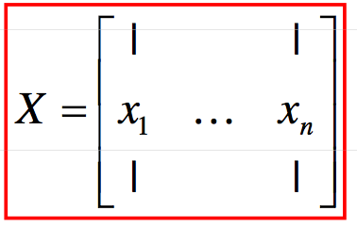
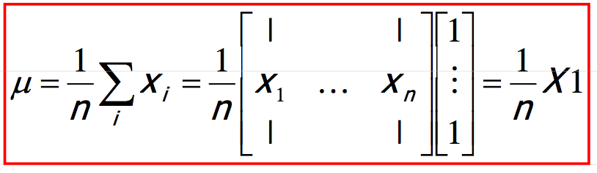
PCA by SVD
To relate this to PCA, we consider the data matrix
The sample mean is
Slide inspired by N. Vasconcelos

Slide 43
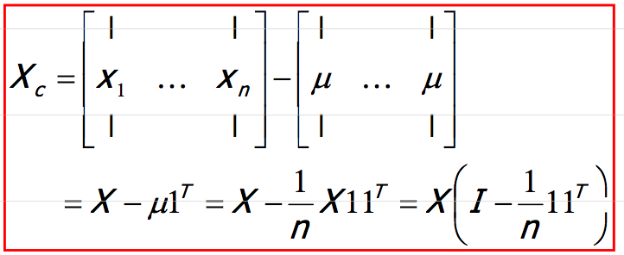
PCA by SVD
Center the data by subtracting the mean to each column of X
The centered data matrix is
Slide inspired by N. Vasconcelos

Slide 44
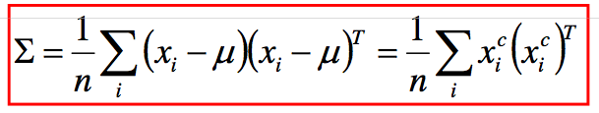
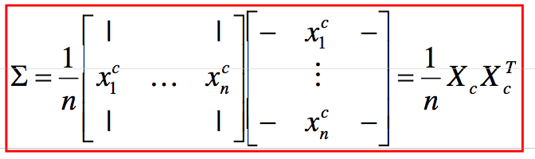
PCA by SVD
The sample covariance matrix is
where x_{i}^{c} is the i^{th} column of X_{c}
This can be written as
Slide inspired by N. Vasconcelos

Slide 45
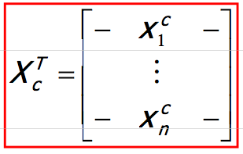

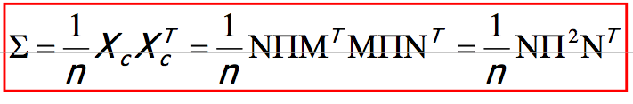
PCA by SVD
The matrix
is real (n x d). Assuming n>d it has SVD decomposition
and
Slide inspired by N. Vasconcelos

Slide 46
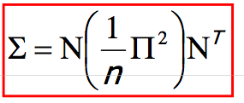
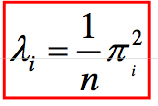
PCA by SVD
Note that N is (d x d) and orthonormal, and Π² is diagonal. This is just the eigenvalue decomposition of Σ
It follows that
  The eigenvectors of Σ are the columns of N
  The eigenvalues of Σ are
This gives an alternative algorithm for PCA
Slide inspired by N. Vasconcelos

Slide 47
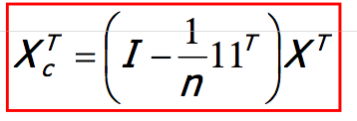

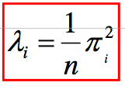
PCA by SVD
In summary, computation of PCA by SVD
Given X with one example per column
  Create the centered data matrix
  Compute its SVD
  Principal components are columns of N, eigenvalues are
Slide inspired by N. Vasconcelos

Slide 48
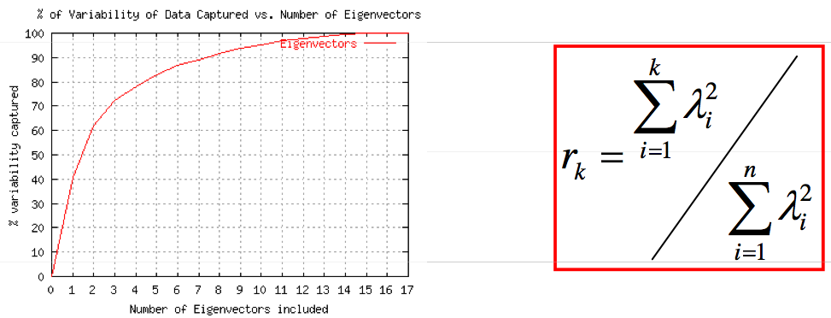
Rule of thumb for finding the number of PCA components
A natural measure is to pick the eigenvectors that explain p% of the data variability
  Can be done by plotting the ratio r_{k} as a function of k
  E.g. we need 3 eigenvectors to cover 70% of the variability of this dataset
Slide inspired by N. Vasconcelos

Slide 49
What we will learn today
Introduction to face recognition
Principal Component Analysis (PCA)
Image compression

Slide 50
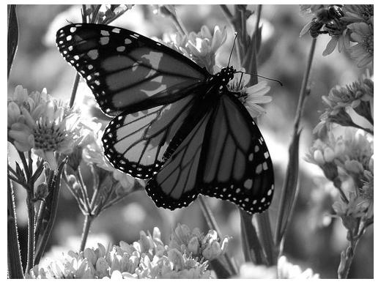
Original Image
Divide the original 372x492 image into patches:
  Each patch is an instance that contains 12x12 pixels on a grid
View each as a 144-D vector

Slide 51
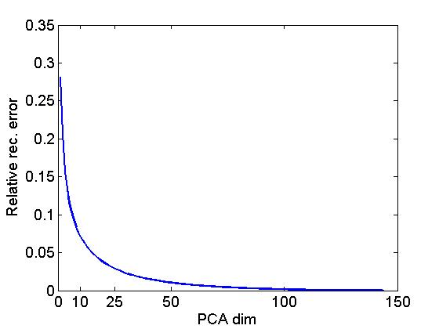
L₂ error and PCA dim

Slide 52
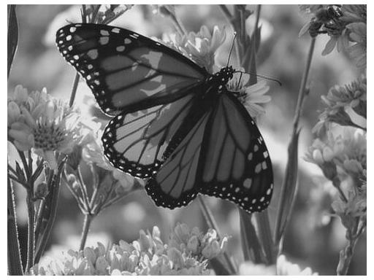
PCA compression: 144D ) 60D

Slide 53
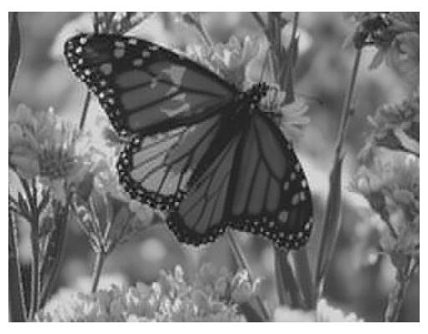
PCA compression: 144D ) 16D

Slide 54
16 most important eigenvectors

Slide 55

PCA compression: 144D ) 6D

Slide 56
6 most important eigenvectors

Slide 57

PCA compression: 144D ) 3D

Slide 58
3 most important eigenvectors

Slide 59
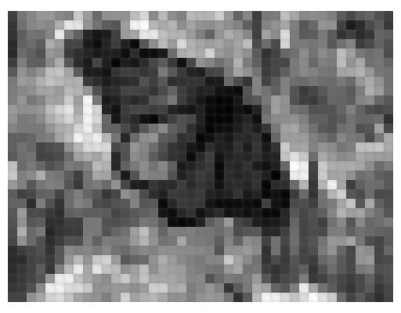
PCA compression: 144D ) 1D

Slide 60
What we have learned today
Introduction to face recognition
Principal Component Analysis (PCA)
Image compression

