Slide 1
Linear systems and Convolutions
Ranjay Krishna
Stanford Vision and Learning Lab
Notes:
Edges are significant local changes in the image and are important features for analyzing images.Edges typically occur on the boundary between two different regions in an image.

Slide 2


Linear Systems (filters)
Linear filtering:
  Form a new image whose pixels are a weighted sum of original pixel values
  Use the same set of weights at each point
S is a linear system (function) iff it S satisfies
superposition property
Notes:
Moving average is an example of a linear filter.
Here a more general definition.

Slide 3
2D impulse function
1 at [0,0].
0 everywhere else

Slide 4
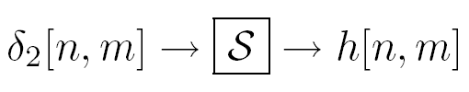

LSI (linear shift invariant) systems
Impulse response
Notes:
LSI systems can be characterized by the impulse response.
\delta_2 is the impulse (an image with 1 pixel =1, all the rest =0)
h is the response

Slide 5
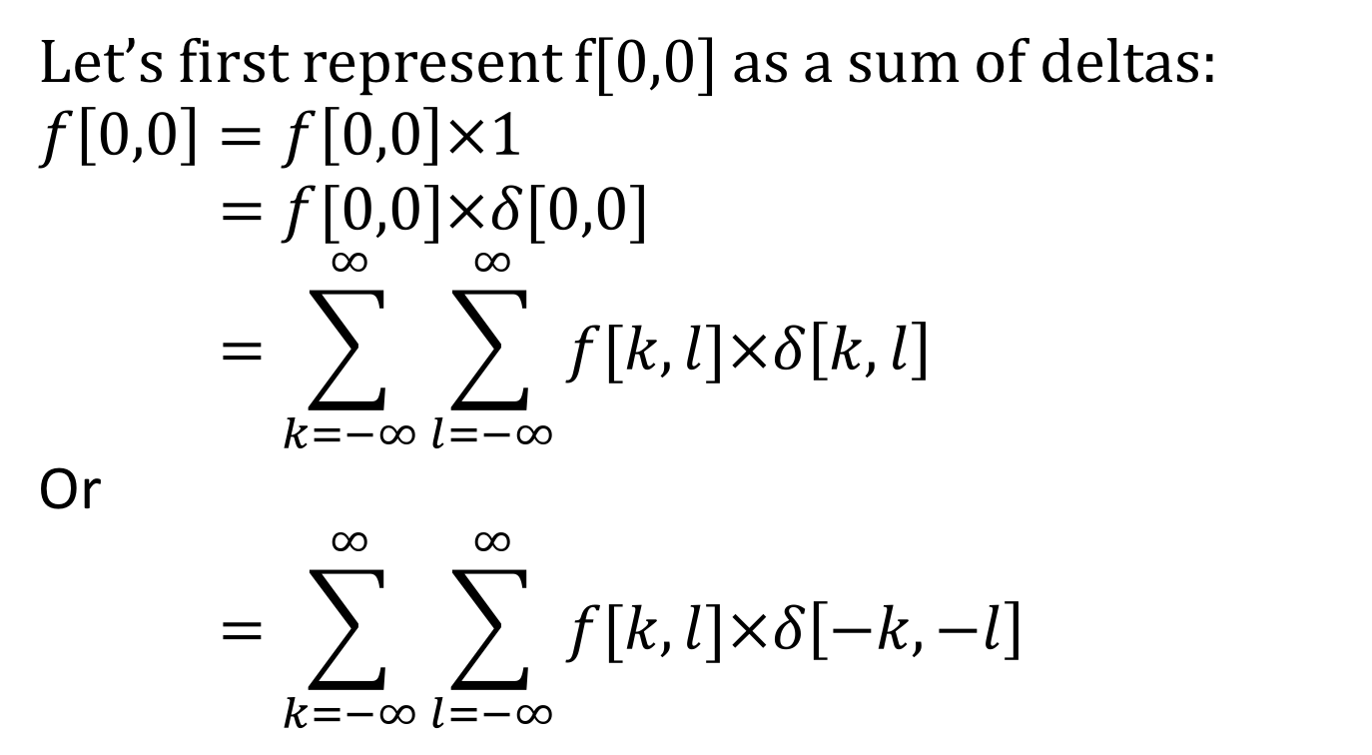
Why are convolutions flipped?
Let’s first represent f[0,0] as a sum of deltas:
$$f\left[0,0\right]=f\left[0,0\right]×1$$
$$=f[0,0]×δ[0,0]$$
$$=\sum_{k=−∞}^{∞}{\sum_{l=−∞}^{∞}{f[k,l]×δ\left[k,l\right]}}$$
Or
$$=\sum_{k=−∞}^{∞}{\sum_{l=−∞}^{∞}{f[k,l]×δ\left[−k,−l\right]}}$$

Slide 6
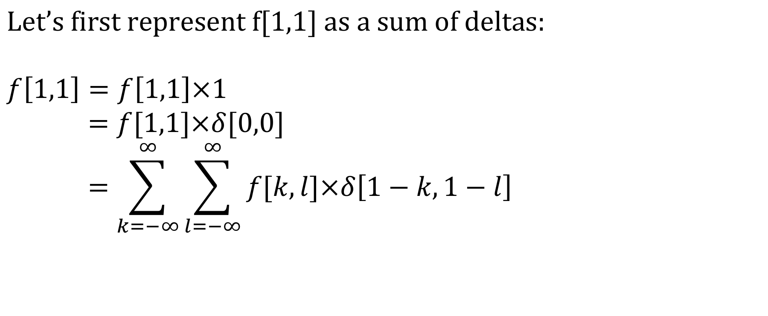
Why are convolutions flipped?
$$\text{Let}\text{’}\text{s} \text{first} \text{represent} \text{f}\text{[1,1] }\text{as} \text{a} \text{sum} \text{of} \text{deltas}\text{:}$$
$$f\left[1,1\right]=f\left[1,1\right]×1$$
$$=f[1,1]×δ[0,0]$$
$$=\sum_{k=−∞}^{∞}{\sum_{l=−∞}^{∞}{f[k,l]×δ\left[1−k,1−l\right]}}$$

Slide 7
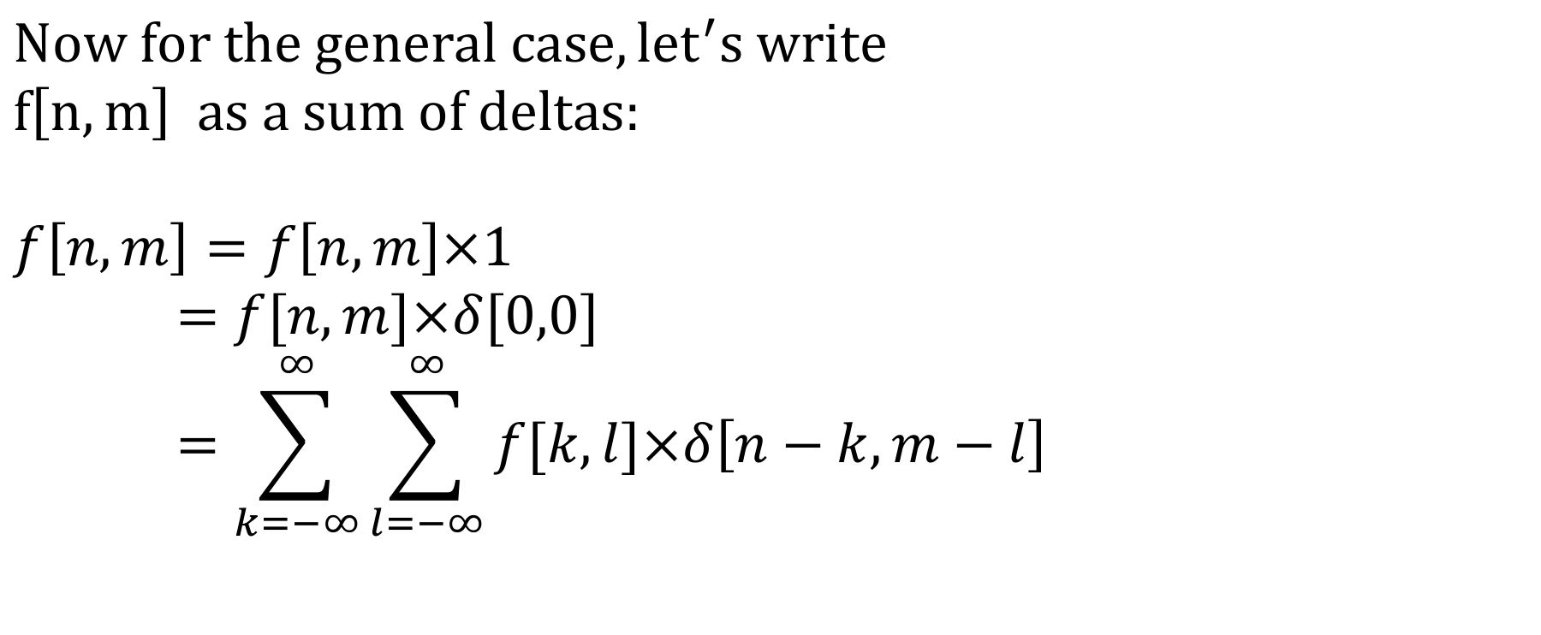
Why are convolutions flipped?
$$Now for the general case, {let}^{′}s write$$
$$f\left[n,m\right] as a sum of deltas:$$
$$f\left[n,m\right]=f\left[n,m\right]×1$$
$$=f[n,m]×δ[0,0]$$
$$=\sum_{k=−∞}^{∞}{\sum_{l=−∞}^{∞}{f[k,l]×δ\left[n−k,m−l\right]}}$$

Slide 8
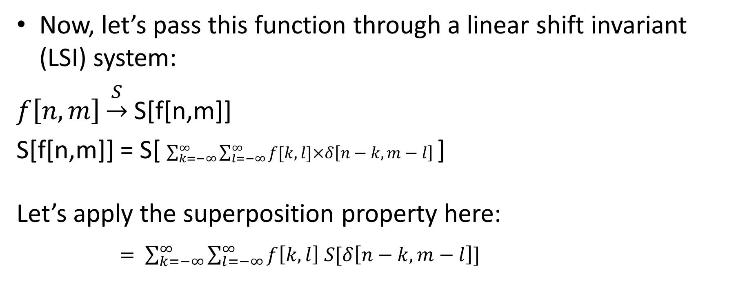
Why are convolutions flipped?
Now, let’s pass this function through a linear shift invariant (LSI) system:
$f\left[n,m\right]\underset{→}{S}$S[f[n,m]]
S[f[n,m]] = S[ $\sum_{k=−∞}^{∞}{\sum_{l=−∞}^{∞}{f[k,l]×δ\left[n−k,m−l\right]}}$]
Let’s apply the superposition property here:
$= \sum_{k=−∞}^{∞}{\sum_{l=−∞}^{∞}{f\left[k,l\right] S[δ\left[n−k,m−l\right]}}]$

Slide 9
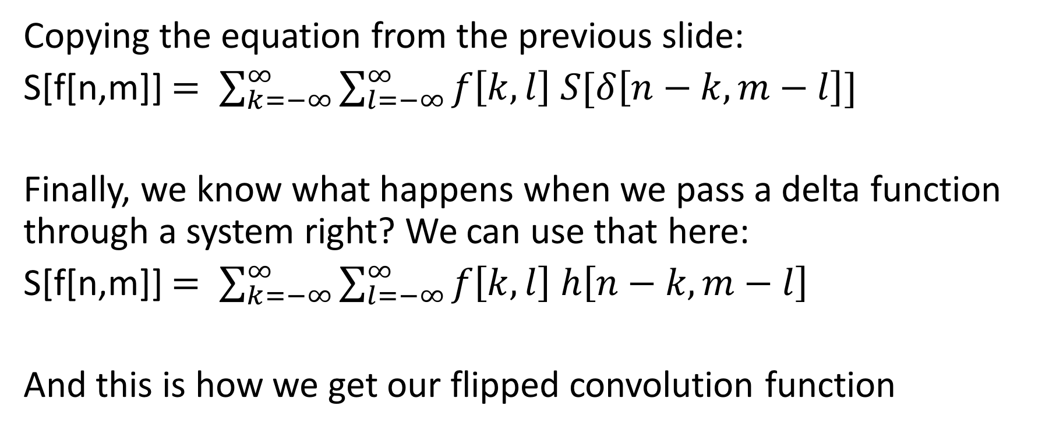
Why are convolutions flipped?
Copying the equation from the previous slide:
S[f[n,m]] $= \sum_{k=−∞}^{∞}{\sum_{l=−∞}^{∞}{f\left[k,l\right] S[δ\left[n−k,m−l\right]}}]$
Finally, we know what happens when we pass a delta function through a system right? We can use that here:
S[f[n,m]] $= \sum_{k=−∞}^{∞}{\sum_{l=−∞}^{∞}{f\left[k,l\right] h\left[n−k,m−l\right]}}$
And this is how we get our flipped convolution function

