Slide 1
Lecture:
Clustering and Segmentation
Juan Carlos Niebles and Ranjay Krishna
Stanford Vision and Learning Lab

Slide 2
What we will learn today
Introduction to segmentation and clustering
Gestalt theory for perceptual grouping
Agglomerative clustering
Oversegmentation
Reading: [FP] Chapters: 14.2, 14.4

Slide 3
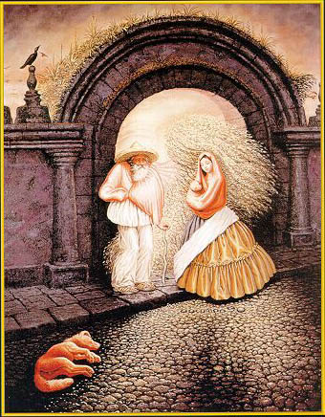

Slide 4
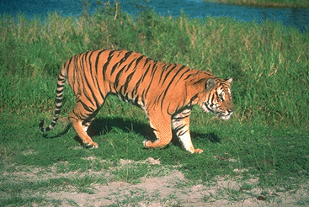
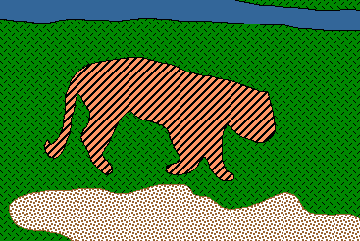
Image Segmentation
Goal: identify groups of pixels that go together
Slide credit: Steve Seitz, Kristen Grauman

Slide 5
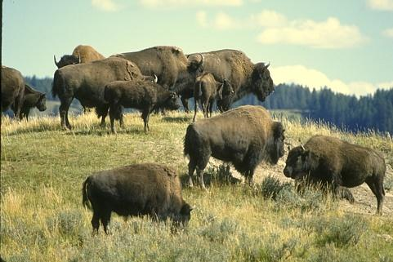
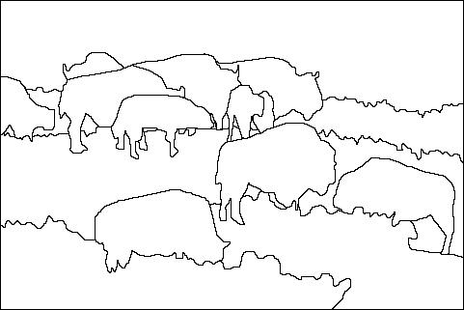
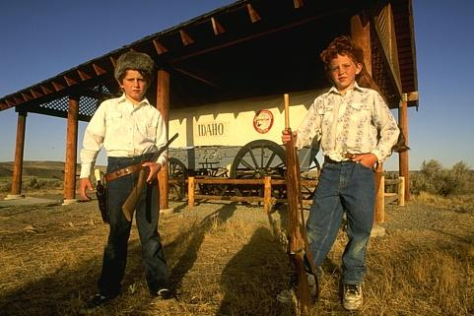
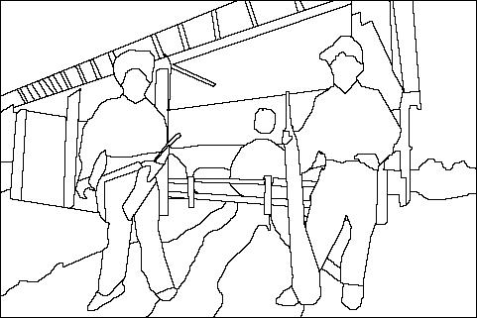
The Goals of Segmentation
Separate image into coherent “objects”
Image
Human segmentation
Slide credit: Svetlana Lazebnik

Slide 6
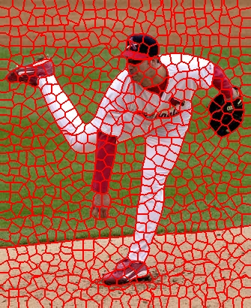
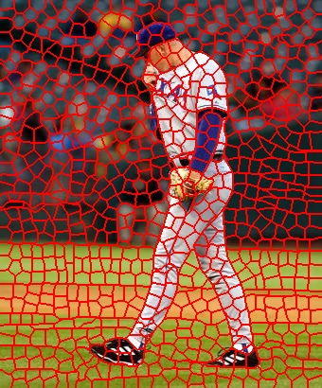
The Goals of Segmentation
Separate image into coherent “objects”
Group together similar-looking pixels for efficiency of further processing
“superpixels”
Slide credit: Svetlana Lazebnik
X. Ren and J. Malik. Learning a classification model for segmentation. ICCV 2003.

Slide 7
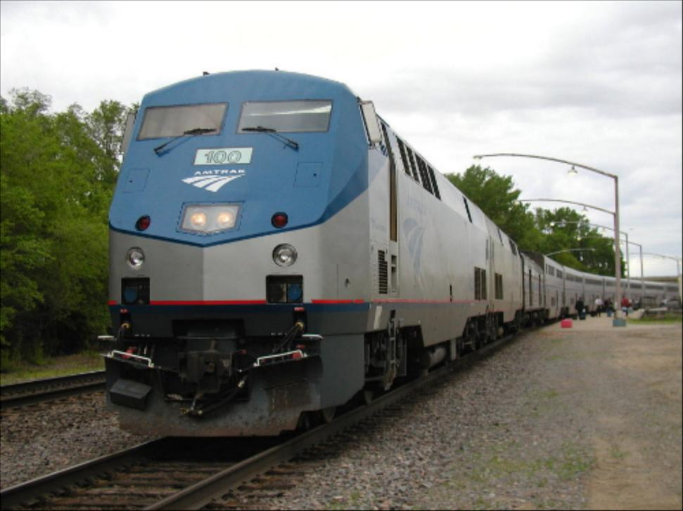
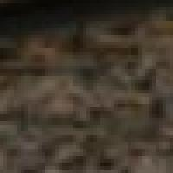
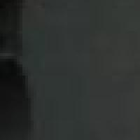
Segmentation for feature support
50x50 Patch
50x50 Patch
Slide: Derek Hoiem

Slide 8
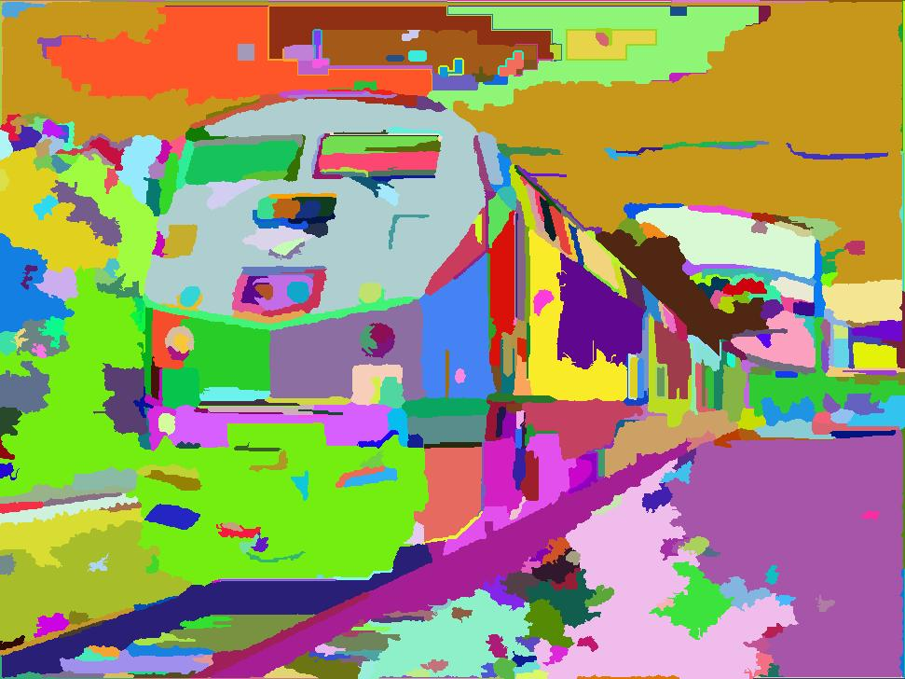
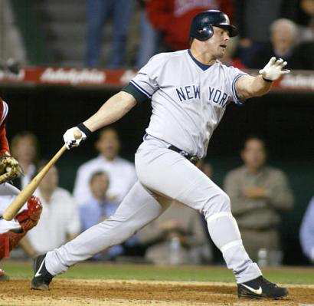
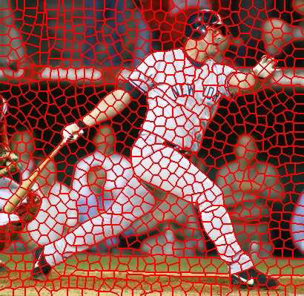
Segmentation for efficiency
[Felzenszwalb and Huttenlocher 2004]
[Hoiem et al. 2005, Mori 2005]
[Shi and Malik 2001]
Slide: Derek Hoiem

Slide 9
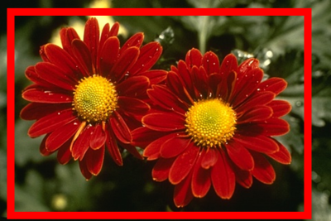
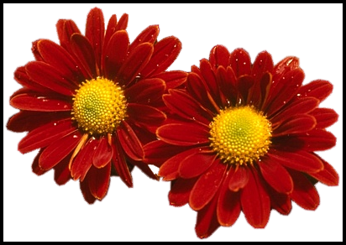
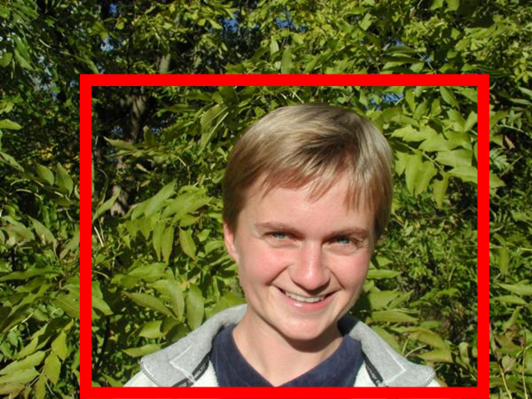
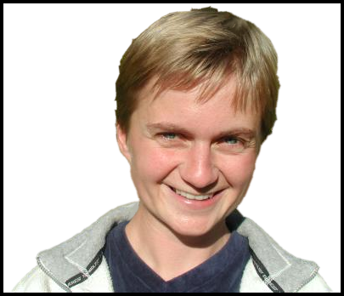
Segmentation as a result
Rother et al. 2004

Slide 10
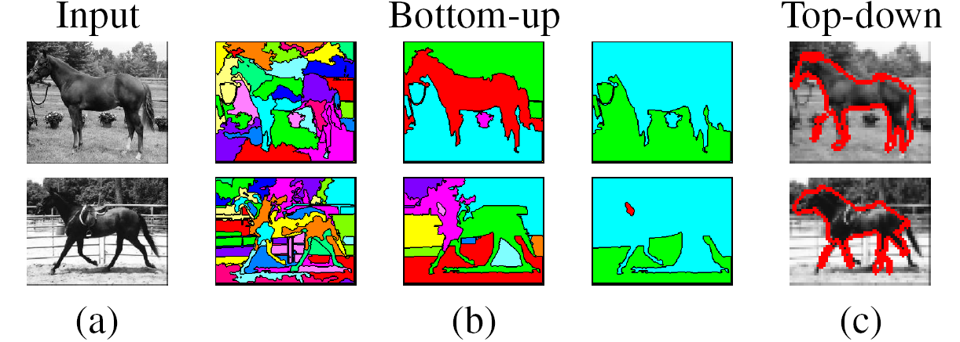
Types of segmentations
Oversegmentation
Undersegmentation
Multiple Segmentations

Slide 11
One way to think about “segmentation” is Clustering
Clustering: group together similar data points and represent them with a single token
Key Challenges:
1) What makes two points/images/patches similar?
2) How do we compute an overall grouping from pairwise similarities?
Slide: Derek Hoiem

Slide 12
Why do we cluster?
Summarizing data
  Look at large amounts of data
  Patch-based compression or denoising
  Represent a large continuous vector with the cluster number
Counting
  Histograms of texture, color, SIFT vectors
Segmentation
  Separate the image into different regions
Prediction
  Images in the same cluster may have the same labels
Slide: Derek Hoiem

Slide 13
How do we cluster?
Agglomerative clustering
  Start with each point as its own cluster and iteratively merge the closest clusters
K-means (next lecture)
  Iteratively re-assign points to the nearest cluster center
Mean-shift clustering (next lecture)
  Estimate modes of pdf

Slide 14
General ideas
Tokens
  whatever we need to group (pixels, points, surface elements, etc., etc.)
Bottom up clustering
  tokens belong together because they are locally coherent
Top down clustering
  tokens belong together because they lie on the same visual entity (object, scene…)
> These two are not mutually exclusive

Slide 15
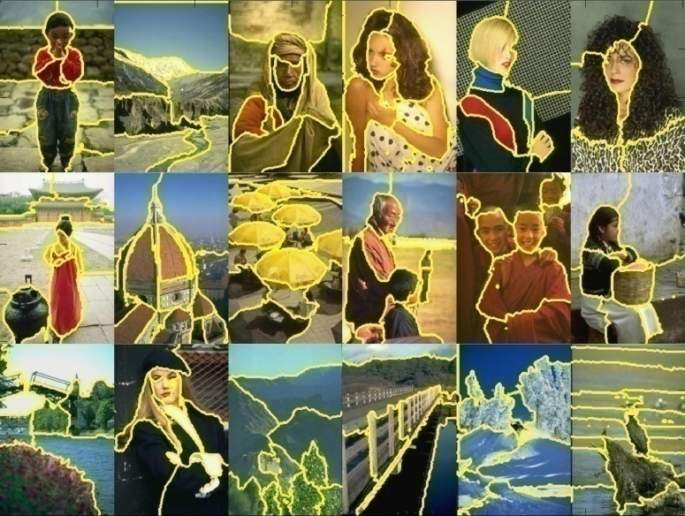
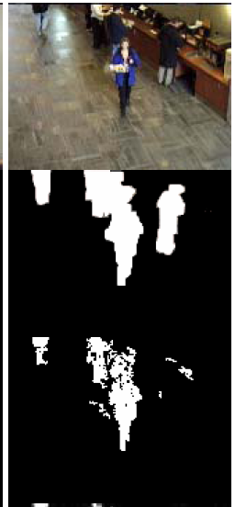
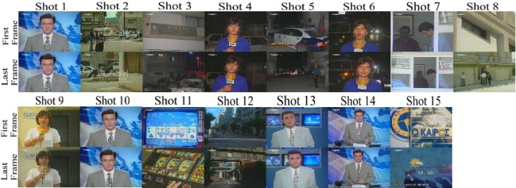
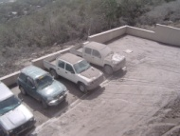
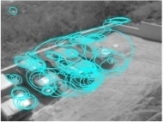
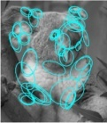
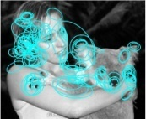

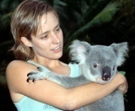
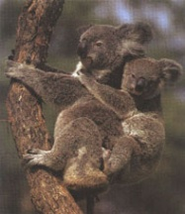
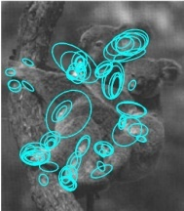
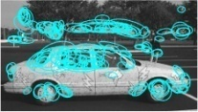

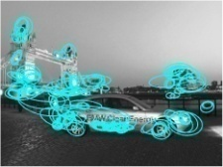




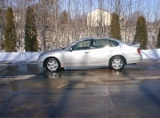
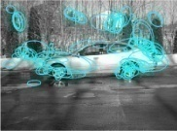

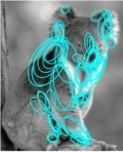

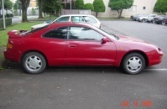
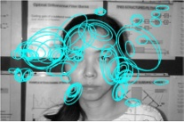
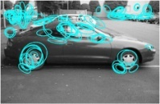
Examples of Grouping in Vision
Grouping video frames into shots
Determining image regions
What things should
be grouped?
Figure-ground
What cues
indicate groups?
Object-level grouping
Slide credit: Kristen Grauman

Slide 16
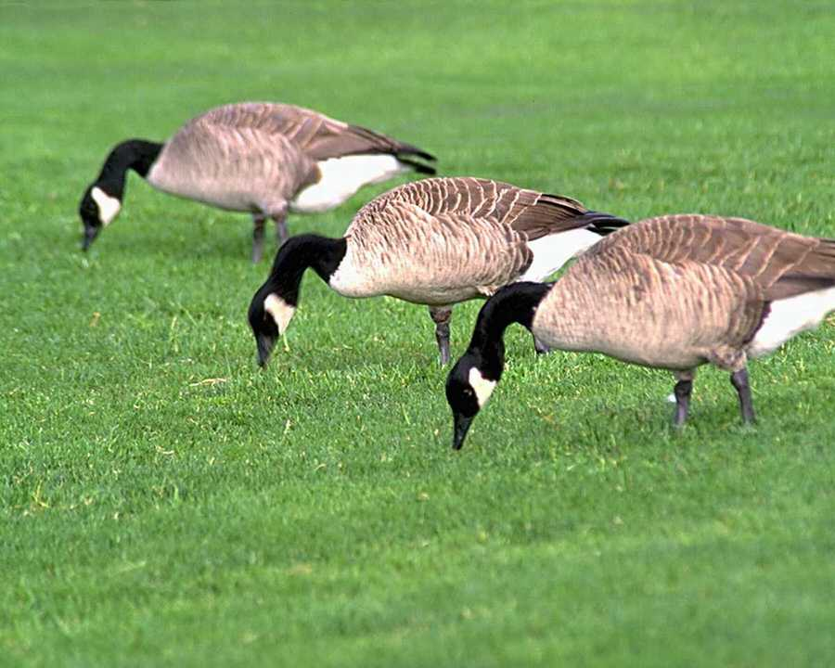
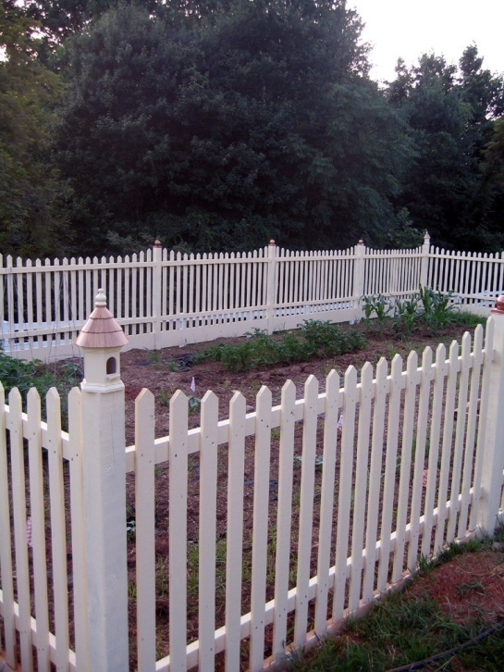
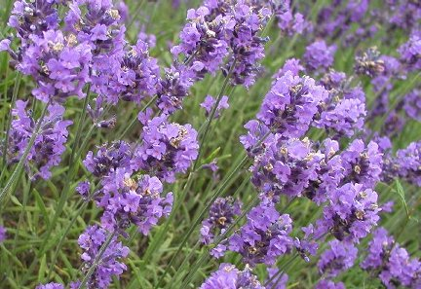
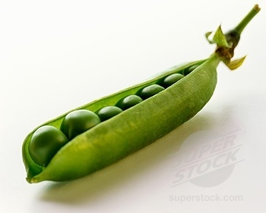
Similarity
Slide credit: Kristen Grauman

Slide 17
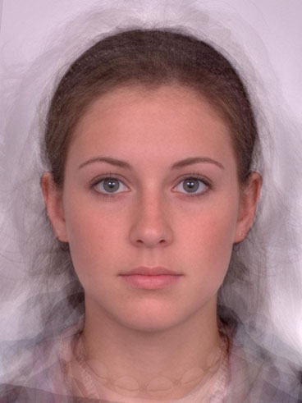
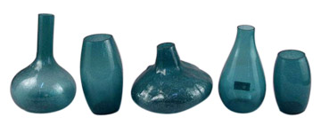
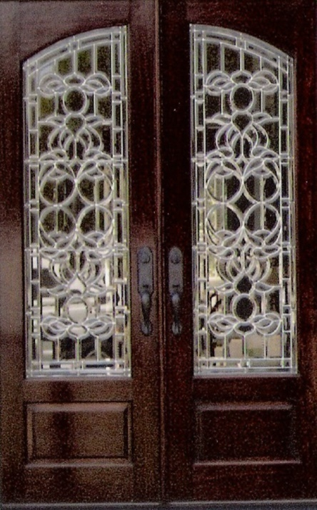
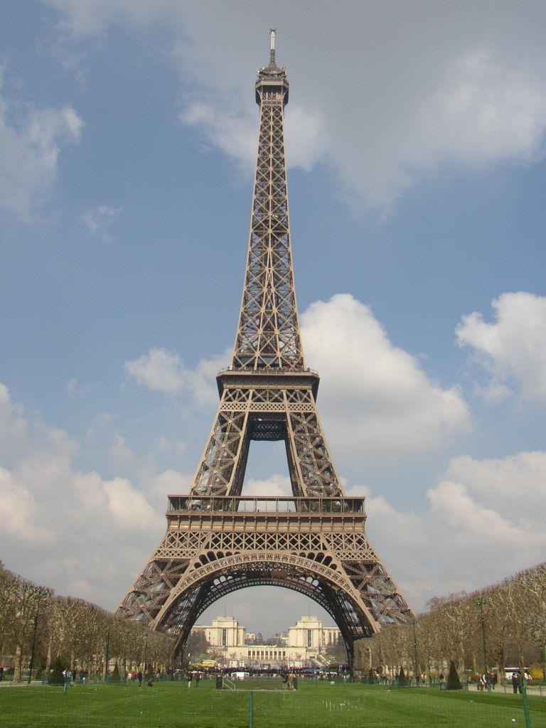
Symmetry
Slide credit: Kristen Grauman

Slide 18
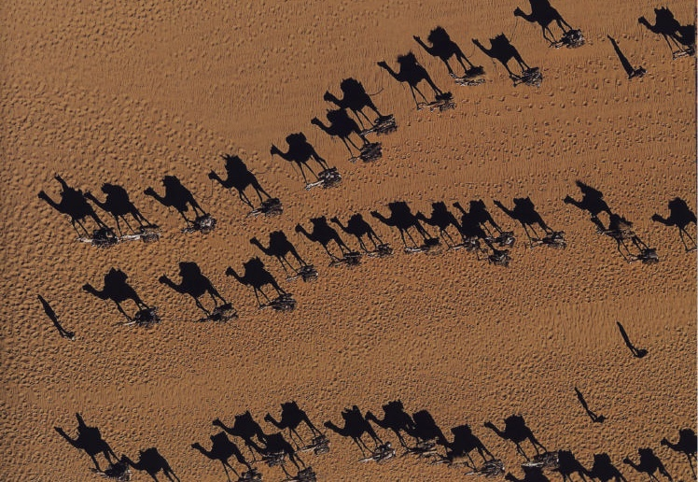
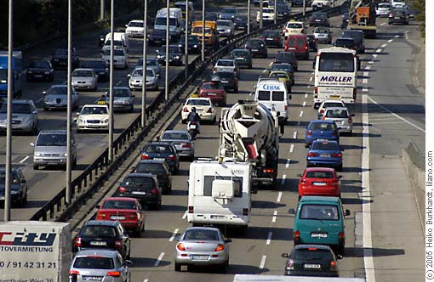
Common Fate
Image credit: Arthus-Bertrand (via F. Durand)
Slide credit: Kristen Grauman

Slide 19


Proximity
Slide credit: Kristen Grauman

Slide 20
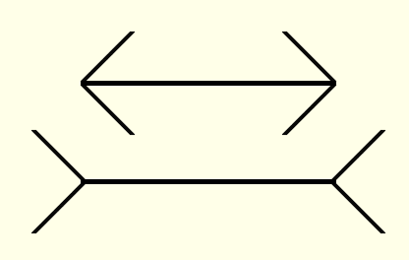
Muller-Lyer Illusion
What makes the bottom line look longer than the top line?

Slide 21
What we will learn today
Introduction to segmentation and clustering
Gestalt theory for perceptual grouping
Agglomerative clustering
Oversegmentation

Slide 22
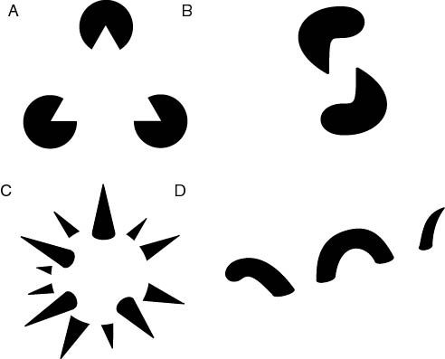
The Gestalt School
Grouping is key to visual perception
Elements in a collection can have properties that result from relationships
  “The whole is greater than the sum of its parts”
Illusory/subjective
contours
Occlusion
Slide credit: Svetlana Lazebnik
Familiar configuration
http://en.wikipedia.org/wiki/Gestalt_psychology

Slide 23

Gestalt Theory
Gestalt: whole or group
  Whole is greater than sum of its parts
  Relationships among parts can yield new properties/features
Psychologists identified series of factors that predispose set of elements to be grouped (by human visual system)
        “I stand at the window and see a house, trees, sky.
        Theoretically I might say there were 327 brightnesses
        and nuances of colour. Do I have "327"? No. I have sky, house, and trees.”
        Max Wertheimer
        (1880-1943)
Untersuchungen zur Lehre von der Gestalt,
Psychologische Forschung, Vol. 4, pp. 301-350, 1923
http://psy.ed.asu.edu/~classics/Wertheimer/Forms/forms.htm

Slide 24


Gestalt Factors
These factors make intuitive sense, but are very difficult to translate into algorithms.
Image source: Forsyth & Ponce

Slide 25

Continuity through Occlusion Cues

Slide 26

Continuity through Occlusion Cues
Continuity, explanation by occlusion

Slide 27

Continuity through Occlusion Cues
Image source: Forsyth & Ponce

Slide 28

Continuity through Occlusion Cues
Image source: Forsyth & Ponce

Slide 29

Figure-Ground Discrimination

Slide 30

The Ultimate Gestalt?

Slide 31
What we will learn today
Introduction to segmentation and clustering
Gestalt theory for perceptual grouping
Agglomerative clustering
Oversegmentation

Slide 32

What is similarity?
Similarity is hard to define, but… “We know it when we see it” The real meaning of similarity is a philosophical question. We will take a more pragmatic approach.

Slide 33


Clustering: distance measure
Clustering is an unsupervised learning method. Given items
, the goal is to group them into clusters. We need a pairwise distance/similarity function between items, and sometimes the desired number of clusters.
When data (e.g. images, objects, documents) are represented by feature vectors, a commonly used similarity measure is the cosine similarity. Let be two data vectors. There is angle
between the two vectors .

Slide 34



Defining Distance Measures
Let x and x’ be two objects from the universe of possible objects. The distance (similarity) between x and x’ is a real number denoted by sim(x, x’).
The euclidian similarity is defined as
In contrast, cosine distance measure would be

Slide 35
Desirable Properties of a Clustering Algorithms
Scalability (in terms of both time and space)
Ability to deal with different data types
Minimal requirements for domain knowledge to determine input parameters
Interpretability and usability Optional
  Incorporation of user-specified constraints

Slide 36


Animated example
source

Slide 37
Animated example
source

Slide 38
Animated example
source

Slide 39

Agglomerative clustering
Slide credit: Andrew Moore

Slide 40

Agglomerative clustering
Slide credit: Andrew Moore

Slide 41

Agglomerative clustering
Slide credit: Andrew Moore

Slide 42

Agglomerative clustering
Slide credit: Andrew Moore

Slide 43

Agglomerative clustering
Slide credit: Andrew Moore

Slide 44

Agglomerative clustering
How to define cluster similarity?
Average distance between points,
maximum distance
minimum distance
Distance between means or medoids
How many clusters?
Clustering creates a dendrogram (a tree)
Threshold based on max number of clusters or based on distance between merges
distance

Slide 45

Agglomerative Hierarchical Clustering - Algorithm

Slide 46


Different measures of nearest clusters
Single Link
Long, skinny clusters

Slide 47

Different measures of nearest clusters
Complete Link
Tight clusters

Slide 48

Different measures of nearest clusters
Average Link
Robust against noise.

Slide 49
Conclusions: Agglomerative Clustering
Good
Simple to implement, widespread application.
Clusters have adaptive shapes.
Provides a hierarchy of clusters.
No need to specify number of clusters in advance.
Bad
May have imbalanced clusters.
Still have to choose number of clusters or threshold.
Does not scale well. Runtime of O(n³).
Can get stuck at a local optima.

Slide 50
What we will learn today?
Introduction to segmentation and clustering
Gestalt theory for perceptual grouping
Agglomerative clustering
Oversegmentation

Slide 51


How do we segment using Clustering?
Solution: Oversegmentation algorithm
  Introduced by Felzenszwalb and Huttenlocher in the paper titled Efficient Graph-Based Image Segmentation.

Slide 52

Problem Formulation
Graph G = (V, E)
V is set of nodes (i.e. pixels)
E is a set of undirected edges between pairs of pixels
w(vi , vj ) is the weight of the edge between nodes vi and vj .
S is a segmentation of a graph G such that G’ = (V, E’) where E’ ⊂ E.
S divides G into G’ such that it contains distinct clusters C.

Slide 53


Predicate for segmentation
Predicate D determines whether there is a boundary for segmentation.
Where
dif(C1 , C2 ) is the difference between two clusters.
in(C1 , C2 ) is the internal different in the clusters C1 and C2

Slide 54


Predicate for Segmentation
Predicate D determines whether there is a boundary for segmentation.
The different between two components is the minimum weight edge that connects a node vi in clusters C1 to node vj in C2

Slide 55

Predicate for Segmentation
Predicate D determines whether there is a boundary for segmentation.
In(C1, C2) is to the maximum weight edge that connects two nodes in the same component.

Slide 56

Predicate for Segmentation
k/|C| sets the threshold by which the components need to be different from the internal nodes in a component.
Properties of constant k:
  If k is large, it causes a preference of larger objects.
  k does not set a minimum size for components.

Slide 57

Features and weights
Project every pixel into feature space defined by (x, y, r, g, b).
Every pixel is connected to its 8 neighboring pixels and the weights are determined by the difference in intensities.
Weights between pixels are determined using L2 (Euclidian) distance in feature space.
Edges are chosen for only top ten nearest neighbors in feature space to ensure run time of O(n log n) where n is number of pixels.

Slide 58

Results

Slide 59
What we have learned today?
Introduction to segmentation and clustering
Gestalt theory for perceptual grouping
Agglomerative clustering
Oversegmentation

