Slide 1
Lecture:
Image Resizing
Juan Carlos Niebles and Ranjay Krishna
Stanford Vision and Learning Lab

Slide 2
Today’s agenda
Image resizing
  Seam carving
  Dynamic programming
Applications

Slide 3
Display Devices
Notes:
There are tons of digital devices that we use to consume information or view images. They come in numerous different sizes and shapes. So, the images that we display on one device might have to be resized or rescaled when viewed on a different device. But resizing images usually causes a lot of artifacts. That’s what we will talk about in class today.

Slide 4
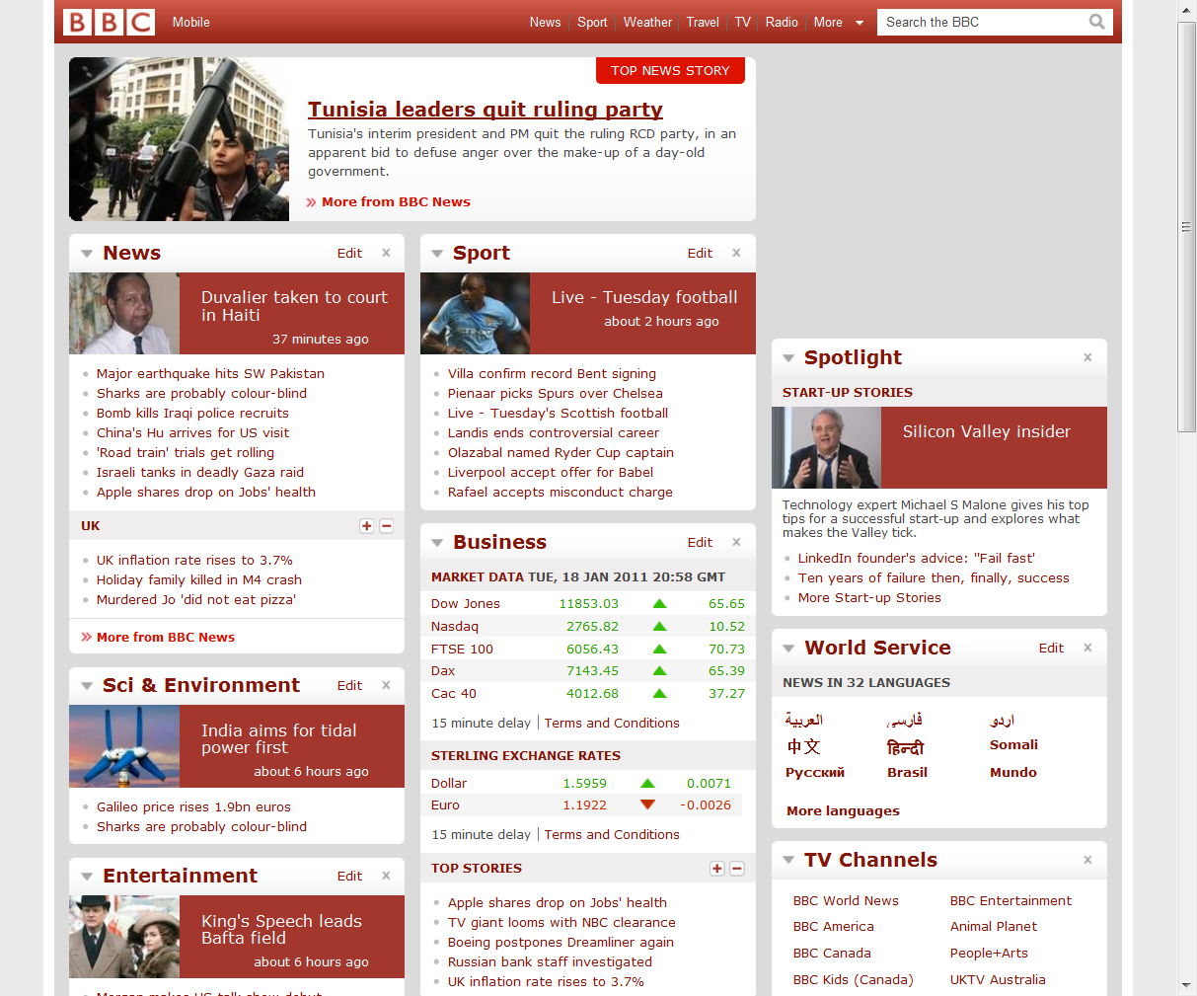

Content Retargeting
PC
iPhone

Slide 5
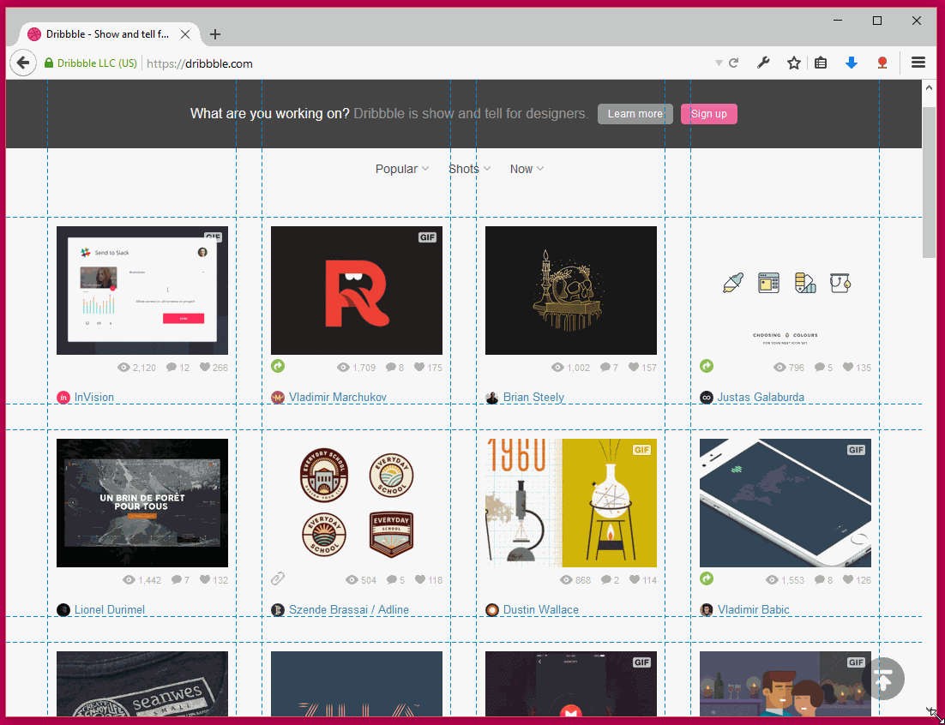
Page Layout

Slide 6
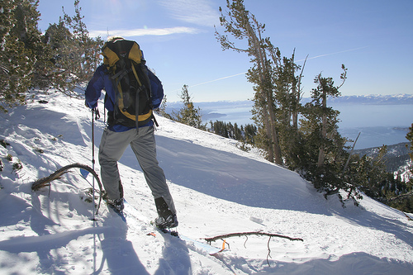

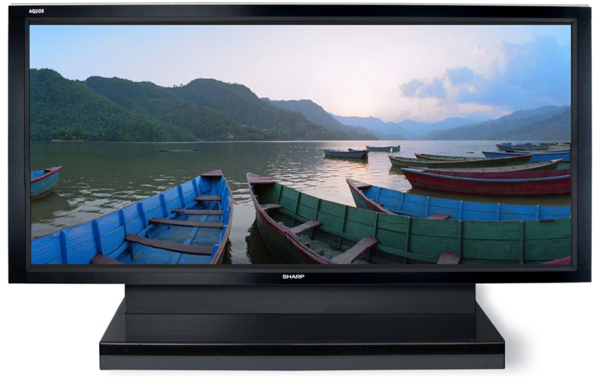
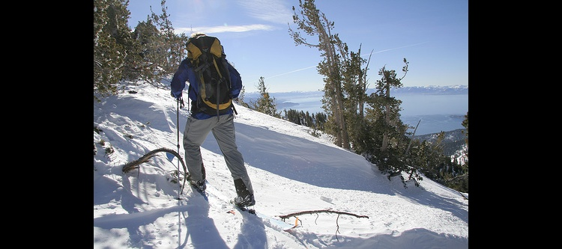


Simple Media Retargeting Operators
Letterboxing
Scaling
?
?

Slide 7
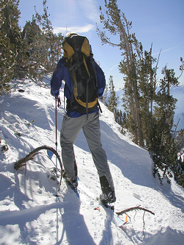
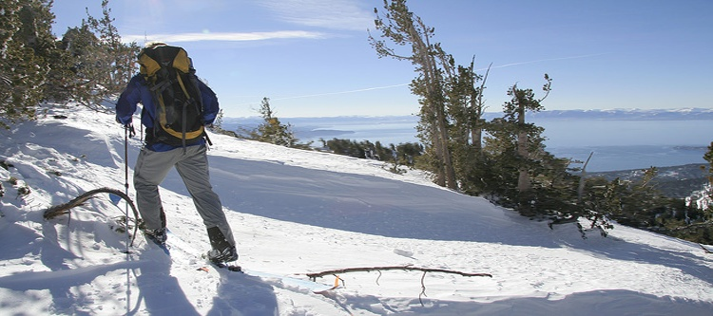
Content-aware Retargeting Operators
“Important”
content
Content-
aware
Content-
oblivious

Slide 8




Content-aware Retargeting
Scale
Crop
Content-aware
“less-Important”
content
Input

Slide 9
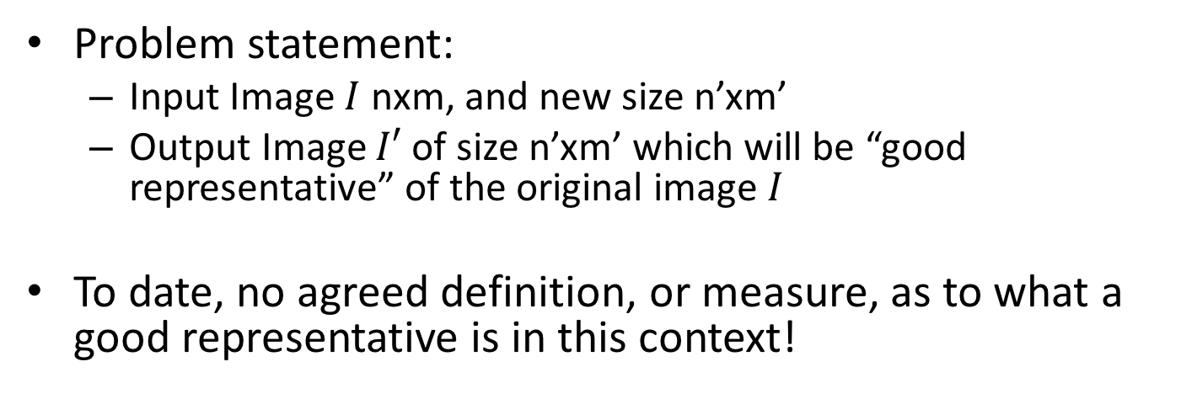
Image Retargeting
Problem statement:
  Input Image $I$ nxm, and new size n’xm’
  Output Image $I′$ of size n’xm’ which will be “good representative” of the original image $I$
To date, no agreed definition, or measure, as to what a good representative is in this context!

Slide 10
Image/Video Retargeting
In large, we would expect retargeting to:
Adhere to the geometric constraints (display/aspect ratio)
Preserve the important content and structures
Limit artifacts
Very Ill-posed!
  How do we define important? Is there a universal ground truth?
  Would different viewers think the same about a retargeted image?
  What about artistic impression in the original content?
Notes:
Well-posed problem:
1. A solution exists
2. The solution is unique
3. The solution depends continuously on the data (numerical stability/conditioning)

Slide 11
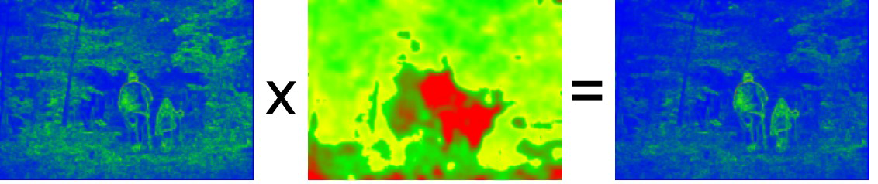
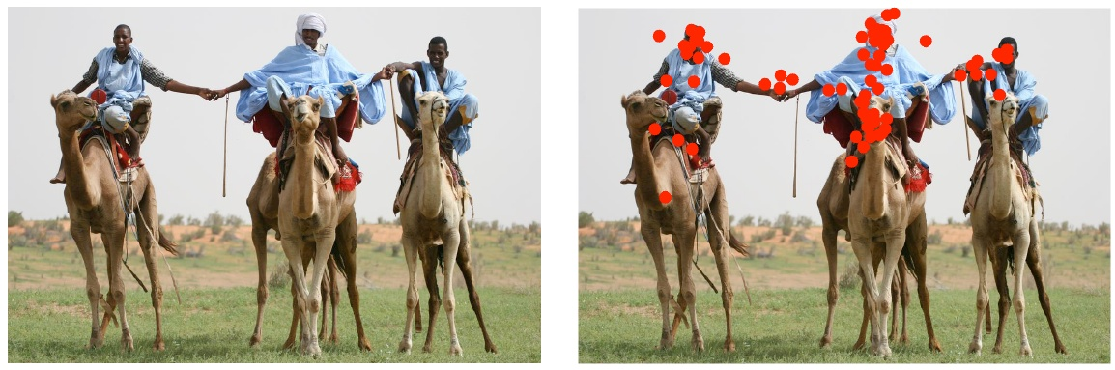
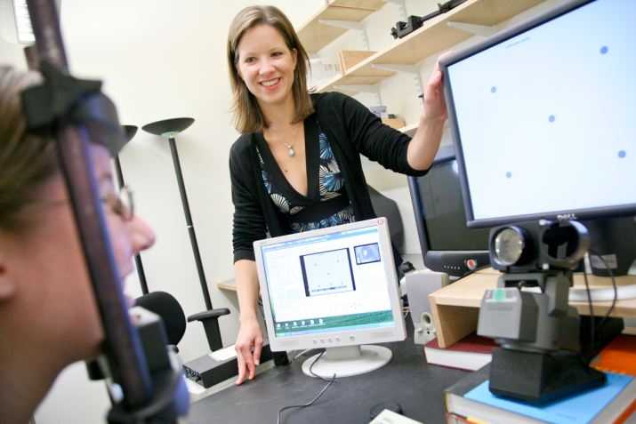
Importance (Saliency) Measures
A function S: p → [0,1]
Wang et al. 2008
More sophisticated: attention models, eye tracking (gazing studies), face detectors, …
Judd et al. ICCV09 Learning to predict where people look

Slide 12
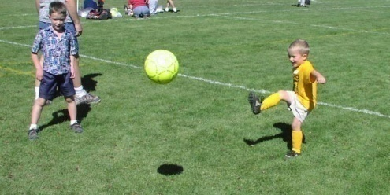
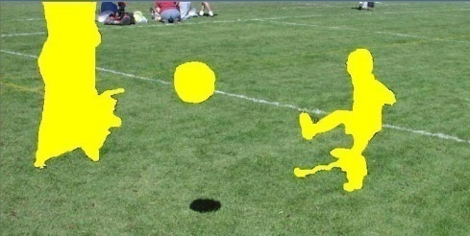
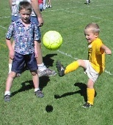
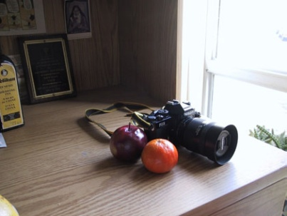
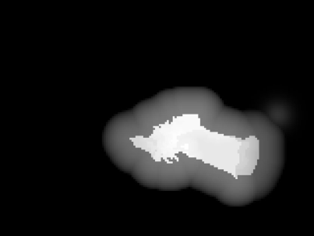
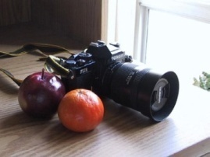
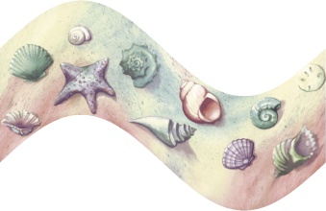

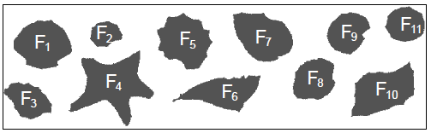
General Retargeting Framework
Define an energy function E(I)
(interest, importance, saliency)
2. Use some operator(s) to change the image I
Setlur et al.
[2005]
Recompose
Santella et al. [2005]
Crop
Gal et al. [2006]
Warp

Slide 13
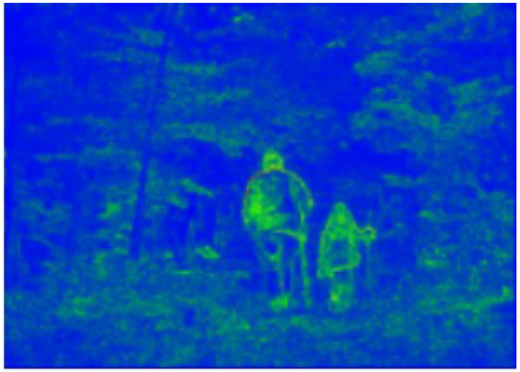
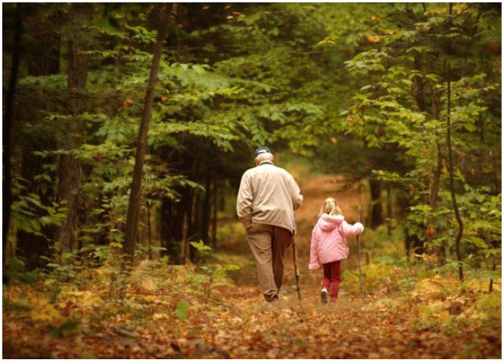
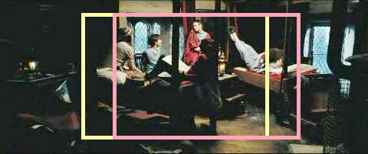



Previous Retargeting Approaches
Optimal Cropping Window
For videos: “Pan and scan”
  Still done manually in the movie industry
Liu and Gleicher, Video Retargeting: Automating Pan and Scan (2006)

Slide 14

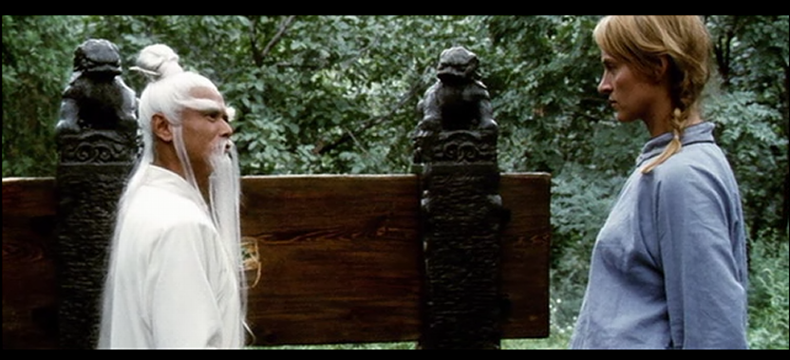

Cropping

Slide 15
Seam Carving
Assume m x n → m x n’, n’<n (summarization)

Slide 16

Seam Carving
Assume m x n → m x n’, n’<n (summarization)
Basic Idea: remove unimportant pixels from the image
  Unimportant = pixels with less “energy”

Slide 17
Seam Carving
Assume m x n → m x n’, n’<n (summarization)
Basic Idea: remove unimportant pixels from the image
  Unimportant = pixels with less “energy”
Intuition for gradient-based energy:
  Preserve strong contours
  Human vision more sensitive to edges – so try remove content from smoother areas
  Simple enough for producing some nice results

Slide 18
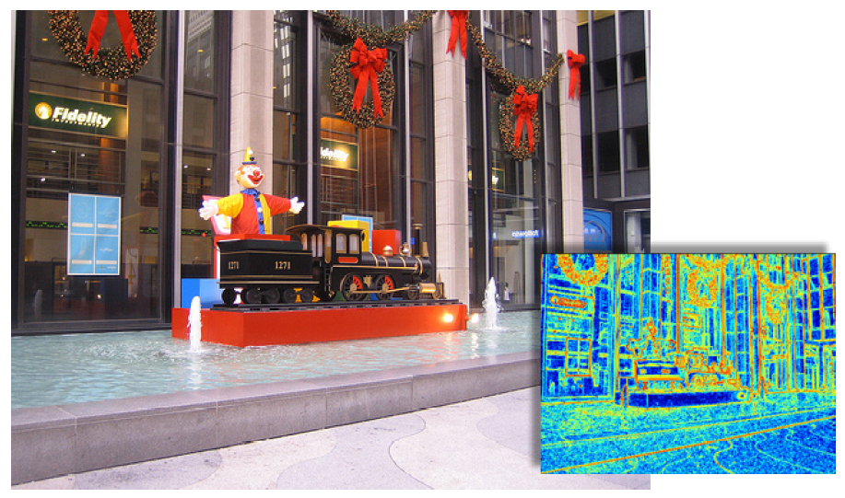
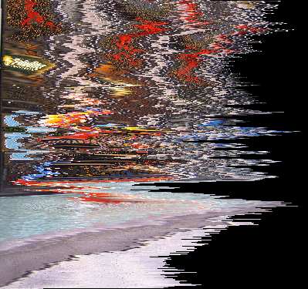
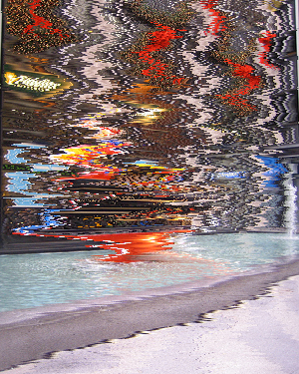
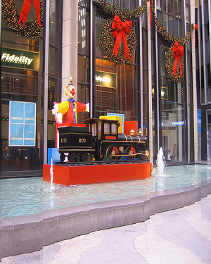
Pixel Removal
Optimal
Least-energy pixels
(per row)
Least-energy columns

Slide 19
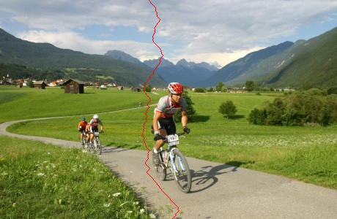
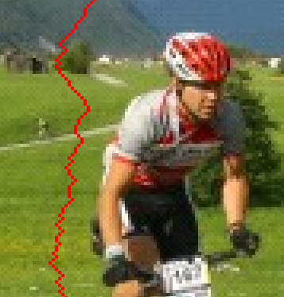
A Seam
A connected path of pixels from top to bottom (or left to right). Exactly one in each row

Slide 20
A Seam
A connected path of pixels from top to bottom (or left to right). Exactly one in each row

Slide 21
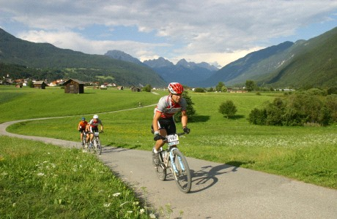
Finding the Seam?

Slide 22
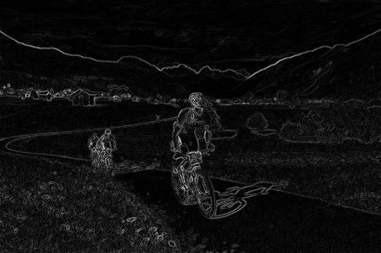
The Optimal Seam

Slide 23
The Optimal Seam
The recursion relation
Can be solved efficiently using dynamic programming in
  (s=3 in the original algorithm)

Slide 24
Dynamic Programming
Invariant property:
  M(i,j) = minimal cost of a seam going through (i,j) (satisfying the seam properties)
5 | 8 | 12 | 3
4 | 2 | 3 | 9
7 | 3 | 4 | 2
5 | 5 | 7 | 8
5 | 8 | 12 | 3
9 | 2
Energy - E(I,j)

Slide 25
Dynamic Programming
5 | 8 | 12 | 3
4 | 2 | 3 | 9
7 | 3 | 4 | 2
5 | 5 | 7 | 8
5 | 8 | 12 | 3
9 | 2+5
Energy - E(I,j)

Slide 26
Dynamic Programming
5 | 8 | 12 | 3
4 | 2 | 3 | 9
7 | 3 | 4 | 2
5 | 5 | 7 | 8
5 | 8 | 12 | 3
9 | 7 | 3+3
Energy - E(I,j)

Slide 27
Dynamic Programming
5 | 8 | 12 | 3
4 | 2 | 3 | 9
7 | 3 | 4 | 2
5 | 5 | 7 | 8
5 | 8 | 12 | 3
9 | 7 | 6 | 12
14 | 9 | 10 | 8
14 | 14 | 15 | 8+8
Energy - E(I,j)

Slide 28
Searching for Minimum
Backtrack (can store choices along the path, but do not have to)
5 | 8 | 12 | 3
9 | 7 | 6 | 12
14 | 9 | 10 | 8
14 | 14 | 15 | 16

Slide 29
Backtracking the Seam
5 | 8 | 12 | 3
9 | 7 | 6 | 12
14 | 9 | 10 | 8
14 | 14 | 15 | 16

Slide 30
Backtracking the Seam
5 | 8 | 12 | 3
9 | 7 | 6 | 12
14 | 9 | 10 | 8
14 | 14 | 15 | 16

Slide 31
Backtracking the Seam
5 | 8 | 12 | 3
9 | 7 | 6 | 12
14 | 9 | 10 | 8
14 | 14 | 15 | 16

Slide 32
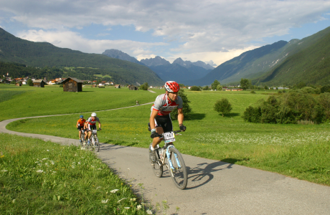


H & V Cost Maps
High cost
Low cost
Horizontal Cost
Vertical Cost

Slide 33
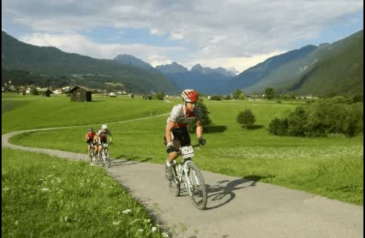
Seam Carving

Slide 34
The Seam-Carving Algorithm
SEAM-CARVING(im,n’) // size(im) = mxn
Do (n-n’) times
  2.1. E ← Compute energy map on im
  2.2. s ← Find optimal seam in E
  2.3. im ← Remove s from im
Return im
For vertical resize: transpose the image
Running time:
  2.1 O(mn) 2.2 O(mn) 2.3 O(mn)
  O(dmn) d=n-n’

Slide 35
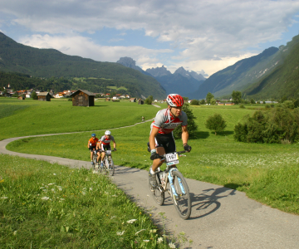
Changing Aspect Ratio

Slide 36
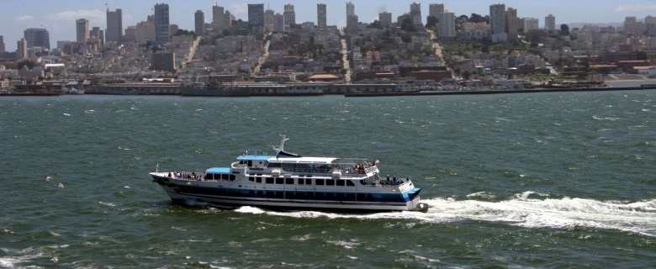
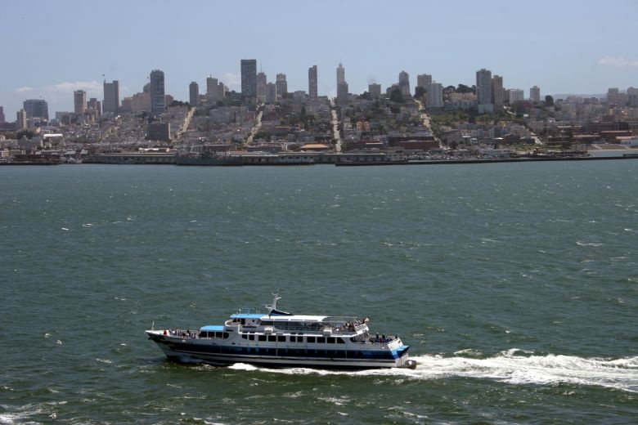

Changing Aspect Ratio
Seam Carving
Original
Scaling

Slide 37




Changing Aspect ratio
Cropping
Seams
Scaling

Slide 38
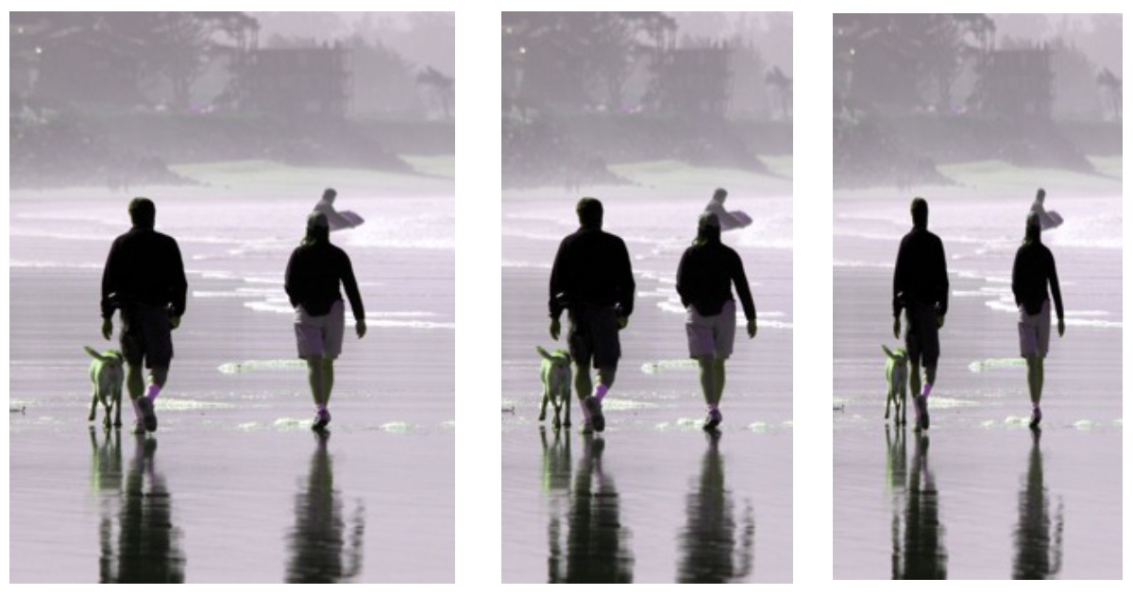
Changing Aspect Ratio
Scaling

Slide 39
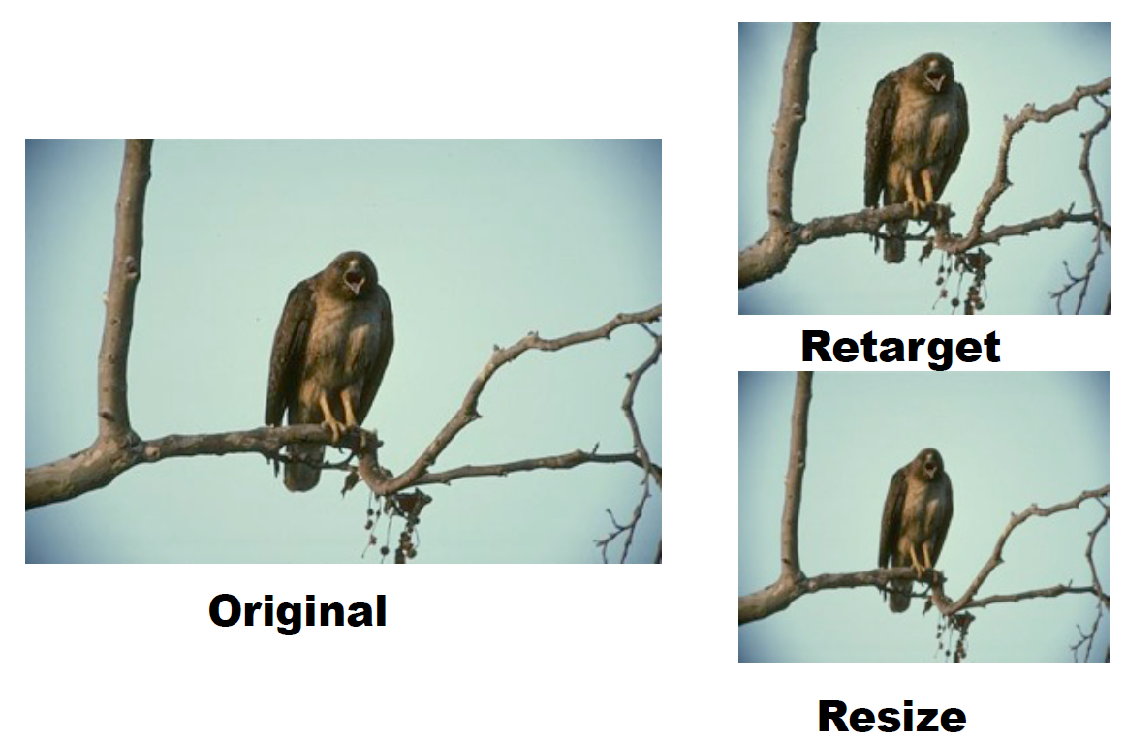
Changing Aspect Ratio
Scaling

Slide 40
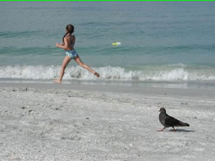
Example seam carving

Slide 41
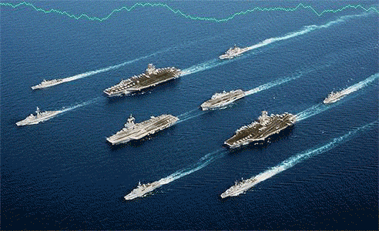
Another example

Slide 42
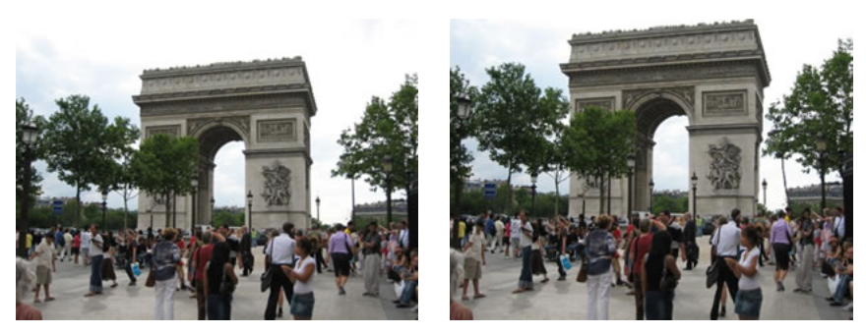
Content Enhancement
How would you use seam carving to do this?

Slide 43
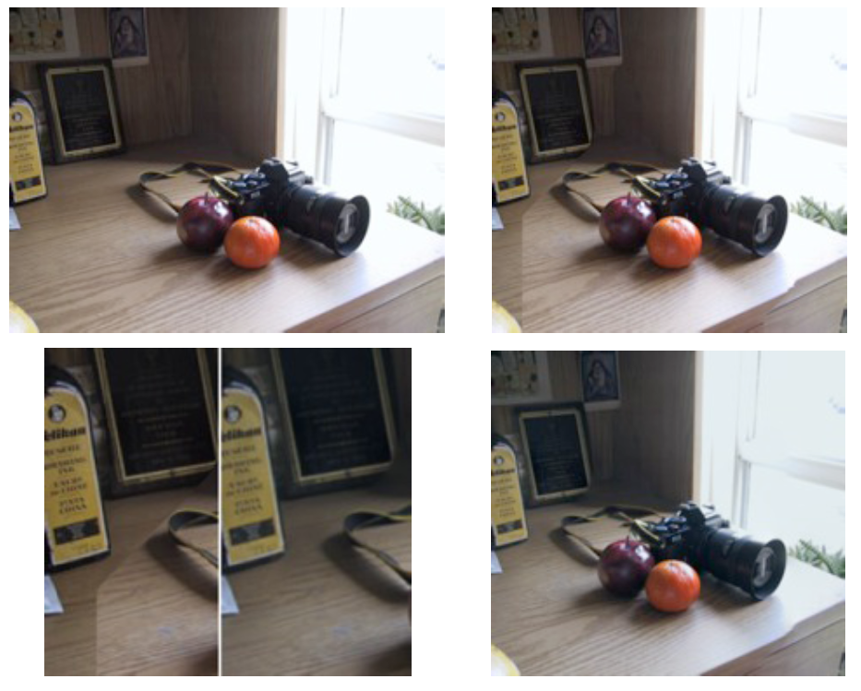
Seam Carving in the Gradient Domain
Notes:
The wooden desk is visibly altered. By calculating the seams in the gradient domain, they can overcome this.

Slide 44
Questions?
Q: Will the result be the same if the image is flipped upside down?
A: Yes (up to numerical stability)
Q: Can we improve the running time?
A: Yes. by factor (account for locality of operations)

Slide 45
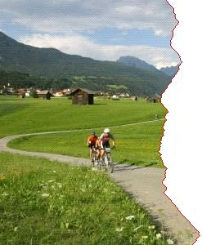
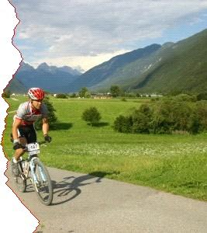
A Local Operator

Slide 46
Questions?
Q: Will the result be the same if the image is flipped upside down?
A: Yes (up to numerical stability)
Q: Can we improve the running time?
A: By factor (local operations)
Q: What happens to the overall energy in the image during seam carving?

Slide 47
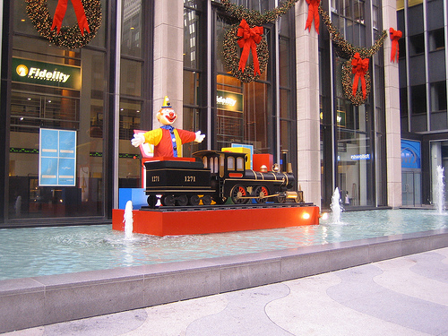
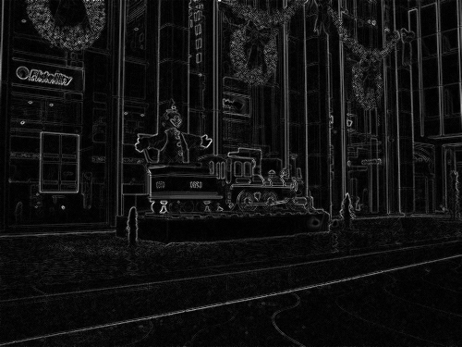
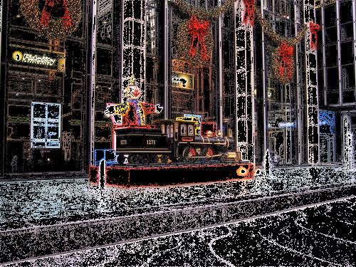
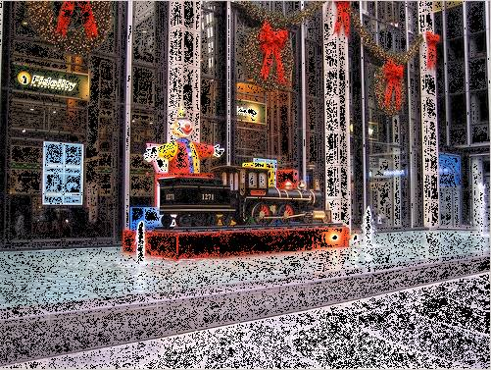
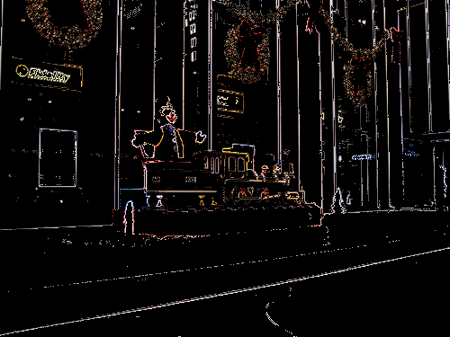
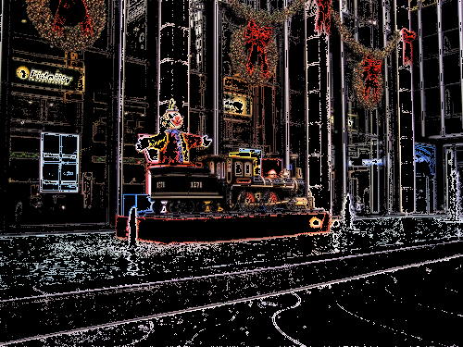
Preserved Energy
Energy
10%
30%
40%
75%
While resizing: remove as many low energy pixels and as few high energy pixels!

Slide 48
Preserved Energy
If we measure the average energy of pixels in the image after applying a resizing operator…
…the average should increase!
Average Pixel Energy
While resizing: remove as many low energy pixels and as few high energy pixels!
Image Reduction

Slide 49










Preserved Energy
Average Pixel Energy
Image Reduction
crop
column
seam
pixel
optimal

Slide 50


Both Dimensions?
m x n → m’ x n’
Remove horizontal seam first?
Remove vertical seams first?
Alternate between the two?
The optimal order can be found! → Dynamic Prog (again)

Slide 51


Retargeting in Both Dimensions
The recursion relation:

Slide 52
Retargeting in Both Dimensions
The recursion relation:

Slide 53
Optimal Order Map
Removal of vertical seams
0 | 13 | 16 | 19
16 | 17 | 22 | 28
19 | 31 | 25 | 35
24 | 28 | 29 | ???
32 | 35 | 33
41 | 38 | 35
Removal of horizontal seams

Slide 54
Is it optimal…
… for removing ONE seam?
… for removing multiple seams?

Slide 55
Is it optimal…
… for removing ONE seam?
… for removing multiple seams?
  Consider HVV (how many possibly orderings?)
  Cost(V) on HV not necessarily equal Cost(V) on VH
  But we keep track of only one: min(HV,VH)…

Slide 56




Image Expansion (Synthesis)

Slide 57



Image Expansion – take 2
Scaling

Slide 58


Enlarged or Reduced?

Slide 59

Combined Insert and Remove
Insert & remove seams
Scaling

Slide 60
Questions?

Slide 61
Multi-Size Images
We can create a new representation of an image that will allow adapting it to different sizes!
  Precompute all seams once
  Realtime resizing / transmit with content

Slide 62



Multi-Size Images
First to be removed
…
Last to be removed

Slide 63

Multi-Size Image Representation
+

Slide 64


Multi-Size Image Representation

Slide 65
2D Multi-Size Representation?
Alternatives
  Use seams in one direction, row/column seams in the other direction
  Compute seams in one direction and use them to constrain seams in the other direction
    - If you can do that you’ll have a nice publication ☺

Slide 66
Auxiliary Energy
Recall our seam equation

Slide 67



Object Removal

Slide 68

Object Removal

Slide 69




Find the Missing Shoe!

Slide 70
Solution

Slide 71

Limitations

Slide 72

With face detector

Slide 73

With User Constraints

Slide 74
Preserved Energy - Revisited
Average Pixel Energy
Image Reduction
crop
column
seam
pixel
optimal

Slide 75


Inserted Energy

Slide 76
Minimize Inserted Energy
Instead of removing the seam of least energy, remove the seam that inserts the least energy to the image !

Slide 77
Tracking Inserted Energy
Three possibilities when removing pixel P_{i,j}
p_{i-1,j-1}
p_{i-1,j-1}
p_{i-1,j}
p_{i-1,j+1}
p_{i,j-1}
p_{i,j}
p_{i,j}
p_{i,j+1}

Slide 78
Pixel P_{i,j} : Left Seam
p_{i-1,j-1}
p_{i-1,j-1}
p_{i-1,j}
p_{i-1,j+1}
p_{i,j-1}
p_{i,j}
p_{i,j}
p_{i,j+1}

Slide 79
Pixel P_{i,j} : Right Seam
p_{i-1,j-1}
p_{i-1,j}
p_{i-1,j+1}
p_{i-1,j+1}
p_{i,j-1}
p_{i,j}
p_{i,j}
p_{i,j+1}

Slide 80
Pixel P_{i,j} : Vertical Seam
p_{i-1,j-1}
p_{i-1,j}
p_{i-1,j}
p_{i-1,j+1}
p_{i,j-1}
p_{i,j}
p_{i,j}
p_{i,j+1}

Slide 81
Old “Backward” Energy
E

Slide 82



New Forward Looking Energy
E

Slide 83
Adding “Pixel Energy”

Slide 84

Results
Backward
Input
Backward
Forward
Input
Forward

Slide 85



Results

Slide 86



Backward vs. Forward
Backward
Forward

Slide 87



Results

Slide 88
From Images to Videos
In general, video processing is a much (much!) harder problem
Cardinality
  Suppose 1min of video x 30 fps = 1800 frames
  Say your algorithm processes an image in 1 minute → 30 hours !!
Dimensionality/algorithmic
  Temporal coherency: human visual system is highly sensitive to motion!

Slide 89



Seam-Carving Video?
Naive… frame by frame independently
Time

Slide 90

Frame-by-frame Seam-Carving
Let’s check out this video

Slide 91

From 2D to 3D
1D paths in images
2D manifolds in video cubes

Slide 92

Example video retargeting

Slide 93

Object Removal…

Slide 94

Object detection + seam carving

Slide 95
References
Seam Carving for Content-Aware Image Resizing – Avidan and Shamir 2007
Content-driven Video Retargeting – Wolf et al. 2007
Improved Seam Carving for Video Retargeting – Rubinstein et al. 2008
Optimized Scale-and-Stretch for Image Resizing – Wang et al. 2008
Summarizing Visual Data Using Bidirectional Similarity – Simakov et al. 2008
Multi-operator Media Retargeting – Rubinstein et al. 2009
Shift-Map Image Editing – Pritch et al. 2009
Energy-Based Image Deformation – Karni et al. 2009
Seam carving in Photoshop CS4: http://help.adobe.com/en_US/Photoshop/11.0/WS6F81C45F-2AC0-4685-8FFD-DBA374BF21CD.html

