Slide 1
Lecture:
Feature Descriptors
Juan Carlos Niebles and Ranjay Krishna
Stanford Vision and Learning Lab

Slide 2
What we will learn today?
Scale invariant region selection
  Automatic scale selection
  Difference-of-Gaussian (DoG) detector
SIFT: an image region descriptor
HOG: another image descriptor
Application: Panorama
Some background reading: David Lowe, IJCV 2004

Slide 3
A quick review
Local invariant features
  Motivation
  Requirements, invariances
Keypoint localization
  Harris corner detector

Slide 4
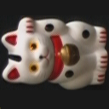
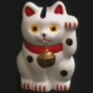


General Approach
1. Find a set of
distinctive key-
points
A₁
B₃
2. Define a region
around each
keypoint
A₂
A₃
3. Extract and
normalize the
region content
B₁
B₂
Similarity measure
4. Compute a local
descriptor from the
normalized region
N pixels
e.g. color
e.g. color
Slide credit: Bastian Leibe
N pixels
5. Match local
descriptors

Slide 5
A quick review
Local invariant features
  Motivation
  Requirements, invariances
Keypoint localization
  Harris corner detector

Slide 6

Quick review: Harris Corner Detector
“flat” region:
no change in all directions
“edge”:
no change along the edge direction
“corner”:
significant change in all directions
Slide credit: Alyosha Efros

Slide 7
Quick review: Harris Corner Detector
Fast approximation
  Avoid computing the
  eigenvalues
  α: constant
  (0.04 to 0.06)
“Edge”
θ < 0
“Corner”
θ > 0
Slide credit: Kristen Grauman
“Flat” region
“Edge”
θ < 0
λ₁

Slide 8
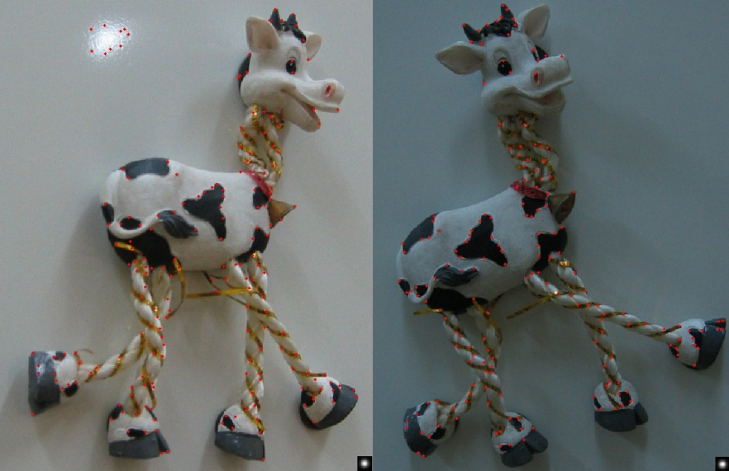
Quick review: Harris Corner Detector
Slide adapted from Darya Frolova, Denis Simakov

Slide 9
Quick review: Harris Corner Detector
Translation invariance
Rotation invariance
Scale invariance?
Corner
All points will be classified as edges!
Slide credit: Kristen Grauman
Not invariant to image scale!

Slide 10
What we will learn today?
Scale invariant keypoint detection
  Automatic scale selection
  Difference-of-Gaussian (DoG) detector
SIFT: an image region descriptor
HoG: another image region descriptor
Application: Panorama

Slide 11
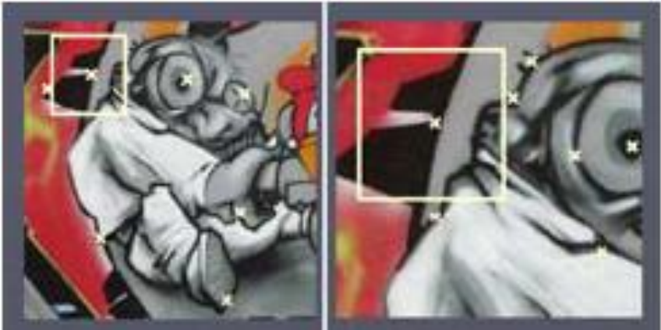
Does scale matter?
When detecting corners, the `scale` of the window you use can change the corners you detect.

Slide 12
Scale Invariant Detection
Consider regions (e.g. circles) of different sizes around a point
Find regions of corresponding sizes that will look the same in both images?

Slide 13
Scale Invariant Detection
The problem: how do we choose corresponding circles independently in each image?

Slide 14
Scale Invariant Detection
Solution:
  Design a function on the region (circle), which is “scale invariant” (the same for corresponding regions, even if they are at different scales)
Example: average intensity. For corresponding regions (even of different sizes) it will be the same.
  For a point in one image, we can consider it as a function of region size (circle radius)
f
Image 1
f
Image 2
scale = 1/2
region size
region size

Slide 15
Scale Invariant Detection
Common approach:
Take a local maximum of this function
Observation: region size, for which the maximum is achieved, should be co-variant with image scale.
Important: this scale invariant region size is found in each image independently!
f
Image 1
f
Image 2
scale = 1/2
s₁
region size
s₂
region size

Slide 16
Scale Invariant Detection
A “good” function for scale detection:
has one stable sharp peak
f
f
f
Good !
bad
bad
region size
region size
region size
For usual images: a good function would be one which responds to contrast (sharp local intensity change)

Slide 17
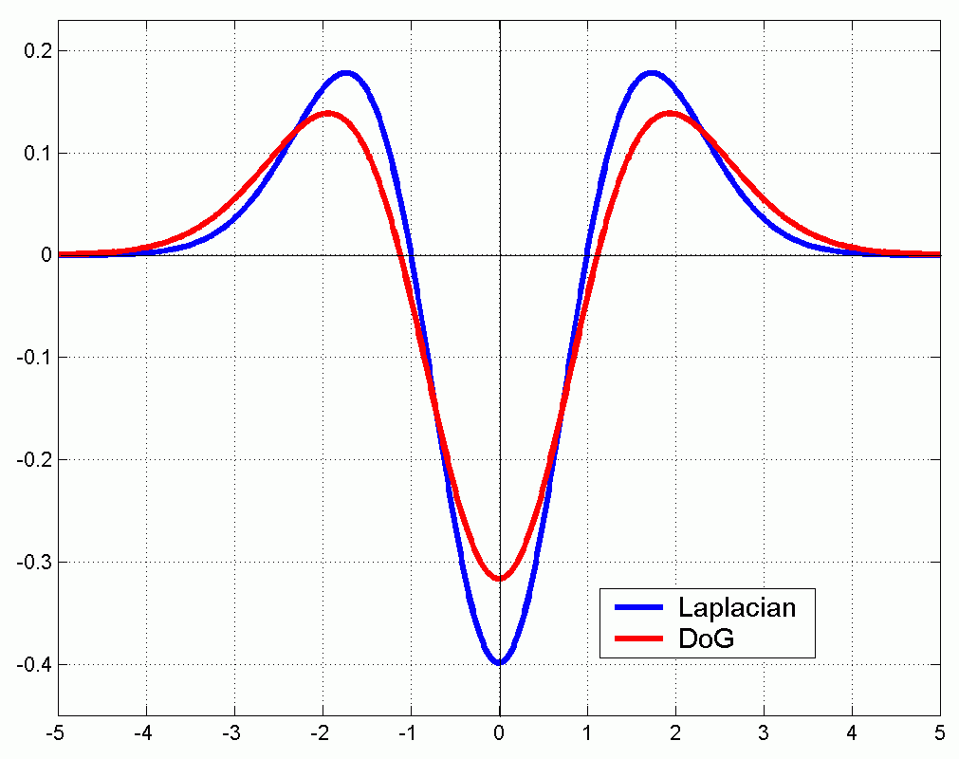
Scale Invariant Detection
Functions for determining scale
Kernels:
(Laplacian)
(Difference of Gaussians)
where Gaussian
Note: both kernels are invariant to scale and rotation

Slide 18
Scale Invariant Detectors
scale
Harris-Laplacian¹
Find local maximum of:
  Harris corner detector in space (image coordinates)
  Laplacian in scale
← Laplacian →
y
← Harris →
x
¹ K.Mikolajczyk, C.Schmid. “Indexing Based on Scale Invariant Interest Points”. ICCV 2001
² D.Lowe. “Distinctive Image Features from Scale-Invariant Keypoints”. IJCV 2004
Notes:
1- do harris to find 2d points, then compute laplacian across scales and pick max response
2- instead of 2 functions, faster to use a single function...
do DoG and check neighbor pixels in space and scale.

Slide 19
Laplacian

Slide 20
Scale Invariant Detectors
scale
Harris-Laplacian¹
Find local maximum of:
  Harris corner detector in space (image coordinates)
  Laplacian in scale
← Laplacian →
y
← Harris →
x
SIFT (Lowe)²
Find local maximum of:
  Difference of Gaussians in space and scale
scale
← DoG →
y
← DoG →
x
¹ K.Mikolajczyk, C.Schmid. “Indexing Based on Scale Invariant Interest Points”. ICCV 2001
² D.Lowe. “Distinctive Image Features from Scale-Invariant Keypoints”. IJCV 2004
Notes:
1- do harris to find 2d points, then compute laplacian across scales and pick max response
2- instead of 2 functions, faster to use a single function...
do DoG and check neighbor pixels in space and scale.

Slide 21
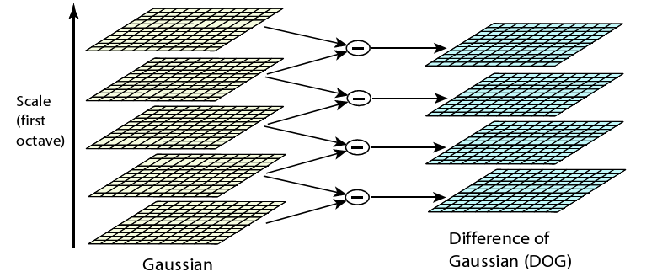
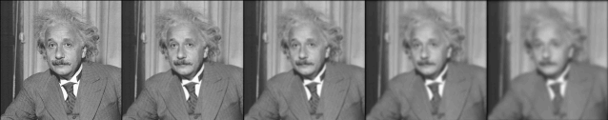
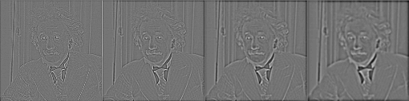
Difference-of-Gaussians

Slide 22
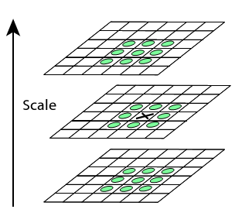
Scale-Space Extrema
Choose all extrema within 3x3x3 neighborhood.
X is selected if it is larger or smaller than all 26 neighbors

Slide 23

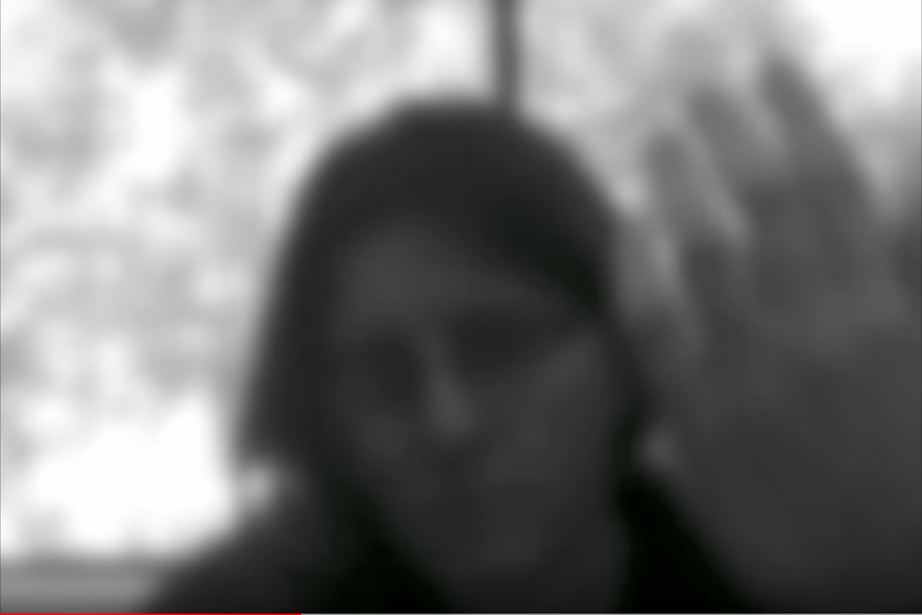
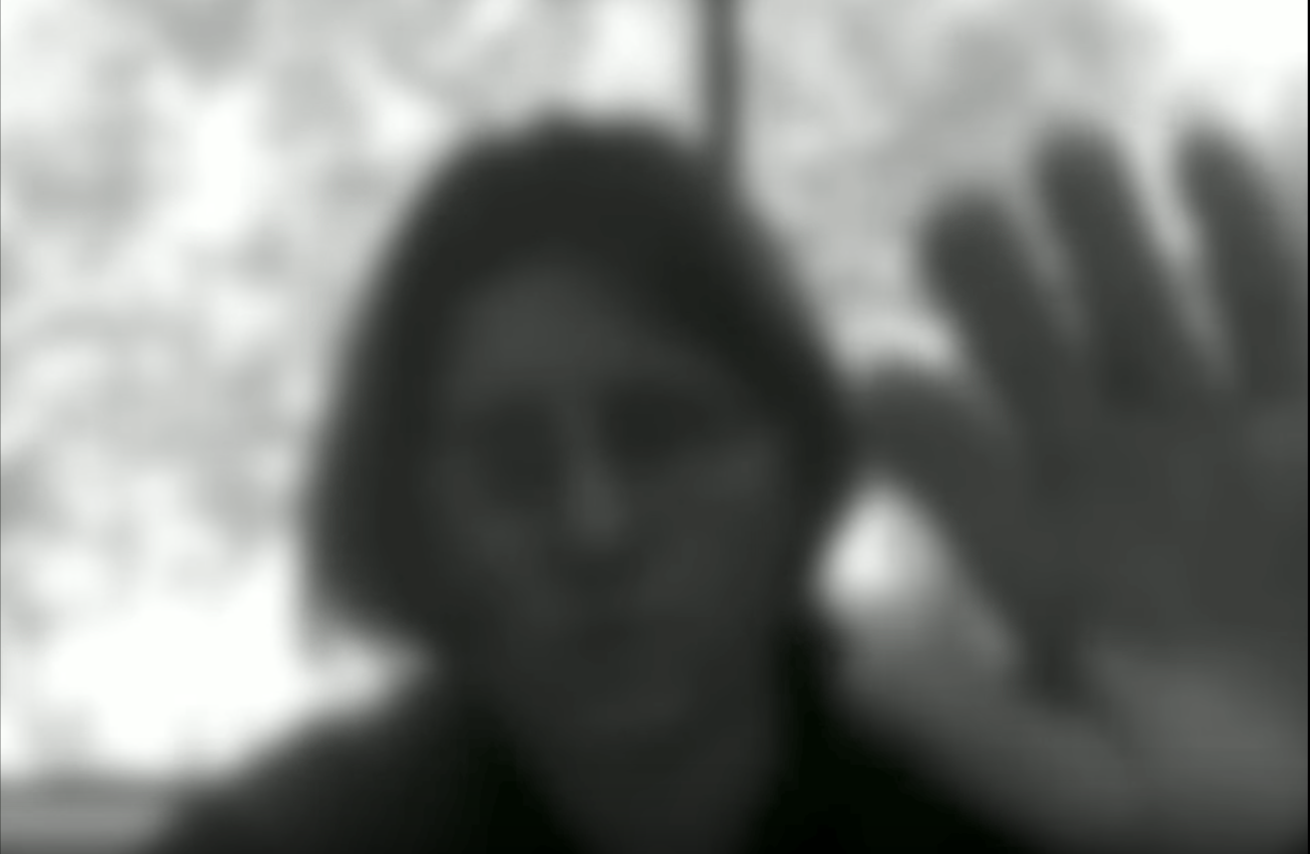
Example of Gaussian kernel
Original video
Blurred with a gaussian kernel
Blurred with a different gaussian kernel
source

Slide 24
Example of gaussian kernel
Original video
Blurred with a gaussian kernel
Blurred with a different gaussian kernel
What happens if you subtract one blurred image from another?
source

Slide 25
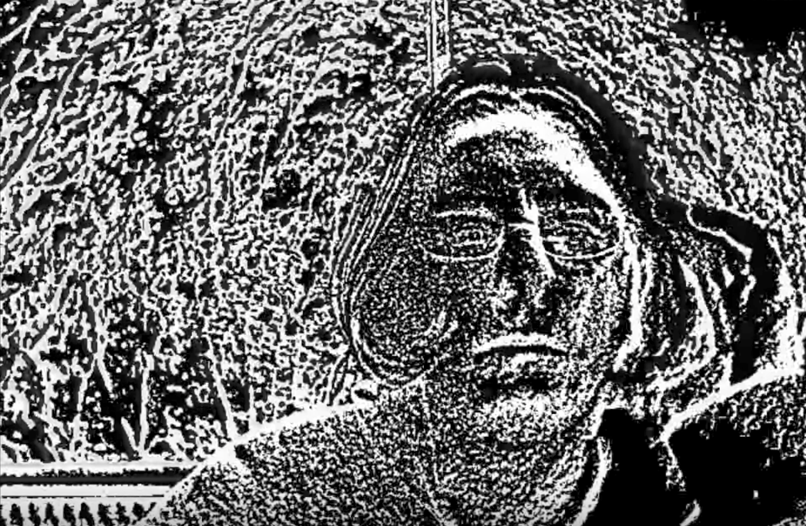
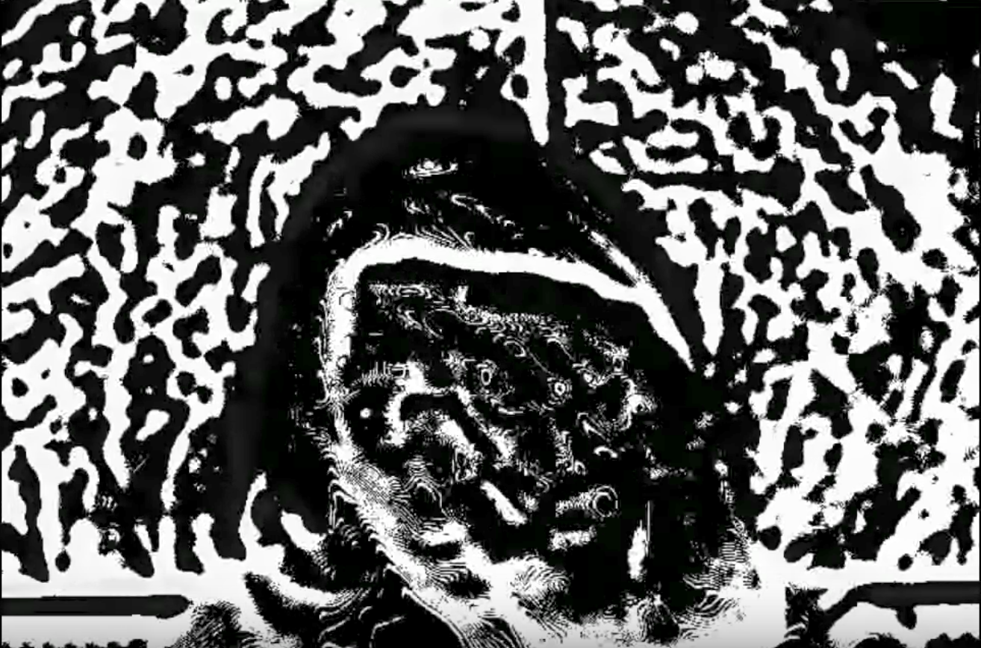
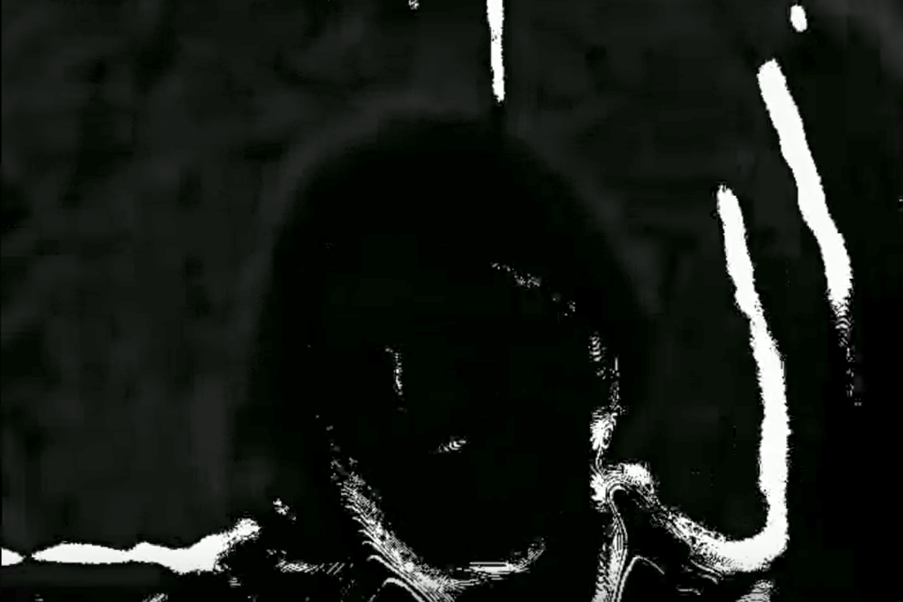
Difference of Gaussians (DoG)
Original video
Blurred with a gaussian kernel: k₁
Blurred with a different gaussian kernel: k₂
DoG: k₁ – k₂
DoG: k₁ – k₃
DoG: k₁ – k₄
source
Notes:
Source: https://www.youtube.com/watch?v=oTud1De_W4s

Slide 26
Difference of Gaussians (DoG)
At different resolutions of kernel size, we see different fine details of the image. In other words, we can capture keypoints at varying scales.
Original video
Blurred with a gaussian kernel: k₁
Blurred with a different gaussian kernel: k₂
DoG: k₁ – k₂
DoG: k₁ – k₃
DoG: k₁ – k₄
source
Notes:
Source: https://www.youtube.com/watch?v=oTud1De_W4s

Slide 27
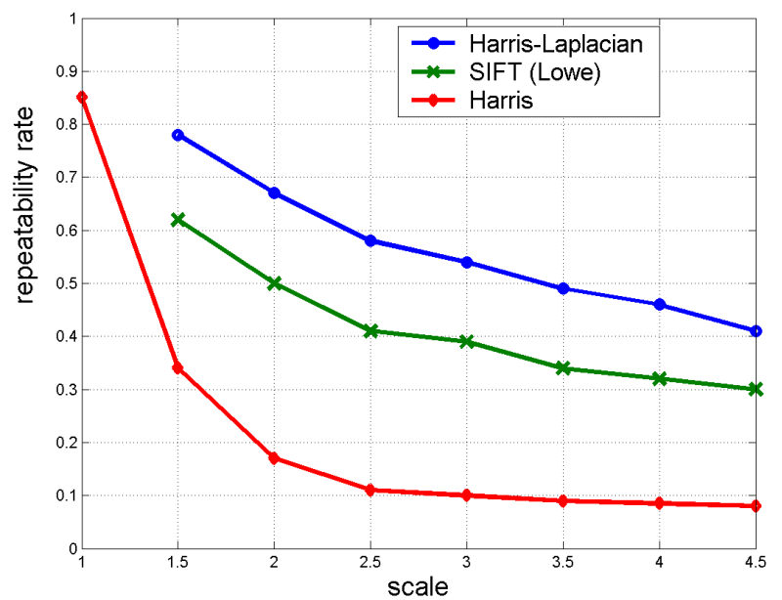
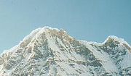

Scale Invariant Detectors
Experimental evaluation of detectors
w.r.t. scale change
Repeatability rate:
# correspondences
# possible correspondences
K.Mikolajczyk, C.Schmid. “Indexing Based on Scale Invariant Interest Points”. ICCV 2001

Slide 28
Scale Invariant Detection: Summary
Given: two images of the same scene with a large scale difference between them
Goal: find the same interest points independently in each image
Solution: search for maxima of suitable functions in scale and in space (over the image)
Methods:
Harris-Laplacian [Mikolajczyk, Schmid]: maximize Laplacian over scale, Harris’ measure of corner response over the image
SIFT [Lowe]: maximize Difference of Gaussians over scale and space

Slide 29
What’s next?
So we have can detect keypoints at varying scales. But what can we do with those keypoints?
Things we would like to do:
Search:
  We would need to find similar key points in other images
Panorama
  Match keypoints from one image to another.
Etc…
For all such applications, we need a way of `describing` the keypoints.

Slide 30
What we will learn today?
Scale invariant region selection
  Automatic scale selection
  Difference-of-Gaussian (DoG) detector
SIFT: an image region descriptor
HoG: another image region descriptor
Application: Panorama

Slide 31
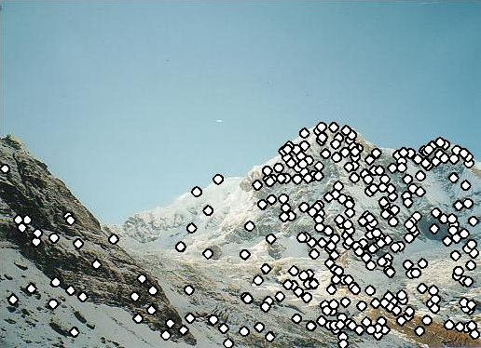
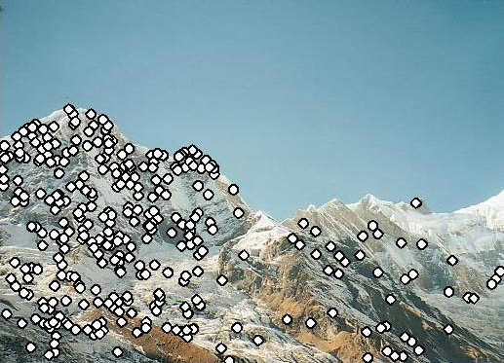
Local Descriptors
We know how to detect points
Next question:
How to describe them for matching?
?
Slide credit: Kristen Grauman
Point descriptor should be:
  Invariant
  Distinctive

Slide 32
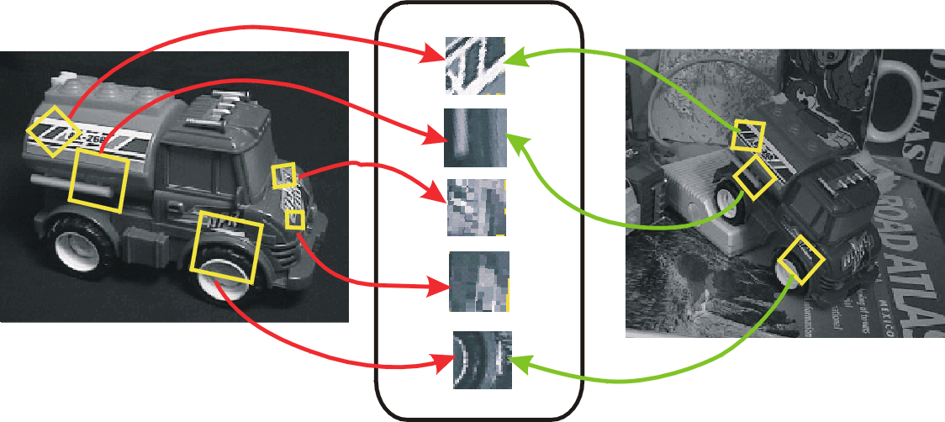
Invariant Local Features
Image content is transformed into local feature coordinates that are invariant to translation, rotation, scale, and other imaging parameters
Following slides credit: CVPR 2003 Tutorial on Recognition and Matching Based on Local Invariant Features David Lowe

Slide 33
Advantages of invariant local features
Locality: features are local, so robust to occlusion and clutter (no prior segmentation)
Distinctiveness: individual features can be matched to a large database of objects
Quantity: many features can be generated for even small objects
Efficiency: close to real-time performance
Extensibility: can easily be extended to wide range of differing feature types, with each adding robustness

Slide 34
Scale invariance
Requires a method to repeatably select points in location and scale:
The only reasonable scale-space kernel is a Gaussian (Koenderink, 1984; Lindeberg, 1994)
An efficient choice is to detect peaks in the difference of Gaussian pyramid (Burt & Adelson, 1983; Crowley & Parker, 1984 – but examining more scales)
Difference-of-Gaussian with constant ratio of scales is a close approximation to Lindeberg’s scale-normalized Laplacian (can be shown from the heat diffusion equation)

Slide 35
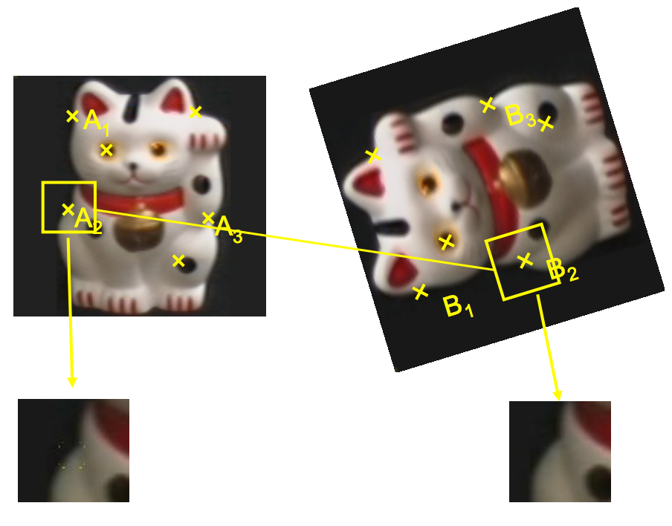
Becoming rotation invariant

Slide 36
Becoming rotation invariant
We are given a keypoint and its scale from DoG
We will select a characteristic orientation for the keypoint (based on the most prominent gradient there; discussed next slide)
We will describe all features relative to this orientation
Causes features to be rotation invariant!
  If the keypoint appears rotated in another image, the features will be the same, because they’re relative to the characteristic orientation

Slide 37
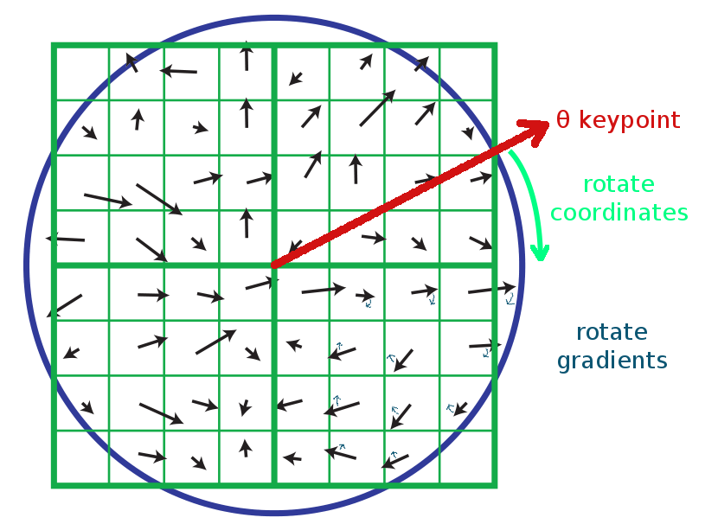
SIFT descriptor formation
Use the blurred image associated with the keypoint’s scale
Take image gradients over the keypoint neighborhood.
To become rotation invariant, rotate the gradient directions AND locations by (-keypoint orientation)
  Now we’ve cancelled out rotation and have gradients expressed at locations relative to keypoint orientation θ
  We could also have just rotated the whole image by -θ, but that would be slower.

Slide 38
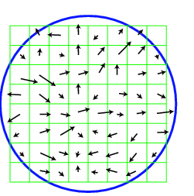
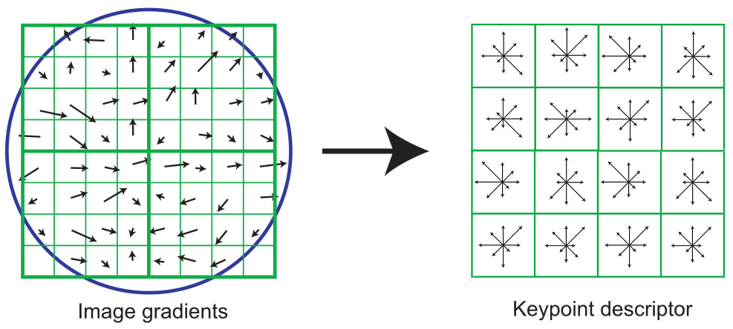
SIFT descriptor formation
0
2
π
Using precise gradient locations is fragile. We’d like to allow some “slop” in the image, and still produce a very similar descriptor
Create array of orientation histograms (a 4x4 array is shown)
Put the rotated gradients into their local orientation histograms
  A gradients’s contribution is divided among the nearby histograms based on distance. If it’s halfway between two histogram locations, it gives a half contribution to both.
  Also, scale down gradient contributions for gradients far from the center
The SIFT authors found that best results were with 8 orientation bins per histogram.

Slide 39
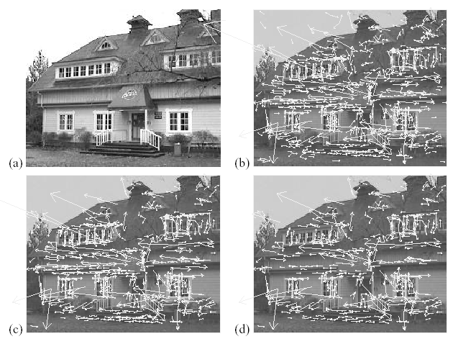
Example of keypoint detection
Threshold on value at DOG peak and on ratio of principle curvatures (Harris approach)
(a) 233x189 image
(b) 832 DOG extrema
(c) 729 left after peak
value threshold
(d) 536 left after testing
ratio of principle
curvatures
Vectors indicate scale, orientation and location.

Slide 40
SIFT descriptor formation
Using precise gradient locations is fragile. We’d like to allow some “slop” in the image, and still produce a very similar descriptor
Create array of orientation histograms (a 4x4 array is shown)
Put the rotated gradients into their local orientation histograms
  A gradients’s contribution is divided among the nearby histograms based on distance. If it’s halfway between two histogram locations, it gives a half contribution to both.
  Also, scale down gradient contributions for gradients far from the center
The SIFT authors found that best results were with 8 orientation bins per histogram, and a 4x4 histogram array.

Slide 41
SIFT descriptor formation
8 orientation bins per histogram, and a 4x4 histogram array, yields 8 x 4x4 = 128 numbers.
So a SIFT descriptor is a length 128 vector, which is invariant to rotation (because we rotated the descriptor) and scale (because we worked with the scaled image from DoG)
We can compare each vector from image A to each vector from image B to find matching keypoints!
  Euclidean “distance” between descriptor vectors gives a good measure of keypoint similarity

Slide 42
SIFT descriptor formation
Adding robustness to illumination changes:
Remember that the descriptor is made of gradients (differences between pixels), so it’s already invariant to changes in brightness (e.g. adding 10 to all image pixels yields the exact same descriptor)
A higher-contrast photo will increase the magnitude of gradients linearly. So, to correct for contrast changes, normalize the vector (scale to length 1.0)
Very large image gradients are usually from unreliable 3D illumination effects (glare, etc). So, to reduce their effect, clamp all values in the vector to be ≤ 0.2 (an experimentally tuned value). Then normalize the vector again.
Result is a vector which is fairly invariant to illumination changes.

Slide 43
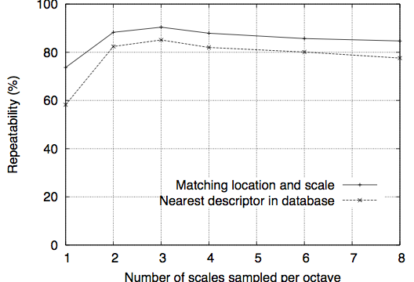
Repeatability vs number of scales sampled per octave
David G. Lowe, "Distinctive image features from scale-invariant keypoints," International Journal of Computer Vision, 60, 2 (2004), pp. 91-110

Slide 44
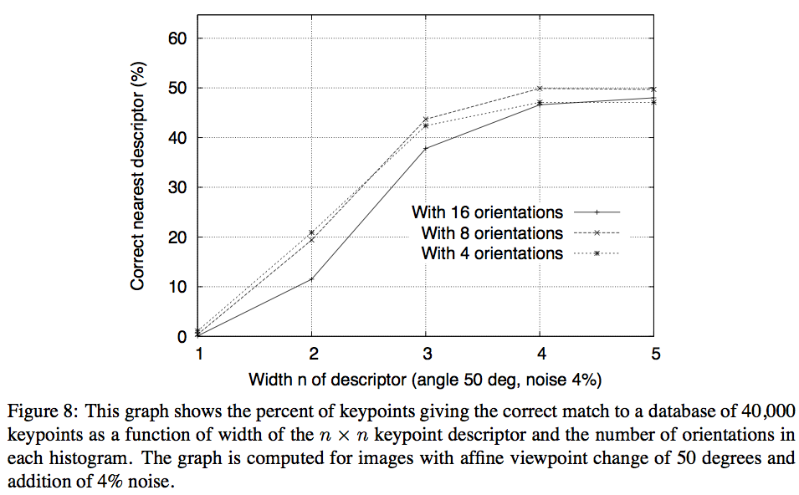
Sensitivity to number of histogram orientations
David G. Lowe, "Distinctive image features from scale-invariant keypoints," International Journal of Computer Vision, 60, 2 (2004), pp. 91-110

Slide 45
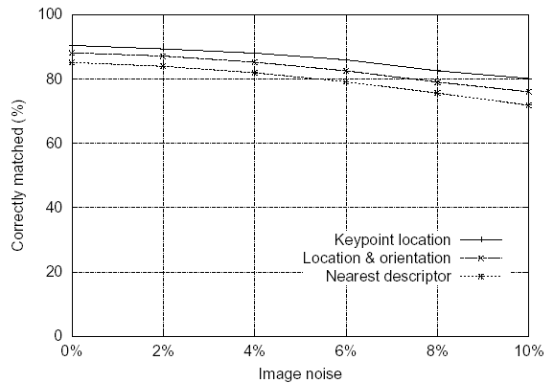
Feature stability to noise
Match features after random change in image scale & orientation, with differing levels of image noise
Find nearest neighbor in database of 30,000 features

Slide 46
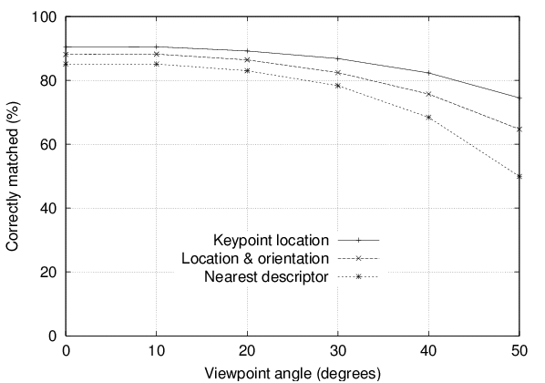
Feature stability to affine change
Match features after random change in image scale & orientation, with 2% image noise, and affine distortion
Find nearest neighbor in database of 30,000 features

Slide 47
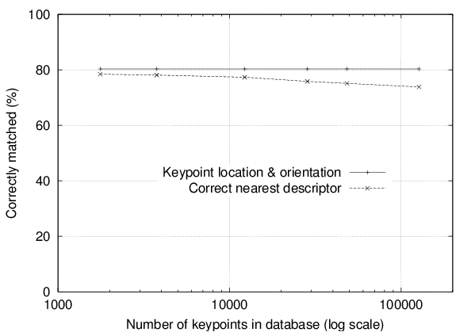
Distinctiveness of features
Vary size of database of features, with 30 degree affine change, 2% image noise
Measure % correct for single nearest neighbor match

Slide 48
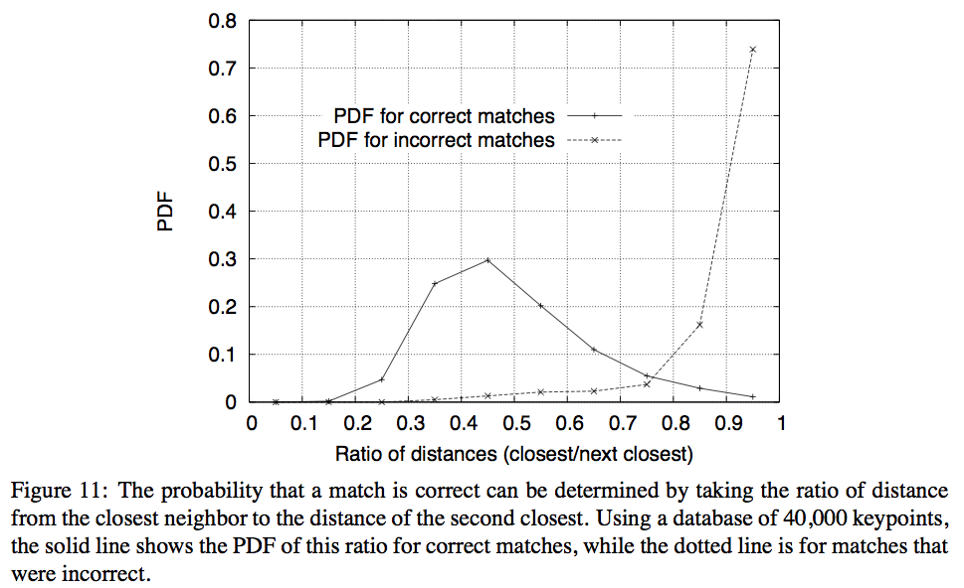
Ratio of distances reliable for matching

Slide 49
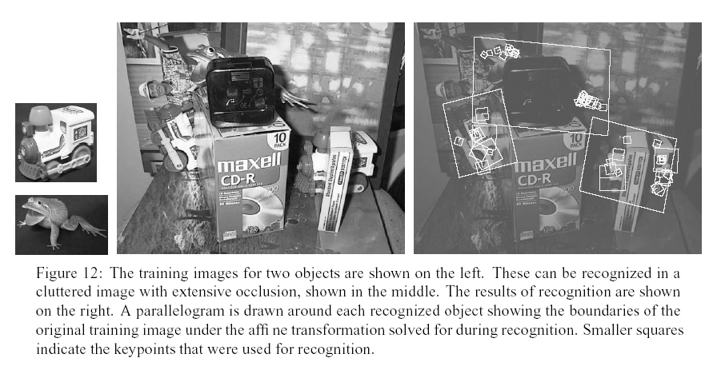

Slide 50
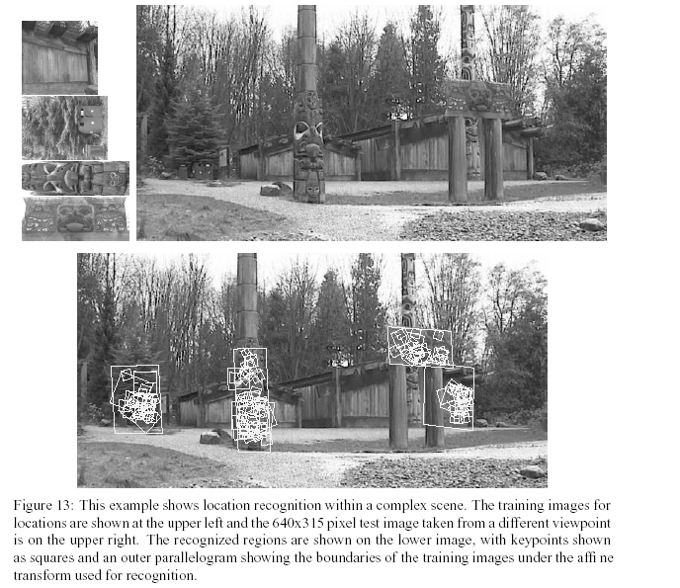
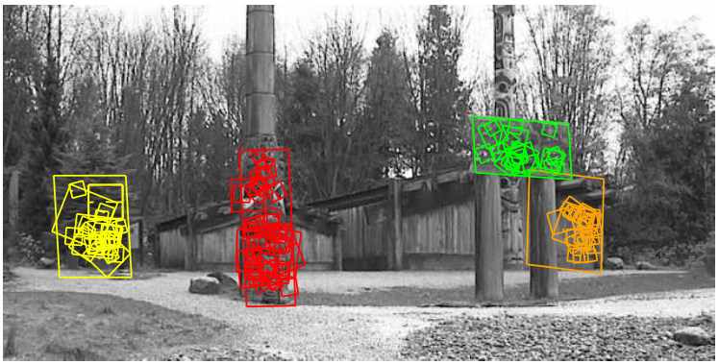

Slide 51
Nice SIFT resources
an online tutorial:http://www.aishack.in/2010/05/sift-scale-invariant-feature-transform/
Wikipedia:http://en.wikipedia.org/wiki/Scale-invariant_feature_transform

Slide 52
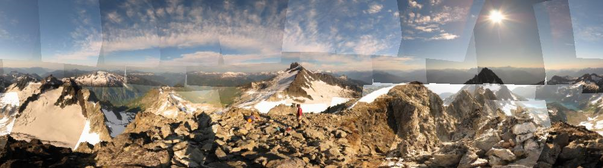
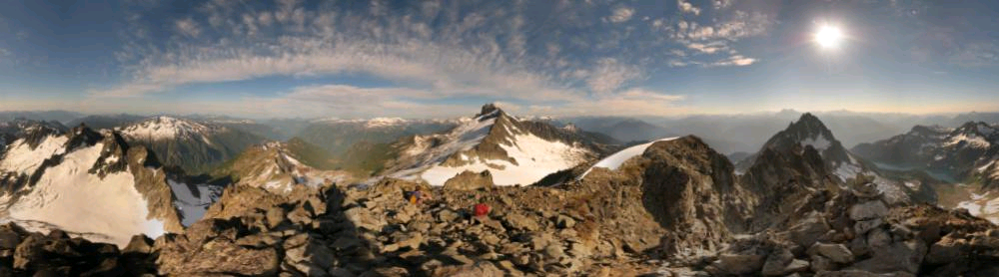
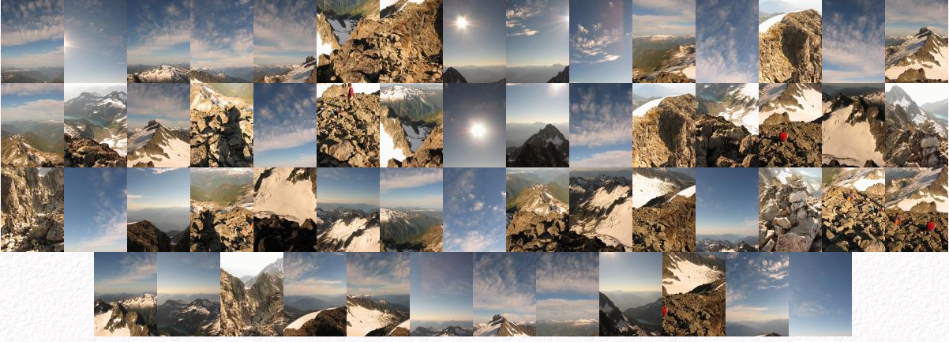
Automatic mosaicing
http://www.cs.ubc.ca/~mbrown/autostitch/autostitch.html

Slide 53
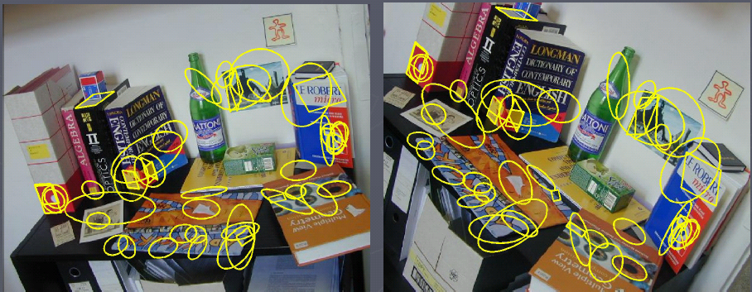
Wide baseline stereo
[Image from T. Tuytelaars ECCV 2006 tutorial]

Slide 54
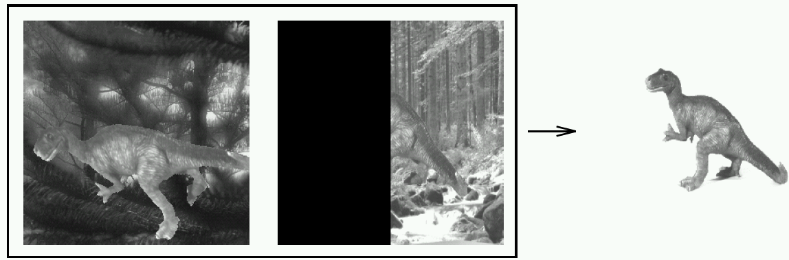
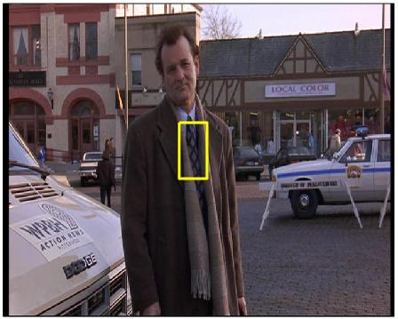
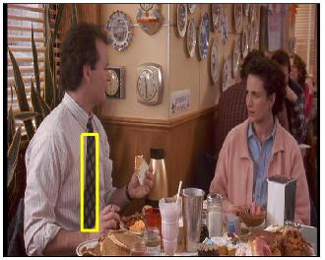
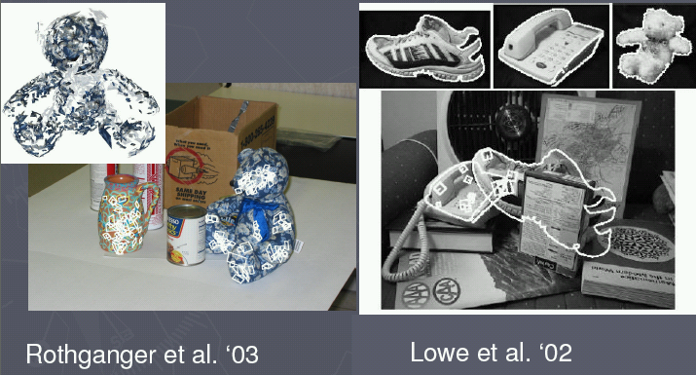
Recognition of specific objects, scenes
Schmid and Mohr 1997
Sivic and Zisserman, 2003
Rothganger et al. 2003
Lowe 2002

Slide 55
Applications of local invariant features
Wide baseline stereo
Motion tracking
Panoramas
Mobile robot navigation
3D reconstruction
Recognition
…

Slide 56
What we will learn today?
Scale invariant region selection
  Automatic scale selection
  Difference-of-Gaussian (DoG) detector
SIFT: an image region descriptor
HoG: another image descriptor
Application: Panorama

Slide 57
Histogram of Oriented Gradients
Find robust feature set that allows object form to be discriminated.
Challenges
  Wide range of pose and large variations in appearances
  Cluttered backgrounds under different illumination
  “Speed” for mobile vision
References
    [1] N. Dalal and B. Triggs. Histograms of Oriented Gradients for Human Detection. In CVPR, pages 886-893, 2005
    [2] Chandrasekhar et al. CHoG: Compressed Histogram of Gradients - A low bit rate feature descriptor, CVPR 2009

Slide 58
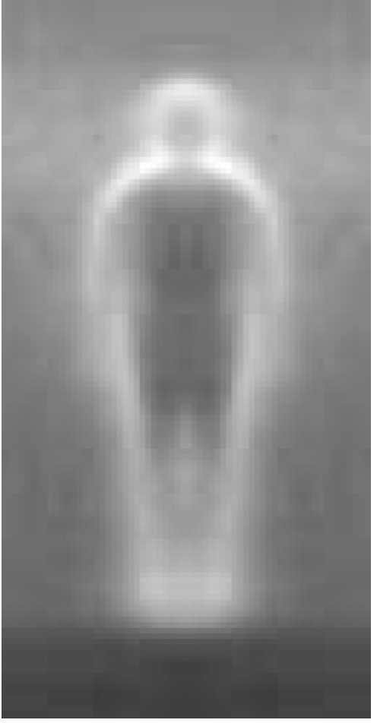
Histogram of Oriented Gradients
Local object appearance and shape can often be characterized rather well by the distribution of local intensity gradients or edge directions.

Slide 59
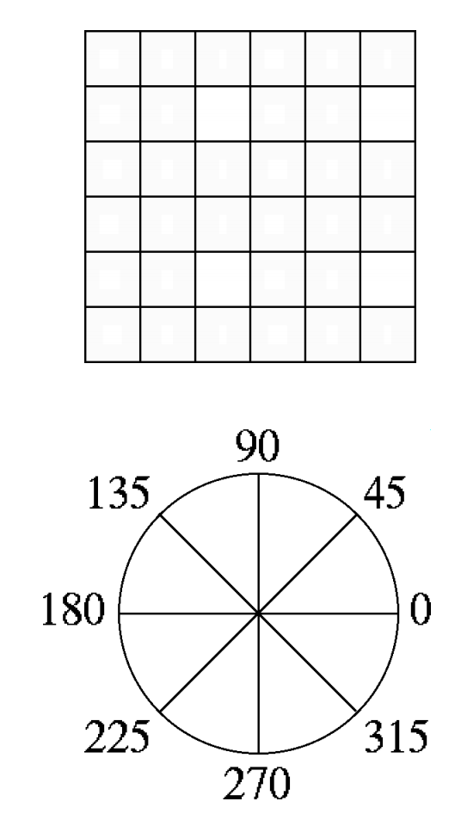
Histogram of Oriented Gradients
Dividing the image window into small spatial regions (cells)
Cells can be either rectangle or radial.
Each cell accumulating a weighted local 1-D histogram of gradient directions over the pixels of the cell.

Slide 60
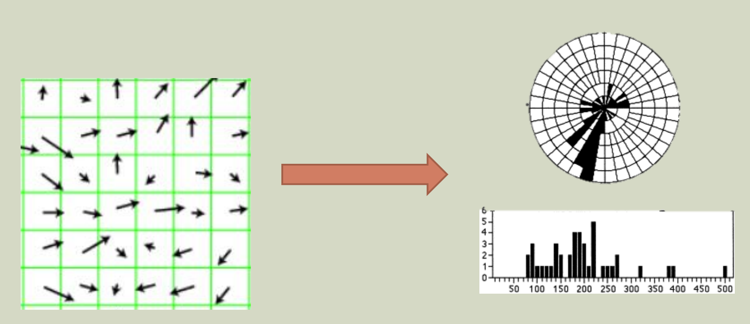
Histogram of Oriented Gradients

Slide 61
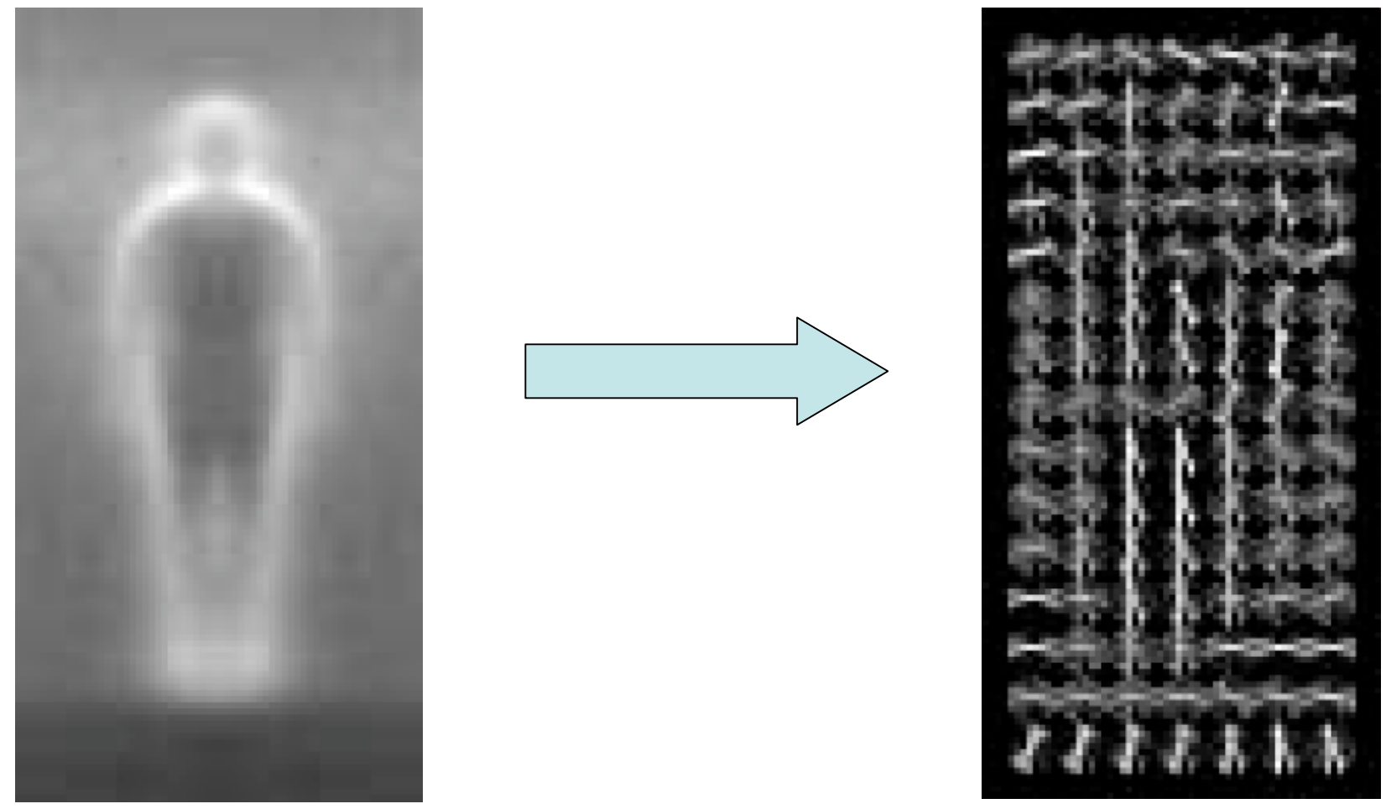
Histogram of Oriented Gradients

Slide 62
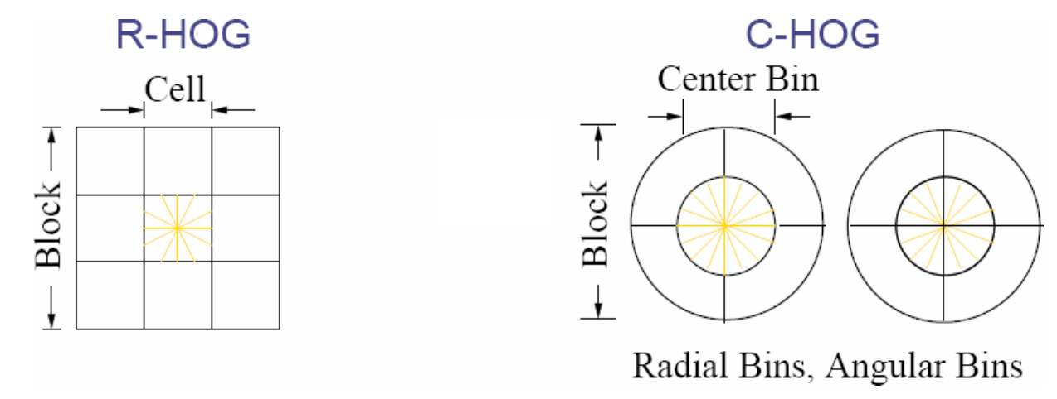
Normalization
For better invariance to illumination and shadowing. it is useful to contrast-normalize the local responses before using them.
Accumulate local histogram “energy” over a larger regions (“blocks”) to normalize all of the cells in the block.

Slide 63
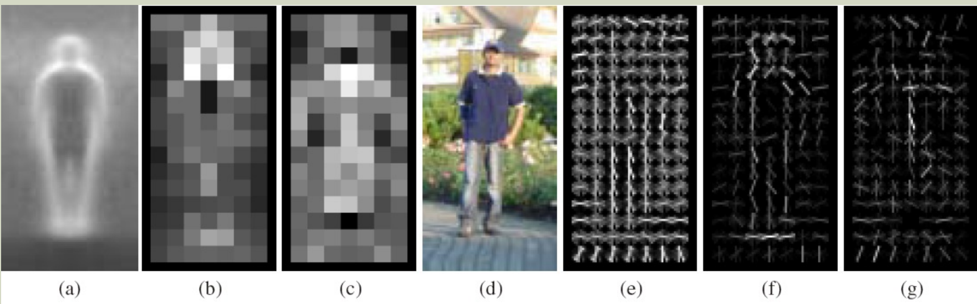
Visualizing HoG
Average gradient over positive examples
Maximum positive weight in each block
Maximum negative weight in each block
A test image
It’s R-HOG descriptor
R-HOG descriptor weighted by positive weights
R-HOG descriptor weighted by negative weights

Slide 64
Visualizing HoG
Average gradient over positive examples
Maximum positive weight in each block
Maximum negative weight in each block
A test image
It’s R-HOG descriptor
R-HOG descriptor weighted by positive weights
R-HOG descriptor weighted by negative weights

Slide 65
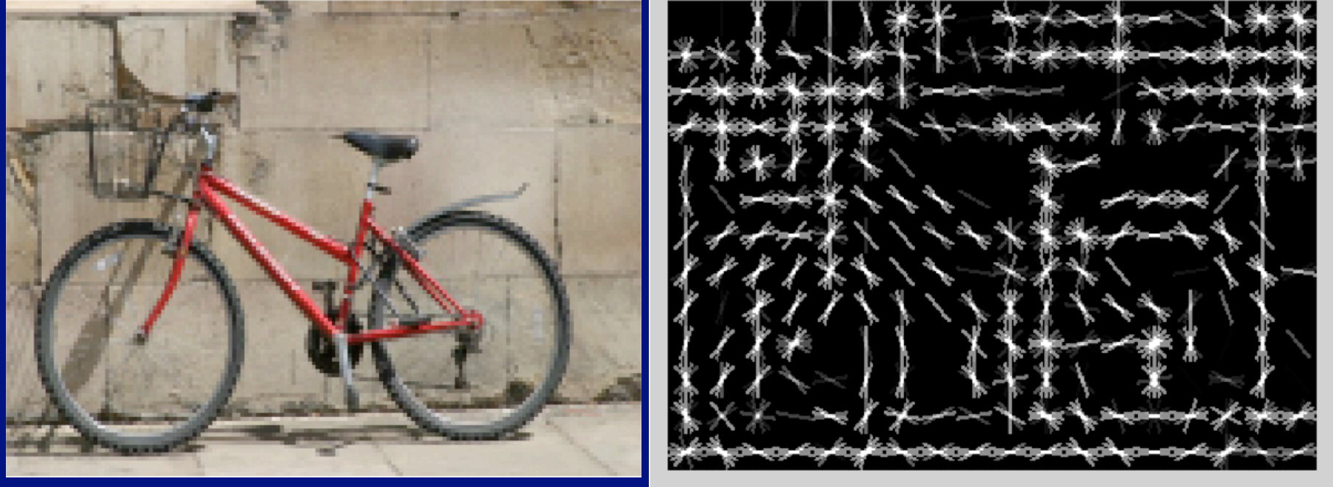
Visualizing HoG

Slide 66
Difference between HoG and SIFT
HoG is usually used to describe entire images. SIFT is used for key point matching
SIFT histrograms are oriented towards the dominant gradient. HoG is not.
HoG gradients are normalized using neighborhood bins.
SIFT descriptors use varying scales to compute multiple descriptors.

Slide 67
What we will learn today?
Scale invariant region selection
  Automatic scale selection
  Difference-of-Gaussian (DoG) detector
SIFT: an image region descriptor
HoG: another image descriptor
Application: Panorama

Slide 68
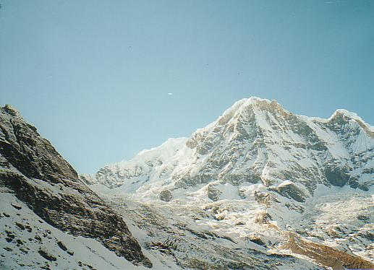
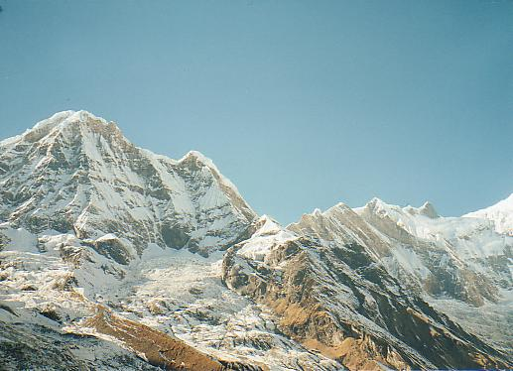
Application: Image Stitching
Slide credit: Darya Frolova, Denis Simakov

Slide 69
Application: Image Stitching
Slide credit: Darya Frolova, Denis Simakov
Procedure:
  Detect feature points in both images
  Find corresponding pairs
  Use these pairs to align the images

Slide 70
Application: Image Stitching
Slide credit: Darya Frolova, Denis Simakov
Procedure:
  Detect feature points in both images
  Find corresponding pairs
  Use these pairs to align the images

Slide 71

Application: Image Stitching
Slide credit: Darya Frolova, Denis Simakov
Procedure:
  Detect feature points in both images
  Find corresponding pairs
  Use these pairs to align the images

Slide 72


Main Flow
Detect key points

Slide 73

Detect Key Points

Slide 74


Main Flow
Detect key points
Build the SIFT descriptors

Slide 75
Build the SIFT Descriptors

Slide 76
Main Flow
Detect key points
Build the SIFT descriptors
Match SIFT descriptors

Slide 77

Match SIFT Descriptors
Euclidean distance between descriptors

Slide 78
Skeleton Code
Match SIFT descriptors (6 lines of code)
  Input: D1, D2, thresh (default 0.7)
  Output: match [D1’s index, D2’s index]
  Try to use one for loop

Slide 79

Main Flow
Detect key points
Build the SIFT descriptors
Match SIFT descriptors
Fitting the transformation

Slide 80

Fitting the transformation
2D transformations

Slide 81

Skeleton Code
Fit the transformation matrix
Six variables
  each point give two equations
  at least three points
Least squares

Slide 82
Main Flow
Detect key points
Build the SIFT descriptors
Match SIFT descriptors
Fitting the transformation
RANSAC

Slide 83
RANSAC
A further refinement of matches

Slide 84

Skeleton Code
RANSAC
  ComputeError

Slide 85

Main Flow
Detect key points
Build the SIFT descriptors
Match SIFT descriptors
Fitting the transformation
RANSAC

Slide 86


Results

Slide 87


Results

Slide 88
What we have learned this week?
Scale invariant region selection
  Automatic scale selection
  Difference-of-Gaussian (DoG) detector
SIFT: an image region descriptor
Application: Panorama
Some background reading: R. Szeliski, Ch 4.1.1; David Lowe, IJCV 2004

