Slide 1
Lecture:
Pixels and Filters
Juan Carlos Niebles and Ranjay Krishna
Stanford Vision Lab

Slide 2
Announcements
HW1 due Monday
HW2 is out
Class notes – Make sure to find the source and cite the images you use.

Slide 3
What we will learn today?
Image sampling and quantization
Image histograms
Images as functions
Linear systems (filters)
Convolution and correlation
Some background reading:
Forsyth and Ponce, Computer Vision, Chapter 7

Slide 4
What we will learn today?
Image sampling and quantization
Image histograms
Images as functions
Linear systems (filters)
Convolution and correlation
Some background reading:
Forsyth and Ponce, Computer Vision, Chapter 7

Slide 5
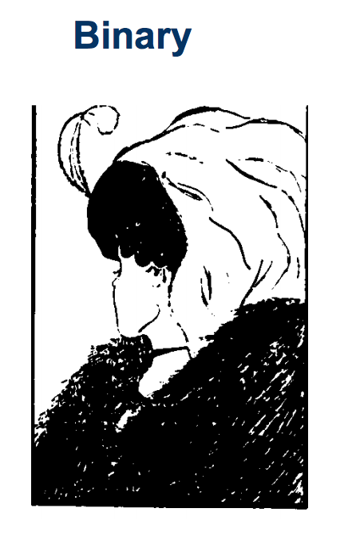
Types of Images

Slide 6
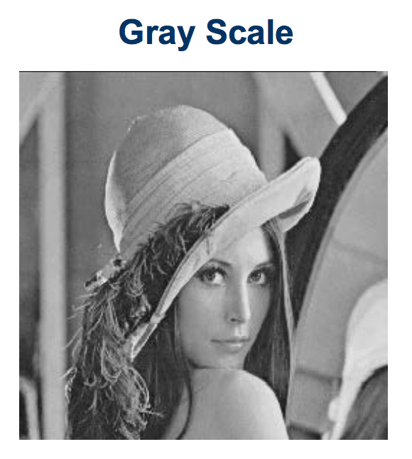
Types of Images

Slide 7
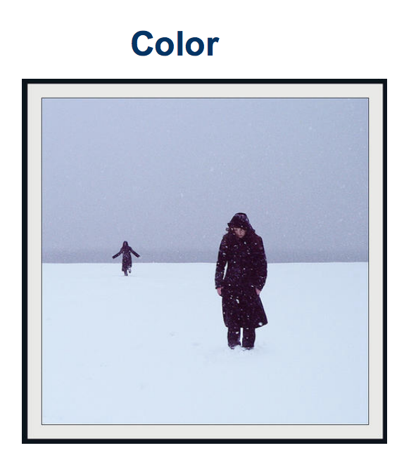
Types of Images

Slide 8
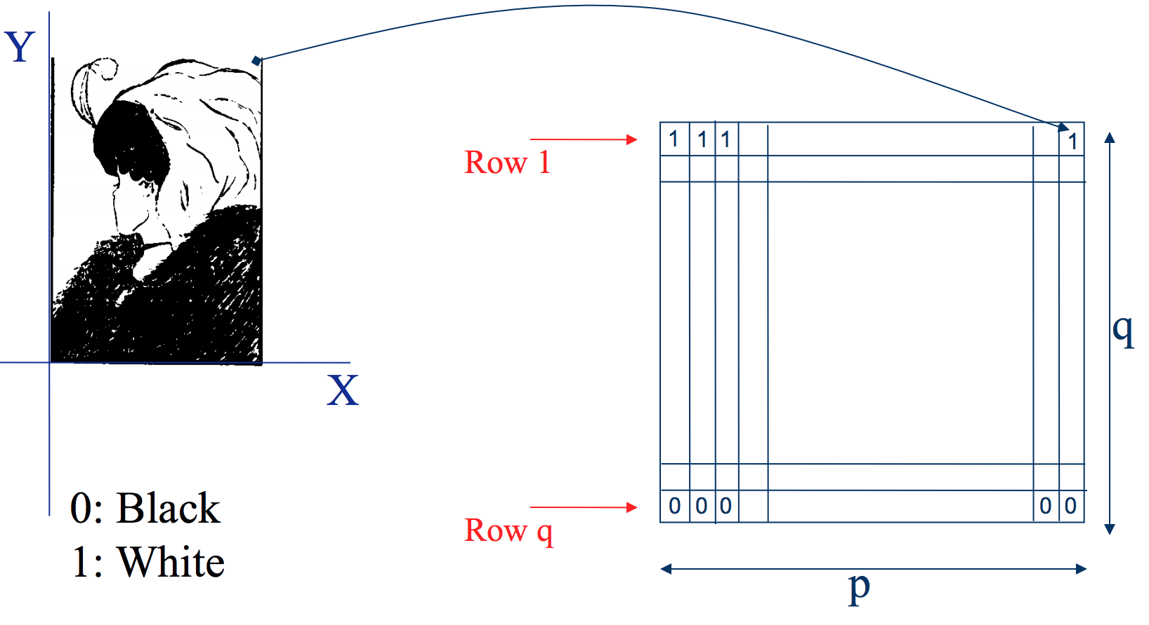
Binary image representation
Slide credit: Ulas Bagci

Slide 9
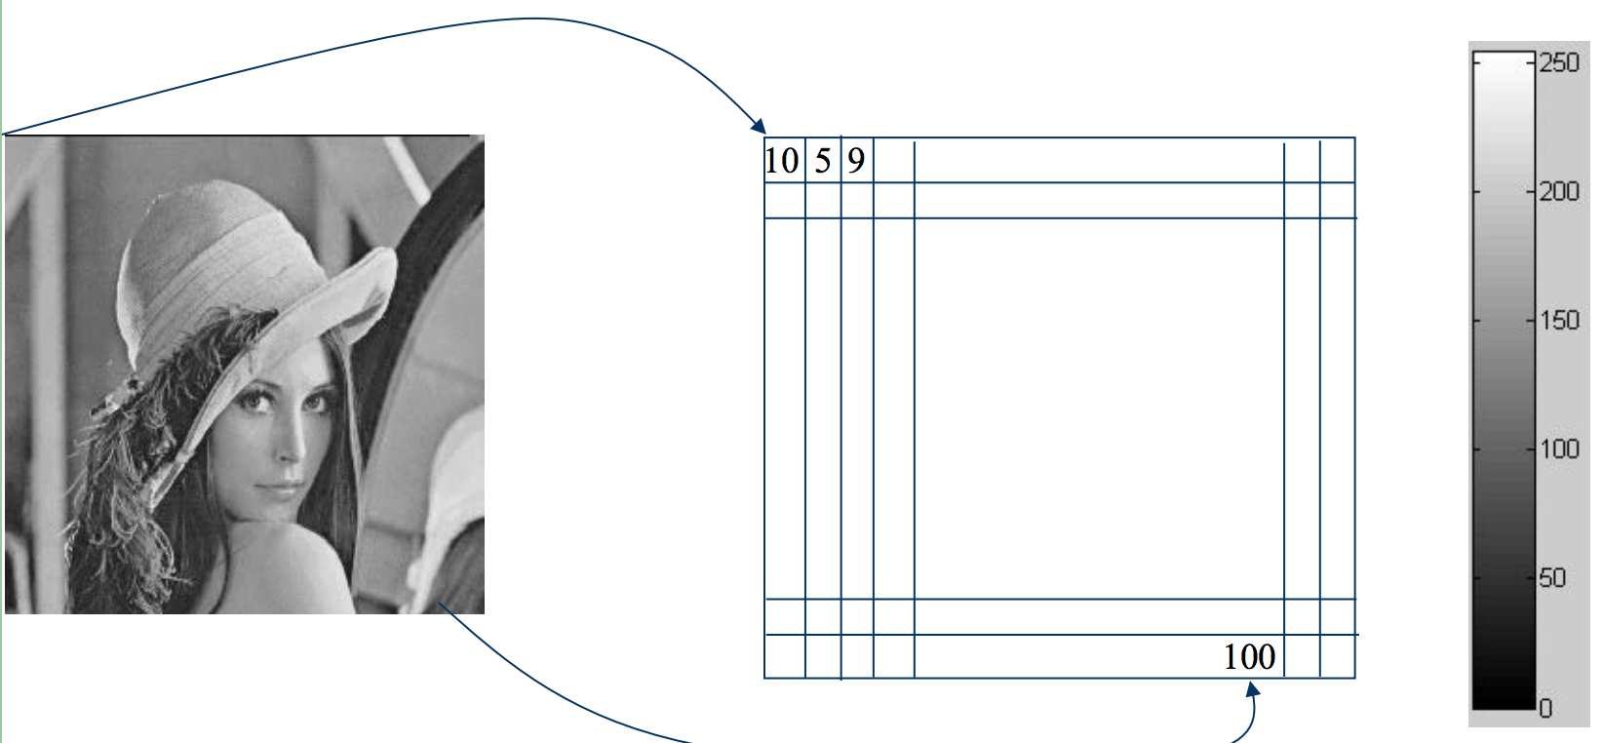
Grayscale image representation
Slide credit: Ulas Bagci

Slide 10
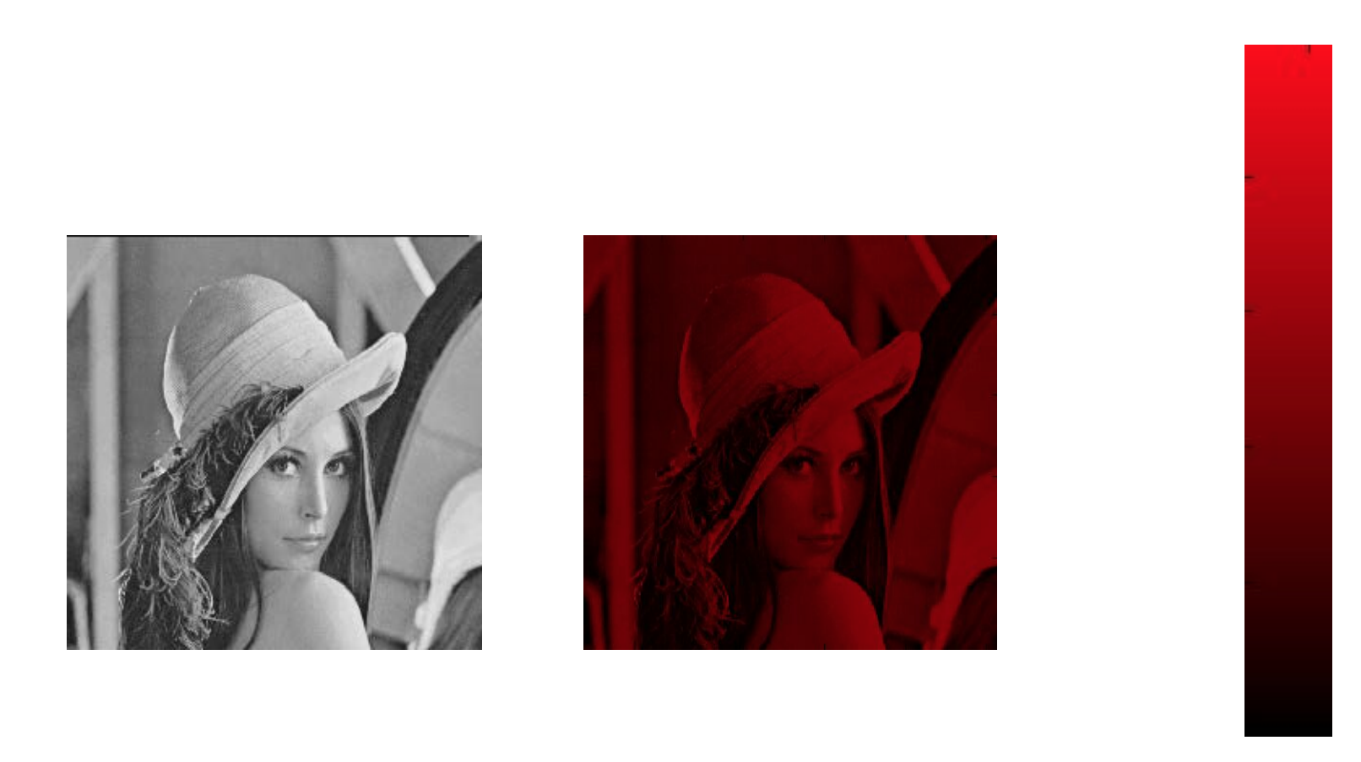
Color Image - one channel
Slide credit: Ulas Bagci

Slide 11
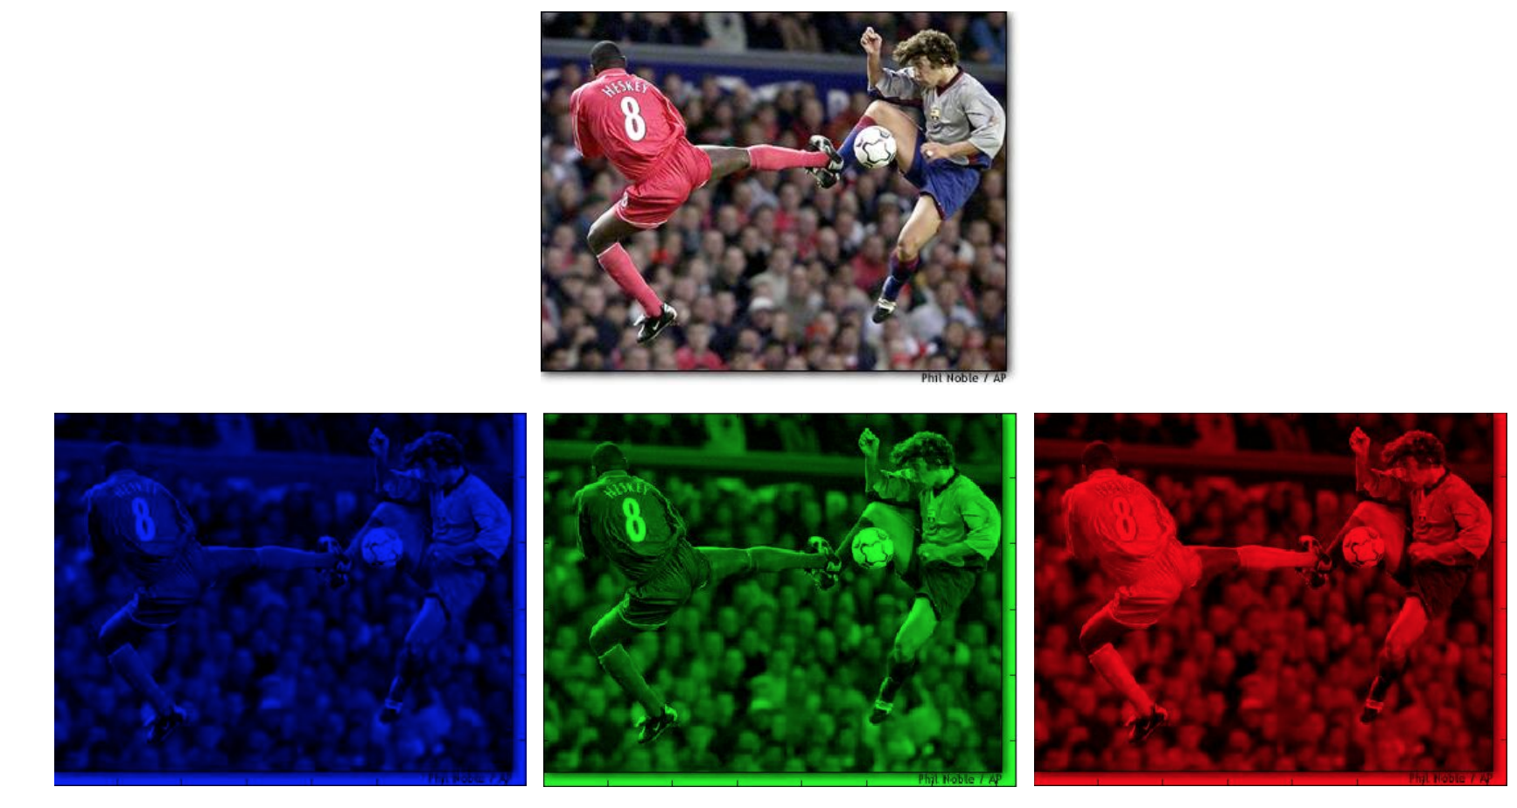
Color image representation
Slide credit: Ulas Bagci

Slide 12
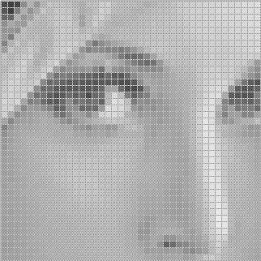
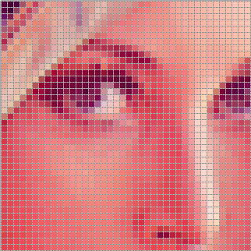
Images are sampled
What happens when we zoom into the images we capture?

Slide 13
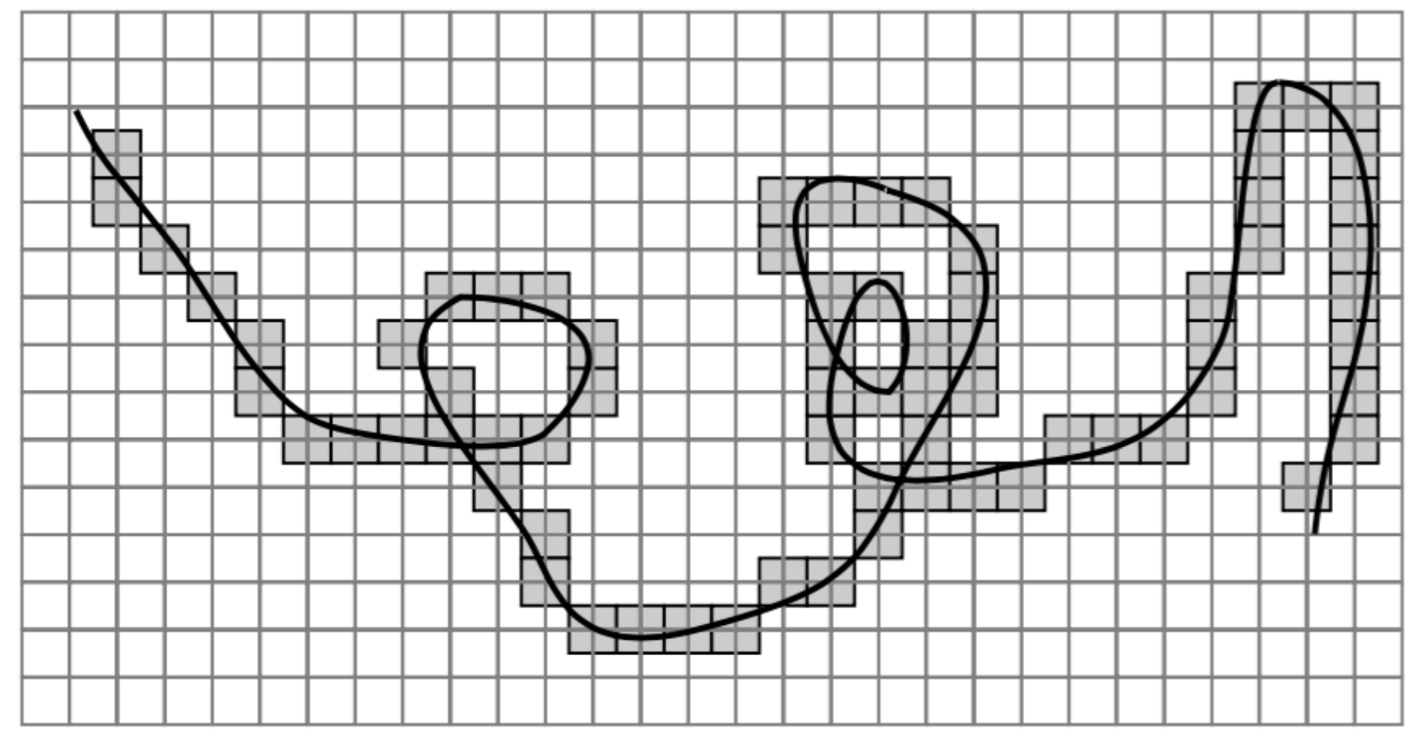
Errors due Sampling
Slide credit: Ulas Bagci

Slide 14

Resolution
is a sampling parameter, defined in dots per inch (DPI) or equivalent measures of spatial pixel density, and its standard value for recent screen technologies is 72 dpi
Slide credit: Ulas Bagci

Slide 15
Images are Sampled and Quantized
An image contains discrete number of pixels
  A simple example
  Pixel value:
    “grayscale”
    (or “intensity”): [0,255]
75
231
148
Notes:
Last time: Images as Matrices
intensity
temperature
depth

Slide 16
Images are Sampled and Quantized
An image contains discrete number of pixels
  A simple example
  Pixel value:
    “grayscale”
    (or “intensity”): [0,255]
    “color”
      RGB: [R, G, B]
      Lab: [L, a, b]
      HSV: [H, S, V]
[90, 0, 53]
[249, 215, 203]
[213, 60, 67]

Slide 17
With this loss of information (from sampling and quantization),
Can we still use images for useful tasks?

Slide 18
What we will learn today?
Image sampling and quantization
Image histograms
Images as functions
Linear systems (filters)
Convolution and correlation
Some background reading:
Forsyth and Ponce, Computer Vision, Chapter 7

Slide 19
Histogram
Histogram of an image provides the frequency of the brightness (intensity) value in the image.
def histogram(im):
h = np.zeros(255)
for row in im.shape[0]:
for col in im.shape[1]:
val = im[row, col]
h[val] += 1

Slide 20
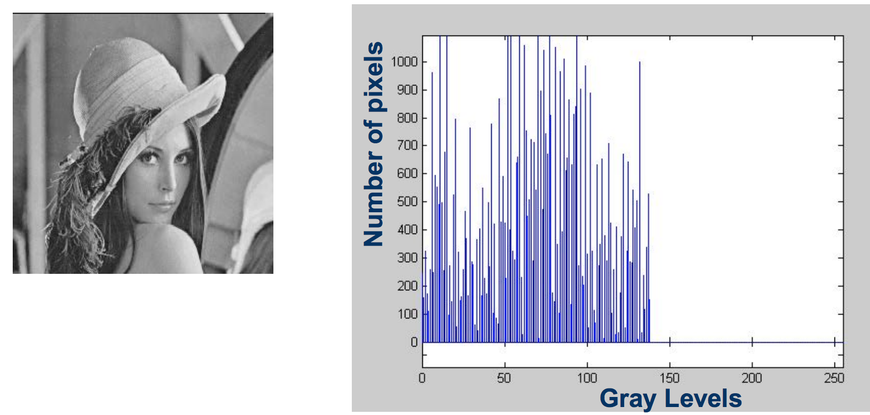
Histogram
Histogram captures the distribution of gray levels in the image.
How frequently each gray level occurs in the image

Slide 21
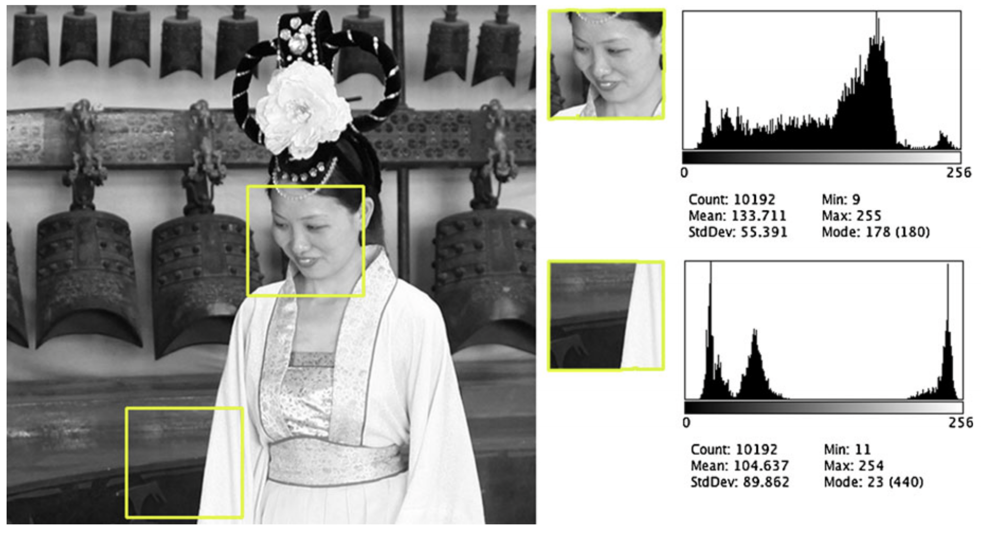
Histogram
Slide credit: Dr. Mubarak Shah

Slide 22
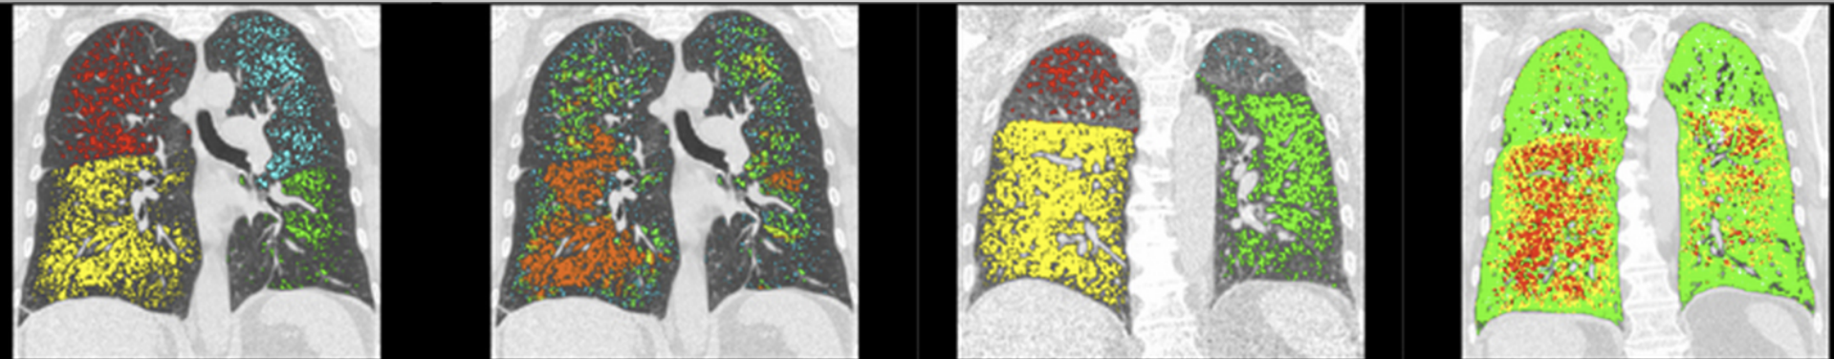
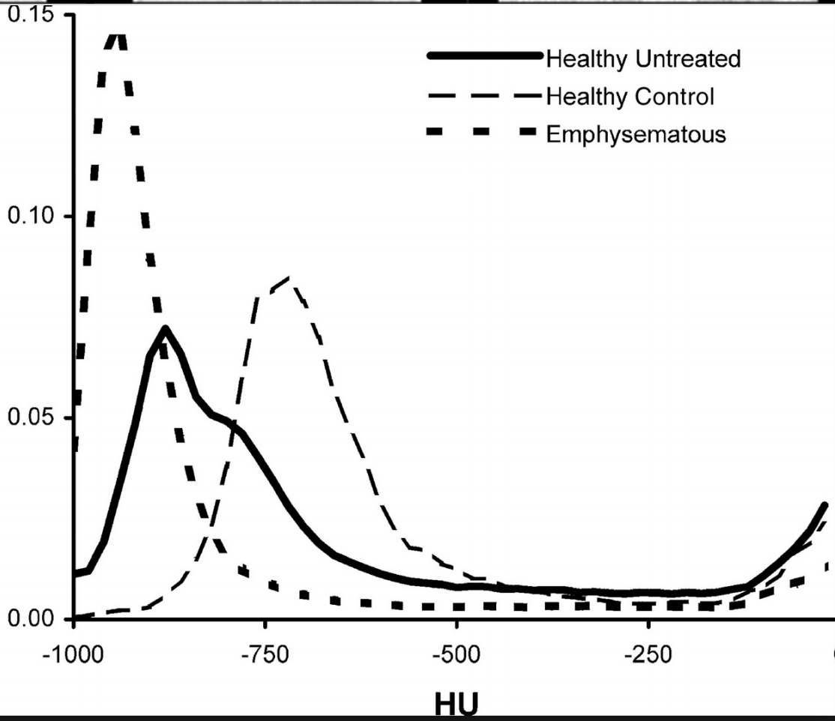
Histogram – use case
Slide credit: Dr. Mubarak Shah

Slide 23
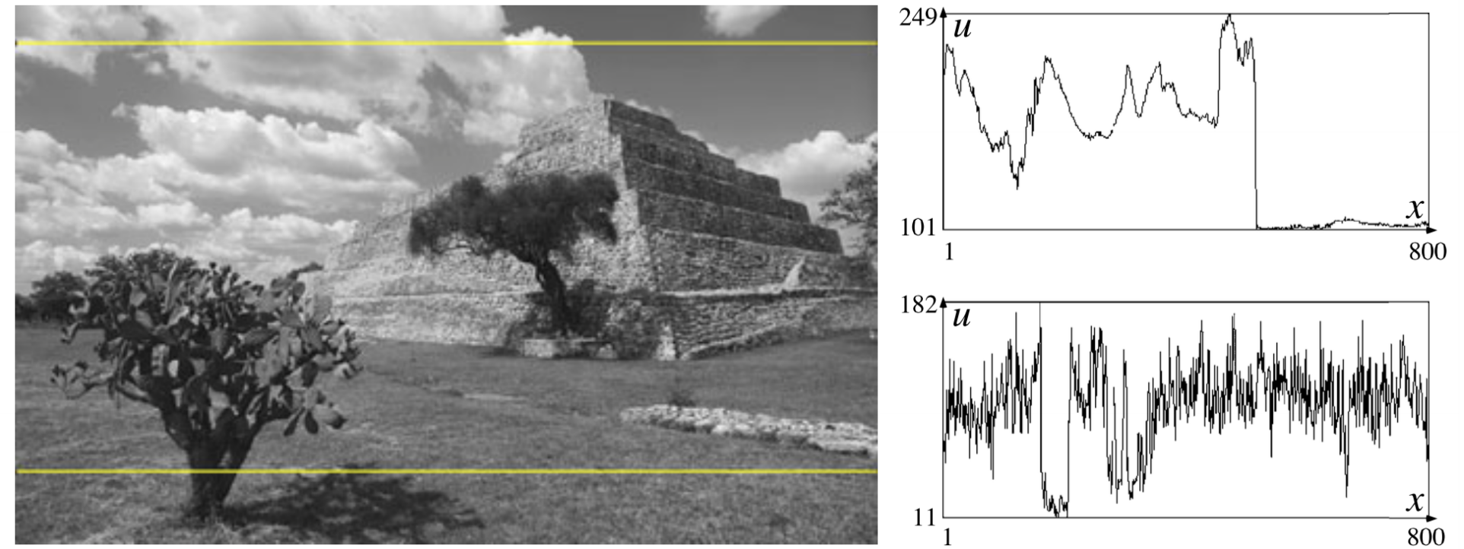
Histogram – another use case
Slide credit: Dr. Mubarak Shah

Slide 24
What we will learn today?
Image sampling and quantization
Image histograms
Images as functions
Linear systems (filters)
Convolution and correlation
Some background reading:
Forsyth and Ponce, Computer Vision, Chapter 7

Slide 25

Images as discrete functions
Images are usually digital (discrete):
  Sample the 2D space on a regular grid
Represented as a matrix of integer values
pixel

Slide 26
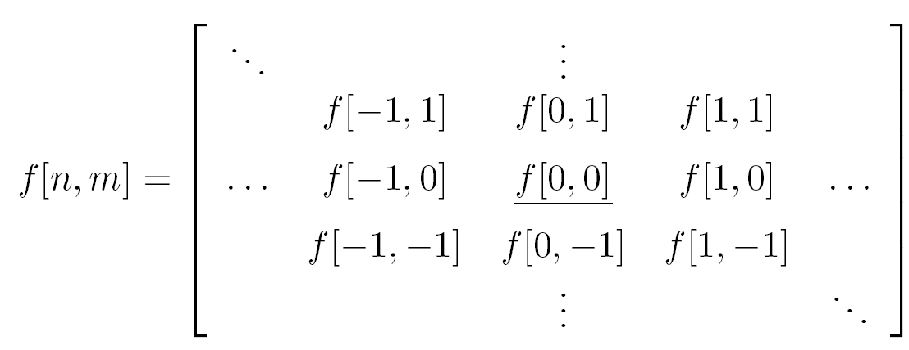
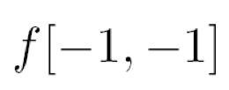







Images as coordinates
Cartesian coordinates
Notation for
discrete
functions

Slide 27
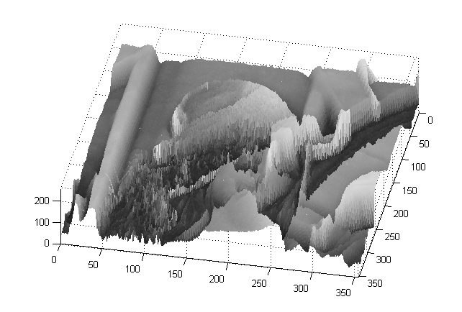
Images as functions
An Image as a function f from R² to R^{M}:
  f( x, y ) gives the intensity at position ( x, y )
  Defined over a rectangle, with a finite range:
    f: [a,b] x [c,d ] → [0,255]
Domain
support
range

Slide 28
Images as functions
An Image as a function f from R² to R^{M}:
  f( x, y ) gives the intensity at position ( x, y )
  Defined over a rectangle, with a finite range:
    f: [a,b] x [c,d ] → [0,255]
Domain
support
range
A color image:
Notes:
Each r, g, b are functions that like the one above

Slide 29
Histograms are a type of image function

Slide 30
What we will learn today?
Image sampling and quantization
Image histograms
Images as functions
Linear systems (filters)
Convolution and correlation
Some background reading:
Forsyth and Ponce, Computer Vision, Chapter 7

Slide 31
Systems and Filters
Filtering:
  Forming a new image whose pixel values are transformed from original pixel values
Goals:
Goal is to extract useful information from images, or transform images into another domain where we can modify/enhance image properties
  Features (edges, corners, blobs…)
  super-resolution; in-painting; de-noising

Slide 32

System and Filters
we define a system as a unit that converts an input function f[n,m] into an output (or response) function g[n,m], where (n,m) are the independent variables.
  In the case for images, (n,m) represents the spatial position in the image.

Slide 33

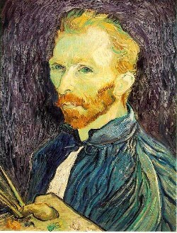
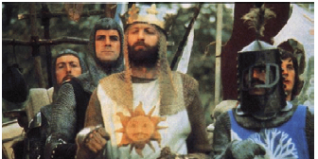
Super-resolution
De-noising
In-painting
Bertamio et al

Slide 34
Images as coordinates
Cartesian coordinates
Notation for
discrete
functions

Slide 35

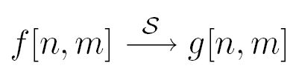
2D discrete-space systems (filters)
S is the system operator, defined as a mapping or assignment of a member of the set of possible outputs g[n,m] to each member of the set of possible inputs f[n,m].

Slide 36
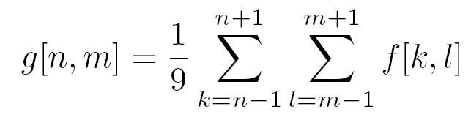

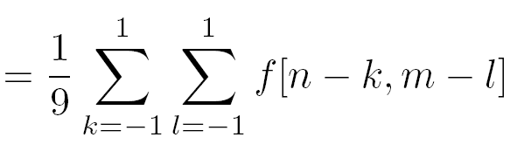
Filter example #1: Moving Average
2D DS moving average over a 3 × 3 window of neighborhood
h
1
1
1
1
1
1
1
1
1
Notes:
Board:
Input image
Output image
each pixel results from a neighborhood operation

Slide 37


Filter example #1: Moving Average
0 | 0 | 0 | 0 | 0 | 0 | 0 | 0 | 0 | 0
0 | 0 | 0 | 0 | 0 | 0 | 0 | 0 | 0 | 0
0 | 0 | 0 | 90 | 90 | 90 | 90 | 90 | 0 | 0
0 | 0 | 0 | 90 | 90 | 90 | 90 | 90 | 0 | 0
0 | 0 | 0 | 90 | 90 | 90 | 90 | 90 | 0 | 0
0 | 0 | 0 | 90 | 0 | 90 | 90 | 90 | 0 | 0
0 | 0 | 0 | 90 | 90 | 90 | 90 | 90 | 0 | 0
0 | 0 | 0 | 0 | 0 | 0 | 0 | 0 | 0 | 0
0 | 0 | 90 | 0 | 0 | 0 | 0 | 0 | 0 | 0
0 | 0 | 0 | 0 | 0 | 0 | 0 | 0 | 0 | 0
 | 0
0 | 0 | 0 | 0 | 0 | 0 | 0 | 0 | 0 | 0
0 | 0 | 0 | 0 | 0 | 0 | 0 | 0 | 0 | 0
0 | 0 | 0 | 90 | 90 | 90 | 90 | 90 | 0 | 0
0 | 0 | 0 | 90 | 90 | 90 | 90 | 90 | 0 | 0
0 | 0 | 0 | 90 | 90 | 90 | 90 | 90 | 0 | 0
0 | 0 | 0 | 90 | 0 | 90 | 90 | 90 | 0 | 0
0 | 0 | 0 | 90 | 90 | 90 | 90 | 90 | 0 | 0
0 | 0 | 0 | 0 | 0 | 0 | 0 | 0 | 0 | 0
0 | 0 | 90 | 0 | 0 | 0 | 0 | 0 | 0 | 0
0 | 0 | 0 | 0 | 0 | 0 | 0 | 0 | 0 | 0
Courtesy of S. Seitz

Slide 38
Filter example #1: Moving Average
0 | 0 | 0 | 0 | 0 | 0 | 0 | 0 | 0 | 0
0 | 0 | 0 | 0 | 0 | 0 | 0 | 0 | 0 | 0
0 | 0 | 0 | 90 | 90 | 90 | 90 | 90 | 0 | 0
0 | 0 | 0 | 90 | 90 | 90 | 90 | 90 | 0 | 0
0 | 0 | 0 | 90 | 90 | 90 | 90 | 90 | 0 | 0
0 | 0 | 0 | 90 | 0 | 90 | 90 | 90 | 0 | 0
0 | 0 | 0 | 90 | 90 | 90 | 90 | 90 | 0 | 0
0 | 0 | 0 | 0 | 0 | 0 | 0 | 0 | 0 | 0
0 | 0 | 90 | 0 | 0 | 0 | 0 | 0 | 0 | 0
0 | 0 | 0 | 0 | 0 | 0 | 0 | 0 | 0 | 0
 | 0 | 10
0 | 0 | 0 | 0 | 0 | 0 | 0 | 0 | 0 | 0
0 | 0 | 0 | 0 | 0 | 0 | 0 | 0 | 0 | 0
0 | 0 | 0 | 90 | 90 | 90 | 90 | 90 | 0 | 0
0 | 0 | 0 | 90 | 90 | 90 | 90 | 90 | 0 | 0
0 | 0 | 0 | 90 | 90 | 90 | 90 | 90 | 0 | 0
0 | 0 | 0 | 90 | 0 | 90 | 90 | 90 | 0 | 0
0 | 0 | 0 | 90 | 90 | 90 | 90 | 90 | 0 | 0
0 | 0 | 0 | 0 | 0 | 0 | 0 | 0 | 0 | 0
0 | 0 | 90 | 0 | 0 | 0 | 0 | 0 | 0 | 0
0 | 0 | 0 | 0 | 0 | 0 | 0 | 0 | 0 | 0
38

Slide 39
Filter example #1: Moving Average
0 | 0 | 0 | 0 | 0 | 0 | 0 | 0 | 0 | 0
0 | 0 | 0 | 0 | 0 | 0 | 0 | 0 | 0 | 0
0 | 0 | 0 | 90 | 90 | 90 | 90 | 90 | 0 | 0
0 | 0 | 0 | 90 | 90 | 90 | 90 | 90 | 0 | 0
0 | 0 | 0 | 90 | 90 | 90 | 90 | 90 | 0 | 0
0 | 0 | 0 | 90 | 0 | 90 | 90 | 90 | 0 | 0
0 | 0 | 0 | 90 | 90 | 90 | 90 | 90 | 0 | 0
0 | 0 | 0 | 0 | 0 | 0 | 0 | 0 | 0 | 0
0 | 0 | 90 | 0 | 0 | 0 | 0 | 0 | 0 | 0
0 | 0 | 0 | 0 | 0 | 0 | 0 | 0 | 0 | 0
 | 0 | 10 | 20
0 | 0 | 0 | 0 | 0 | 0 | 0 | 0 | 0 | 0
0 | 0 | 0 | 0 | 0 | 0 | 0 | 0 | 0 | 0
0 | 0 | 0 | 90 | 90 | 90 | 90 | 90 | 0 | 0
0 | 0 | 0 | 90 | 90 | 90 | 90 | 90 | 0 | 0
0 | 0 | 0 | 90 | 90 | 90 | 90 | 90 | 0 | 0
0 | 0 | 0 | 90 | 0 | 90 | 90 | 90 | 0 | 0
0 | 0 | 0 | 90 | 90 | 90 | 90 | 90 | 0 | 0
0 | 0 | 0 | 0 | 0 | 0 | 0 | 0 | 0 | 0
0 | 0 | 90 | 0 | 0 | 0 | 0 | 0 | 0 | 0
0 | 0 | 0 | 0 | 0 | 0 | 0 | 0 | 0 | 0

Slide 40
Filter example #1: Moving Average
0 | 0 | 0 | 0 | 0 | 0 | 0 | 0 | 0 | 0
0 | 0 | 0 | 0 | 0 | 0 | 0 | 0 | 0 | 0
0 | 0 | 0 | 90 | 90 | 90 | 90 | 90 | 0 | 0
0 | 0 | 0 | 90 | 90 | 90 | 90 | 90 | 0 | 0
0 | 0 | 0 | 90 | 90 | 90 | 90 | 90 | 0 | 0
0 | 0 | 0 | 90 | 0 | 90 | 90 | 90 | 0 | 0
0 | 0 | 0 | 90 | 90 | 90 | 90 | 90 | 0 | 0
0 | 0 | 0 | 0 | 0 | 0 | 0 | 0 | 0 | 0
0 | 0 | 90 | 0 | 0 | 0 | 0 | 0 | 0 | 0
0 | 0 | 0 | 0 | 0 | 0 | 0 | 0 | 0 | 0
 | 0 | 10 | 20 | 30
0 | 0 | 0 | 0 | 0 | 0 | 0 | 0 | 0 | 0
0 | 0 | 0 | 0 | 0 | 0 | 0 | 0 | 0 | 0
0 | 0 | 0 | 90 | 90 | 90 | 90 | 90 | 0 | 0
0 | 0 | 0 | 90 | 90 | 90 | 90 | 90 | 0 | 0
0 | 0 | 0 | 90 | 90 | 90 | 90 | 90 | 0 | 0
0 | 0 | 0 | 90 | 0 | 90 | 90 | 90 | 0 | 0
0 | 0 | 0 | 90 | 90 | 90 | 90 | 90 | 0 | 0
0 | 0 | 0 | 0 | 0 | 0 | 0 | 0 | 0 | 0
0 | 0 | 90 | 0 | 0 | 0 | 0 | 0 | 0 | 0
0 | 0 | 0 | 0 | 0 | 0 | 0 | 0 | 0 | 0

Slide 41
Filter example #1: Moving Average
0 | 0 | 0 | 0 | 0 | 0 | 0 | 0 | 0 | 0
0 | 0 | 0 | 0 | 0 | 0 | 0 | 0 | 0 | 0
0 | 0 | 0 | 90 | 90 | 90 | 90 | 90 | 0 | 0
0 | 0 | 0 | 90 | 90 | 90 | 90 | 90 | 0 | 0
0 | 0 | 0 | 90 | 90 | 90 | 90 | 90 | 0 | 0
0 | 0 | 0 | 90 | 0 | 90 | 90 | 90 | 0 | 0
0 | 0 | 0 | 90 | 90 | 90 | 90 | 90 | 0 | 0
0 | 0 | 0 | 0 | 0 | 0 | 0 | 0 | 0 | 0
0 | 0 | 90 | 0 | 0 | 0 | 0 | 0 | 0 | 0
0 | 0 | 0 | 0 | 0 | 0 | 0 | 0 | 0 | 0
 | 0 | 10 | 20 | 30 | 30

Slide 42
Filter example #1: Moving Average
0 | 0 | 0 | 0 | 0 | 0 | 0 | 0 | 0 | 0
0 | 0 | 0 | 0 | 0 | 0 | 0 | 0 | 0 | 0
0 | 0 | 0 | 90 | 90 | 90 | 90 | 90 | 0 | 0
0 | 0 | 0 | 90 | 90 | 90 | 90 | 90 | 0 | 0
0 | 0 | 0 | 90 | 90 | 90 | 90 | 90 | 0 | 0
0 | 0 | 0 | 90 | 0 | 90 | 90 | 90 | 0 | 0
0 | 0 | 0 | 90 | 90 | 90 | 90 | 90 | 0 | 0
0 | 0 | 0 | 0 | 0 | 0 | 0 | 0 | 0 | 0
0 | 0 | 90 | 0 | 0 | 0 | 0 | 0 | 0 | 0
0 | 0 | 0 | 0 | 0 | 0 | 0 | 0 | 0 | 0
 | 0 | 10 | 20 | 30 | 30 | 30 | 20 | 10
 | 0 | 20 | 40 | 60 | 60 | 60 | 40 | 20
 | 0 | 30 | 60 | 90 | 90 | 90 | 60 | 30
 | 0 | 30 | 50 | 80 | 80 | 90 | 60 | 30
 | 0 | 30 | 50 | 80 | 80 | 90 | 60 | 30
 | 0 | 20 | 30 | 50 | 50 | 60 | 40 | 20
 | 10 | 20 | 30 | 30 | 30 | 30 | 20 | 10
 | 10 | 10 | 10 | 0 | 0 | 0 | 0 | 0
Source: S. Seitz
Notes:
What is the effect on the output?
What happens to the sharp edges?

Slide 43
Filter example #1: Moving Average
In summary:
This filter “Replaces” each pixel with an average of its neighborhood.
Achieve smoothing effect (remove sharp features)
1
1
1
1
1
1
1
1
1

Slide 44

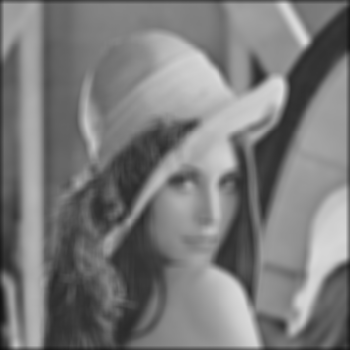
Filter example #1: Moving Average

Slide 45
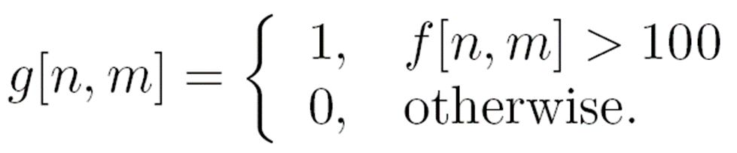

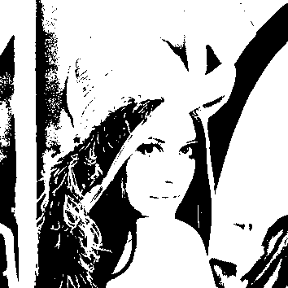
Filter example #2: Image Segmentation
Image segmentation based on a simple threshold:
255,

Slide 46

Properties of systems
Amplitude properties:
  Additivity

Slide 47

Properties of systems
Amplitude properties:
  Additivity
  Homogeneity

Slide 48
Properties of systems
Amplitude properties:
  Additivity
  Homogeneity
  Superposition

Slide 49

Properties of systems
Amplitude properties:
  Additivity
  Homogeneity
  Superposition
  Stability

Slide 50

Properties of systems
Amplitude properties:
  Additivity
  Homogeneity
  Superposition
  Stability
  Invertibility

Slide 51

Properties of systems
Spatial properties
  Causality
  Shift invariance:

Slide 52
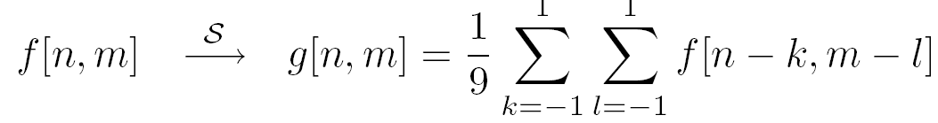
Is the moving average system is shift invariant?
0 | 0 | 0 | 0 | 0 | 0 | 0 | 0 | 0 | 0
0 | 0 | 0 | 0 | 0 | 0 | 0 | 0 | 0 | 0
0 | 0 | 0 | 90 | 90 | 90 | 90 | 90 | 0 | 0
0 | 0 | 0 | 90 | 90 | 90 | 90 | 90 | 0 | 0
0 | 0 | 0 | 90 | 90 | 90 | 90 | 90 | 0 | 0
0 | 0 | 0 | 90 | 0 | 90 | 90 | 90 | 0 | 0
0 | 0 | 0 | 90 | 90 | 90 | 90 | 90 | 0 | 0
0 | 0 | 0 | 0 | 0 | 0 | 0 | 0 | 0 | 0
0 | 0 | 90 | 0 | 0 | 0 | 0 | 0 | 0 | 0
0 | 0 | 0 | 0 | 0 | 0 | 0 | 0 | 0 | 0
 | 0 | 10 | 20 | 30 | 30 | 30 | 20 | 10
 | 0 | 20 | 40 | 60 | 60 | 60 | 40 | 20
 | 0 | 30 | 60 | 90 | 90 | 90 | 60 | 30
 | 0 | 30 | 50 | 80 | 80 | 90 | 60 | 30
 | 0 | 30 | 50 | 80 | 80 | 90 | 60 | 30
 | 0 | 20 | 30 | 50 | 50 | 60 | 40 | 20
 | 10 | 20 | 30 | 30 | 30 | 30 | 20 | 10
 | 10 | 10 | 10 | 0 | 0 | 0 | 0 | 0

Slide 53
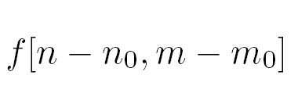
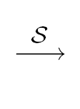
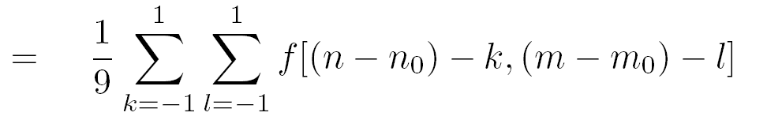

Is the moving average system is shift invariant?
Yes!

Slide 54
Is the moving average system is casual?
0 | 0 | 0 | 0 | 0 | 0 | 0 | 0 | 0 | 0
0 | 0 | 0 | 0 | 0 | 0 | 0 | 0 | 0 | 0
0 | 0 | 0 | 90 | 90 | 90 | 90 | 90 | 0 | 0
0 | 0 | 0 | 90 | 90 | 90 | 90 | 90 | 0 | 0
0 | 0 | 0 | 90 | 90 | 90 | 90 | 90 | 0 | 0
0 | 0 | 0 | 90 | 0 | 90 | 90 | 90 | 0 | 0
0 | 0 | 0 | 90 | 90 | 90 | 90 | 90 | 0 | 0
0 | 0 | 0 | 0 | 0 | 0 | 0 | 0 | 0 | 0
0 | 0 | 90 | 0 | 0 | 0 | 0 | 0 | 0 | 0
0 | 0 | 0 | 0 | 0 | 0 | 0 | 0 | 0 | 0
 | 0 | 10 | 20 | 30 | 30 | 30 | 20 | 10
 | 0 | 20 | 40 | 60 | 60 | 60 | 40 | 20
 | 0 | 30 | 60 | 90 | 90 | 90 | 60 | 30
 | 0 | 30 | 50 | 80 | 80 | 90 | 60 | 30
 | 0 | 30 | 50 | 80 | 80 | 90 | 60 | 30
 | 0 | 20 | 30 | 50 | 50 | 60 | 40 | 20
 | 10 | 20 | 30 | 30 | 30 | 30 | 20 | 10
 | 10 | 10 | 10 | 0 | 0 | 0 | 0 | 0

Slide 55

Linear Systems (filters)
Linear filtering:
  Form a new image whose pixels are a weighted sum of original pixel values
  Use the same set of weights at each point
S is a linear system (function) iff it S satisfies
superposition property
Notes:
Moving average is an example of a linear filter.
Here a more general definition.

Slide 56
Linear Systems (filters)
Is the moving average a linear system?
Is thresholding a linear system?
  f1[n,m] + f2[n,m] > T
  f1[n,m] < T
  f2[n,m]<T
No!
Notes:
Show on the board equations for moving average.

Slide 57
2D impulse function
1 at [0,0].
0 everywhere else

Slide 58
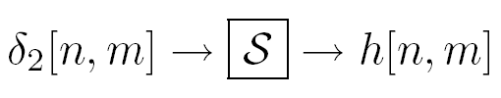

LSI (linear shift invariant) systems
Impulse response
Notes:
LSI systems can be characterized by the impulse response.
\delta_2 is the impulse (an image with 1 pixel =1, all the rest =0)
h is the response

Slide 59
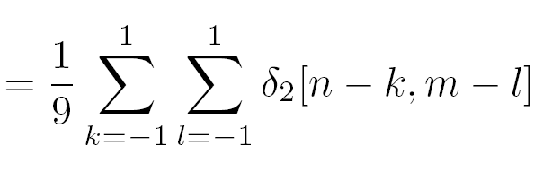
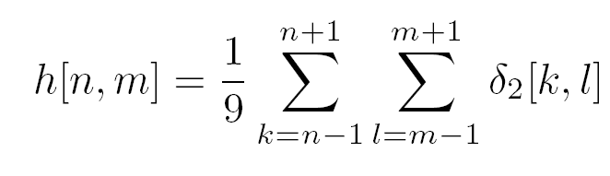
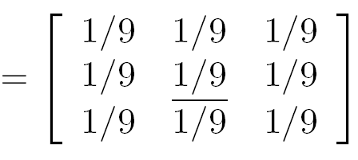
LSI (linear shift invariant) systems
Example: impulse response of the 3 by 3 moving average filter:
h
1
1
1
1
1
1
1
1
1

Slide 60
Filter example #1: Moving Average
2D DS moving average over a 3 × 3 window of neighborhood
h
1
1
1
1
1
1
1
1
1
Notes:
Board:
Input image
Output image
each pixel results from a neighborhood operation

Slide 61
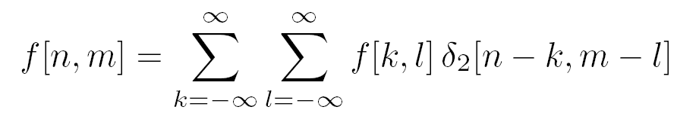
LSI (linear shift invariant) systems
A simple LSI is one that shifts the pixels of an image:
shifting property of the delta function
Notes:
We can write any function as a sum of impulses…
Let’s pass this function over our system..
Using superposition, we get a sum over the impulse responses…
Final equation: we call this a convolution. Applying the impulse response h to f at all locations.

Slide 62
LSI (linear shift invariant) systems
A simple LSI is one that shifts the pixels of an image:
Remember the superposition property:
shifting property of the delta function
superposition property
Notes:
We can write any function as a sum of impulses…
Let’s pass this function over our system..
Using superposition, we get a sum over the impulse responses…
Final equation: we call this a convolution. Applying the impulse response h to f at all locations.

Slide 63
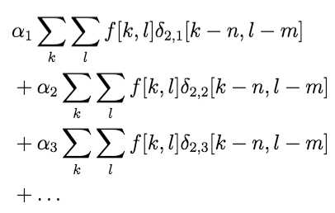
LSI (linear shift invariant) systems
With the superposition property, any LSI system can be represented as a weighted sum of such shifting systems:
Notes:
We can write any function as a sum of impulses…
Let’s pass this function over our system..
Using superposition, we get a sum over the impulse responses…
Final equation: we call this a convolution. Applying the impulse response h to f at all locations.

Slide 64
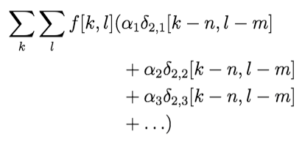
LSI (linear shift invariant) systems
Rewriting the above summation:
Notes:
We can write any function as a sum of impulses…
Let’s pass this function over our system..
Using superposition, we get a sum over the impulse responses…
Final equation: we call this a convolution. Applying the impulse response h to f at all locations.

Slide 65
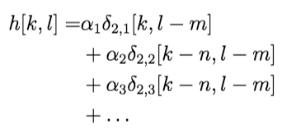
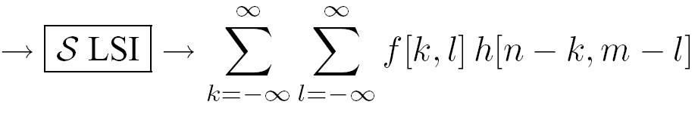
LSI (linear shift invariant) systems
We define the filter of a LSI as:
Notes:
We can write any function as a sum of impulses…
Let’s pass this function over our system..
Using superposition, we get a sum over the impulse responses…
Final equation: we call this a convolution. Applying the impulse response h to f at all locations.

Slide 66
What we will learn today?
Images as functions
Linear systems (filters)
Convolution and correlation
Some background reading:
Forsyth and Ponce, Computer Vision, Chapter 7

Slide 67

1D Discrete convolution (symbol: )
We are going to convolve a function f with a filter h.
h[k,l]
f[k,l]

Slide 68
1D Discrete convolution (symbol: )
We are going to convolve a function f with a filter h.
We first need to calculate h[n-k, m-l]
h[-k]
h[k]
h[n-k]

Slide 69
Discrete convolution (symbol: )
We are going to convolve a function f with a filter h.
h[-2-k]
g[-2]
f[k]

Slide 70
Discrete convolution (symbol: )
We are going to convolve a function f with a filter h.
h[-1-k]
g[-1]
f[k]

Slide 71
Discrete convolution (symbol: )
We are going to convolve a function f with a filter h.
h[-k]
g[0]
f[k]

Slide 72
Discrete convolution (symbol: )
We are going to convolve a function f with a filter h.
h[1-k]
g[1]
f[k]

Slide 73
Discrete convolution (symbol: )
We are going to convolve a function f with a filter h.
h[2-k]
g[2]
f[k]

Slide 74
Discrete convolution (symbol: )
We are going to convolve a function f with a filter h.
h[n-k]
g[n]
f[k]

Slide 75

Discrete convolution (symbol: )
In summary, the steps for discrete convolution are:
Fold h[k,l] about origin to form h[−k]
Shift the folded results by n to form h[n − k]
Multiply h[n − k] by f[k]
Sum over all k
Repeat for every n
n

Slide 76
2D convolution
2D convolution is very similar to 1D.
The main difference is that we now have to iterate over 2 axis instead of 1.
Assume we have a filter(h[,]) that is 3x3. and an image (f[,]) that is 7x7.
n

Slide 77
2D convolution
2D convolution is very similar to 1D.
The main difference is that we now have to iterate over 2 axis instead of 1.
Assume we have a filter(h[,]) that is 3x3. and an image (f[,]) that is 7x7.
n

Slide 78
2D convolution
2D convolution is very similar to 1D.
The main difference is that we now have to iterate over 2 axis instead of 1.
Assume we have a filter(h[,]) that is 3x3. and an image (f[,]) that is 7x7.
n

Slide 79
2D convolution
2D convolution is very similar to 1D.
The main difference is that we now have to iterate over 2 axis instead of 1.
Assume we have a filter(h[,]) that is 3x3. and an image (f[,]) that is 7x7.
n

Slide 80
2D convolution
2D convolution is very similar to 1D.
The main difference is that we now have to iterate over 2 axis instead of 1.
Assume we have a filter(h[,]) that is 3x3. and an image (f[,]) that is 7x7.
n

Slide 81
2D convolution
2D convolution is very similar to 1D.
The main difference is that we now have to iterate over 2 axis instead of 1.
Assume we have a filter(h[,]) that is 3x3. and an image (f[,]) that is 7x7.

Slide 82
LSI (linear shift invariant) systems
An LSI system is completely specified by its impulse response.
shifting property of the delta function
superposition
Discrete convolution
Notes:
We can write any function as a sum of impulses…
Let’s pass this function over our system..
Using superposition, we get a sum over the impulse responses…
Final equation: we call this a convolution. Applying the impulse response h to f at all locations.

Slide 83
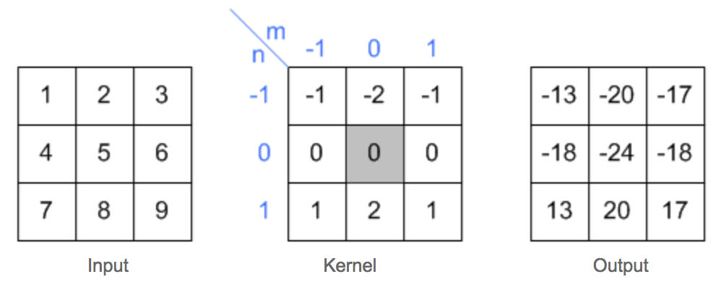
2D convolution example
Slide credit: Song Ho Ahn

Slide 84
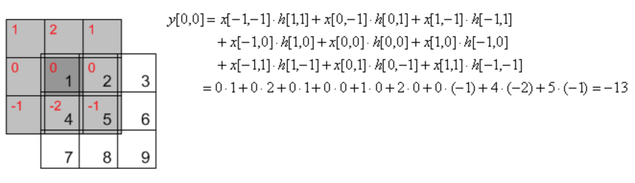
2D convolution example
Slide credit: Song Ho Ahn

Slide 85
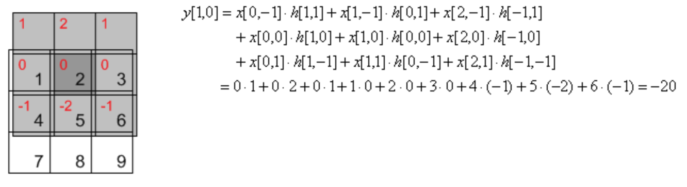
2D convolution example
Slide credit: Song Ho Ahn

Slide 86
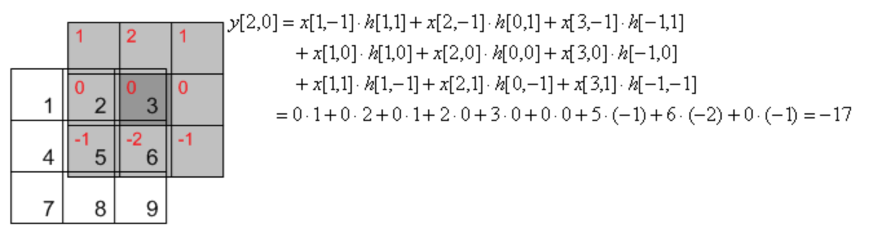
2D convolution example
Slide credit: Song Ho Ahn

Slide 87
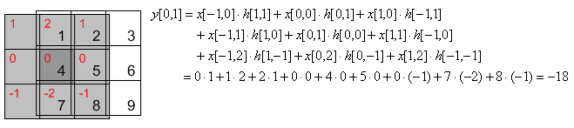
2D convolution example
Slide credit: Song Ho Ahn

Slide 88
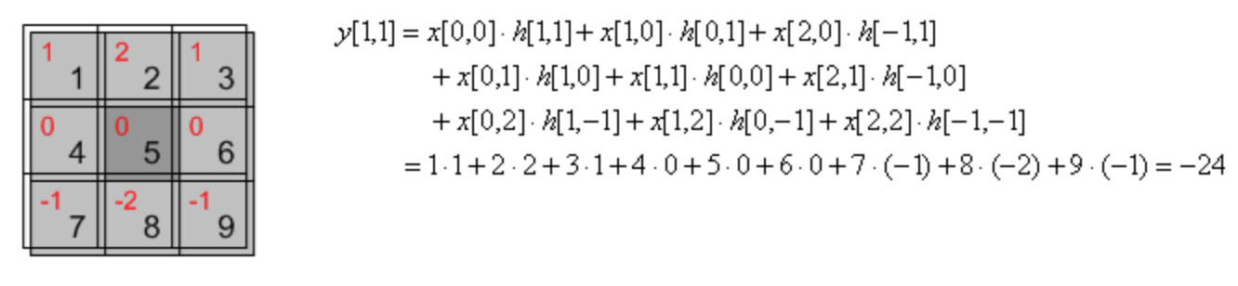
2D convolution example
Slide credit: Song Ho Ahn

Slide 89
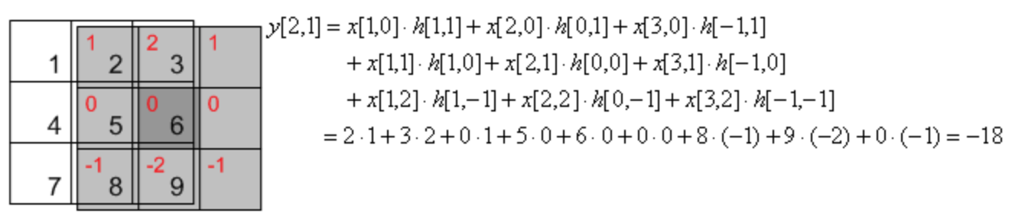
2D convolution example
Slide credit: Song Ho Ahn

Slide 90
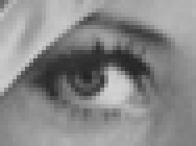
Convolution in 2D - examples
0
0
0
?
*
=
0
1
0
0
0
0
Original
Courtesy of D Lowe

Slide 91
Convolution in 2D - examples
0
0
0
*
=
0
1
0
0
0
0
Original
Filtered
(no change)
Courtesy of D Lowe

Slide 92
Convolution in 2D - examples
0
0
0
?
*
=
0
0
1
0
0
0
Original
Courtesy of D Lowe

Slide 93
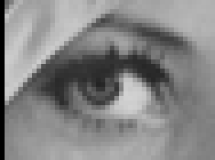
Convolution in 2D - examples
0
0
0
*
=
0
0
1
0
0
0
Original
Shifted right
By 1 pixel
Courtesy of D Lowe

Slide 94
Convolution in 2D - examples
1
1
1
?
*
=
1
1
1
1
1
1
Original
Courtesy of D Lowe

Slide 95
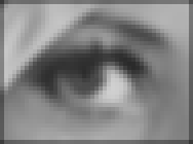
Convolution in 2D - examples
*
1
1
1
=
1
1
1
1
1
1
Original
Blur (with a
box filter)
Courtesy of D Lowe

Slide 96
Convolution in 2D - examples
0
0
0
-
1
1
1
= ?
0
2
0
1
1
1
0
0
0
1
1
1
Original
(Note that filter sums to 1)
“details of the image”
0
0
0
0
0
0
-
1
1
1
0
1
0
+
0
1
0
1
1
1
0
0
0
0
0
0
1
1
1
Courtesy of D Lowe
Notes:
Original image – blur = details!

Slide 97
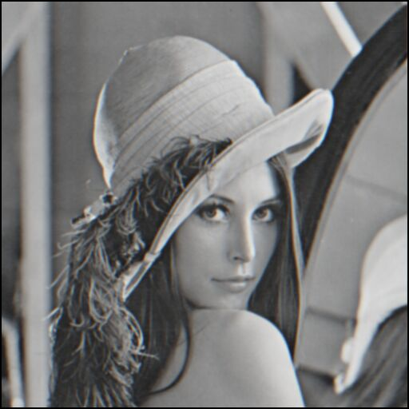


What does blurring take away?
–
=
original
smoothed (5x5)
detail
Let’s add it back:
+ a
=
original
detail
sharpened

Slide 98

Convolution in 2D –
Sharpening filter
0
0
0
-
1
1
1
=
0
2
0
1
1
1
0
0
0
1
1
1
Original
Sharpening filter: Accentuates differences with local average
Courtesy of D Lowe

Slide 99
Image support and edge effect
A computer will only convolve finite support signals.
  That is: images that are zero for n,m outside some rectangular region
numpy’s convolution performs 2D DS convolution of finite-support signals.
=
*
(N1 + N2 − 1) × (M1 +M2 − 1)
N2 ×M2
N1 ×M1

Slide 100
Image support and edge effect
A computer will only convolve finite support signals.
What happens at the edge?
f
• zero “padding”
• edge value replication
• mirror extension
• more (beyond the scope of this class)
-> Matlab conv2 uses zero-padding
h

Slide 101


Slide credit: Wolfram Alpha

Slide 102
What we will learn today?
Image sampling and quantization
Image histograms
Images as functions
Linear systems (filters)
Convolution and correlation
Some background reading:
Forsyth and Ponce, Computer Vision, Chapter 7

Slide 103


(Cross) correlation (symbol: )
Cross correlation of two 2D signals f[n,m] and g[n,m]
Equivalent to a convolution without the flip
(k, l) is called the lag
(g* is defined as the complex conjugate of g. In this class, g(n,m) are real numbers, hence g*=g.)
Notes:
Equation is about the same.
Difference is with the complex conjugate)

Slide 104

(Cross) correlation – example
Courtesy of J. Fessler
Notes:
Use: compare similarity between “kernel” and image.

Slide 105


(Cross) correlation – example
Courtesy of J. Fessler
Notes:
Use: compare similarity between “kernel” and image.

Slide 106


(Cross) correlation – example
Courtesy of J. Fessler
numpy’s correlate
Notes:
Use: compare similarity between “kernel” and image.

Slide 107



(Cross) correlation – example
Left
Right
scanline
Norm. cross corr. score

Slide 108

Convolution vs. (Cross) Correlation
f*h
f**h

Slide 109

Cross Correlation Application: Vision system for TV remote control
  - uses template matching
Figure from “Computer Vision for Interactive Computer Graphics,” W.Freeman et al, IEEE Computer Graphics and Applications, 1998 copyright 1998, IEEE
Notes:
This is a figure from the book, figure 7.16. Read the caption for the story!

Slide 110


properties
• Associative property:
• Distributive property:
The order doesn’t matter!

Slide 111



properties
• Shift property:
• Shift-invariance:

Slide 112
Convolution vs. (Cross) Correlation
A convolution is an integral that expresses the amount of overlap of one function as it is shifted over another function.
  convolution is a filtering operation
Correlation compares the similarity of two sets of data. Correlation computes a measure of similarity of two input signals as they are shifted by one another. The correlation result reaches a maximum at the time when the two signals match best .
  correlation is a measure of relatedness of two signals

Slide 113
What we have learned today?
Image sampling and quantization
Image histograms
Images as functions
Linear systems (filters)
Convolution and correlation

