Slide 1

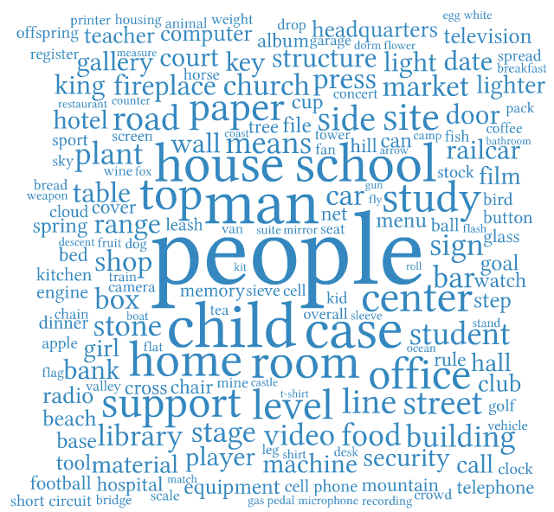
Current
Scale
  11,231,732 images and 15589 synsets
Bounding boxes
  195,331 images and 1000 synsets
Pre-computed features
  1.2 million Images and 1000 Synsets
Toolbox

Slide 2
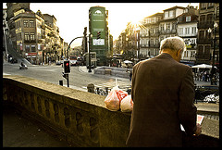




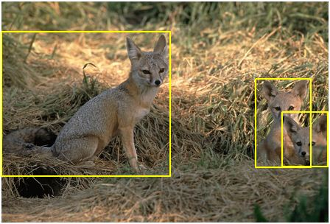
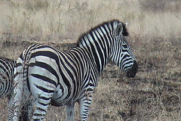
2011 winter release
New categories
  - 5K person synset
Bounding boxes
  - 2500 synsets
New categories
  5K person subtree
Bounding boxes
  2500 synsets
Attributes
  25 attributes, 384 synsets (9600 images)
Toolbox improved
  Easy downloading of images, features, and bounding boxes
Visualization
  New interface using HTML5 technology
  Bounding boxes overlaid on images
optimist, nonsmoker, neighbor, partner, philosopher, player, learner, hugger, jumper, Victorian, sneezer, computer user, …
Attributes
  25 attributes,
  9600 images
Improved toolbox
  - simplified downloading of images, features, bounding boxes
Improved visualization
  - new interface using HTML5
  bounding boxes overlaid on images
Black
White
Striped
Smooth

Slide 3
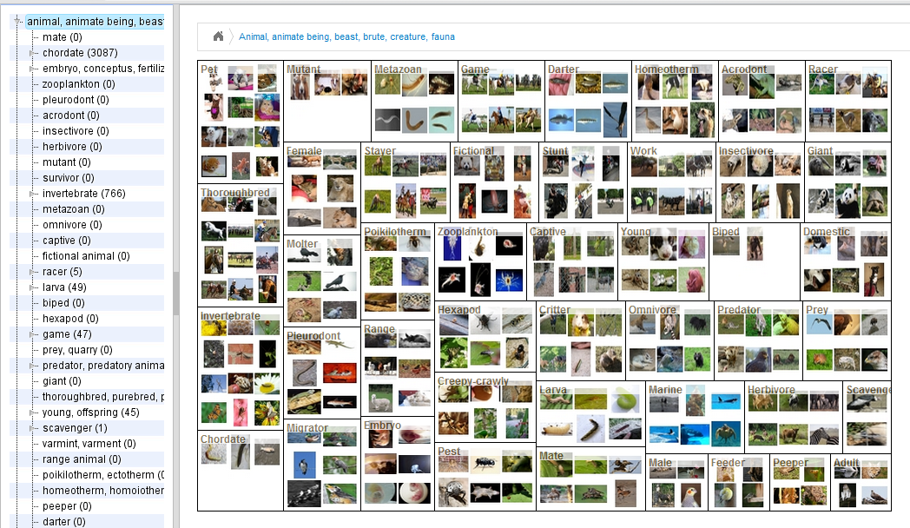
2011 winter release
New categories
  5K person subtree
Bounding boxes
  2500 synsets
Attributes
  25 attributes, 384 synsets (9600 images)
Toolbox improved
  Easy downloading of images, features, and bounding boxes
Visualization
  New interface using HTML5 technology
  Bounding boxes overlaid on images

Slide 4
2011 winter release
New categories
  5K person subtree
Bounding boxes
  2500 synsets
Attributes
  25 attributes, 384 synsets (9600 images)
Toolbox improved
  Easy downloading of images, features, and bounding boxes
Visualization
  New interface using HTML5 technology
  Bounding boxes overlaid on images

Slide 5

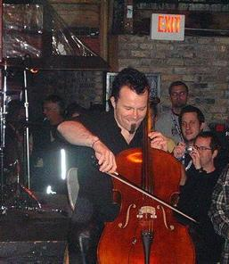

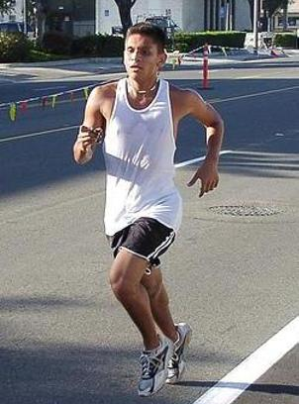
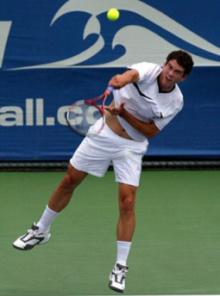
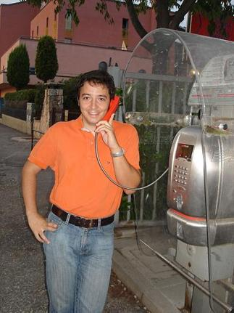
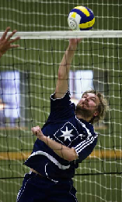
Recognizing Human Actions in Still Images
Bangpeng Yao
Nov.29, 2010
Drinking water
Playing cello
Riding bike
Running
Serving tennis ball
Phoning
Smash volleyball

Slide 6
What is an Action?
Action Theory: A behavior caused by an agent in a particular situation. The agent’s desires and beliefs lead to bodily behavior.
glass
Want a glass of water
Believe the clear liquid in the glass in front of me is water
Reach over
Reach over for the glass
glass
Drinking water
Classification
Understanding
[T. O’Connor & C. Sandis, 2010]

Slide 7
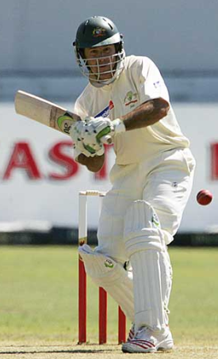
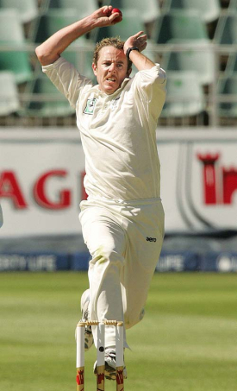
Human pose estimation & Object detection
Human pose estimation is challenging.
Difficult part appearance
Self-occlusion
Image region looks like a body part
Felzenszwalb & Huttenlocher, 2005
Ren et al, 2005
Ramanan, 2006
Ferrari et al, 2008
Yang & Mori, 2008
Andriluka et al, 2009
Eichner & Ferrari, 2009

Slide 8
Human pose estimation & Object detection
Human pose estimation is challenging.
Felzenszwalb & Huttenlocher, 2005
Ren et al, 2005
Ramanan, 2006
Ferrari et al, 2008
Yang & Mori, 2008
Andriluka et al, 2009
Eichner & Ferrari, 2009

Slide 9
Human pose estimation & Object detection
Facilitate
Given the object is detected.

Slide 10
Human pose estimation & Object detection
Object detection is challenging
Small, low-resolution, partially occluded
Image region similar to detection target
Viola & Jones, 2001
Lampert et al, 2008
Divvala et al, 2009
Vedaldi et al, 2009

Slide 11
Human pose estimation & Object detection
Object detection is challenging
Viola & Jones, 2001
Lampert et al, 2008
Divvala et al, 2009
Vedaldi et al, 2009

Slide 12
Human pose estimation & Object detection
Facilitate
Given the pose is estimated.

Slide 13

Human pose estimation & Object detection
Mutual Context
[Yao & Fei-Fei, 2010]

Slide 14

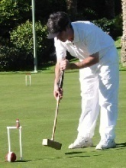
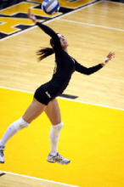
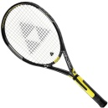




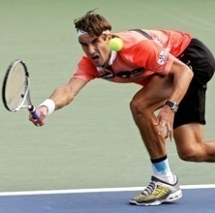
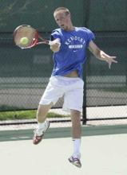
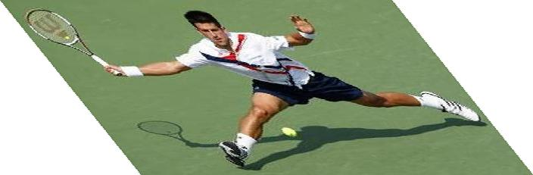
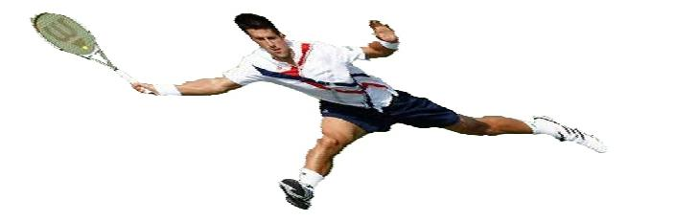
Mutual Context Model Representation
A:
Activity
A
Tennis forehand
Croquet shot
Volleyball smash
Human pose
H
O:
Object
O
Tennis racket
Croquet mallet
Volleyball
Body parts
P₁
P₂
P_{N}
H:
f_{O}
f₁
f₂
f_{N}
Intra-class variations
More than one H for each A;
Unobserved during training.
Image evidence
P:
l_{P}: location; θ_{P}: orientation; s_{P}: scale.
f:
[Yao & Fei-Fei, 2010]
Shape context.
[Belongie et al, 2002]

Slide 15
Mutual Context Model Representation
Markov Random Field
, , : Frequency of co-occurrence between A, O, and H.
A
Clique weight
Clique potential
H
O
P₁
P₂
P_{N}
f_{O}
f₁
f₂
f_{N}
[Yao & Fei-Fei, 2010]

Slide 16
Mutual Context Model Representation
Markov Random Field
, , : Frequency of co-occurrence between A, O, and H.
A
, , : Spatial relationship among object and body parts.
Clique weight
Clique potential
H
O
location
orientation
size
P₁
P₂
P_{N}
f_{O}
f₁
f₂
f_{N}
[Yao & Fei-Fei, 2010]

Slide 17
Mutual Context Model Representation
Markov Random Field
, , : Frequency of co-occurrence between A, O, and H.
A
, , : Spatial relationship among object and body parts.
Clique weight
Clique potential
H
O
Obtained by structure learning
location
orientation
size
Learn structural connectivity among the body parts and the object.
P₁
P₂
P_{N}
f_{O}
f₁
f₂
f_{N}
[Yao & Fei-Fei, 2010]

Slide 18
Mutual Context Model Representation
Markov Random Field
, , : Frequency of co-occurrence between A, O, and H.
A
, , : Spatial relationship among object and body parts.
Clique weight
Clique potential
H
O
location
orientation
size
Learn structural connectivity among the body parts and the object.
P₁
P₂
P_{N}
f_{O}
and : Discriminative part detection scores.
f₁
f₂
f_{N}
Shape context + AdaBoost
[Andriluka et al, 2009]
[Belongie et al, 2002]
[Viola & Jones, 2001]
[Yao & Fei-Fei, 2010]

Slide 19
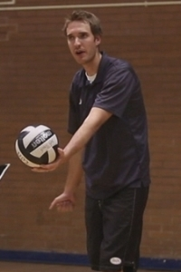
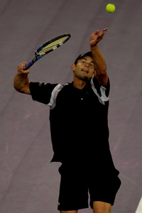
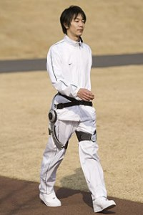
Problems of the Mutual Context Model
Different number of objects.
Desires and beliefs?
Action Theory: A behavior caused by an agent in a particular situation. The agent’s desires and beliefs lead to bodily behavior.
Want a glass of water
Believe the clear liquid in the glass in front of me is water
Desire to drink water
Believe I can drink water from the glass in front of me
Reach over for the glass
Drink

Slide 20



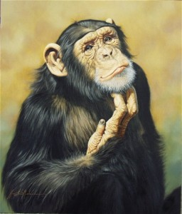
Actions as Interactions of Verb-Noun-Pose
Poses
Drink
Verbs
Nouns
Haha, this is a banana!
Ride?
Play?
[Yao & Fei-Fei, in submission]

Slide 21
Connections of Verb-Noun-Pose

Slide 22
Actions in the Space of Verb-Noun-Pose

Slide 23
Thank you!

Slide 24
Fine-Grained Image Categorization
Aditya Khosla*
Bangpeng Yao*
Fei-Fei Li

Slide 25
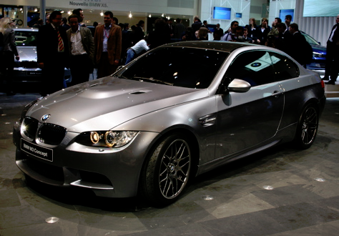
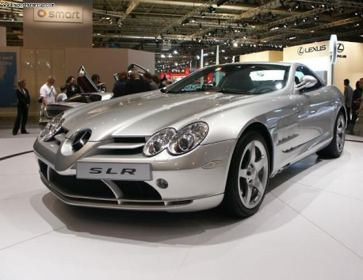

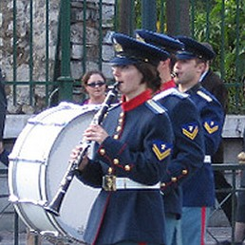
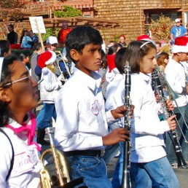
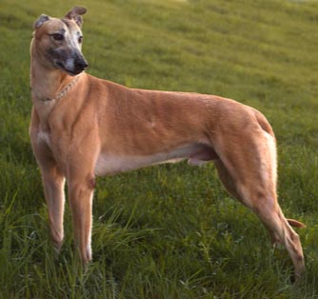
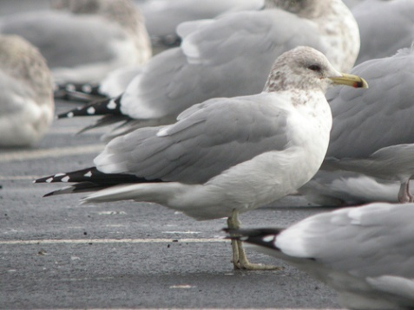
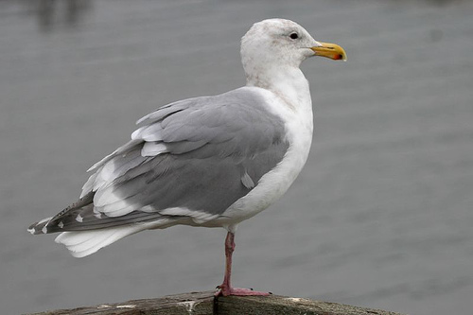
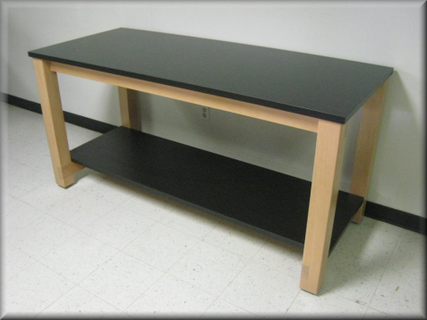
Fine-grained Image Categorization
Object Classification

Slide 26
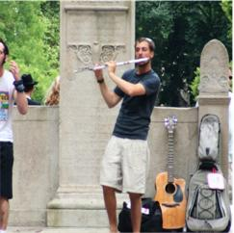
Fine-Grained Image Categorization
Observe that the tasks differ significantly
=> Conventional object recognition algorithms have poor performance.
We develop an algorithm specific to this task:
  Our algorithm searches for
  discriminative regions
  similarly located in the images

Slide 27
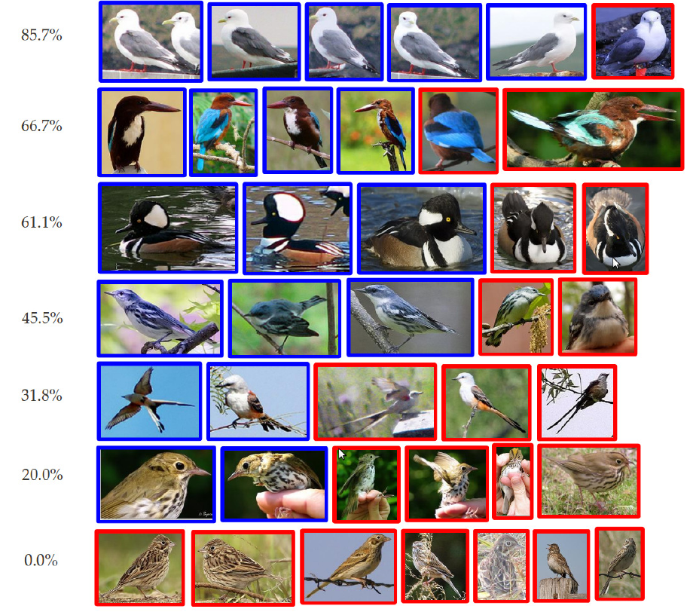
Experimental Results –
200 Bird Species

Slide 28
Experimental Results –
200 Bird Species

Slide 29
Experimental Results –
200 Bird Species

Slide 30
Accuracy (%) Comparison
MKL | LLC | Ours
19 | 16.0 | 19.4
Experimental Results –
200 Bird Species

Slide 31
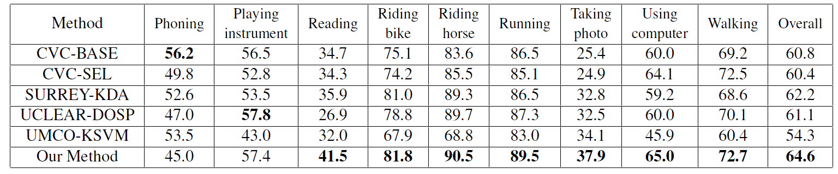
Experimental Results – Activity Recognition
PASCAL VOC2010 Action Classification Challenge (% mAP)

Slide 32
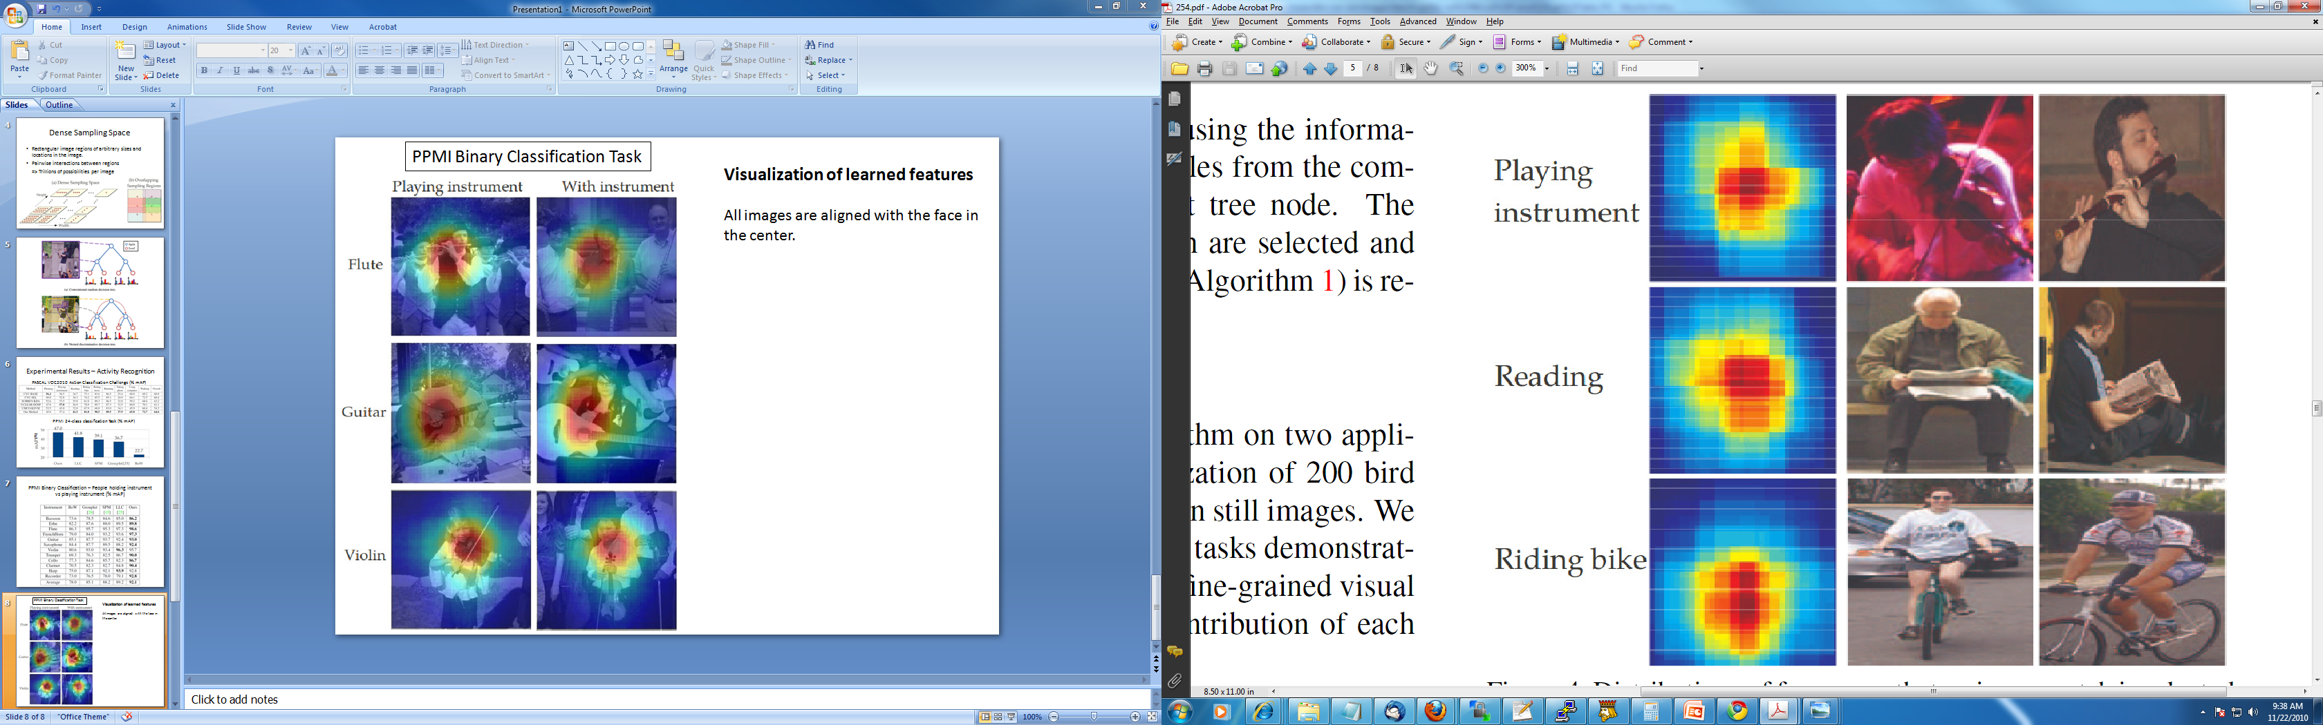
PASCAL VOC2010 Action Classification Challenge (% mAP)

Slide 33
PASCAL VOC2010 Action Classification Challenge (% mAP)

Slide 34
PASCAL VOC2010 Action Classification Challenge (% mAP)

Slide 35
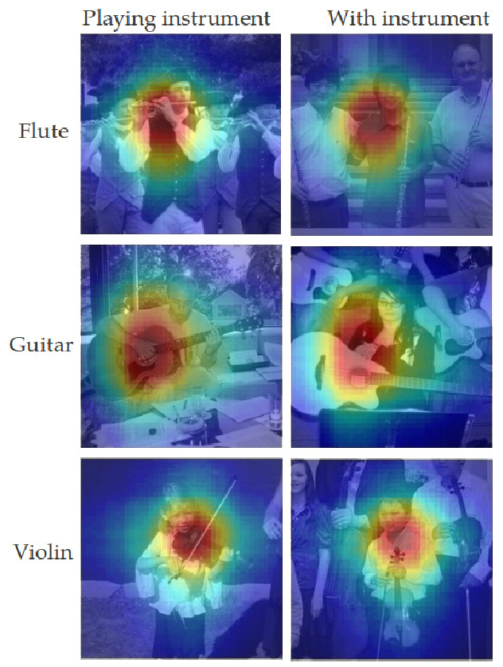
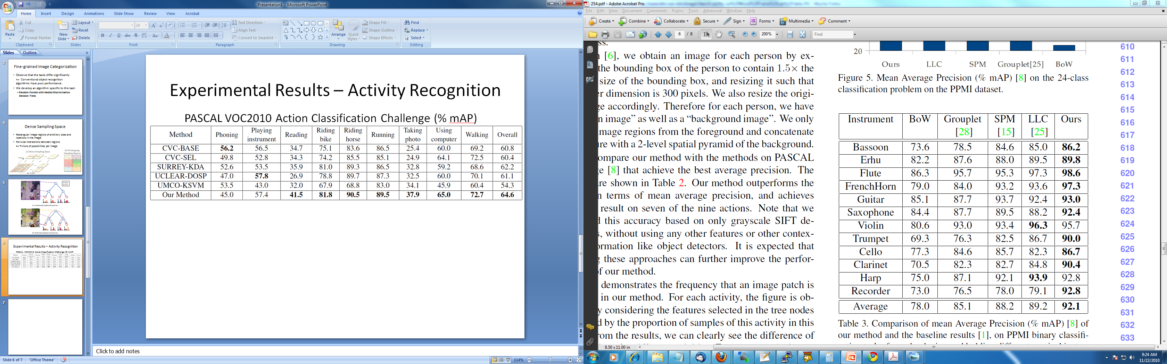
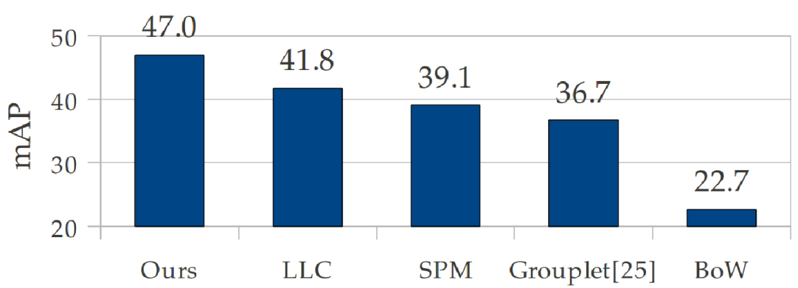
PPMI Binary Classification Task (% mAP)
Improvement in 10 out of 12 instruments!
PPMI 24-class classification Task (% mAP)
All images are aligned with the face in the center.

Slide 36
Thank you!

Slide 37
Learning scene categories from photo streams
Barry Chai
(submitted to CVPR11)
Notes:
I am going to talk about learning scene categories from photo streams by our labmate Barry Chai

Slide 38

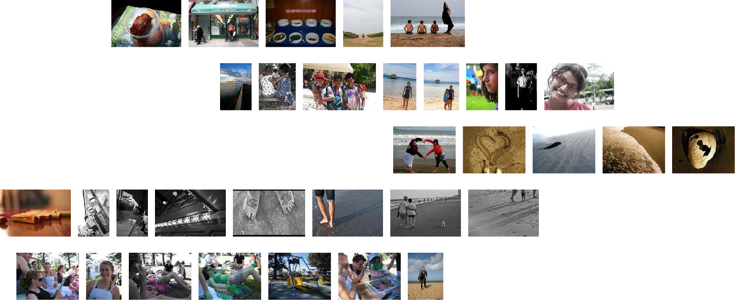
Diverse photo streams & shared canonical photos
Photo streams tagged as beach scenes
Canonical
beach photos
Elisabeth’s photo
Brian’s photo
Geremy’s photo
Kenneth’s photo
Susan’s photo
Notes:
Photo streams from each user reflect their experience. For example, their experience at the beach could be quite diverse. However, some photos among the photo streams are canonical beach images and can be easily recognized as a beach scene. The goal of this paper is to learn scene categories from the diverse photo streams and discover the canonical photos for each scene.

Slide 39
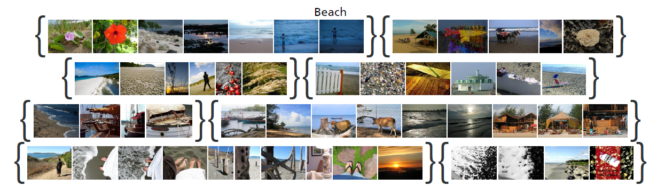
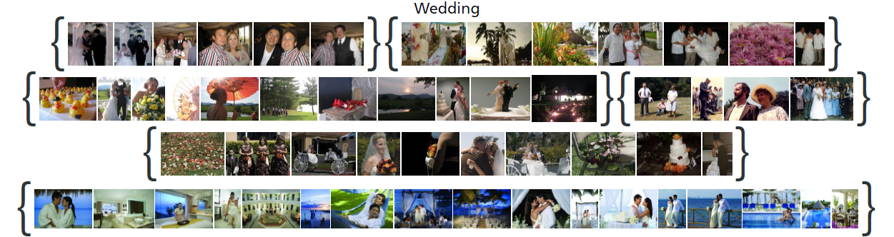

Challenges: noisy user photos
9,152 photo streams across 6 classes
233,417 images
Notes:
We are facing two big challenges for doing this. The user photos could be noisy. Many of them are not visually related to the scene class.

Slide 40
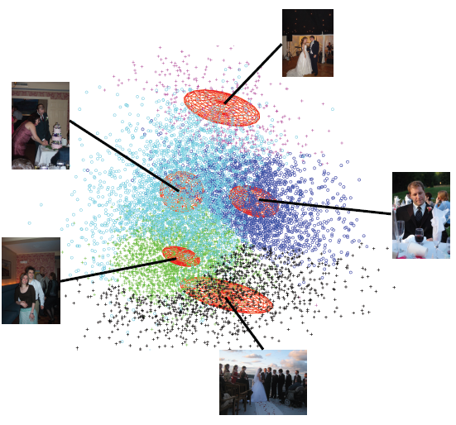
Challenges: multi-modality data
GIST feature
PCA 2 dimensional space
5-component Gaussian
Notes:
If we project the GIST feature of each image to a 2 dim space by using PCA and fit the data with a 5 component gaussian, we can observe that there are multi-modality among the photo streams.

Slide 41
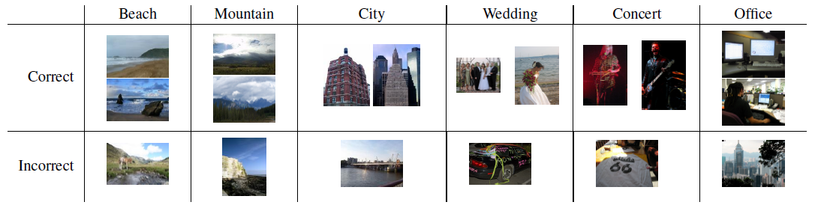
Stream Classification
800 training photo streams per class
100 test photo streams per class
Notes:
Our goal is to classify the photo streams. We use 800 training photo streams and 100 for test for each class. Here is some example classification result.

Slide 42
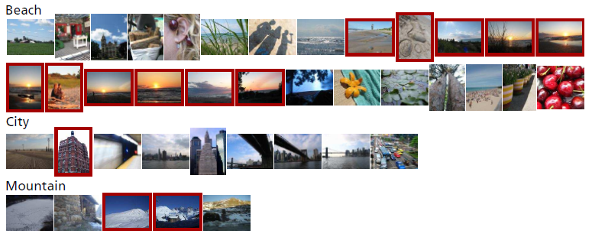
Stream Classification & Canonical Image Discovery
800 training photo streams per class
100 test photo streams per class
Notes:
We show here discovered canonical image example for beach, city and mountain classes

Slide 43
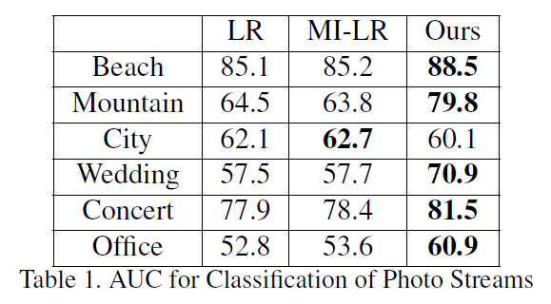
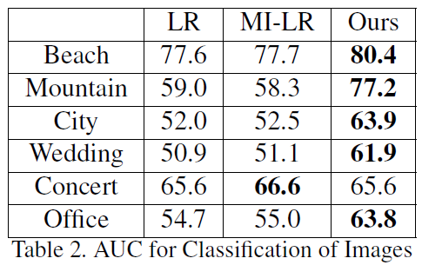
Quantitative Evaluation
Notes:
Our result is further compared to base lines such as logistic regression and multiple instance learning logistic regression for both classifying photo streams and individual images.

Slide 44

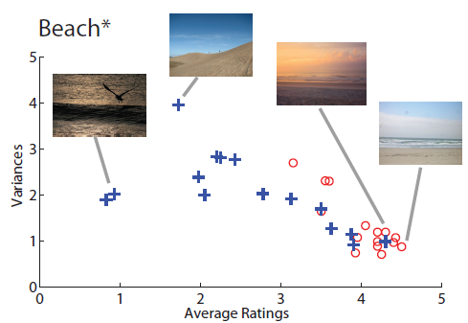
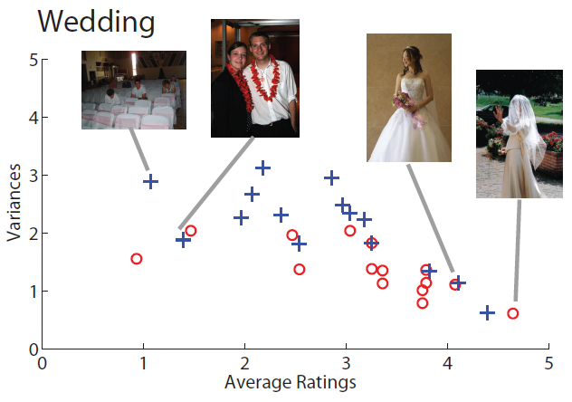

Canonical Image Discovery
Ours
Notes:
Judging an image is a canonical image or not is subjective. We ask multiple users from the amazon mechanical turk service to label how canonical an image is for a scene class. The users rate the automatically discovered canonical images from 1 to 5, with 5 representing the most canonical images. As we can see from the figure that images selected by our algorithm have higher average ratings than those selected by SVM.

Slide 45


Slide 46
Random versus semantic attributes
Olga Russakovsky and Li Fei-Fei
Submitted to CVPR 2011

Slide 47
Representation
Feature: classifier trained on binary splits of data
Notes:
Feature: classifier trained on binary splits of data
Semantic attribute classifier
Positive: objects that contain certain semantic property
Negative: objects that don’t
Random split attribute classifier
Positive: random subset of object classes
Negative: random disjoint subset of classes
Many such classifiers trained
Can be run on new images
Classifier outputs used as features for higher-level tasks
Zero-shot learning, one-shot learning, classification, etc.
Correlated splits, e.g., on PASCAL VOC classes, “head/nose/eyes” highly correlated since always occur together unless occluded

Slide 48
Multi-class classification
aPascal dataset (Farhadi ‘09)
  Pascal VOC images; 64 semantic attributes
  20 object classes
Image representation:
  Outputs of classifiers trained on splits of training data
Training:
  Multiclass SVM on training images
Testing:
  Classification of unseen images from same 20 classes

Slide 49
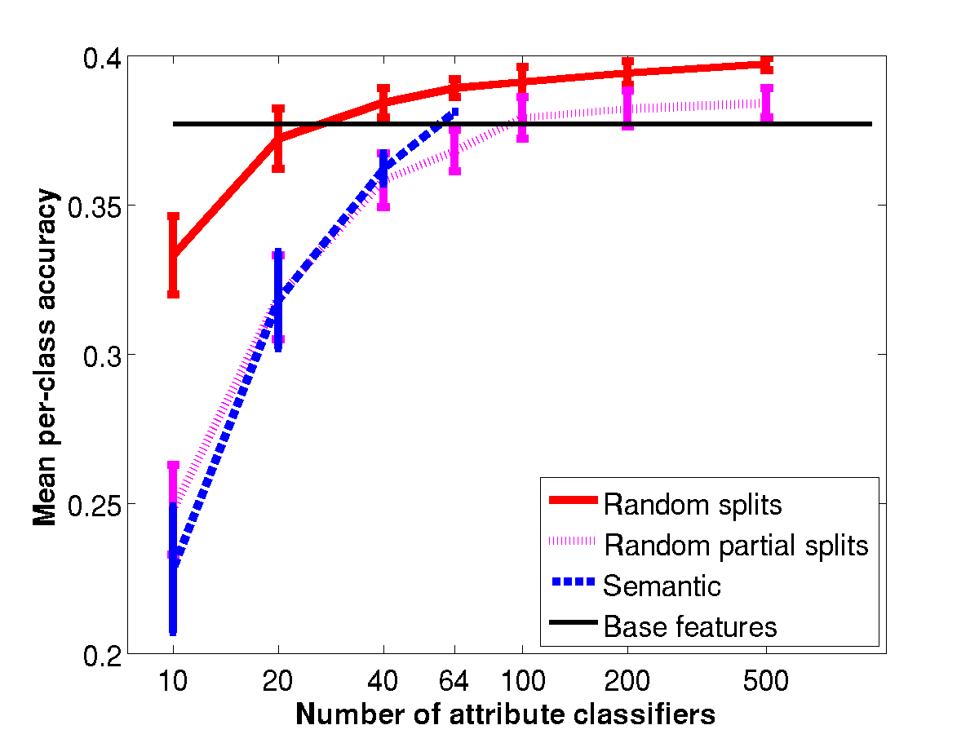
Multi-class classification
Base features
  Low-level visual features
Semantic (64)
  Hand-annotated splits
Random partial split
  Binary split of subset of training classes
Random split
  Binary split of all training classes
Notes:
X-axis
Y-axis
Base features
Semantic (at 10, at 20, at 64)
Random partial splits (Farhadi combined them with semantic; Farhadi also selected most discriminative)
Random splits

Slide 50
Limitations of semantic attributes
Correlations between semantic attributes
  Thus improved classification performance by using random split classifiers
Difficulty with dense classification
  Distinguishing between dogs/cats/wolves which have similar semantic attributes
Inability to transfer information between domains
  Test classes must have same semantic attributes as training classes
Random split classifiers solve these issues

Slide 51
Large Scale Image Classification & Retrieval
Jia Deng, Alex Berg, Li Fei-Fei

Slide 52
Large Scale Classification & retrieval
Why:
  Human ability – tens of thousands of categories
  Real world applications – large scale, many categories
What:
  Empirical study on classification of 10K+ categories [Deng et. al. ECCV 2010]
  Large scale Image Retrieval with many categories. [Deng, Berg & Fei-Fei, submitted]

Slide 53
Large scale classification
Exploiting hierarchy:
  Define a hierarchical classification cost: classify “dog” as “cat” better than as “car”
  more informative results

Slide 54
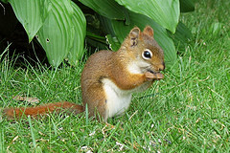










Large scale retrieval
Define similarity to bridge the semantic gap
  From low level features to high level concepts
  Large number of semantic concepts
Indexing for efficient retrieval
  High dimensional data: tens of thousands
  Large database: millions to billions of images
?
Image Database
Similar images

Slide 55

Define similarity by hierarchy
Object
…
…
Rodent
 | Red Squirrel | Chipmunk | Laptop
Red Squirrel | 1.0 | 0.8 | 0.1
Chipmunk | 0.8 | 1.0 | 0
Laptop | 0.1 | 0.1 | 1.0
Similarity matrix S between categories

Slide 56
Experiments: Hierarchical retrieval

Slide 57

Indexing: Locality sensitive hashing
Novel hashing for bilinear similarity $x^{T}Sy$
Hashing constructions for
  $S$ that is symmetric and diagonally dominant
  $S$ that encodes hierarchical similarity
Achieves 1K times speedup with 90% of the linear scan precision.

Slide 58







Object Bank: An Object-Level Image Representation for High-Level Visual Tasks & Semantic Feature Sparsification
Li-Jia Li^{*1,} Hao Su^{*1,} Yongwhan Lim¹, Eric Xing², Li Fei-Fei¹
¹Computer Science Department, Stanford University
²Machine Learning Department, Carnegie Mellon University
*indicates equal contributions

Slide 59















Recognizing complex scenes is a challenging problem
Same class
Different classes
Bull
Horse
Notes:
Bull-fighting rodeo

Slide 60





Why not use objects as features or attributes for scene recognition?
Felzenszwalb et al IJCV 2009

Slide 61









N: nGridsperScale
Spatial Bias for different objects
Sailboat response
…
N

Slide 62




N: nGridsperScale, M: nScale
Object size variance
Sailboat response
…
N
…
…
…
…
M x N
…
N

Slide 63




N: nGridsperScale, M: nScale, O: nObject
Sailboat response
…
N
…
…
…
…
M x N
…
…
N
…
…
M x N x O= thousands
…
…
…
E.g., In our setting:
12 x 21x 177=44604
Bear response
…
…
N
…
…
M x N
…
…
…
Water response
N
…
…

Slide 64
Problem
…
…
High dimensional representation
with redundancy
…
…
Curse of dimensionality
…
Complexity (running time) increases
Overfitting
Requirement of number of training
data samples increases
…
…
…

Slide 65






Motivation
A few objects are adequate for differentiating
different classes (object sparsity)
…
Polo
Croquet
…
High dimensional representation
with redundancy
…
Size of objects matters for differentiating
different classes (scale sparsity)
…
Curse of dimensionality
…
Complexity (running time) increases
Overfitting
Requirement of number of training
data samples increases
Different objects exhibit biased spatial
preference
…
…
…

Slide 66
Compression via feature selection
…
…
…
High dimensional representation
with redundancy
…
…
Curse of dimensionality
…
…
Complexity (running time) increases
Overfitting
Requirement of number of training
data samples increases
…
…
…

Slide 67









Logistic Regression
Log loss
Sailboat response
Use all feature dimensions
β¹
Linear classifier
β²
…
Bear response
βº
Water response
OB of each image
Image class
βº
Weight of each feature
Weights of features within an object

Slide 68
Regularized Logistic Regression for Feature Selection
Sailboat response
Use less feature dimensions
Regularizer
β¹
β²
…
Bear response
βº
Water response
OB of each image
Image class
βº
Weight of each feature
Weights of features within an object
Optimization method: spectral projected gradient method

Slide 69


Feature sparsity via L1 regularization
Sailboat response
Selected feature dimensions
β¹
β²
…
Bear response
βº
Water response
OB of each image
Image class
βº
Weight of each feature
Weights of features within an object
Optimization method: spectral projected gradient method

Slide 70
Object sparsity via L1/L2 (group) regularization (LRG)
O
o
o
Sailboat response
Selected object group dimensions
β₁
β₂
…
…
Bear response
βº
Water response
OB of each image
Image class
βº
Weight of each feature
Weights of features within an object
Optimization method: blockwise coordinate descent method

Slide 71

Joint object/feature sparsity via L1/L2 + L1 regularization (LRG1)
Sailboat response
β₁
β₂
…
Bear response
βº
Water response
OB of each image
Image class
βº
Weight of each feature
Weights of features within an object
Optimization method: coordinate descent method

Slide 72

Classification Performance on UIUC Sports Dataset

Slide 73




Semantic Feature Sparsification Over OB
Classification performance
w.r.t no. of training images
Classification performance
w.r.t no. of object filters
Classification performance w.r.t feature dimension
Log scale
UIUC sports dataset

Slide 74










Learned object pattern given scene class
Sky
Mountain
Tree
Rock
LabelMe Scene dataset

Slide 75









Learned object pattern given scene class
Sky
Water
Sand
Grass
LabelMe Scene dataset

Slide 76










Learned object pattern given scene class
Scale pattern
Weights of OB feature at different scales
Spatial pattern
heat map of OB feature weights at the scale with highest weight sum

Slide 77










Learned object pattern given scene class
Scale pattern
Weights of OB feature at different scales
Spatial pattern
heat map of OB feature weights at the scale with highest weight sum

Slide 78





Learned object pattern given scene class
Scale pattern
Weights of OB feature at different scales
Spatial pattern
heat map of OB feature weights at the scale with highest weight sum

Slide 79
Thank you!

